Slide 1
E-Commerce Cohort Analysis & Business Insights
Customer Retention, Revenue Trends, and Key Drivers

Slide 2
Business Problem
The company wants to better understand:
- Customer retention behavior (loyalty)
- Revenue trends and seasonality
- Key revenue drivers (countries, products)
Objective: Improve customer lifetime value and boost revenue consistency.

Slide 3
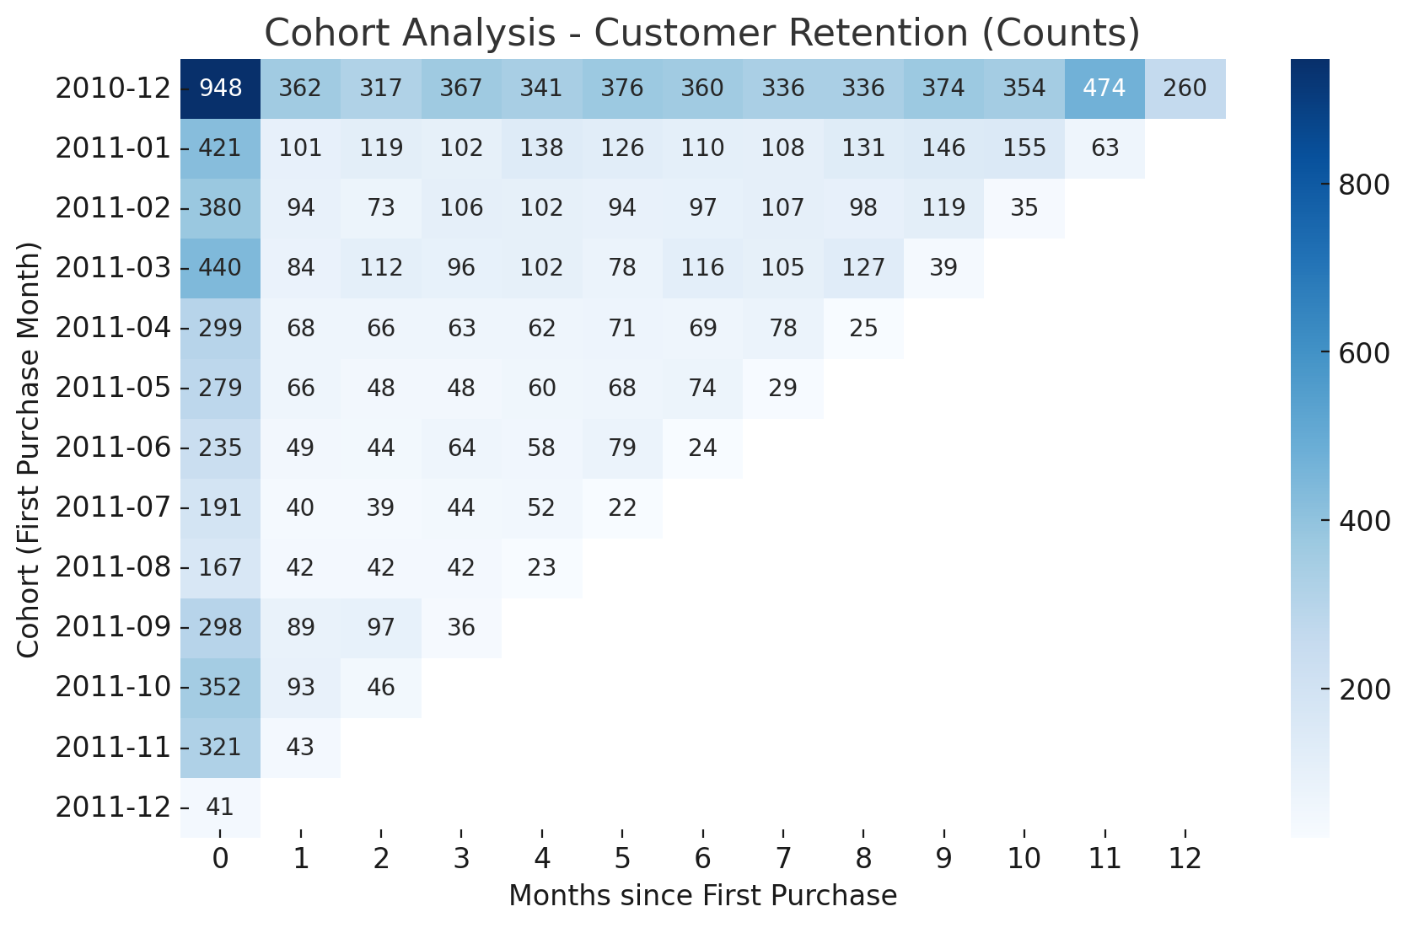
Cohort Analysis - Customer Retention (Counts)

Slide 4
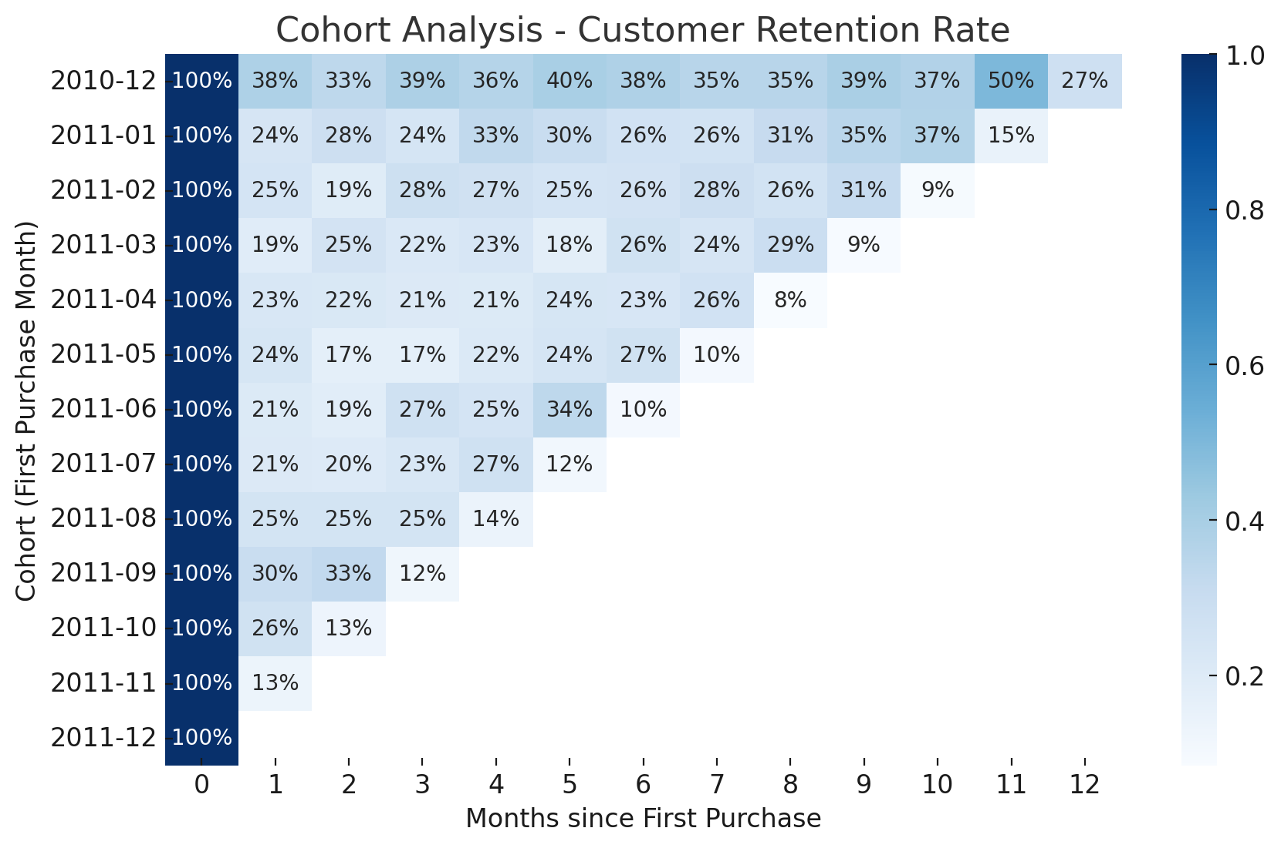
Cohort Analysis - Customer Retention (Rates)

Slide 5
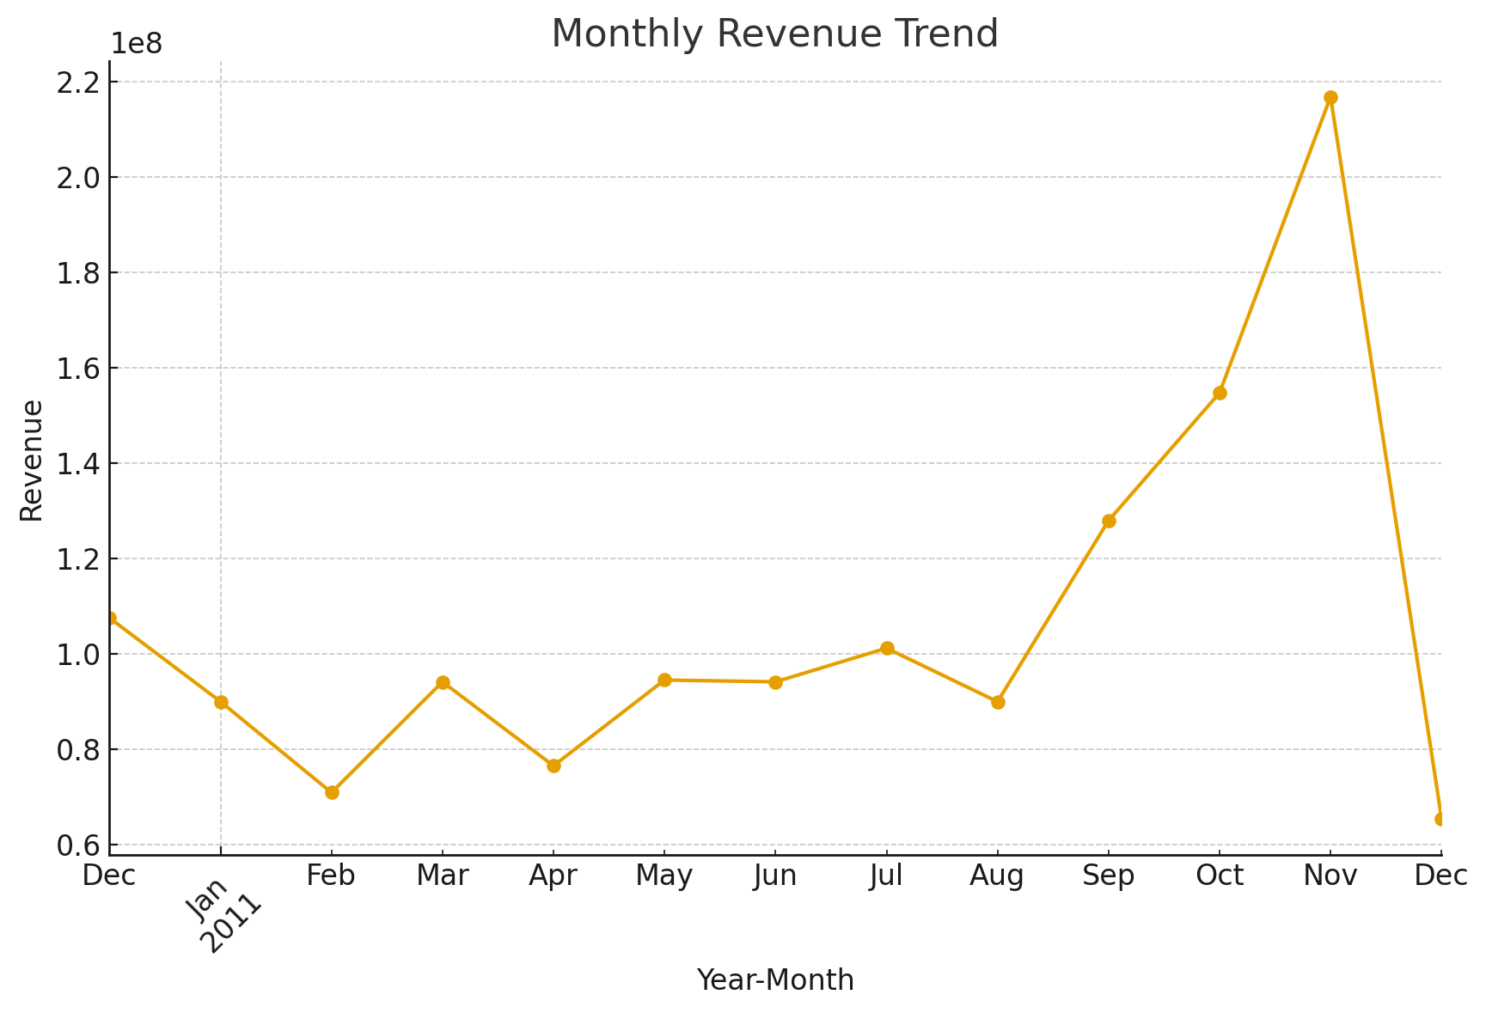
Monthly Revenue Trend

Slide 6
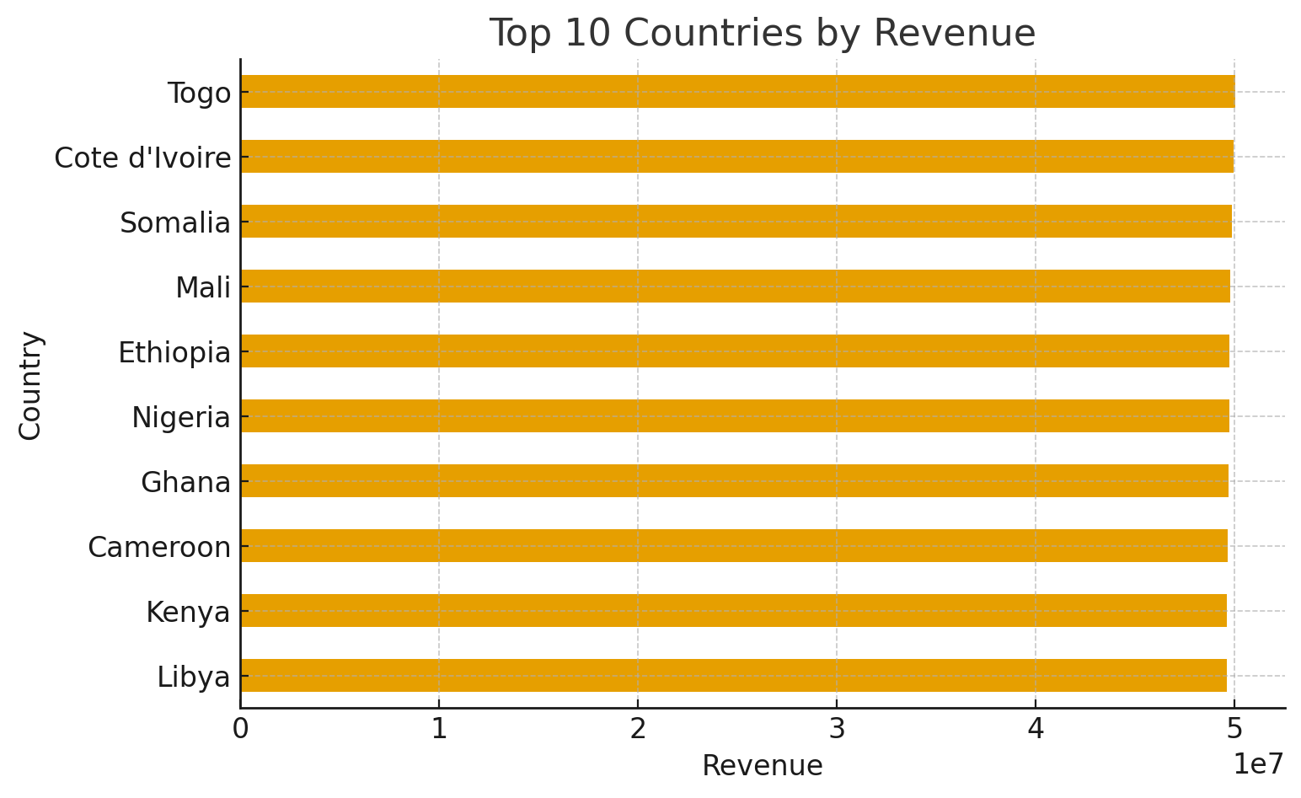
Top 10 Countries by Revenue

Slide 7
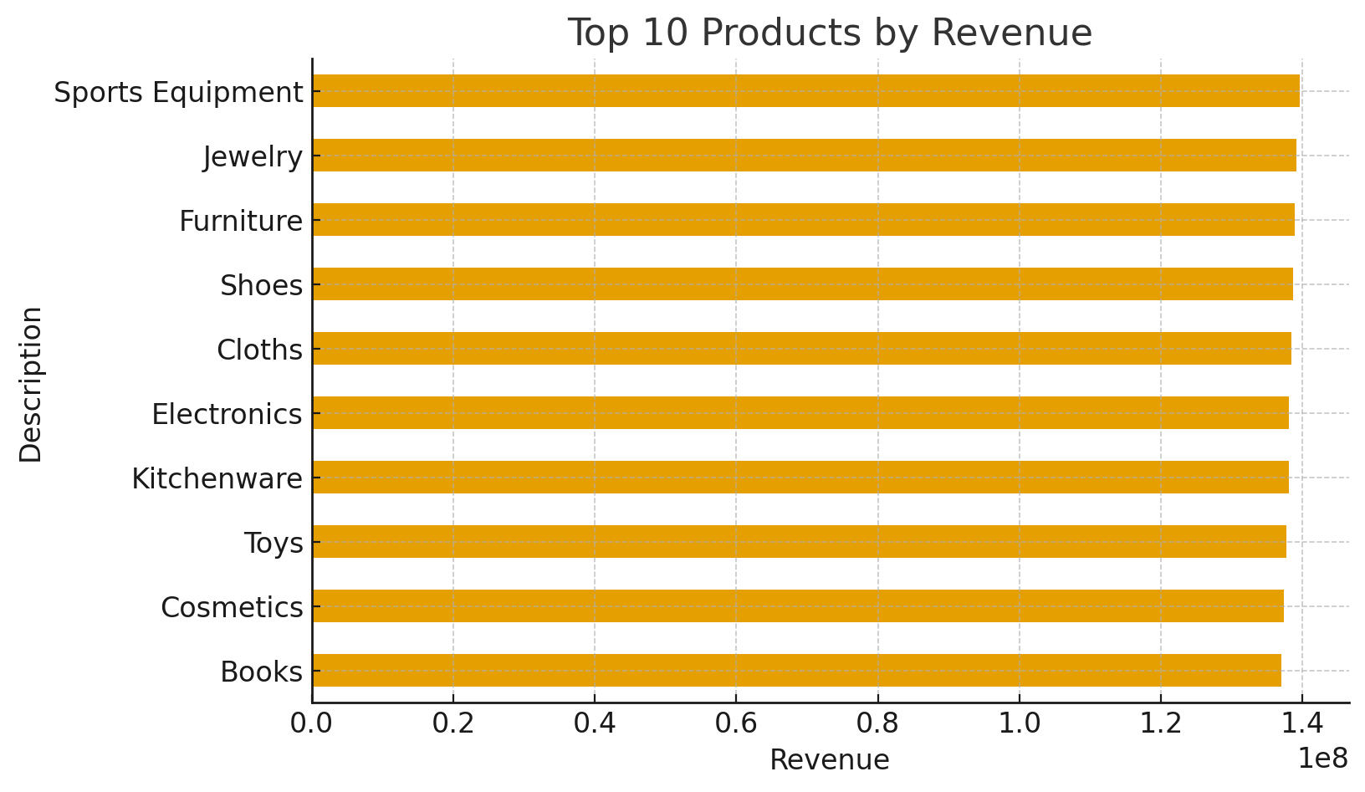
Top 10 Products by Revenue

Slide 8
Recommendations
- Develop loyalty programs to improve retention
- Focus marketing on top-performing regions/products
- Smooth revenue by diversifying product categories
- Personalize offers to reduce early churn

