Slide 1

CBBMS
Centralized Blood Bank Management System
A public Interest Project
Presented by
Muhammad Hanif
CIIT Virtual Campus

Slide 2
PROJECT TEAM
Supervisor : Ms. Sana
Development Team :
Muhammad Hanif(002)
Ms. Ifrah Ali(028)
Mr. Mazhar Ahmed(049)

Slide 3
PROJECT IDEA
Scope:
The purpose of the blood bank management system is to simplify and automate the process of searching for blood in case of emergency and maintain the records of blood donors, recipients, blood donation programs and blood stocks in the bank.
This system will provide following functionalities:
Blood donation at any branch
Blood collection at any branch
Information of surplus stock of any branch
Management of Emergency Stock of blood in particular area on the basis of population and blood requirement
Maintain Database of donor and recipients

Slide 4

Project Scope
This Application will help Blood Bank Management to manage the blood bank specific activities and Blood inventory, public to get information about available blood stock in their nearest area of reach. This System provide a centralized repository for decision making of allocating quota of specific area for keeping emergency level.

Slide 5
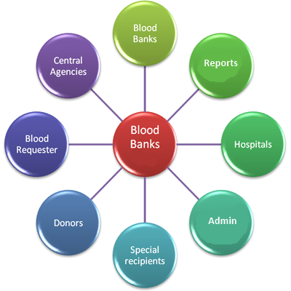
Main features
Blood Inventory Management
Blood Donation and Dissemination
Donation and Dissemination Record Management
Reporting

Slide 6
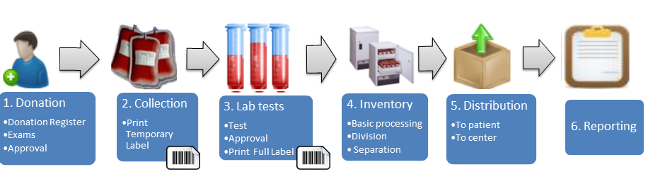
Main Process

Slide 7
Outcomes of Project
Easiness in donation and transfusion of Blood
Timely Information about availability of blood in nearest blood bank along with exact location
Blood bank data digitalization
Tracing of donor and recipient any time
Minimize the chance of wrong blood group transfusion
Get ride of requirement of Blood Donation / Payment at the same franchise while required blood at any franchise

Slide 8
Development Environment
TimeLine: 40 weeks
Type: Web Application
Webserver : Microsoft IIS Express
Web Frame Work: Asp.net
IDE : Microsoft Visual Studio
Database : Microsoft SQL Database
Server side Programing : C-Sharp

Slide 9
END

