Slide 1



Cyber Physical System Digital Twin For CNC Tuning
Internship Presentation
Darga Noor Mohammed Ali
Third Year , Fifth Semester
R N S Institute of Technology, Bangalore
Conducted by
Sponsored by

Slide 2
Acknowledgement
Since I began my work in the internship programme, in Dec. 2021, many people have given invaluable support and have been influential in shaping my thoughts on how to perform best and gain beneficial knowledge from the work. I want to say A BIG THANKS to everyone who helped me in successfully completing this internship and gain a lot of knowledge at the end.
I would like to express my deepest gratitude to our respected Mentors Dr.M. Kantha Babu and Mr. Prabhu, for their continuous support and wonderful guidance through various stages of internship activities, which led to the successful completion of internship task.They provided us with materials and other resources to learn and get an idea on the working of model, we were designing. They checked the working of our models and confirmed our meeting’s works. They motivated us and shared a lot of knowledge with us.
Next I would like to thank my team members Mr. Ayush Patil and Mr. Allapathi Sharon Kumar. We were in one team, working for development of Digital twin for CNC tuning. They shared their ideas and we together designed the code and really it took less time than expected.
Finally I would like to thank AMTDC for providing such a nice platform for students to learn industrial and real time works and contribute their works to the Government. Also I would like to express my thanks to my parents and colleagues to provide immense support to me for successfully completing this task.

Slide 3
Agenda
Abstract
Objective
Introduction
Precise Summary Of Internship Activities
Work
Summary
References

Slide 4
Abstract
During this internship we were assigned the task to do Machine level concepts from the data obtained from the output obtained.
The Work is conducted around a machine learning model.The main concepts like big data analytics (BDA), and artificial intelligence (AI) have greatly stimulated the development of smart manufacturing.
During this internship, we prepared a machine learning model using sklearn, matplotlib, numpy, pandas which can simulate working of reading datasets under any given condition. Regular meets were conducted to showcase the progress and guidance was provided. In this report we are presenting the problem statement and what work we had done.

Slide 5
Objective:
To create a machine learning model that can predict the surface roughness of CNC tuning machine.
Objectives of the work to find the data and to visualize by over sampling method.
The following are the main output parameters that the model will predict:
->Accuracy of the Model of Surface Roughness

Slide 6
Introduction
The Cyber twin, better known as digital twin, is a digitalization of the machine tool. Some partial versions of this virtual representation of the machine are currently well known by machine tool builders, like computer-aided design (CAD), computer-aided manufacturing (CAM) and finite element modelling (FEM). These tools are very useful to optimize machine tool designs and reduce design and mechanical set-up stages.
In process planning stage, a process planner generates toolpaths, defines cutting parameters, simulates machining setup in a G-code machine simulator module and converts toolpaths as NC codes . Quality evaluation in the simulator considers CAD geometry of the product, generated toolpath, and machine kinematics information.

Slide 7
Precise Summary Of Internship Activities :-
During this internship activity we performed a lot of tasks; first of all we were made clear about our problem statement and were asked to study the working of some of the simulation models. We always used to make PPTs for our works and tasks we completed and present our works during the meeting conducted. Mentors used to take 2 meetings every week.
Then after getting a clear idea of our tasks, we were divided into groups and each were assigned tasks to work based on their domain of experience.
We were mainly working on to predict the surface roughness of the cnc tuning machine.We mainly focused on the machin learning model that gives the best accuracy.So that we are using some of the machine learning models like logistic regression etc.

Slide 8
Work
Firstly, they have given the instructions to select the data.Then we have researched for the data on the sciencedirect.com, then we have taken that data for our project work.Afterward we were asked to build a machine learning model that learned from the traning and testing datasets and predicted the accuracy.
The working principle of a CNC machine is the execution of cutting tasks with the aid of a computer as well as written commands and codes.CNC machines are advanced and are therefore capable of making repetitive cuts to specifications with incredible accuracuy.
We have created a machine learning model to find out the surface roughness of tuning machine with the data taken as mentioned above.I have picked many python embedded libraries that helped me in the process.

Slide 9
Work
We used pandas to read the csv files containing the raw data sets.The data which are got through experimental values results in an overfitting , so as to overcome this fitting we have used cross-validation.
With pandas we could visualize the number of rows and coloumns,we could even describe the head of the dataset and display a part of it in the python work book,after the help of pandas, we used another libraries called matplotlib,seaborn and the attribute under matplotlib was matplotlib.pyplot to draw bar charts to anaylse the variations of any to attributes in the datasset of our choice.Where a seaborn was used to visualize the datasets by graphs.
Now we increased our samples by using under/over sampling methods.After that,we categorised the training and testing datasets based on constraints of the data sets.
With the help of these conditions we came up with a machine learning models called logistic regression,linearSVC and confusion matrix to find out the accuracy.

Slide 10
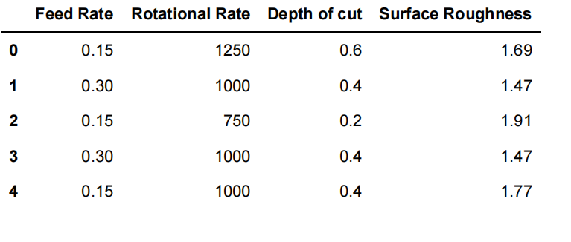
Workdone
I had created this window using Python(Tkinter). First we have to select the type of overhead line to be used and click on go.

Slide 11
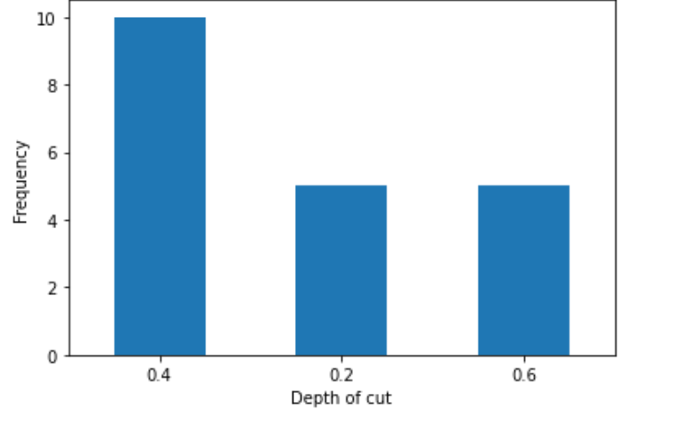
Workdone
Based on the datasets given the bar charts we have get by using Matplotlib library.

Slide 12
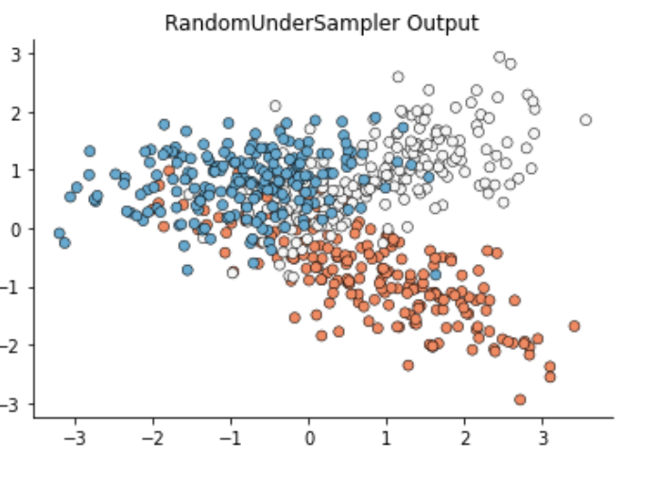
Workdone
This is the data sets that visualized by using random under sampler method.

Slide 13
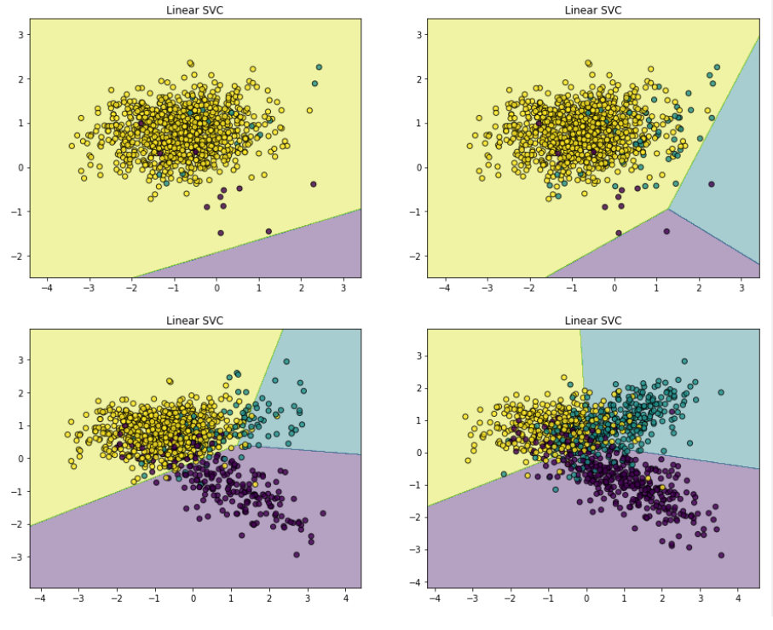
Workdone
This is the linear SVC model we have get by using datasets with sklearn library.

Slide 14
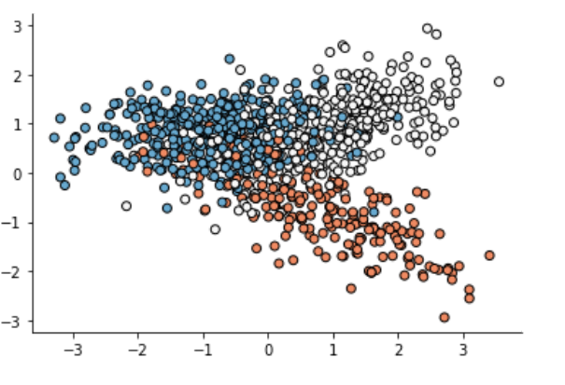
Workdone
This is the scatter plot visualization by using Matplotlib and seaborn.

Slide 15
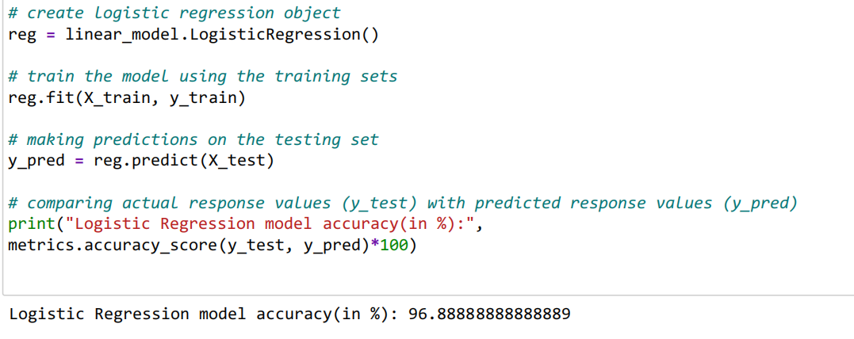
Workdone
This is the logistic regression accuracy of the taken data sets where we have got 96%.

Slide 16
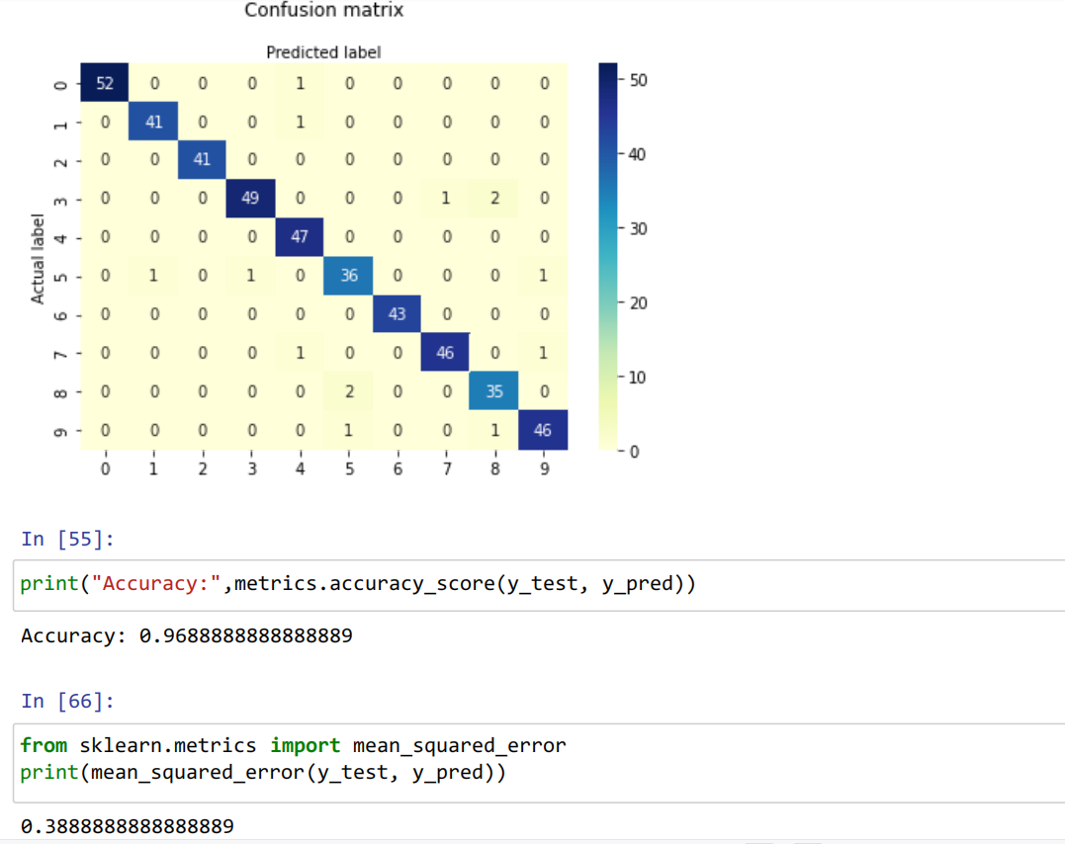
Workdone
This is the confusion matrix where accuracy score is 0.96 and the mean squared error is 0.38

Slide 17
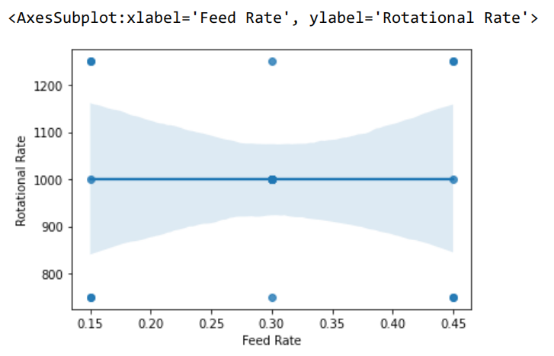
Workdone
This the sns.regplot of the datasets of feed rate and rotational rate.

Slide 18
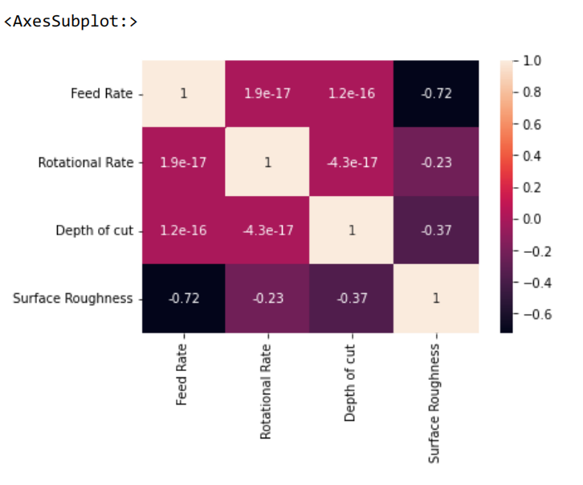
Workdone
The Above image is shown for heat map of data sets (where this after plotting the data sets)

Slide 19
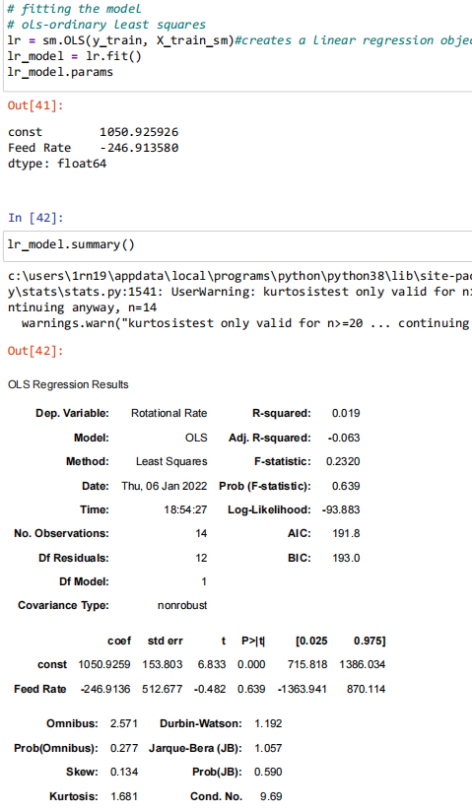
Workdone
This is the ols regression results of data sets.

Slide 20
Summary
During this internship activity we performed a lot of tasks; first of all we were made clear about our problem statement and were asked to study the working of some of the simulation models. We always used to make PPTs for our works and tasks we completed and present our works during the meeting conducted. Mentors used to take 2 meetings every week.
Then after getting a clear idea of our tasks, we divided ourselves into groups and divided the tasks to work based on their domain of experience.
We were mainly working on regression models and preparing a model which could predict the accuracy of the model based on the train and testing datasets
We also used sklearn to plot bar charts and scatter plot to analyse the choosed dataset from various online sources.

Slide 21
References
D. Jones, C. Snider, A. Nassehi, J. Yon, and B. Hicks, “Characterising the Digital Twin: A systematic literature review,” CIRP J. Manuf. Sci. Technol., 2020.
F. Tao, Q. Qi, A. Liu, and A. Kusiak, “Data-driven smart manufacturing,” J. Manuf. Syst., vol. 48, pp. 157–169, 2018.
M. Dr. Grieves, “Digital Twin : Manufacturing Excellence through Virtual Factory Replication This paper introduces the concept of a A Whitepaper by Dr . Michael Grieves,” White Pap., no. March, 2015.

Slide 22
Video of the work done
Brief introduction about the problem / challenge
Objectives of the work
Scope of your work

Slide 23
Thank You

