Slide 1

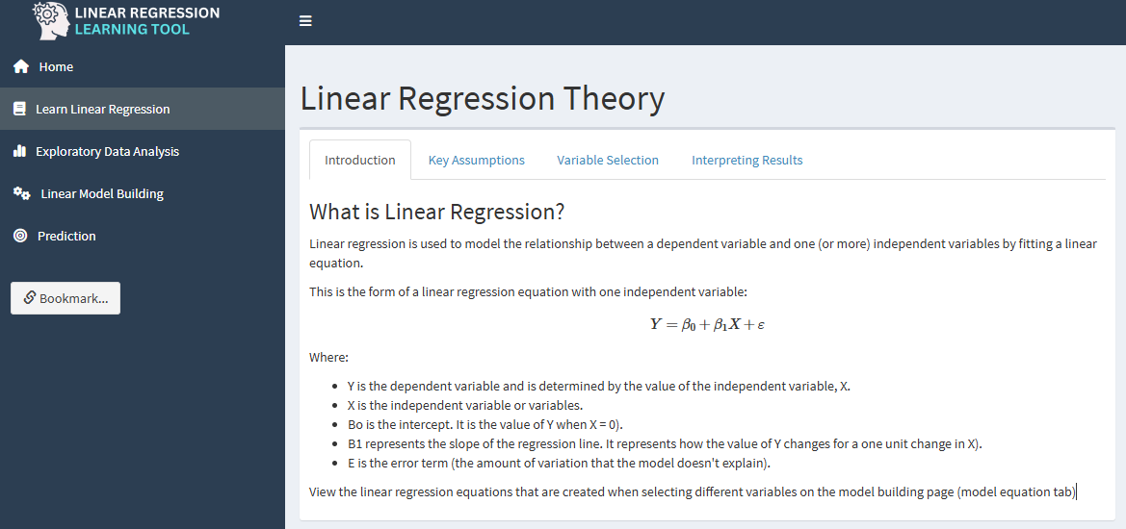
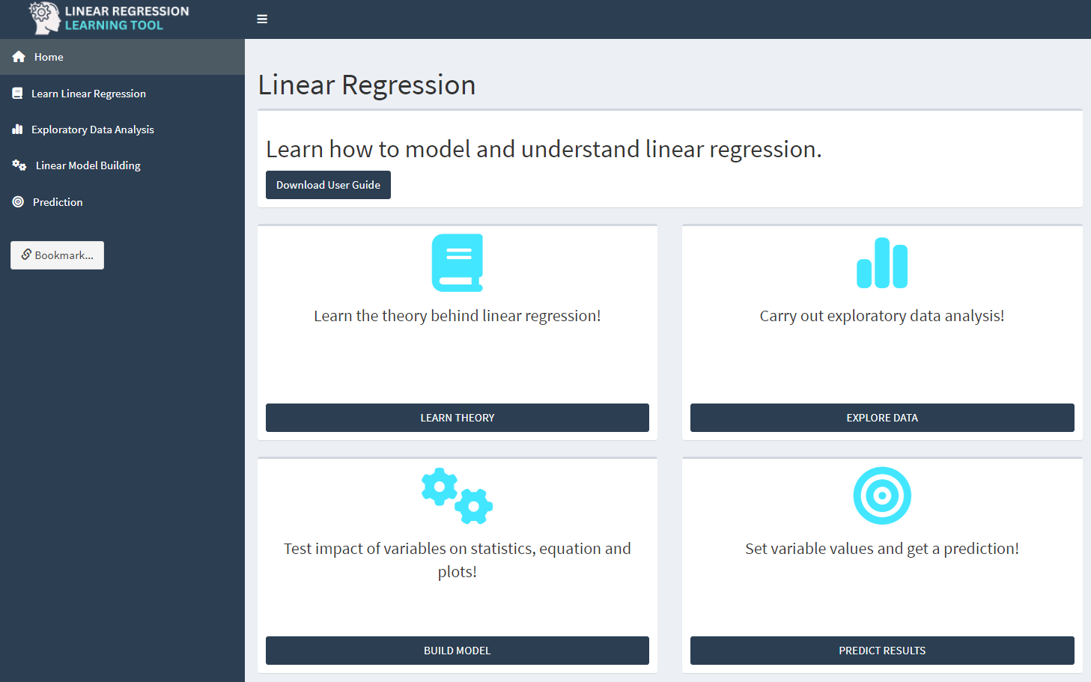
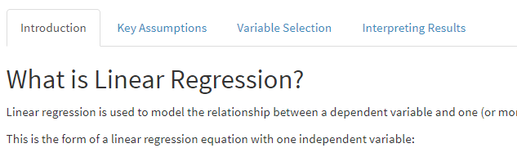
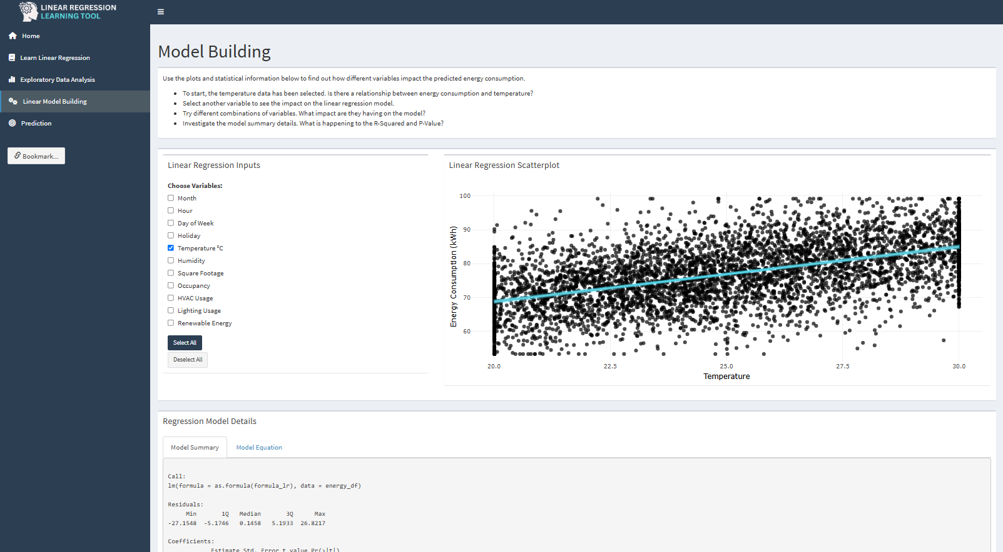

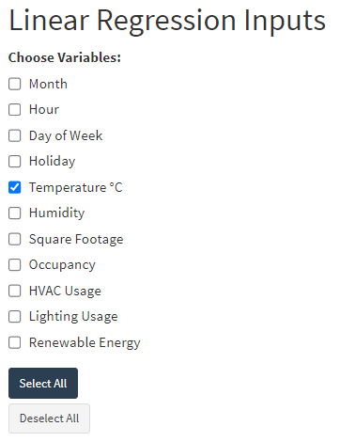
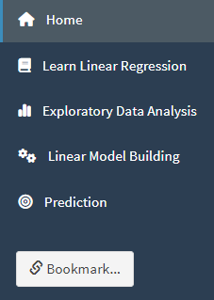
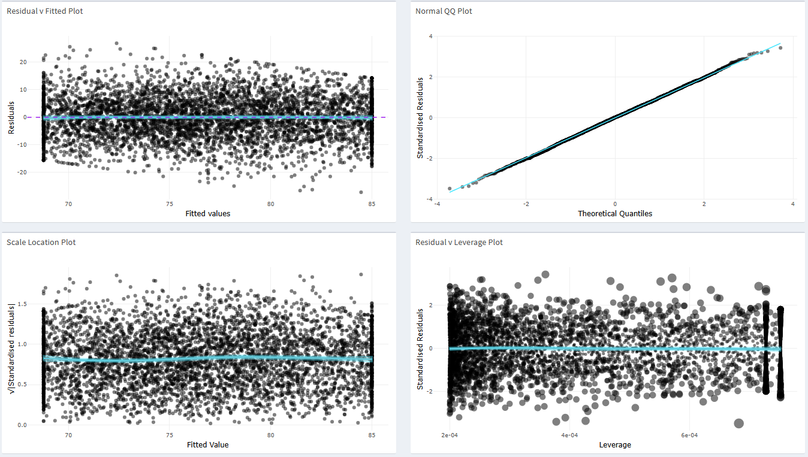
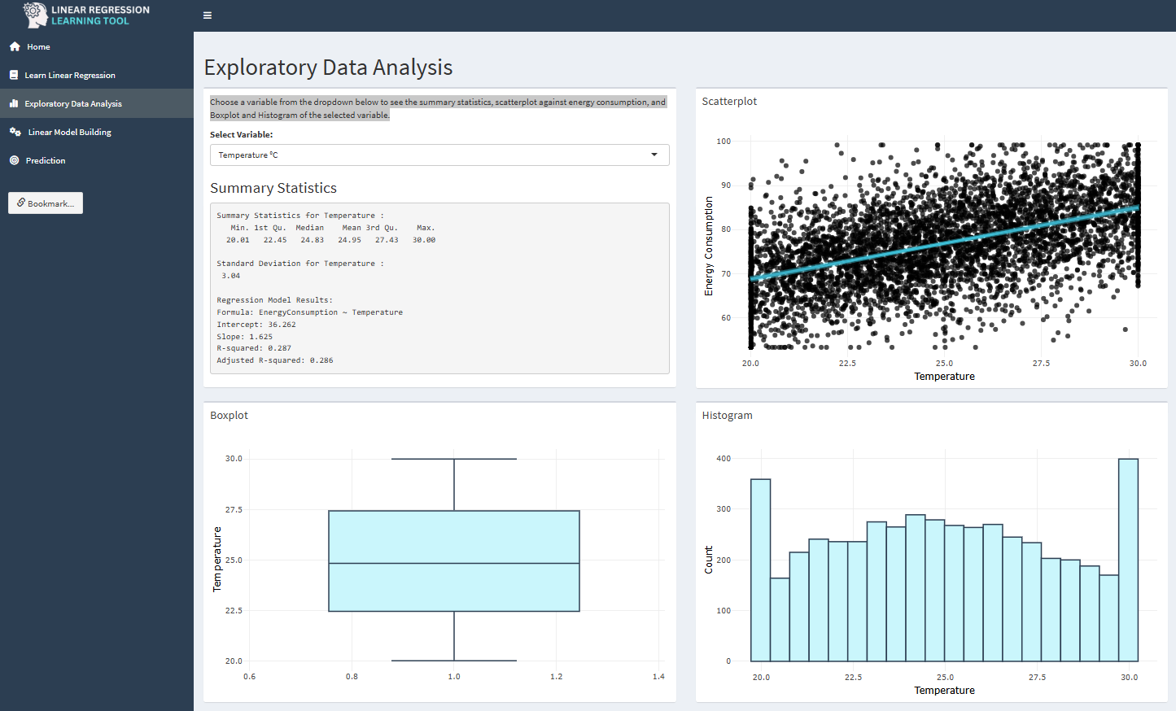
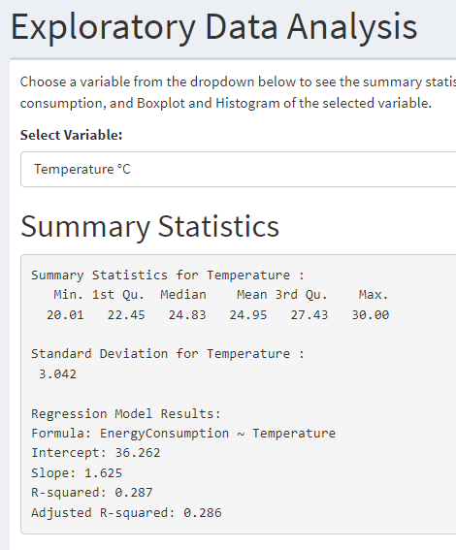
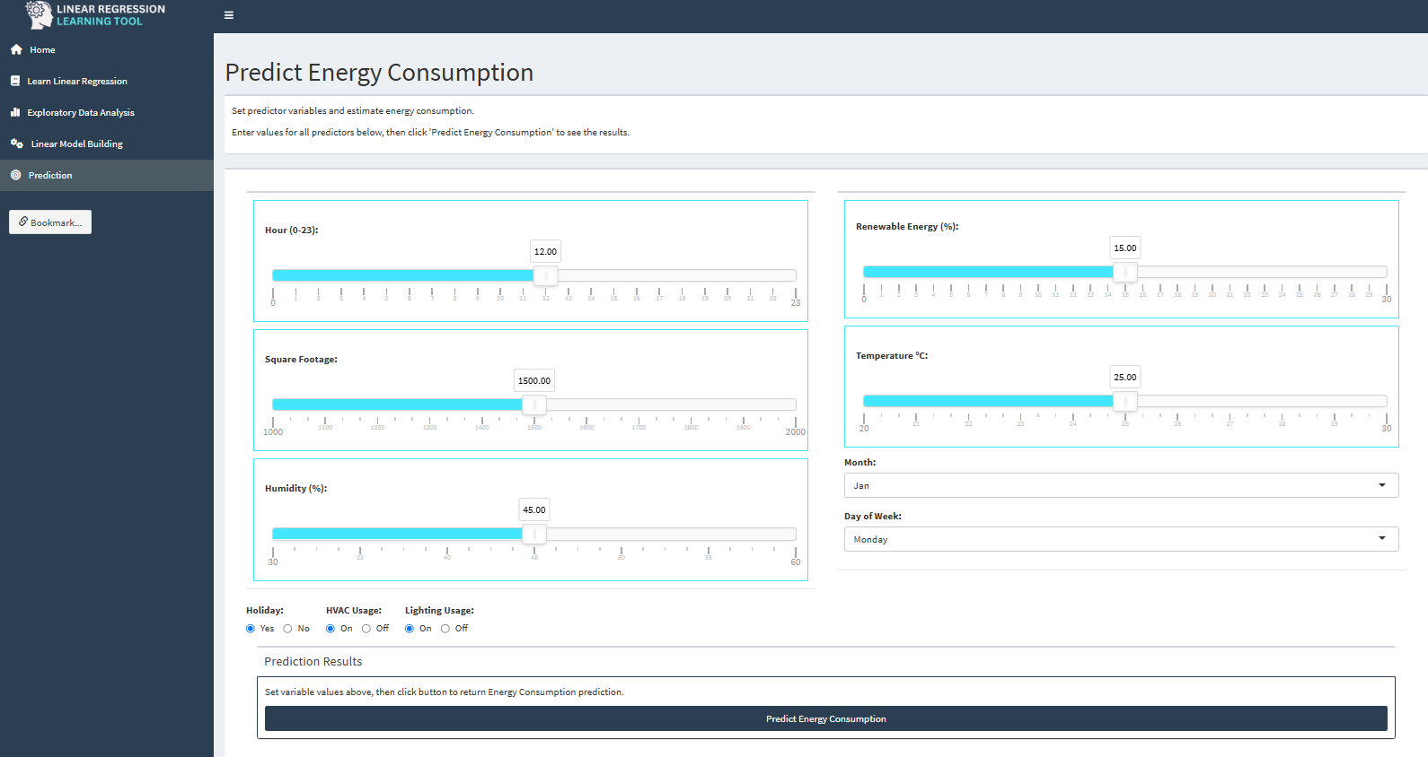

User Guide
Welcome
This app contains tools to help you understand linear regression.
Utilising data about anergy consumption, navigate from the theory, to exploratory data analysis, to create linear regression models and finally, select variable values to predict energy consumption.
>> NAVIGATION
Use links in the left sidebar to navigate through the tabs Home, Learn, Exploratory Data Analysis, Linear Model Building and Prediction.
Use the bookmark link to capture URL to enable any input settings to be retained for future recall.
>> HOME
Download user guide directly from the top of the homepage. The information boxes in the main content are linked to the main app tabs.
>> LEARN LINEAR REGRESSION
The learn tab covers the essential theory of linear regression in a tabbed boxes, for easy navigation.
>> EXPLORATORY DATA ANALYSIS
Choose a variable from the dropdown to return the summary statistics, scatterplot against energy consumption, and Boxplot and Histogram of the selected variable. The temperature variable is pre-selected.
>> LINEAR MODEL BUILDING
Use the check boxes in the main panel to select which variables to add to model. Observe the changes to summary information, plot, equation and scroll down to check assumptions on the diagnostic plots. Try out the on page suggestions at top of page. Use the variable selection in conjunction with summary statistics to perform backward and forward regression selection to define the significant model variables.
>> PREDICTION
Input values on the sliders, dropdowns and radio box and then click the predict button. The predicted value will appear, with information on how to interpret below.

