Slide 1
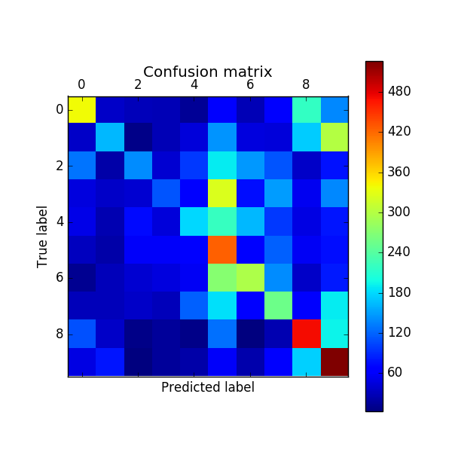
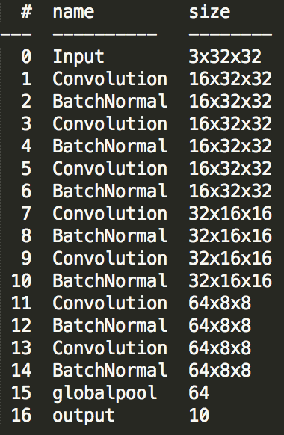
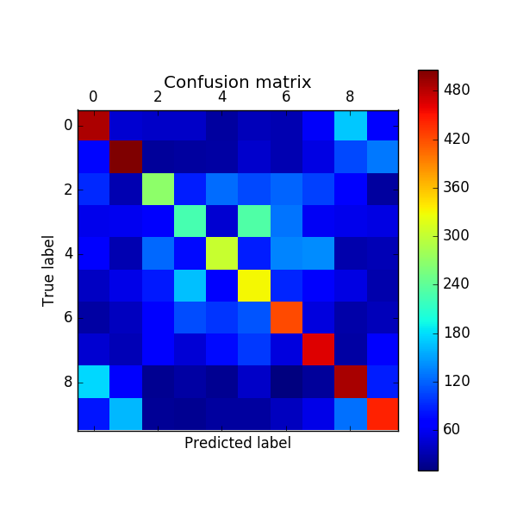
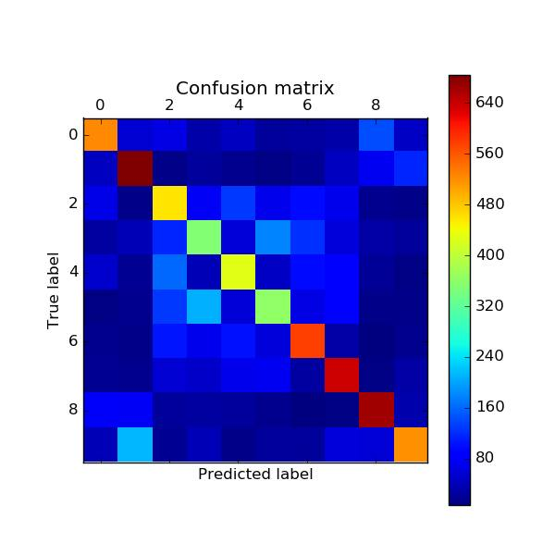
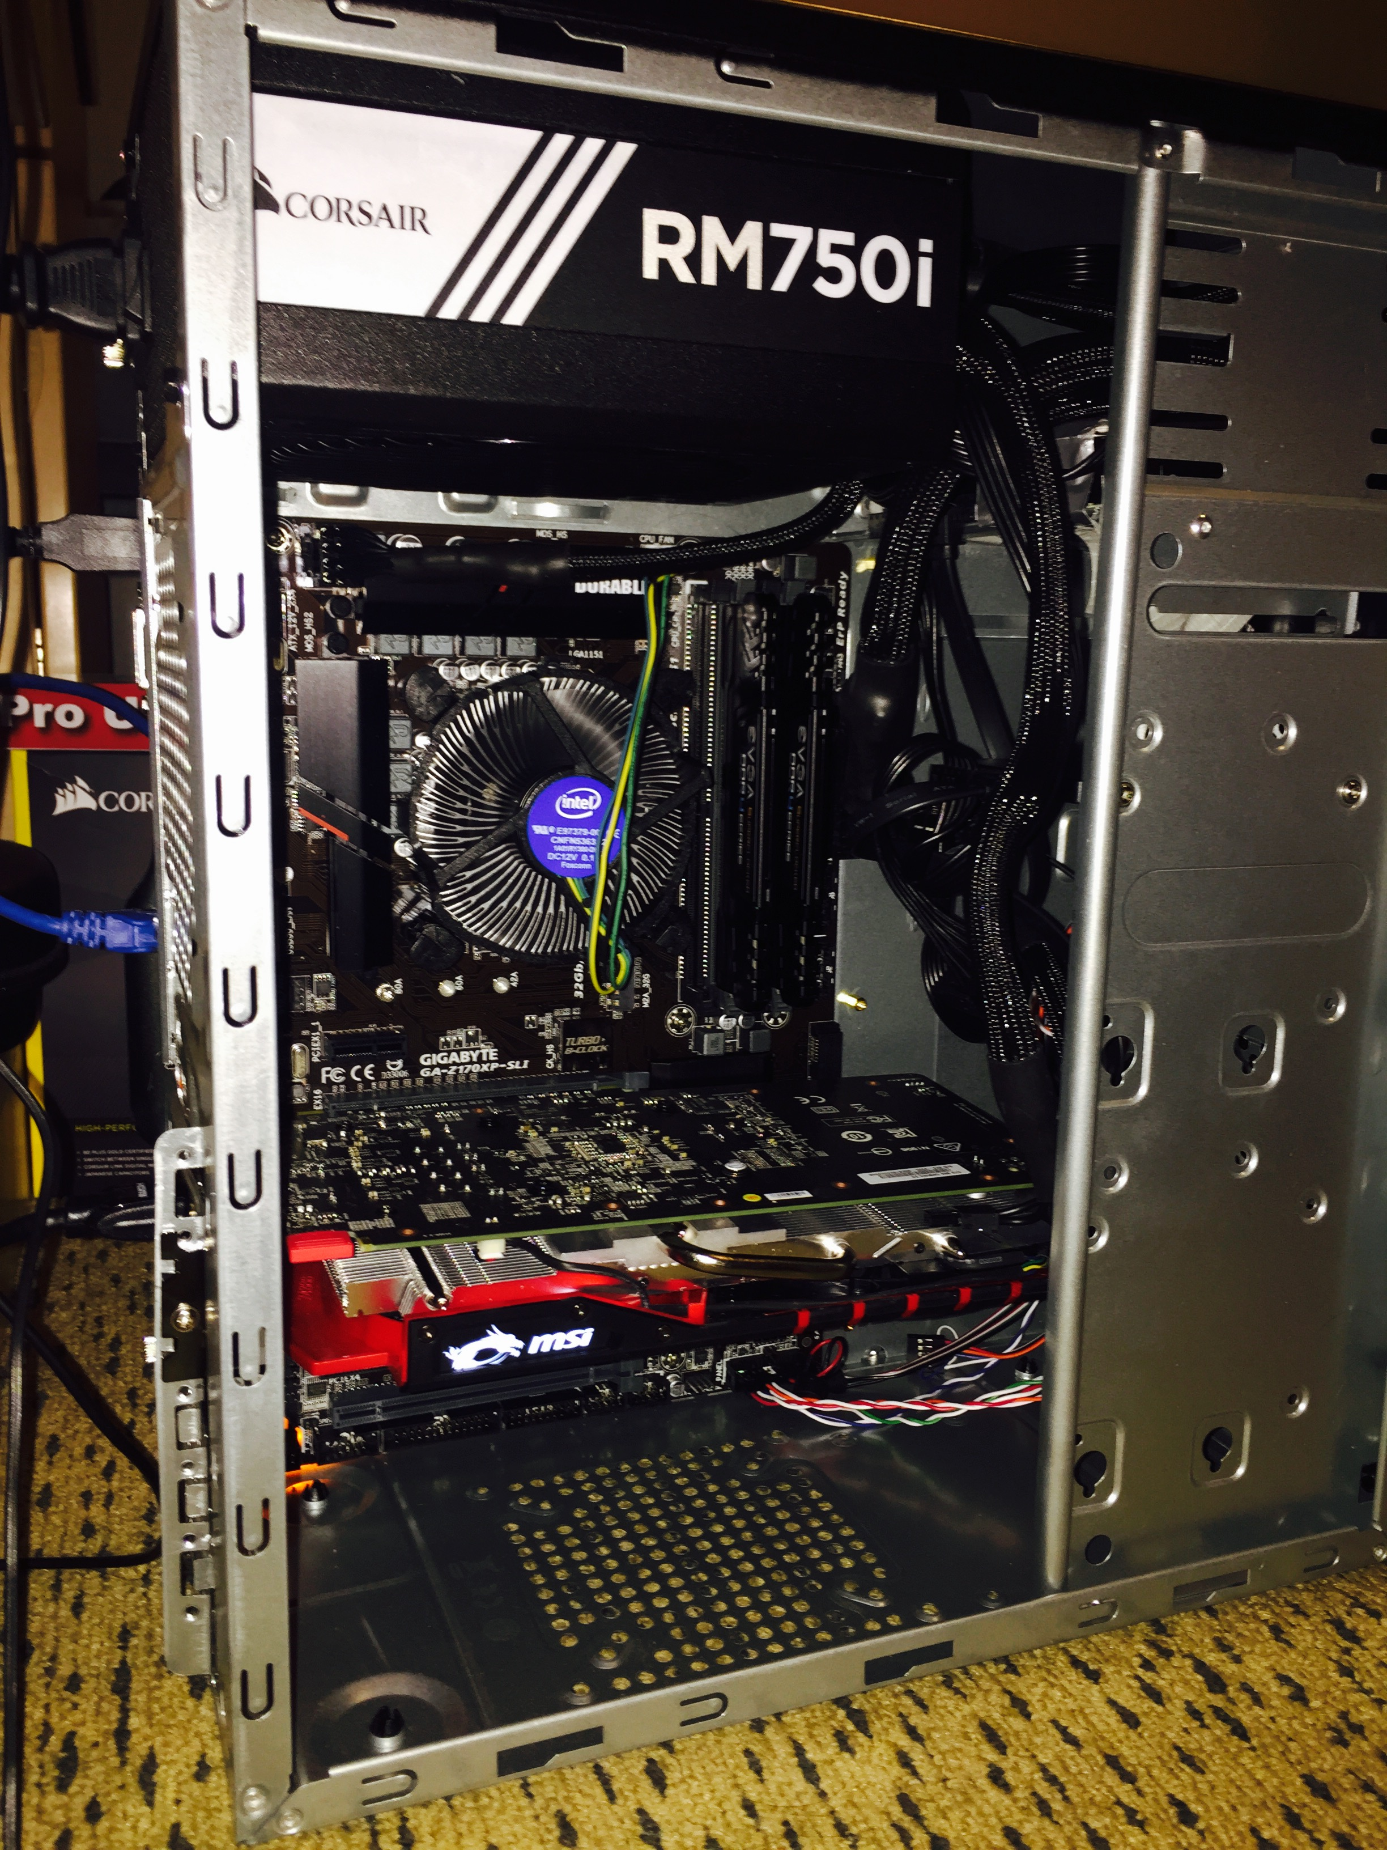
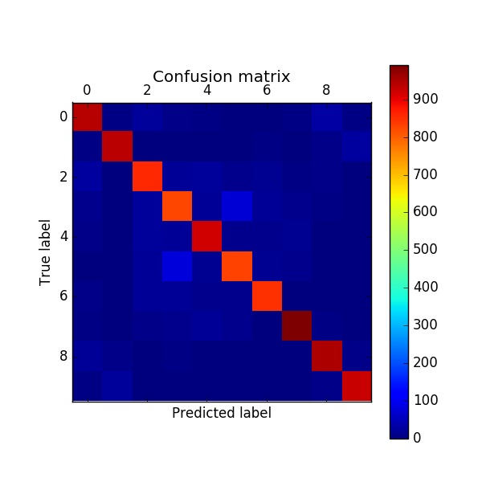
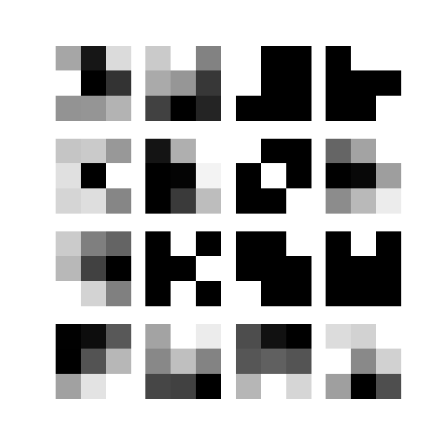
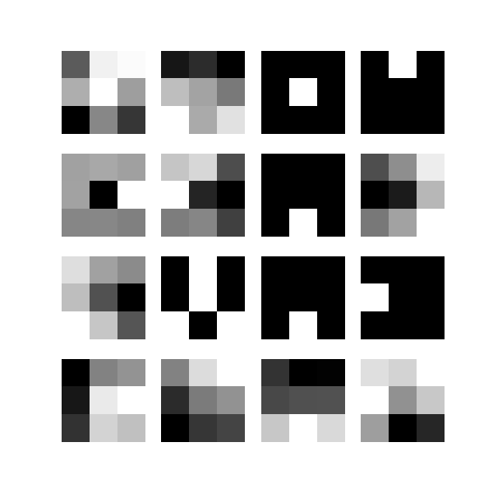
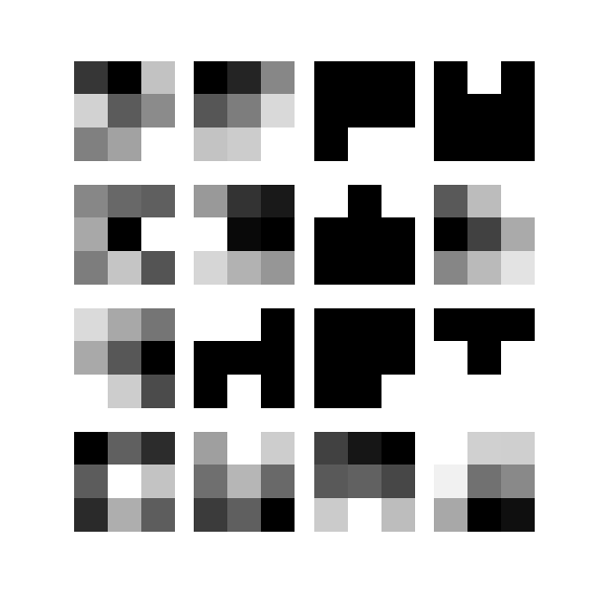
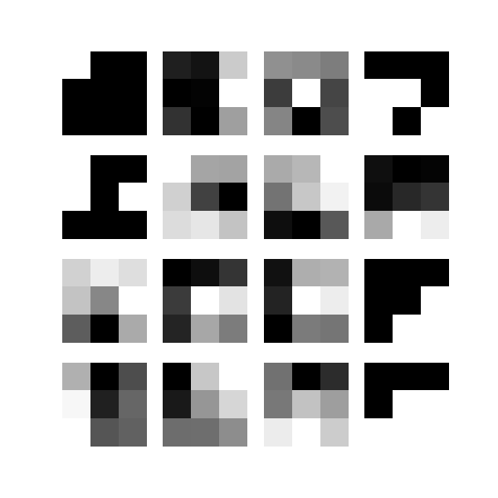
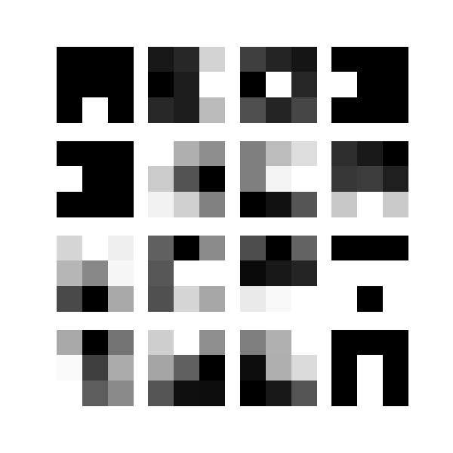
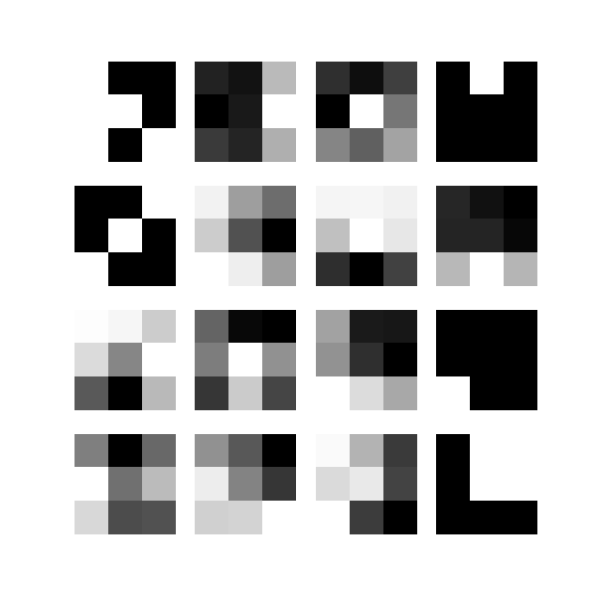
Naïve Bayes: 31%
CIFAR 10 Image Recognition:
Ensembling with Support Vector Machines
CNN Architecture
0: plane
1: car
2: bird
3: cat
4: deer
5: dog
6: frog
7: horse
8: ship
9: truck
To the left, you will see various confusion matrices of different methods we tried on the CIFAR 10 Problem. We found that Naïve Bayes performed the worst (31%), likely since it does not account for the interdependence of the image pixels. Next was Logistic Regression (41%) which observes inter-pixel relationships, but only to a degree. Then was the Neural Network (52%) which heavily learns inter-pixel relationships. Finally was the Convolutional Neural Network (81%) which heavily learns inter-pixel relationships with a specific emphasis on 2D locality, a crucial aspect of images.
To the right, you will see the CNN structure we used to train the various models that were underlying our SVM. This is a powerful ResNet architecture given by He, Zhang, Ren, and Sun at Microsoft Research for the CIFAR-10 Problem. For the conv layers, only 3x3 filters are used.
One-vs-All Logistic Regression: 41%
Using the features learned by CNN’s as input into a linear SVM worked very well (87%), close to human accuracy (94%). Each CNN summarizes each image into 64 key values, and the SVM processes all of the key values of each image from each CNN into a reasonably accurate classification
Hidden Layer
Output: 81%
SVM
Output
87%
Neural Network: 52%
Hidden Layer
Output: 81%
Hidden Layer
Output: 81%
Below are the visuals of the CNN’s first layer weights. The two rows are from different CNN’s. Each column is a representation of the weights for Red, Green and Blue, respectively
We built a computer with a high performance GPU to build our models 20-30x more quickly
Building a Machine Learning Computer
Weight Visualizations for CNN’s
CNN: 81%

