Slide 1
Sortari
(
Daria-Ștefana Clem
Grupa 134

Slide 2

Algoritmii de sortare implementati
,
Radix Sort
Merge Sort
Shell Sort
Counting Sort
Quick Sort

Slide 3
Analiza algoritmilor

Slide 4
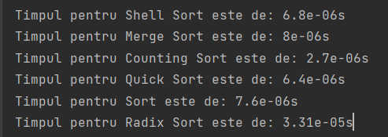
01
1000 1000 1024

Slide 5
Eficienta (Best/Worst)
(
,
Counting Sort
Merge Sort

Slide 6
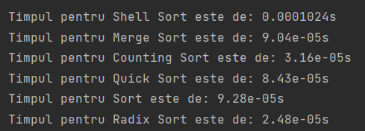
02
1000 1000 2048

Slide 7
Eficienta (Best/Worst)
(
,
Radix Sort
Shell Sort

Slide 8
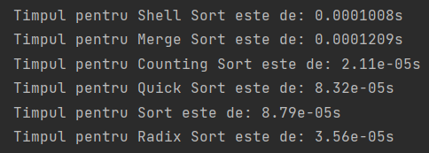
03
1000 1000 4096

Slide 9
Eficienta (Best/Worst)
(
,
Counting Sort
Merge Sort

Slide 10
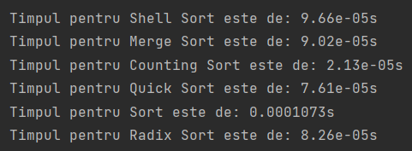
04
1000 1000 8192

Slide 11
Eficienta (Best/Worst)
(
,
Counting Sort
STL Sort

Slide 12
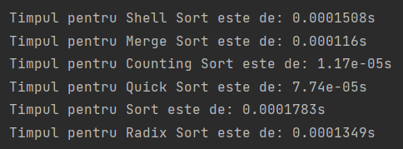
05
1000 1000 16384

Slide 13
Eficienta (Best/Worst)
(
,
Counting Sort
STL Sort

Slide 14
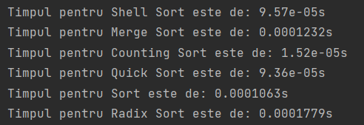
06
1000 1000 32768

Slide 15
Eficienta (Best/Worst)
(
,
Counting Sort
Radix Sort

Slide 16
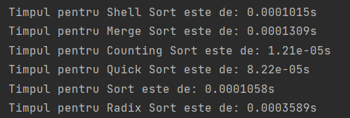
07
1000 1000 65536

Slide 17
Eficienta (Best/Worst)
(
,
Counting Sort
Radix Sort

Slide 18
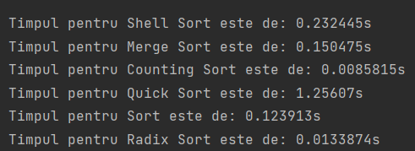
08
1000000 1000 1024

Slide 19
Eficienta (Best/Worst)
(
,
Counting Sort
Quick Sort

Slide 20
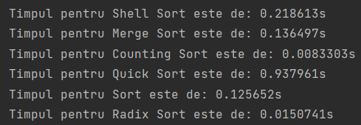
09
1000000 1000 2048

Slide 21
Eficienta (Best/Worst)
(
,
Counting Sort
Quick Sort

Slide 22
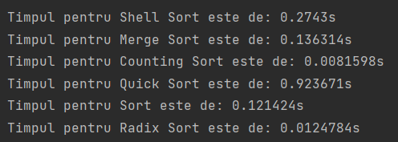
10
1000000 1000 4096

Slide 23
Eficienta (Best/Worst)
(
,
Counting Sort
Quick Sort

Slide 24
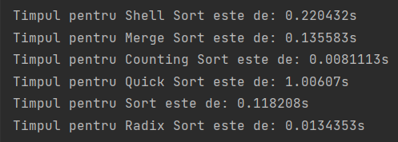
11
1000000 1000 8192

Slide 25
Eficienta (Best/Worst)
(
,
Counting Sort
Quick Sort

Slide 26
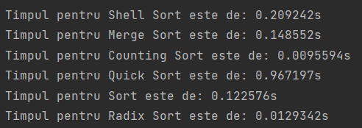
12
1000000 1000 16384

Slide 27
Eficienta (Best/Worst)
(
,
Counting Sort
Quick Sort

Slide 28
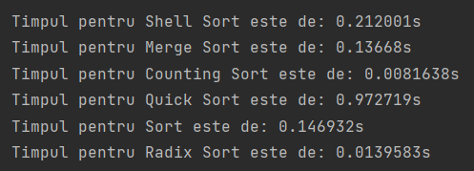
13
1000000 1000 32768

Slide 29
Eficienta (Best/Worst)
(
,
Counting Sort
Quick Sort

Slide 30

14
1000000 1000 65536

Slide 31
Eficienta (Best/Worst)
(
,
Counting Sort
Quick Sort

Slide 32
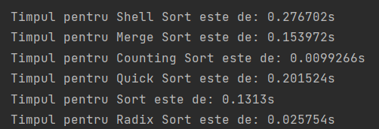
15
1000000 10000 1024

Slide 33
Eficienta (Best/Worst)
(
,
Counting Sort
Shell Sort

Slide 34
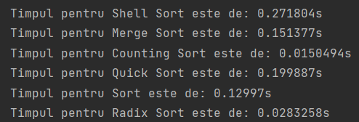
16
1000000 10000 2048

Slide 35
Eficienta (Best/Worst)
(
,
Counting Sort
Shell Sort

Slide 36
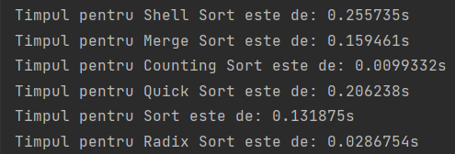
17
1000000 10000 4096

Slide 37
Eficienta (Best/Worst)
(
,
Counting Sort
Shell Sort

Slide 38
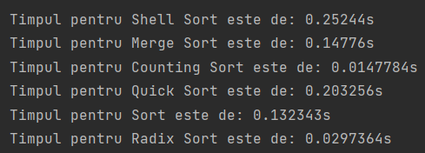
18
1000000 10000 8192

Slide 39
Eficienta (Best/Worst)
(
,
Counting Sort
Shell Sort

Slide 40
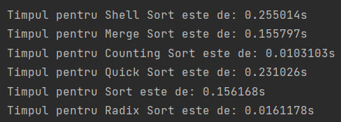
19
1000000 10000 16384

Slide 41
Eficienta (Best/Worst)
(
,
Counting Sort
Shell Sort

Slide 42
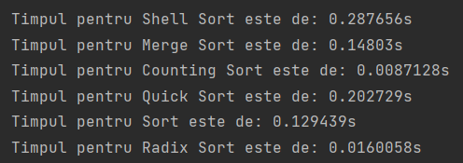
20
1000000 10000 32768

Slide 43
Eficienta (Best/Worst)
(
,
Counting Sort
Shell Sort

Slide 44
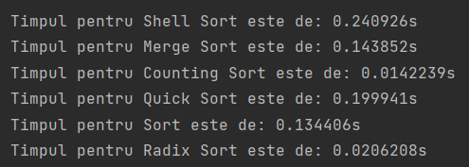
21
1000000 10000 65536

Slide 45
Eficienta (Best/Worst)
(
,
Counting Sort
Shell Sort

Slide 46
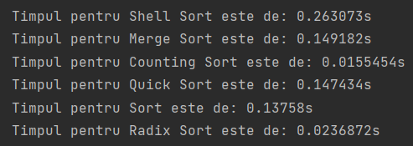
22
1000000 100000 1024

Slide 47
Eficienta (Best/Worst)
(
,
Counting Sort
Shell Sort

Slide 48
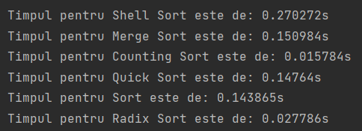
23
1000000 100000 2048

Slide 49
Eficienta (Best/Worst)
(
,
Counting Sort
Shell Sort

Slide 50
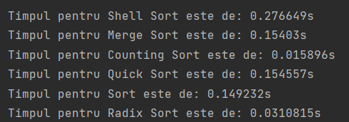
24
1000000 100000 4096

Slide 51
Eficienta (Best/Worst)
(
,
Counting Sort
Shell Sort

Slide 52
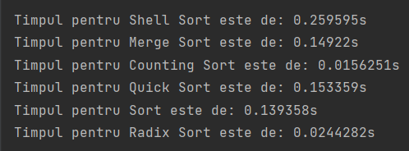
25
1000000 100000 8192

Slide 53
Eficienta (Best/Worst)
(
,
Counting Sort
Shell Sort

Slide 54
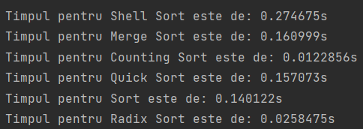
26
1000000 100000 16384

Slide 55
Eficienta (Best/Worst)
(
,
Counting Sort
Shell Sort

Slide 56
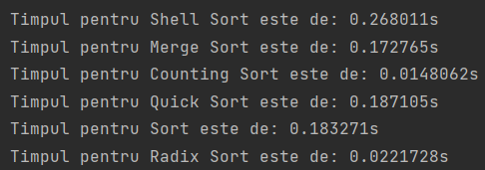
27
1000000 100000 32768

Slide 57
Eficienta (Best/Worst)
(
,
Counting Sort
Shell Sort

Slide 58
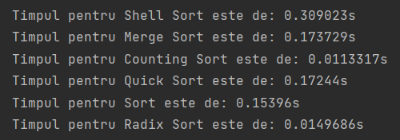
28
1000000 100000 65536

Slide 59
Eficienta (Best/Worst)
(
,
Counting Sort
Shell Sort

Slide 60
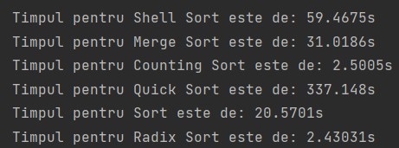
29
100000000 100000000 65536

Slide 61
Eficienta (Best/Worst)
(
,
Radix Sort
Quick Sort

Slide 62

În 85% din cazuri, Radix Sort este mai rapid decât Quick Sort, iar în celelalte cazuri diferenta de timp este foarte mica.
,
(

