Slide 1

3D vides emulatori
 | Paātrinajums headless | Rewards un ietriekšanās sienās | Komentārs
Unreal | 1x | - | Photoreal
Unity | 100x | - | N agents, Sept’17
Udacity (roads only) | OK | OK | Roads only
Gazebo (ROS) | OK | OK | Basic
RobotSchool (OpenAI) | OK | OK | Simple
DeepMind Lab | OK | OK | Rich
Isaac (NVIDIA) |  |  | Not available

Slide 2
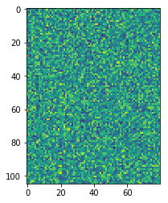
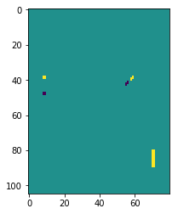
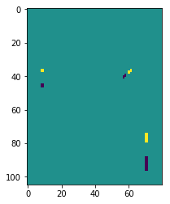

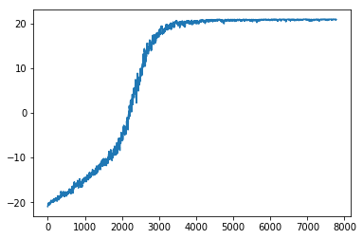
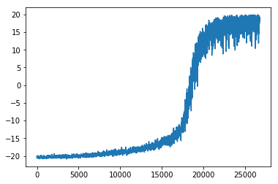
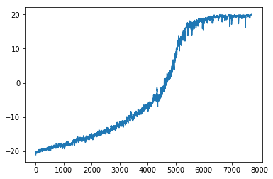
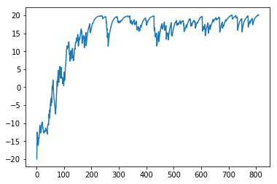
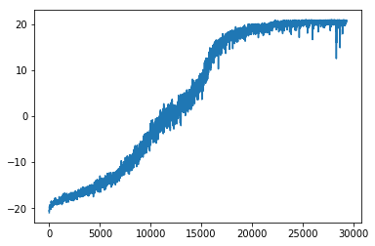
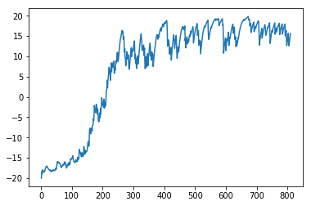
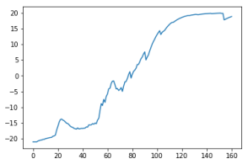
Viss Pytorch uz CUDA
 | Karpathy 8400 dim | tAE-Random 8400 → 80 dim | tAE-Trained 8400 → 80 dim
Initialized Random
Immitation from EpisodicControl
Low-dimensional representation of high-dimensional input

