Slide 1
Systems Engineering & Prototyping
Presented by:
Amer Mohamed Ahmed Mohamed Ali
Badhan Sadim Rahman
Shushkova Daria
Sysoev Andrey
1

Slide 2
Objective & Hardware Components
Objective:
Components:
To build an autonomous vehicle that:
Follows a line (path)
Detects and avoid obstacles in its path
IR Sensors
Ultrasonic Sensors
DC Motors
Arduino
Battery
Motor Driver

Slide 3
Motivation
1. Solving Real-World Problems
Simulating autonomous behaviours like line following and obstacle avoidance.
2. Interdisciplinary Learning
Engineering Design: Prototyping and system modelling
Software: Control logic and algorithm development
Hardware: Sensor integration and circuit implementation
Systems Engineering: System design (SysML diagrams), requirements, testing
3. Engineering Creativity
Handling vehicle behaviour under hardware constraints: speed control, sensor calibration, manoeuvring.

Slide 4
Challenges & Solutions

Slide 5
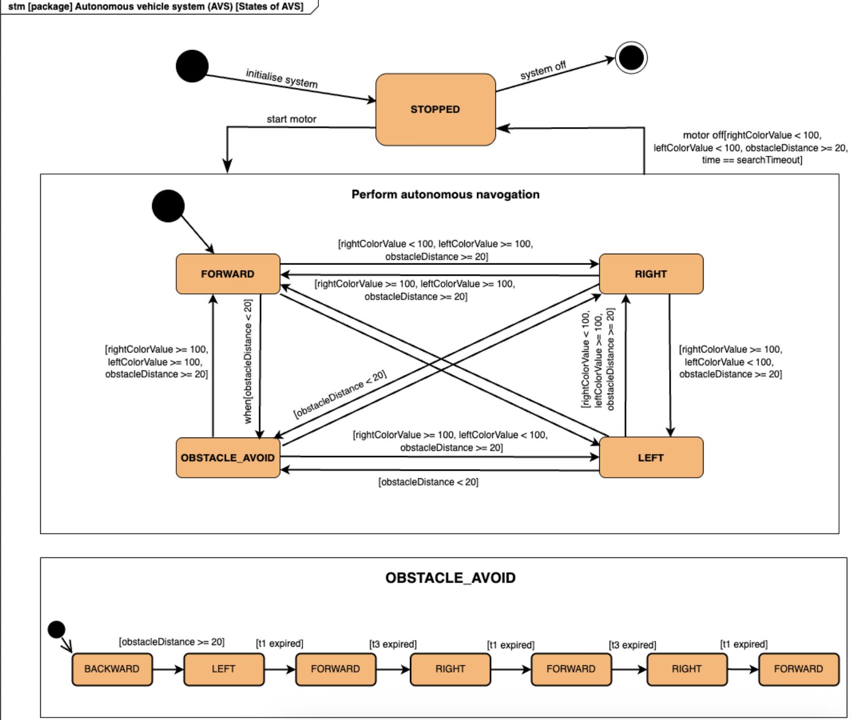
Initially designed State Machine

Slide 6
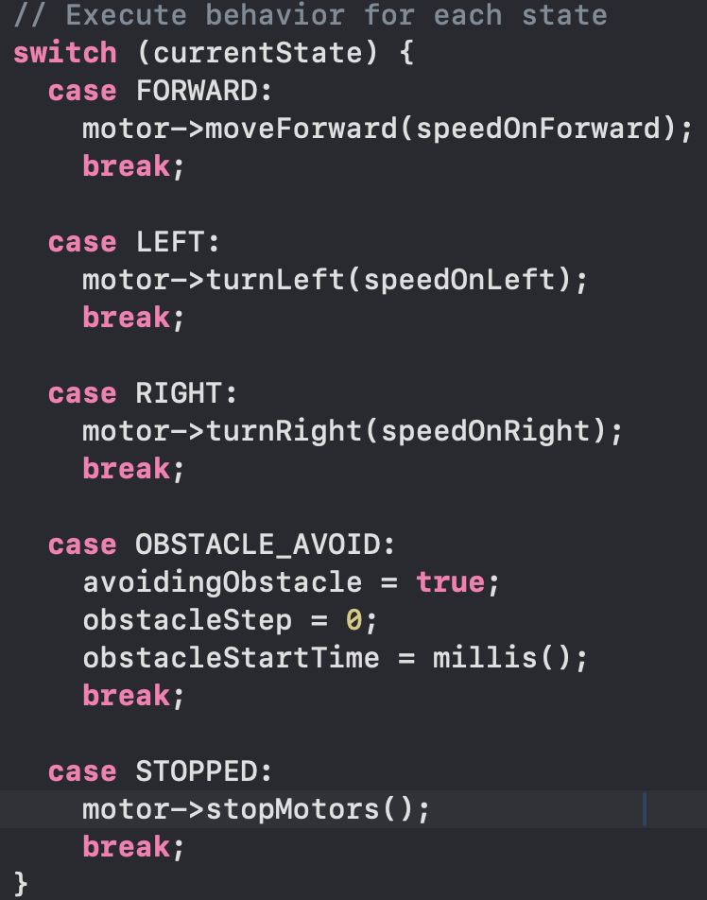
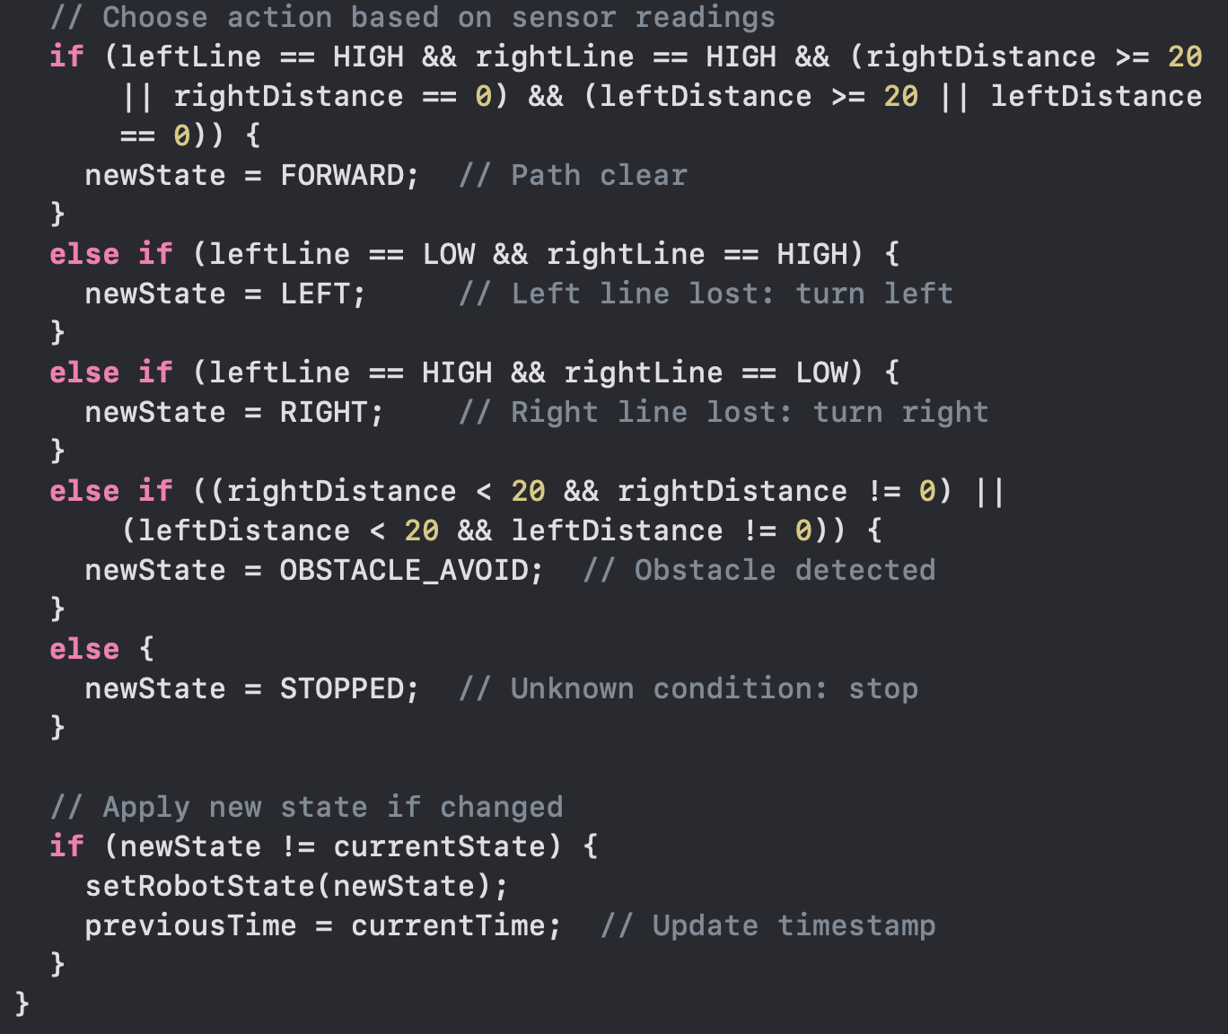
Initially designed State Machine

Slide 7
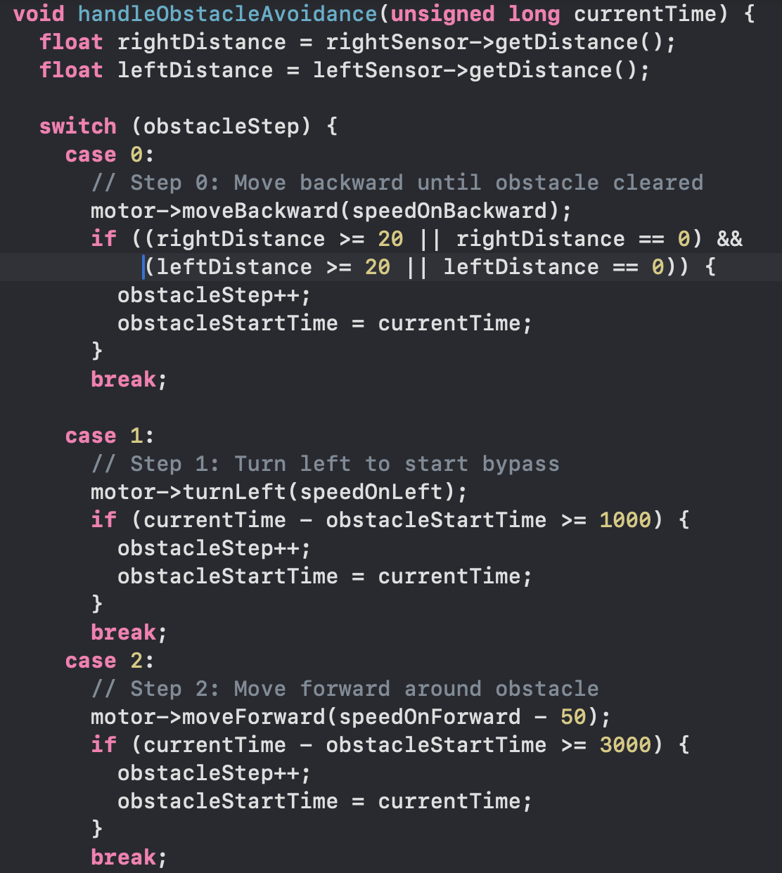
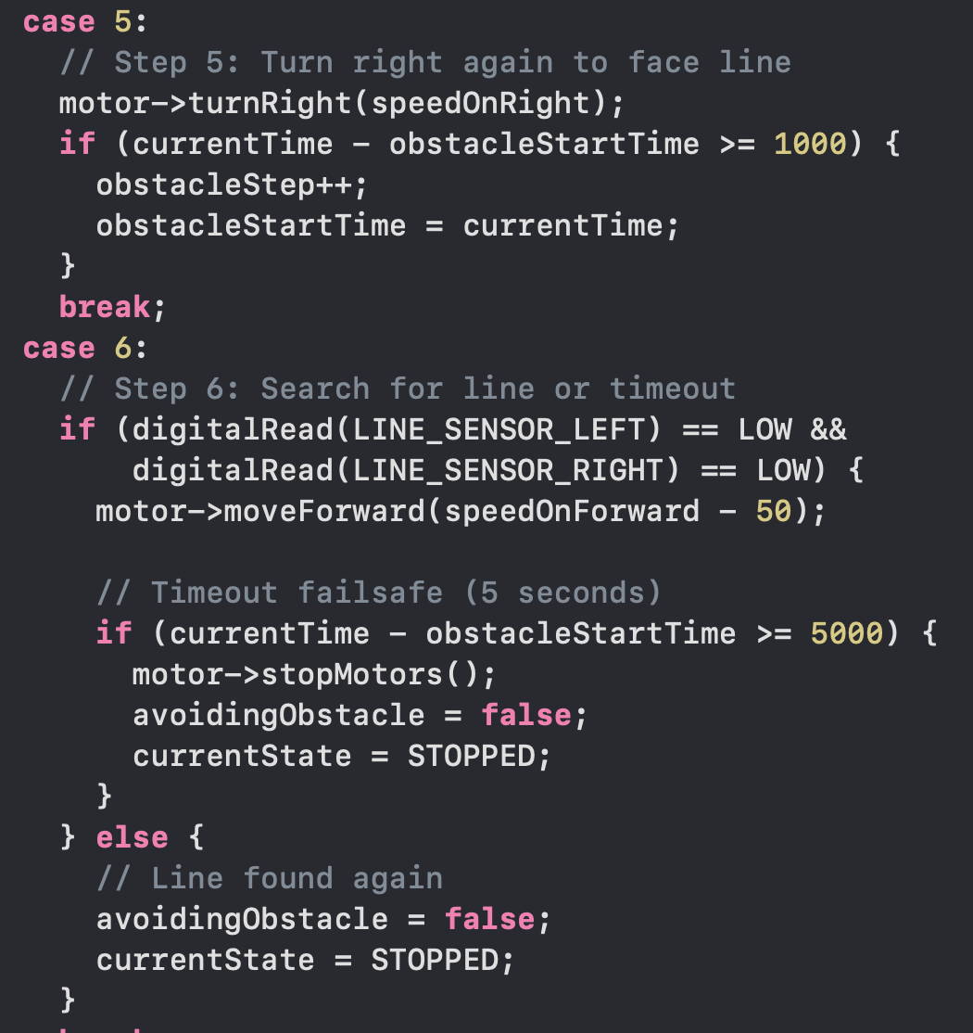
Initially designed State Machine

Slide 8
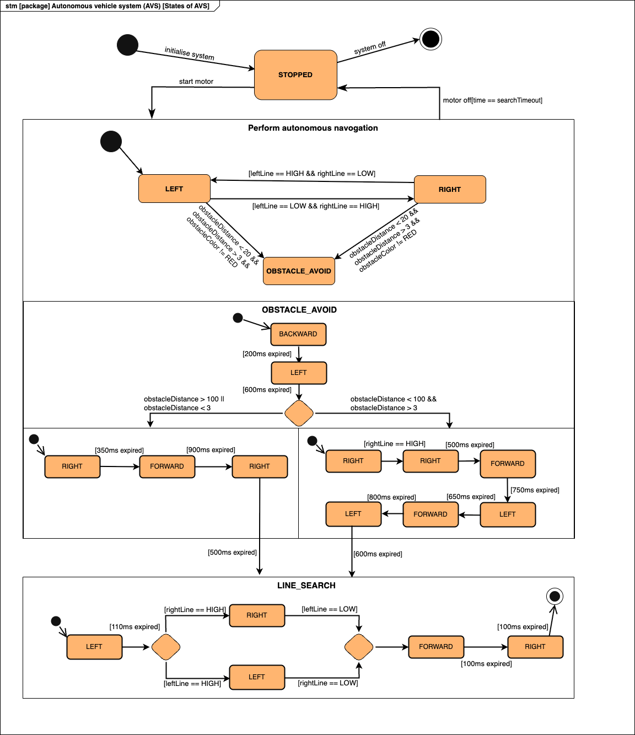
Updated State Machine

Slide 9
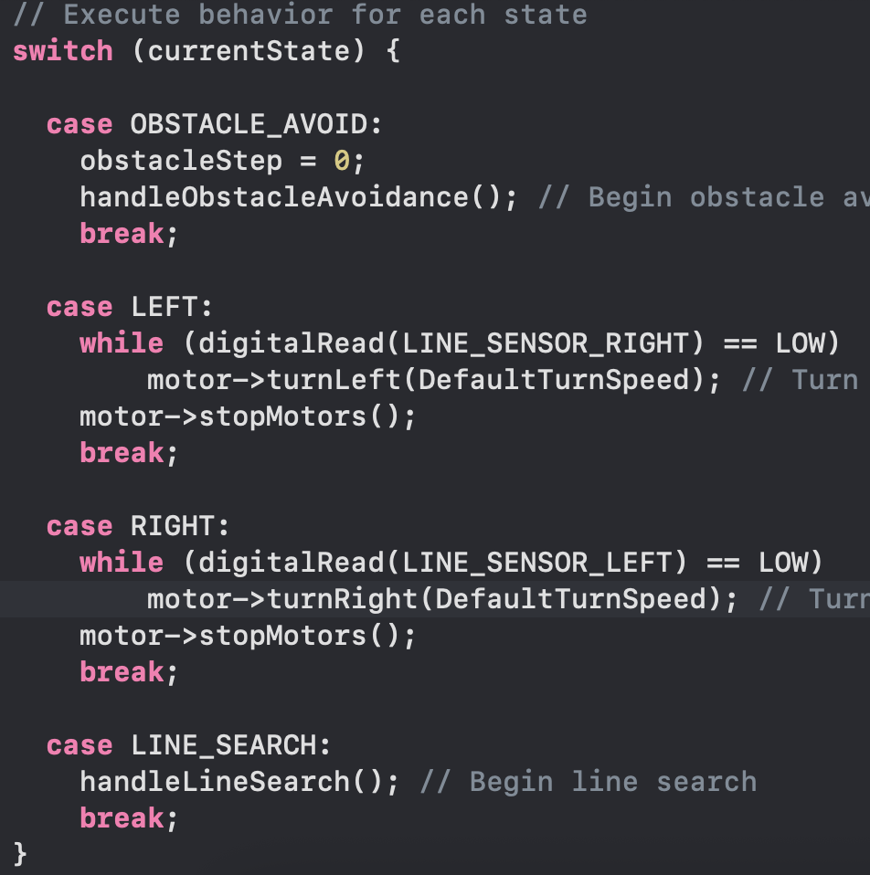
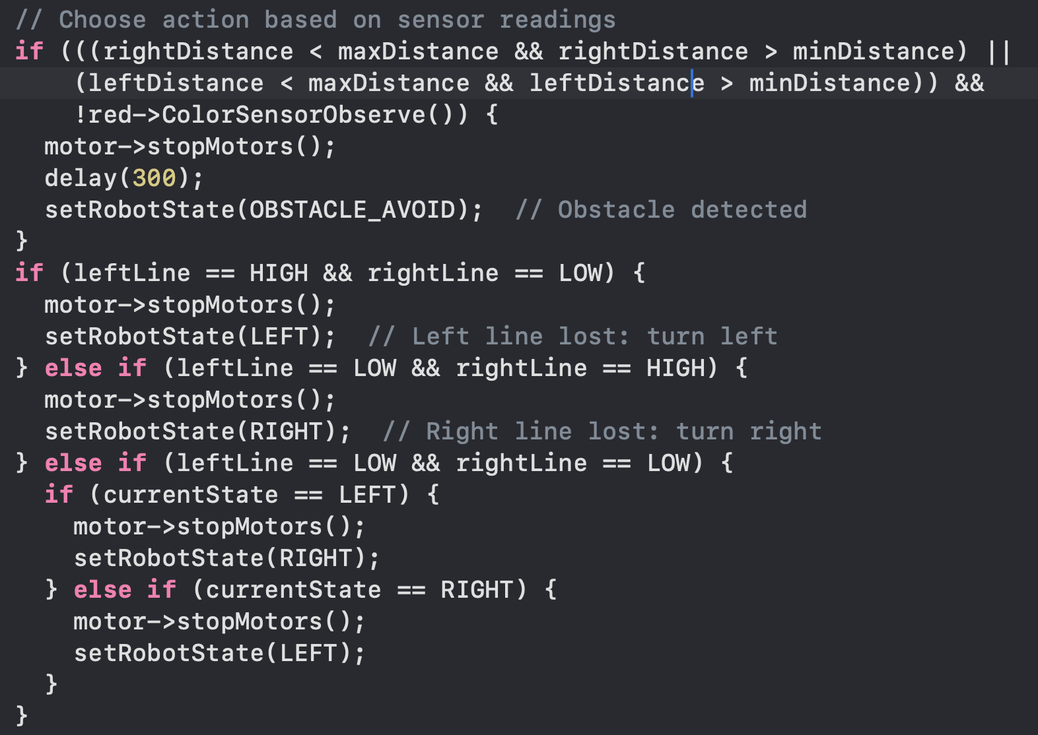
Updated State Machine

Slide 10
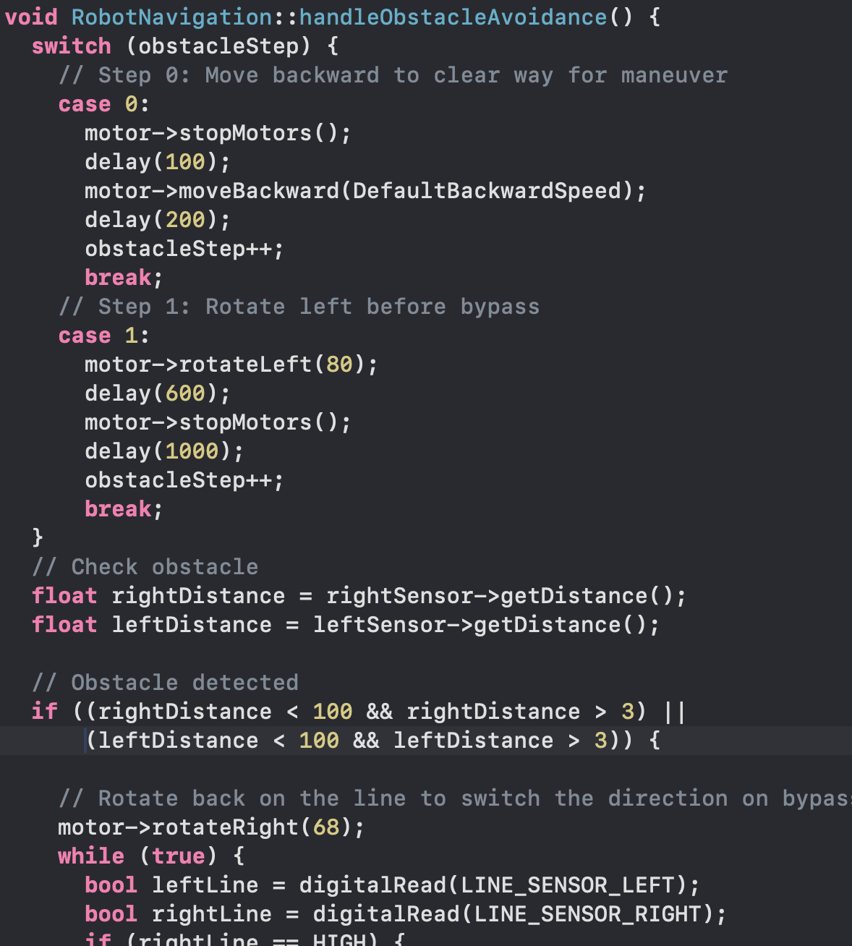
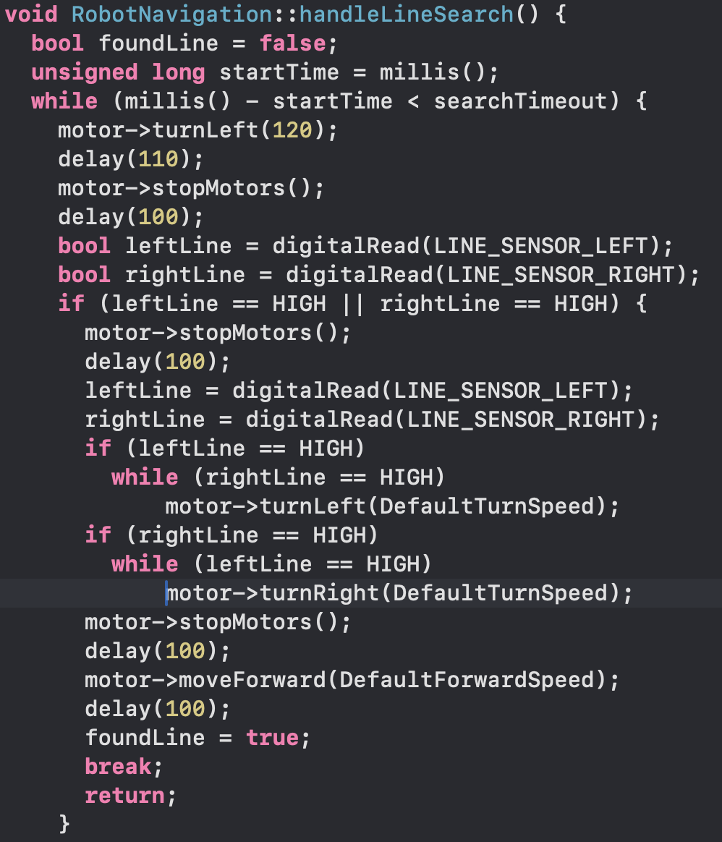
Updated State Machine

Slide 11
Mechanical Fit
The Challenge:
Initial 3D-printed parts were designed to precise dimensions and were designed quite thin to meet time constraint for printing.
After printing testing these parts on the actual chassis, they did not fit well due to real-world imperfections and the 3D printer errors.

Slide 12
Mechanical Fit
The Solution:
Redesigned the parts to be thicker, less rigid, and more adaptable.
Included some tolerances in the designed parts to compensate errors resulted from printing
Added slots to the IR sensor mounts to enable easy location tuning without constraints.

Slide 13
Wiring Management
The Challenge:
The initial wiring was disorganized, with excessively long cables.
This created a "messy" look and posed a functional risk, as wires could snag on moving parts or the environment, interrupting the vehicle's movement.

Slide 14
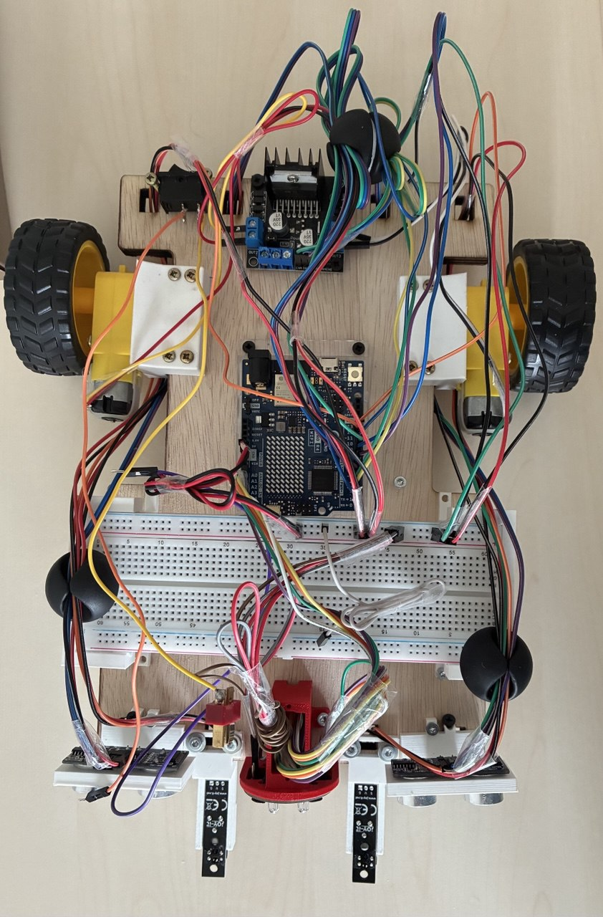
Wiring Management
The Solution:
Implemented a wire management strategy using wire clips and duct tape for a secure and neat fit
This kept the wiring contained, orderly, and clear of any moving components.

Slide 15
Weight Distribution
The Challenge:
In the initial design, the battery was placed at the front of the vehicle horizontally for easy access.
During testing, this caused a critical imbalance, preventing the wheels from gaining proper traction. Thus, The vehicle struggled to move correctly.

Slide 16
Weight Distribution
The Solution:
Instead of a redesign, we added heavy bolts to the rear of the chassis to act as counterweights.
This shifted the centre of gravity to the back, allowing the wheels to function properly.

Slide 17
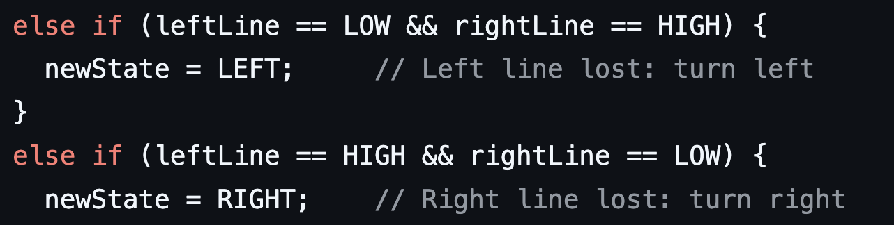
IR Sensors Configuration
The Challenge:
The physical distance between our two IR sensors was much wider than the actual black line used on the track.
Code expected a LOW signal to indicate "line detected”. It caused incorrect logic and movement.

Slide 18
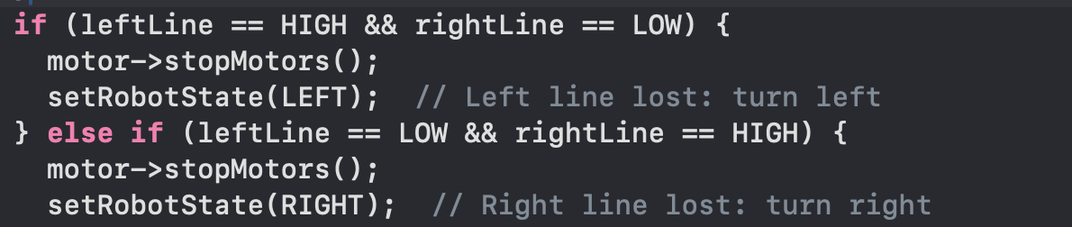
IR Sensors Configuration
The Solution:
Adjusted the Code, inverting the line detection to HIGH instead of LOW
Adjusted the sensor spacing to be reasonable relative to the line thickness

Slide 19
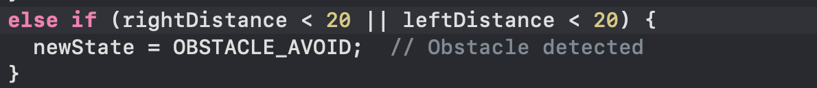
Ultrasonic Configuration
The Challenge :
The ultrasonic sensor was initially configured to detect only maximum distance (e.g.< 20 cm), without initialization of min range.

Slide 20
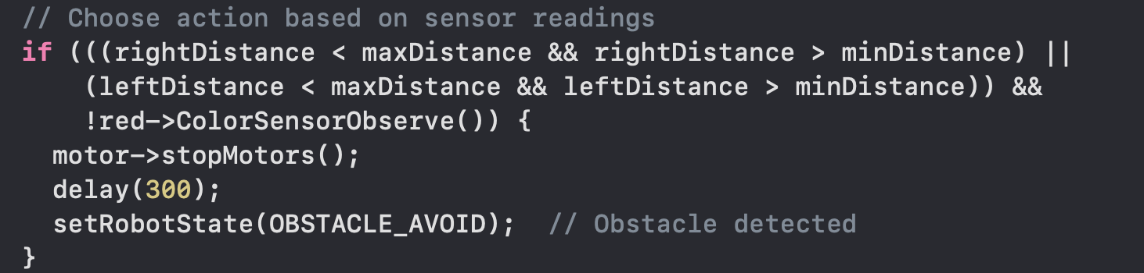
Ultrasonic Configuration
The Solution:
Implemented echo validation to ensure ping response falls within a practical range between minimum and maximum distance (e.g. 3 cm and 20 cm).

Slide 21
Conclusion & Key Learnings
Design for Imperfection: Real-world hardware requires more tolerance and adjustability than CAD models suggest.
Adaptability is Key: Being able to solve problems with code (like the sensor logic) can be faster and more efficient than making physical changes.
Iterative Testing is Crucial: The most effective solutions were found through constant testing, observation, and incremental adjustments to both hardware and software.

Slide 22
Q&A
Thank you!
We’re happy to answer your questions.

