Slide 1
NFL Scoring: Home vs Away
Capstone Phase II — Tableau Analysis • Author: Darien Evans
Dataset: Kaggle NFL scores and betting data (1966–2024)

Slide 2
Problem Statement
Which NFL teams consistently score the most points per game at home vs away?
How large is the home‑field scoring advantage

Slide 3
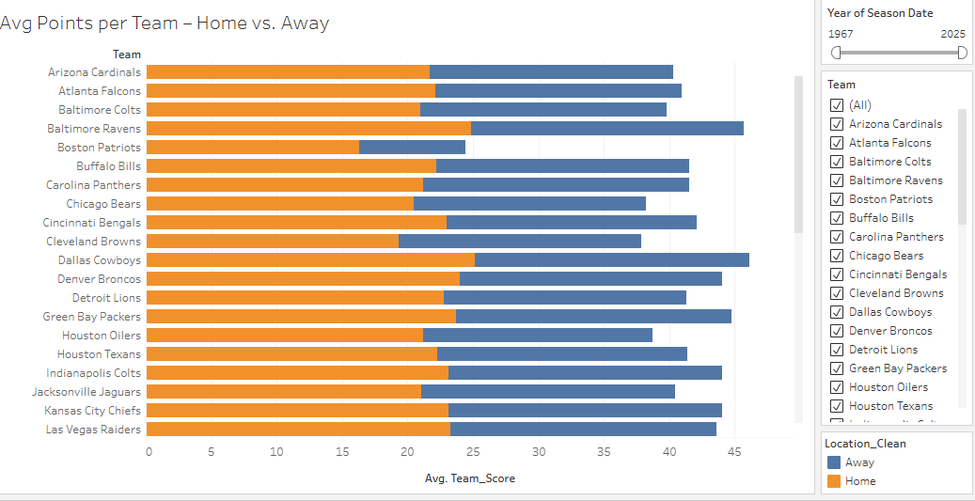
What this shows
Side-by-side bars compare each team’s average points per game at Home vs Away (for the years selected).
Key takeaways
League pattern: Home bars are usually higher → home teams score ~2–3 PPG more on average.
Elite offenses: Teams with both bars high (top quartile for Home and Away) are strong in any stadium.
Home-leaning teams: A big gap (Home ≫ Away, ~3+ PPG) suggests venue/crowd/conditions matter more.
Travel-proof teams: Small gap (≤1 PPG) means their offense travels well—consistent home or road.
Ranking shifts by era: Move the Year slider—orders change, but the home edge generally remains.
“Most teams score a bit more at home, but the best offenses sit high on both bars—those are the ones that travel.”
.

Slide 4
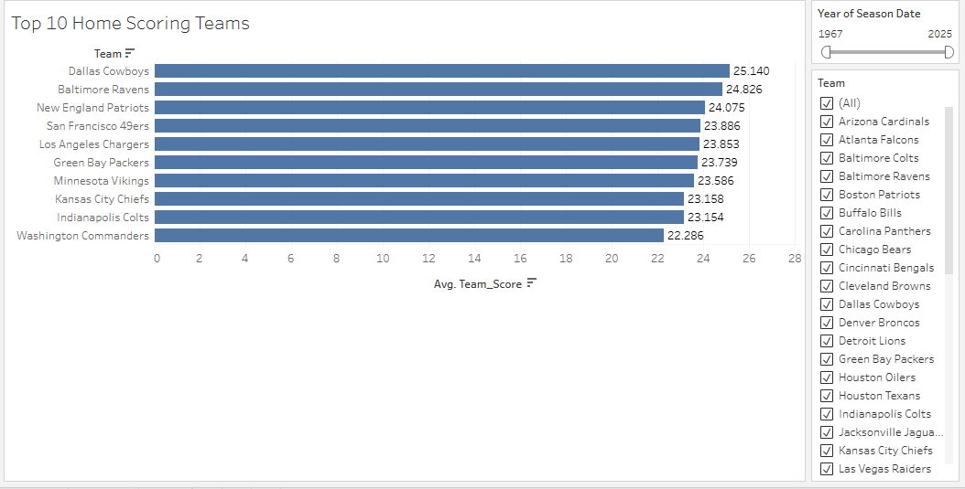
Worksheet 2 — Top 10 Home Scoring Teams
What this shows
The 10 highest average PPG at home for your selected years (bar labels = avg points per game).
Key takeaways
Tight cluster: Leaders sit roughly ~23–25 PPG at home, so the gap from #1 to #10 is small → elite parity.
True elite offenses: Teams that also appear in Worksheet 3 (Top 10 Away) are strong in any stadium (not just a home product).
Home-leaning signals: If a team ranks high here but not away, it hints at venue-driven edge (crowd noise, climate, altitude, or dome years).
Era matters: Slide the Year filter—orders shift across eras, but top home offenses still cluster in the mid-20s PPG.
Context check: A big home average can come from high pace or soft home schedules—use later “advantage” and “trend” sheets to confirm.

Slide 5
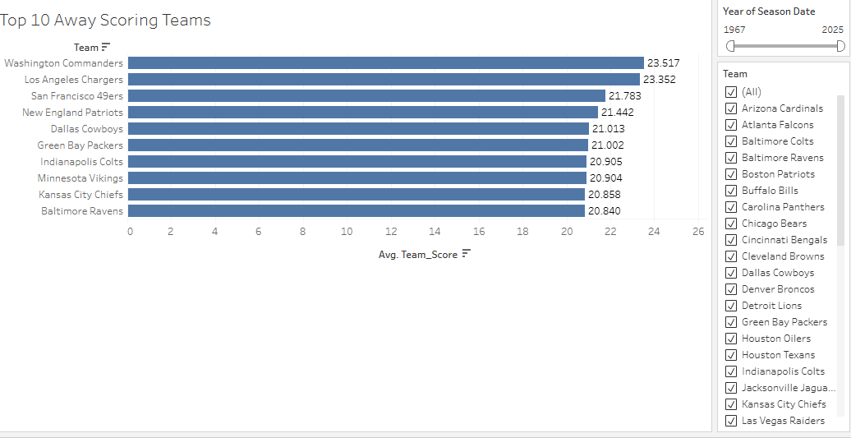
What this shows
The 10 highest average points per game on the road for the years in your filter. (Bar labels = Avg Away PPG.)
Key takeaways
Road resilience: These offenses travel well—they keep scoring even without home-field advantages.
Tight range: Away leaders typically cluster around ~21–23.5 PPG, so the gap from #1 to #10 is small (strong parity at the top).
True elites overlap: Teams that also appear in (Top 10 Home) are the most reliable—they’re strong in any stadium.
Home-leaning vs. portable: If a team ranks high away but mid/low at home, it suggests the offense is system/QB driven more than venue-dependent.
Era-sensitive: Adjust the Year slider—orders shift by era, but top road offenses still stay near the low–mid-20s PPG band.

Slide 6
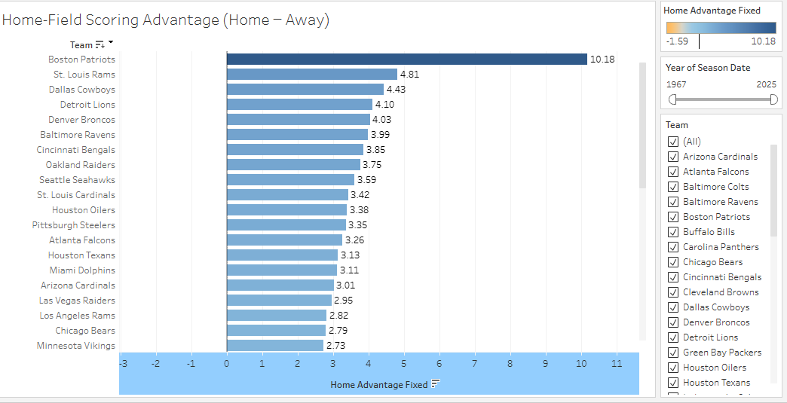
Home field gives a real bump: most teams score about +2 to +3 points per game more at home than away.
Some teams get a bigger boost (around +3 to +4+ PPG). In your view, big examples include Cowboys (~+4.4), Broncos (~+4.0), Ravens (~+4.0), Seahawks (~+3.6), etc.
Near-zero bars mean the team’s offense travels well (home and away scoring are similar).
Historical names (e.g., Boston Patriots, St. Louis Rams) can look extreme because of small/older samples—mention as a caveat.
This chart shows how many extra points per game each team scores at home vs away—most teams are around +2–3 PPG, and a few venues/teams push +4 PPG, which signals a stronger home effect

Slide 7
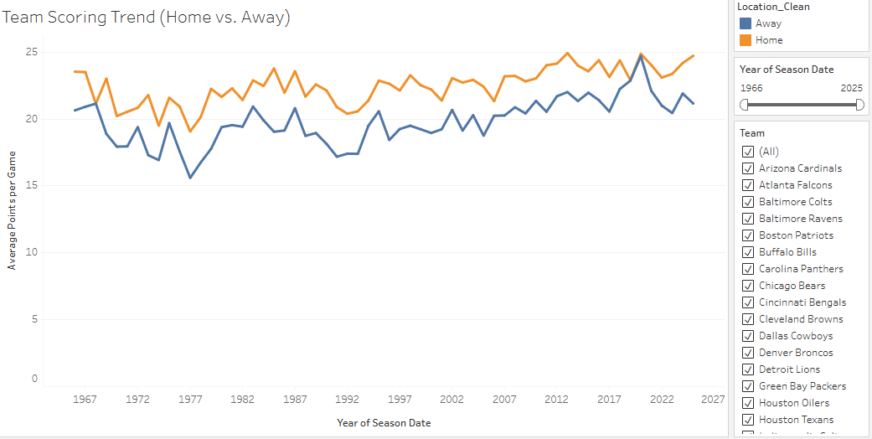
Worksheet 5 — Team Scoring Trend (Home vs Away)
What this shows
A line chart over seasons for one selected team, with two lines:
  Home (orange) average points per game
  Away (blue) average points per game
The Year slider changes the window; Team filter switches the franchise.
Key takeaways
For most teams, the Home line sits above the Away line in most years → a ~2–3 PPG home edge.
The gap size changes by era (coaching/QB changes, rules, venue).
Crossovers (Away above Home for a stretch) highlight road-strong periods or weak home years.
Recent windows (last 5–10 seasons) often tell a clearer, modern story than all-time.
.

Slide 8
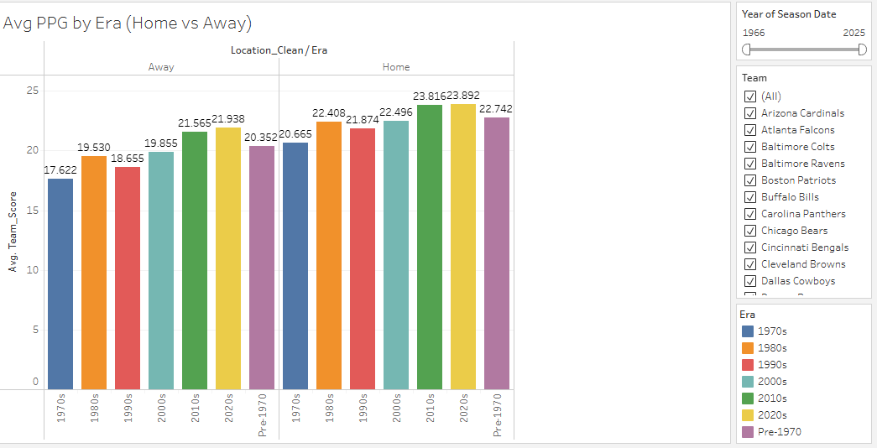
This chart compares the average points per game (PPG) scored by teams at home and away across different NFL eras.
  - Scoring has increased steadily over time for both home and away teams.
  - Home teams consistently outscore away teams in every era.
  - The scoring gap was wider in earlier eras (1970s–1990s) than in recent eras.
  - 2020s show the highest average scoring overall, with home teams averaging nearly 24 PPG.

Slide 9
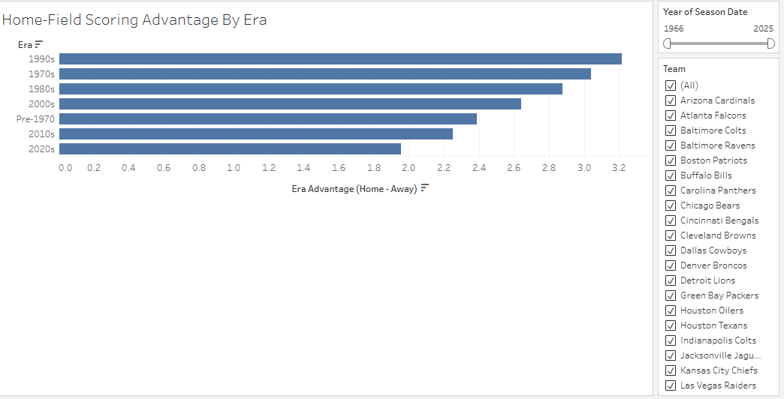
This chart measures the scoring advantage home teams have over away teams in different eras (Home PPG – Away PPG).
  - The 1990s had the largest home-field scoring advantage (+3.2 PPG).
  - The advantage has gradually declined in the 2010s and 2020s.
  - Recent decades suggest that the traditional 'home-field advantage' is shrinking.
  - Possible reasons: improved travel, neutral officiating, and parity in league rules.

Slide 10
Key Insights
Home field adds a small but consistent scoring edge (~2–3 PPG).
The best offenses appear in both Top‑10 lists — strong home & away.
A few venues show a bigger boost (+3–4 PPG) → likely stadium/altitude/noise effects.

