Slide 1
Using Harris, we will demonstrate and discuss Valgrind to detect memory-related errors
Darien Tan

Slide 2
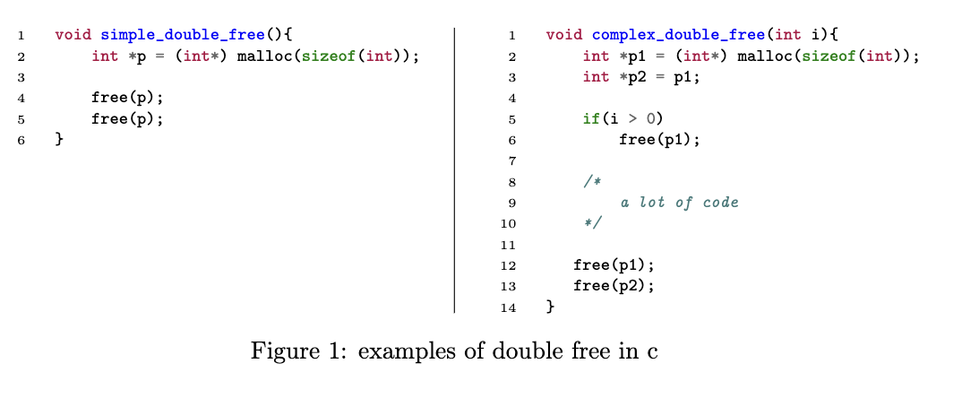
Introduction
C offers different ways to store variables in memory
Programmer have to be remindful to manage the memory blocks
Misuse of dynamic memory
Code may still run without any issues

Slide 3
Related work
Process of debugging has been studied very well
Dennis Ritchie and Brian Kernighan provide an overview of important features in the C programming language, including pointers and dynamic memory.
Brian W. Kernighan and Rob Pike offer principles and strategies for developing and debugging software in different programming languages.
Andreas Zeller proposes the TRAFFIC principle
Valgrind is an instrumentation framework for building dynamic analysis tools.
Memcheck is a tool for Valgrind for finding memory related bugs and has been described and evaluated with the focus on undefined value errors.
More recently the capabilities of Valgrind in parallel environments have been studied.

Slide 4

Memcheck
detect double free errors by running it against faulty code
generates a detailed report
Testbed
Memcheck
Running it on harris
Written in C

Slide 5
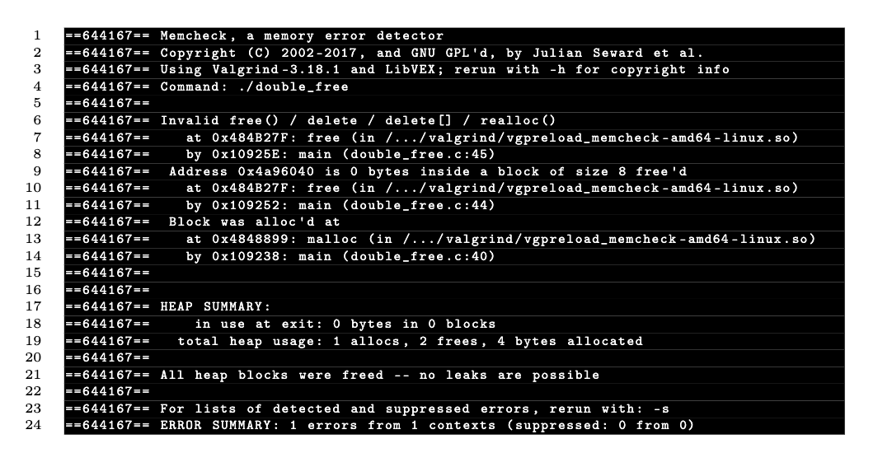
Double free
Function
Executing with Memcheck
Executing without Memcheck

Slide 6
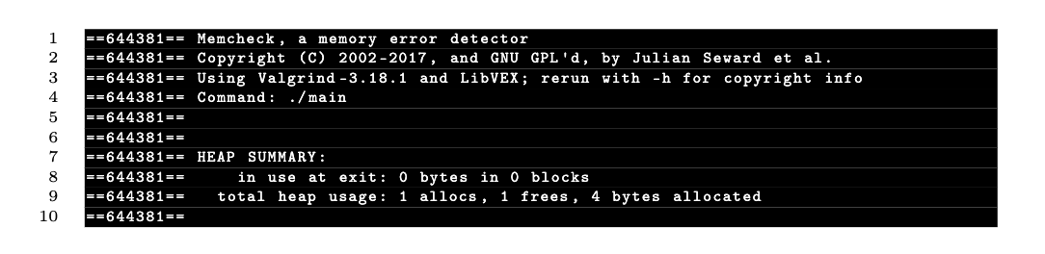
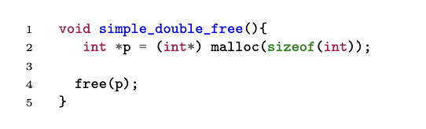
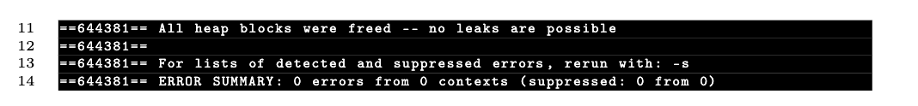
Double free (Correction)
Function
Executing with Memcheck

Slide 7
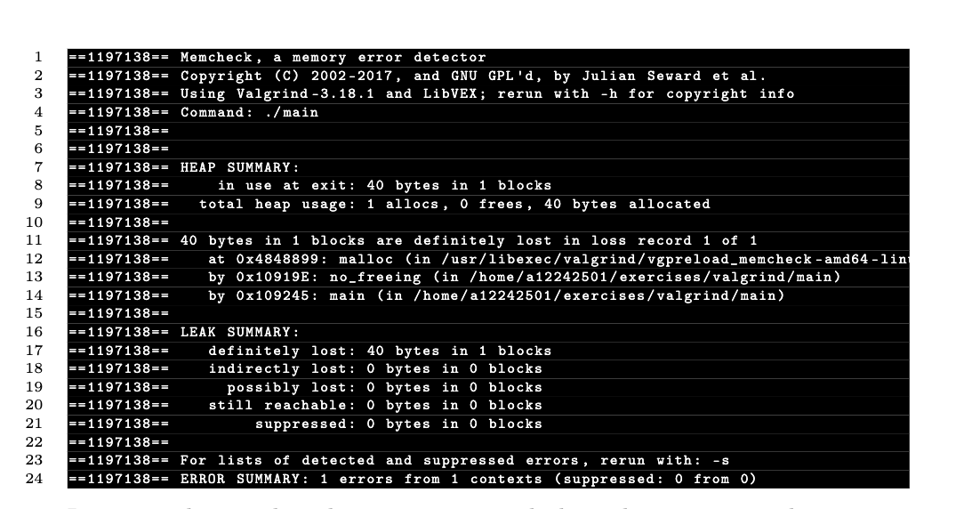
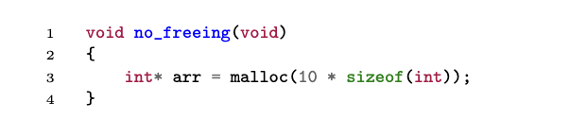
Detecting no free errors
Function
Executing with Memcheck

Slide 8
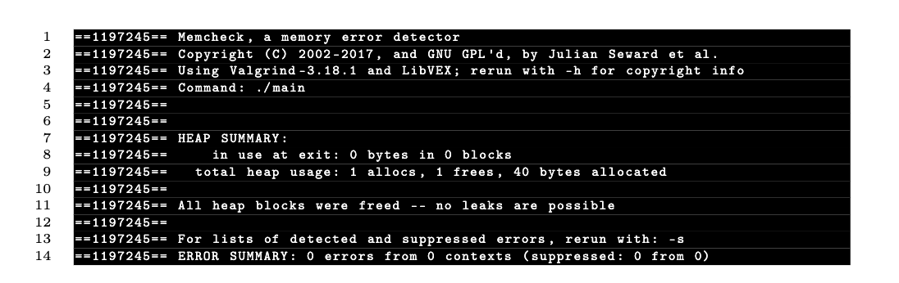
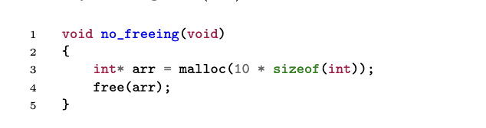
Detecting no free errors (Correction)
Function
Executing with Memcheck

Slide 9
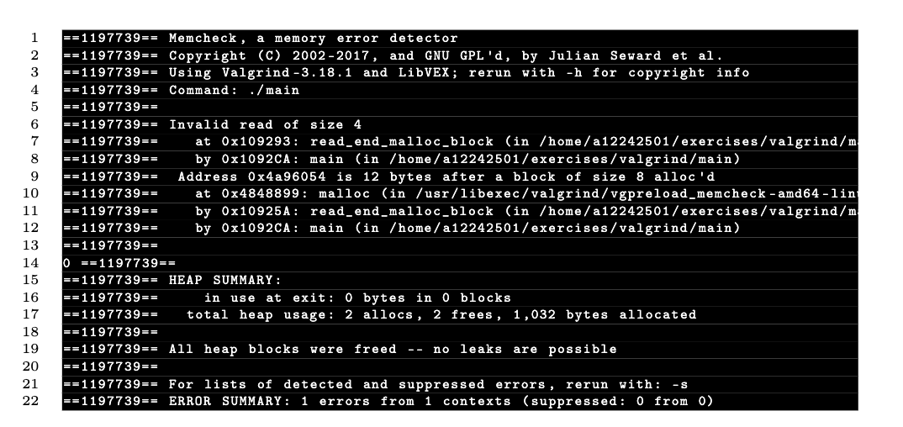
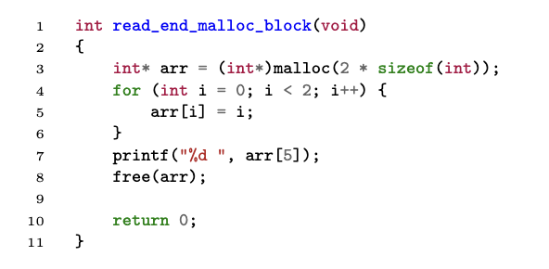
Detecting reading outside of the malloc’d blocks
Function
Executing with Memcheck

Slide 10
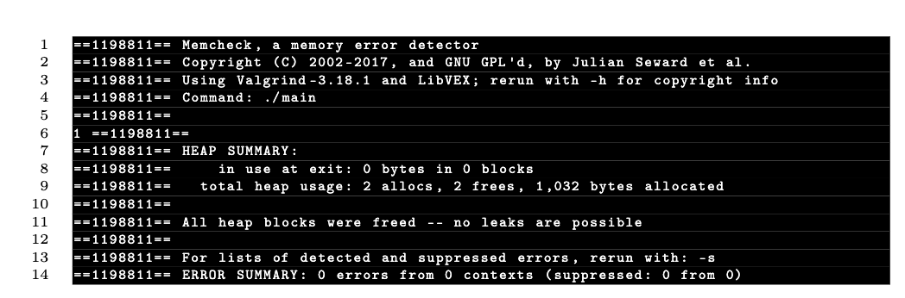
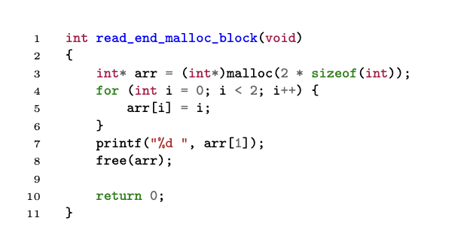
Detecting reading outside of the malloc’d blocks (Correction)
Function
Executing with Memcheck

Slide 11
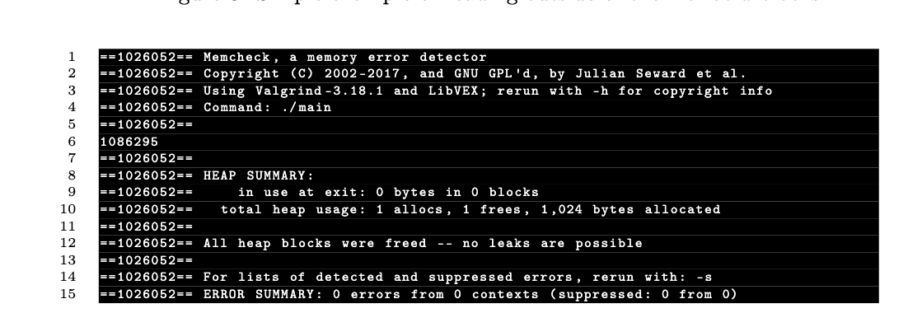
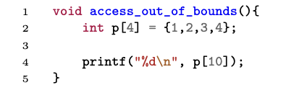
No error detected
Accessing outside the array length
Function
Executing with Memcheck

Slide 12
Conclusion
Valgrind successfully detected a significant number of errors such as double free, no freeing and reading outside of malloc’d blocks in the tested code samples.
Memcheck facilitated the identification of the specific code locations where the errors occurred, enabling developers to address them effectively.
Developers should take note of its limitations
Future research could focus on expanding the evaluation to include a wider range of codebases and programming languages.

