Slide 1
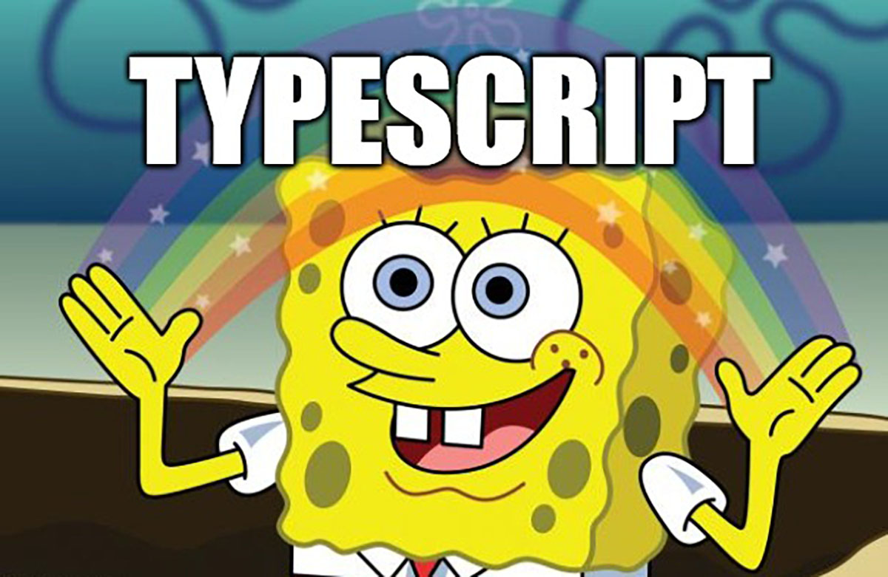
created by Dariia Drobotko ddrobotko@lohika.com

Slide 2
Creating Types from Types
TypeScript’s type system is very powerful because it allows expressing types
in terms of other types.

Slide 3
Creating Types from Types
Keyof Type Operator - Using the `keyof` operator to create new types
Typeof Type Operator - Using the `typeof` operator to create new types
Indexed Access Types - Using Type['a'] syntax to access a subset of a type
Conditional Types - Types which act like if statements in the type system
Template Literal Types - Mapped types which change properties via template literal strings
Mapped Types - Creating types by mapping each property in an existing type
Generics - Types which take parameters
UTILITY Types - utility types to facilitate common type transformations
https://www.typescriptlang.org/docs/handbook/2/types-from-types.html
https://www.typescriptlang.org/docs/handbook/utility-types.html

Slide 4
The keyof Operator
is used to query the names of the properties of a type and represent them as a union (key = property name).
interface MyInterface {
[ index 1]: [ type ],
[ index 2]: [ type ]
}
type newType = keyof MyInterface // “index 1” | “index 2”

Slide 5
The typeof Operator
JavaScript has a typeof operator you can use in an expression context.
TypeScript adds a typeof operator you can use in a type context to refer to the type of a variable or property
let someVariable = "hello";
type newType = typeof someVariable;

Slide 6
Indexed Access Types
We can use an indexed access type to look up a specific property on another type.
interface MyInterface {
[ index ]: [ type ]
}
type newType = MyInterface[ index]

Slide 7
Tupple types
A tuple type combines a set of numerically named properties with the members of an array type.
[ number, number, string ]

Slide 8
Tupple types
Extension to arrays
Type of a fixed number of elements is specified
May contain different types
let myTuple: [ number, string ] = [ 10, 'Macbeth’ ];

Slide 9
Conditional types
we have to make decisions based on input
Helps To describe the relation between the types of inputs and outputs
SomeType extends OtherType ? TrueType : FalseType;
type NameOrId<T extends number | string> = T extends number ? IdLabel : NameLabel;

Slide 10
Union types
Specify several valid types for a value
Vertical bar is used to separate valid types
function logId ( id: string | number ): Logger | null { logger?.log(id);
return logger || null; }

Slide 11
Intersection Types
Specify a value that will contain all members of several types
Ampersand is used to separate included types
function CreateCoolNewDevice(): Phone & Tablet { // some code here }

Slide 12
String Literal Types
let empCategory: 'Manager'; let empCategory: 'Manager' = 'Manager'; let empCategory: 'Manager' = 'Non-Manager’; // ERROR let empCategory: 'Manager' | 'Non-Manager' = 'Manager'; let empCategory: 'Manager' | 'Non-Manager' = 'Non-Manager';

Slide 13
Type Aliases
type EmployeeCategory = 'Manager' | 'Non-Manager'; let managerCategory: EmployeeCategory = 'Manager';

Slide 14
Mapped types
a type based on another type.
build on the syntax for index signatures, which are used to declare the types of properties
interface SomeInterface { property: number; otherProperty: string; } type AnotherType = [ T in keyof SomeInterface] : SomeInterface[T];

Slide 15
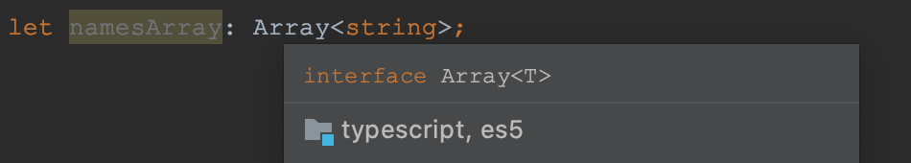
Generics
Reusable code that works with multiple types
May be functions, interfaces, or classes
Code that accepts type parameters for each instance or invocation

Slide 16
Generic Functions
myAction<T>
Function <T>( argument: T ): T
function logAction<T>( action: T ): T { logger.log(action);
return action; }
let logMyStringAction: <string> = logAction;

Slide 17
Generic Interfaces
interface GenericLogger < T > {
(action : T ): T;
}
function logAction<T>( action: T ): T { logger.log(action);
return action; } let logMyStringAction: GenericLogger <string> = logAction;

Slide 18
Generic Classes
class GenericClass<Type, Type1, Type2> { value: Type; add: ( x: Type, y: Type1 ) => Type2; } let myGenericInstance = new GenericClass<string, number, string>(); myGenericInstance.value = 0; // ERROR myGenericInstance.value = '0’; // OK

Slide 19
Utility types
String Manipulation Types
Uppercase<StringType> Lowercase<StringType> Capitalize<StringType> Uncapitalize<StringType>
Type transformations
Partial<Type> Required<Type> Readonly<Type> Record<Keys, Type> Pick<Type, Keys> Omit<Type, Keys> Exclude<Type, ExcludedUnion> Extract<Type, Union> NonNullable<Type> Parameters<Type> ConstructorParameters<Type> ReturnType<Type> InstanceType<Type> ThisParameterType<Type> OmitThisParameter<Type> ThisType<Type>
https://www.typescriptlang.org/docs/handbook/utility-types.html

Slide 20
Utility types
Interesting link - Utility types library:
https://www.npmjs.com/package/utility-types
https://github.com/piotrwitek/utility-types
https://typescript-definitive-guide.ru

Slide 21

created by Dariia Drobotko ddrobotko@lohika.com

