Slide 1
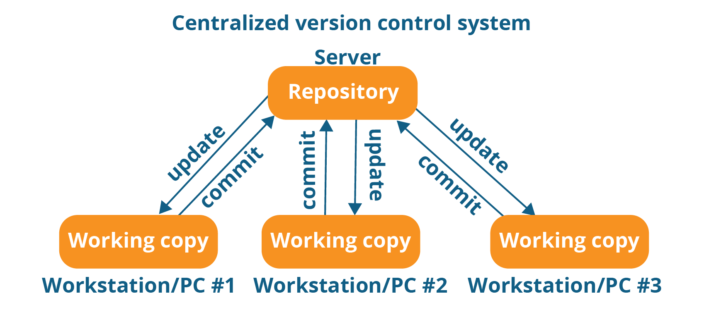

Slide 2
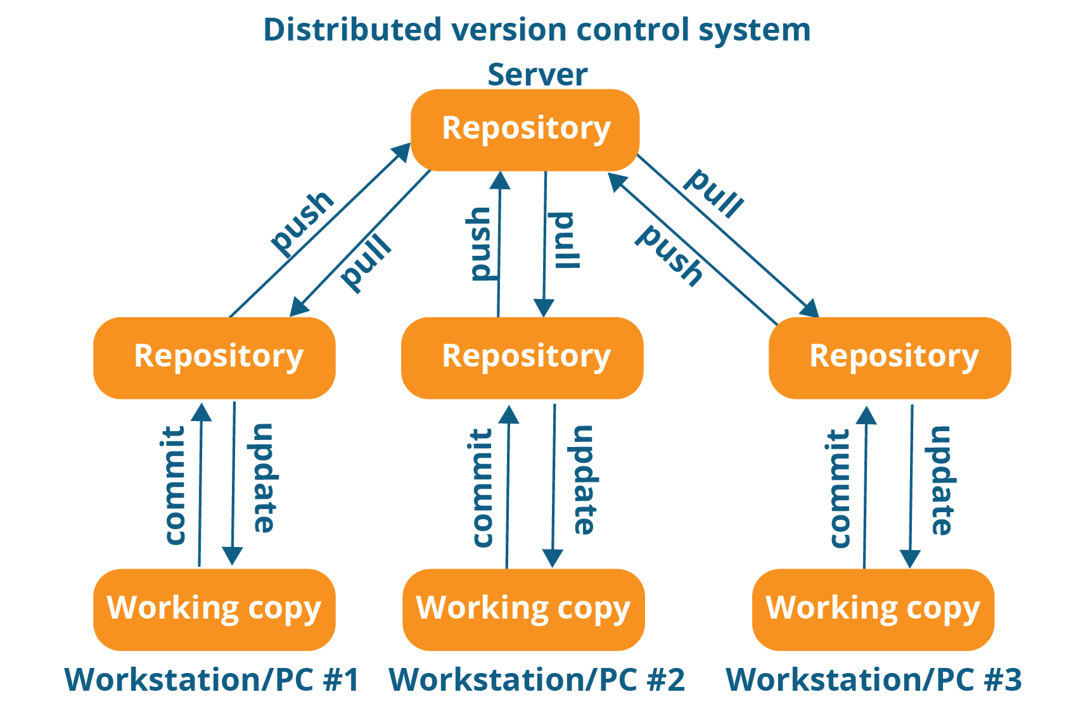
add

Slide 3
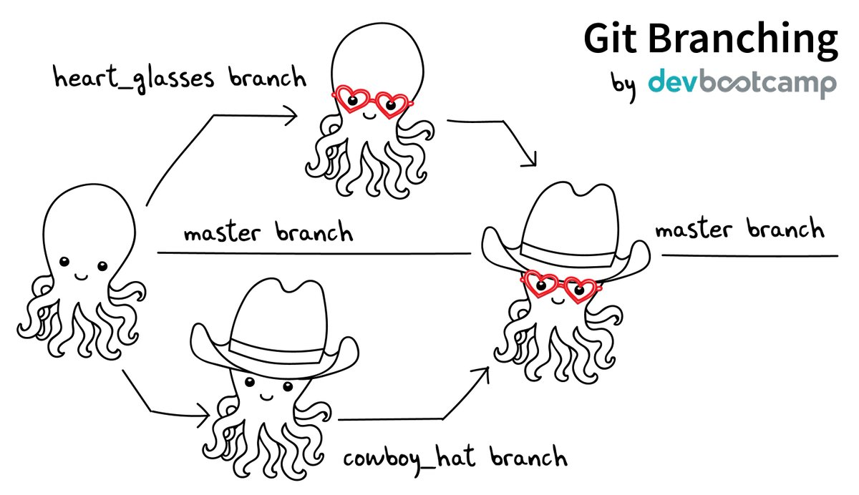

Slide 4
Branching:
One master-file with workflow(workflow_log.txt):
Versions of programs in use
Command line submissions
comments
Pushing:
- your personally developed code (unless you talked with someone and you agreed to work on it together with branching)

Slide 5
Let’s try a workshop with our repo on GitHub!

Slide 6
Cloning a repository
On GitHub, navigate to the main page of the repository
Under the repository name, click Clone or download.
In the Clone with HTTPs section, click to copy the clone URL for the repository:
https://github.com/DariiaVyshenska/IBDteam1.git
Open Git Bash.
Change the current working directory to the location where you want the cloned directory to be made
Type git clone, and then paste the URL you copied in Step 2.

Slide 7
Creating a file and pushing it to GitHub repo
You can create a file in windows, or you can create a file from Git Bash (use command touch) – you can create something you have been planning to do any ways or just a test file and then later delete it (and go through add, commit and push to save the deletion to GitHub)
git status will show you that a new file was created, but is not added to your staging environment (index)
git add your_file.txt – this way you are adding your file to the index. Use git status to check if your file was added to index.
git commit –m “your message is here” – you are committing your changes to your local git repo (saving your changes). Use git status
git push origin master – you are pushing the committed changes to the GitHub repository!

Slide 8
Creating a branch, committing some changes and pushing branch to GitHub repo
git branch – shows you how many branches you have active right now
git checkout -b my_branch_name - this command creates a branch and switches you to it
Now modify (in bash or in windows) file “workflow_log.txt” by adding
Your_name:
- your task for first week
- your task for second week
-etc.
While you in your branch (to check - git branch) use:
git add workflow_log.txt
git commit
git checkout master
git push origin my_branch_name
to add changes to your branch and push them to the origin
Go to GitHub, click on Pull requests, then on the green button “New pull request”.
Select your branch and master as the branch to merge with. Click “Create pull request”. You can leave a comment about this pull request in the next page. Remember to click “Create pull request” again! I will later merge your pull request. You can check to delete your branch while you are submitting pull request
If you forgot to mention deletion of the branch - delete your branch later!
git push -d <remote_name> <branch_name>
git branch -d <branch_name>

Slide 9
Next time you work on the project start with:
if you are on a branch – checkout to master
git checkout master
Update your local master branch to the latest version of remote repository
git pull

