Slide 1
Directed by
Darin & Zerowan

Slide 2


Slide 3
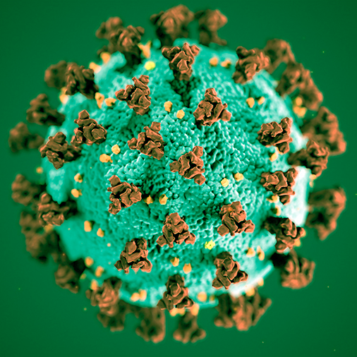
Covid-19

Slide 4
CoronaBot
Statistics & charts by country
Statistics & charts by geolocation
Reporting new cases
Statistics by city (reported via bot)
Push notifications

