Slide 1


Slide 2
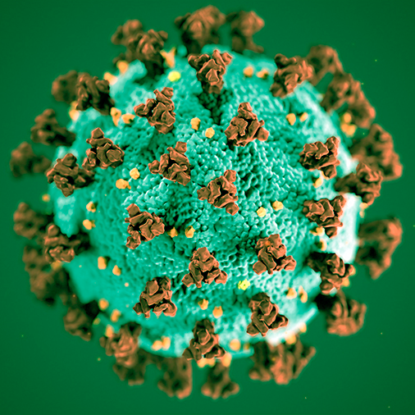
Covid-19

Slide 3
CoronaBot
Statistics & charts by country
Statistics & charts by geolocation
Reporting new cases
Statistics by city (reported via bot)
Push notifications

