Slide 1
Population structure

Slide 2
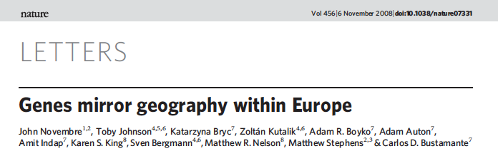
Genes mirror geography within Europe
Nature, 2008, 456:98-101

Slide 3
Nature, 2008, 456:98-101
Science, 2018:10.1101/106427

Slide 4
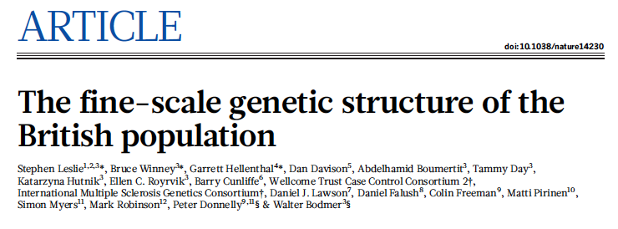


31/March/2015

Slide 5
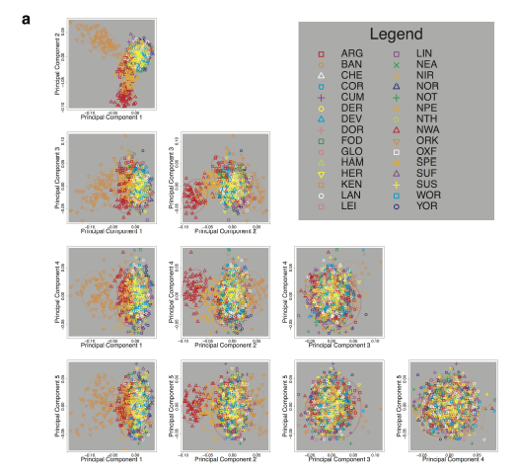
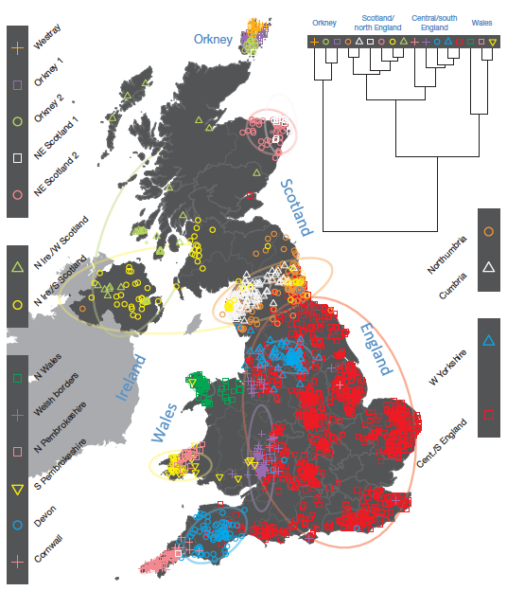

Slide 6
HapMap
A+E | E | As | As | As+E | As | A | As+E | A | E | E
ASW | CEU | CHB | CHD | GIH | JPT | LWK | MEX | MKK | TSI | YRI
ASW | YRI | LWK | MKK | CHD | CHB | JPT | MEX | GIH | TSI | CEU

