Slide 1
Statistical genetics

Slide 2
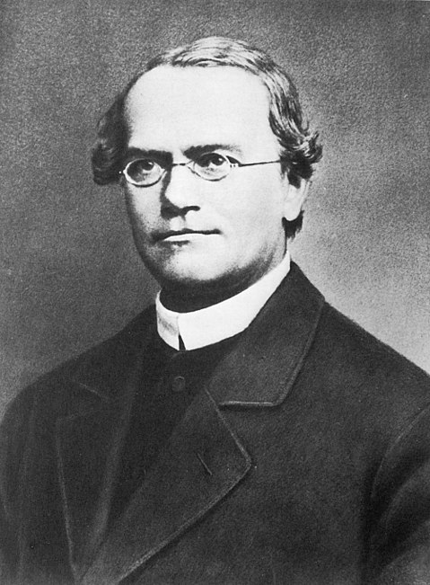
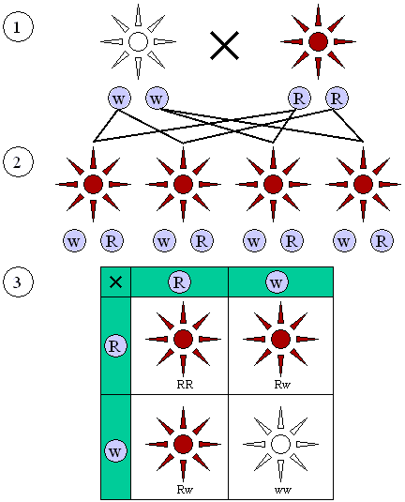
Mendel’s genetics [1822-1884]

Slide 3
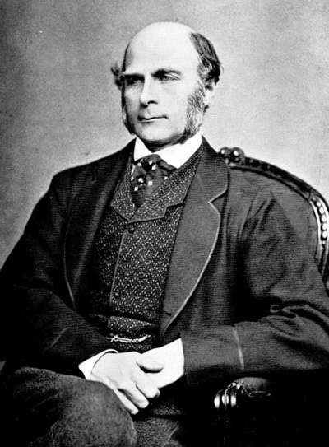
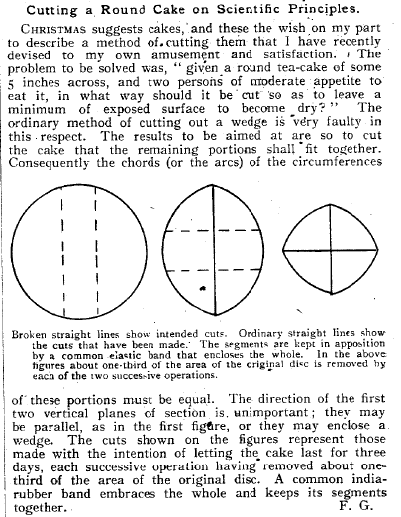
Francis Galton [1822-1911]
Regression
Correlation
Eugenic
Nature versus nurture
Fingerprint
Nature, 1906, V75, 173

Slide 4
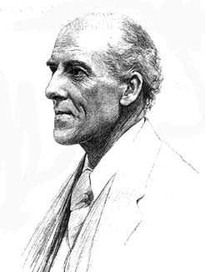
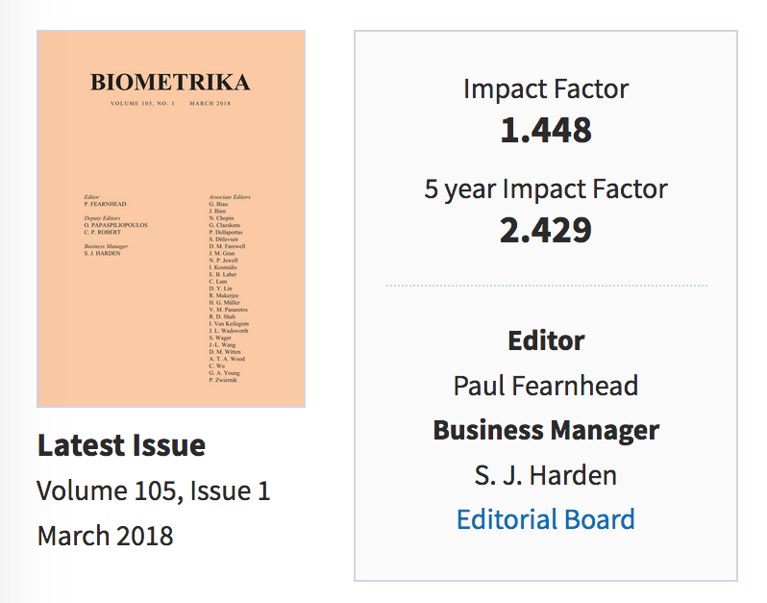
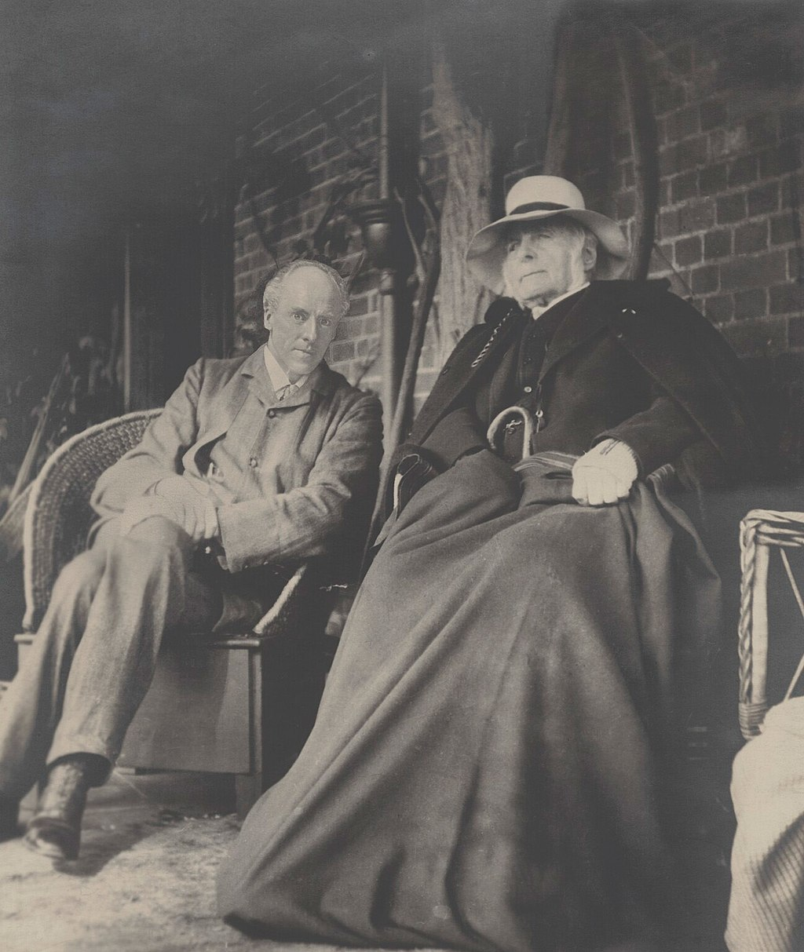
Karl Pearson [1857-1936]
Chi-square test
Principal component analysis
Regression analysis
Biometrika, Annals of Eugenics

Slide 5
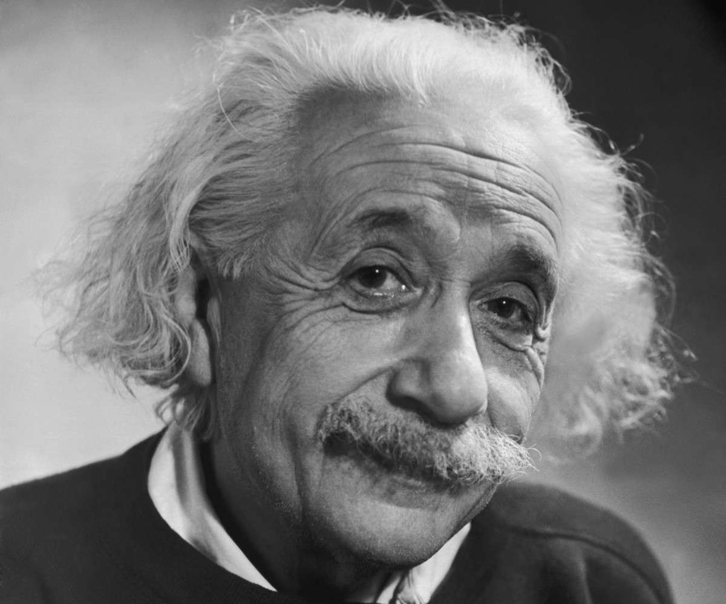
K.P. vs Biologists
K.P. “Before we can accept [any cause of a progressive change] as a factor we must have not only shown its plausibility but if possible have demonstrated its quantitative ability.”
“Almost metaphysical speculation as to the cause of heredity” which had replaced the process of experimental data collection these actually might allow scientist to narrow down potential theories.

Slide 6
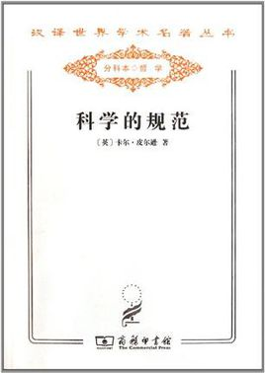
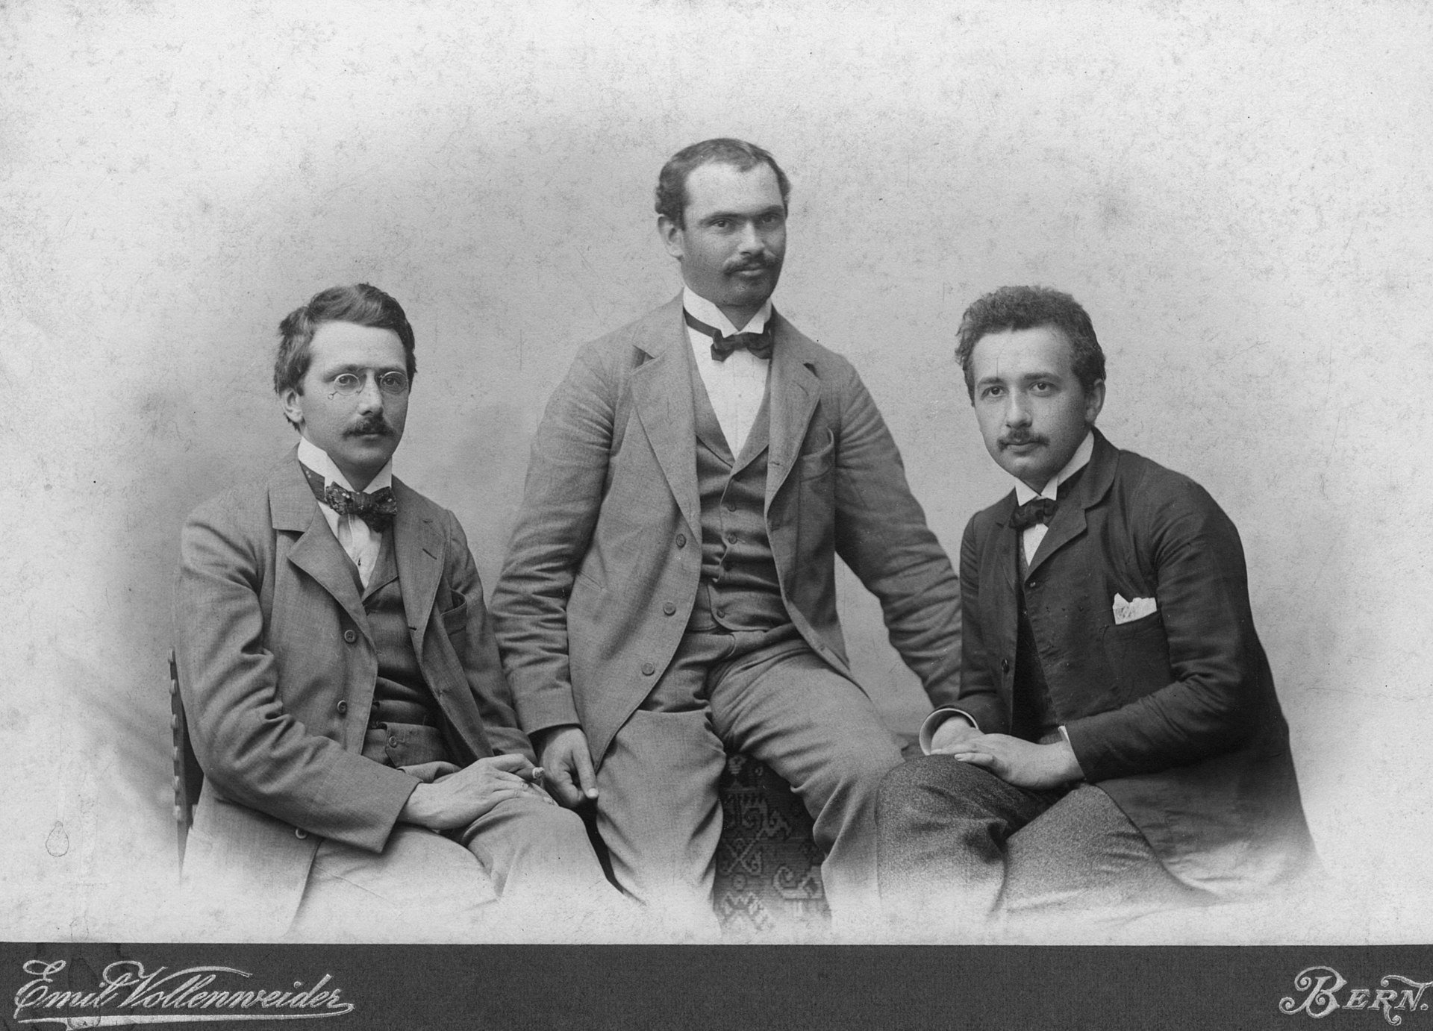
The Grammar of Science

Slide 7
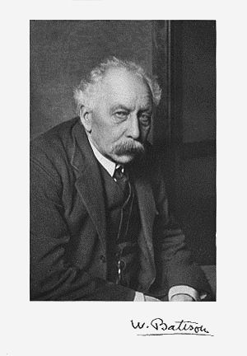
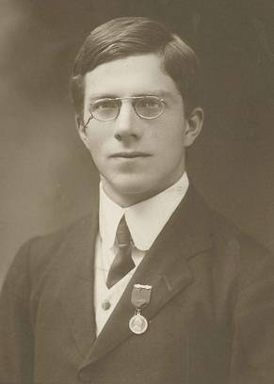
Mendel’s school vs Biometry school

Slide 8
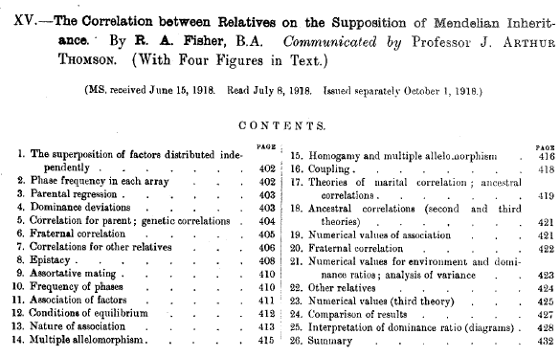

Slide 9
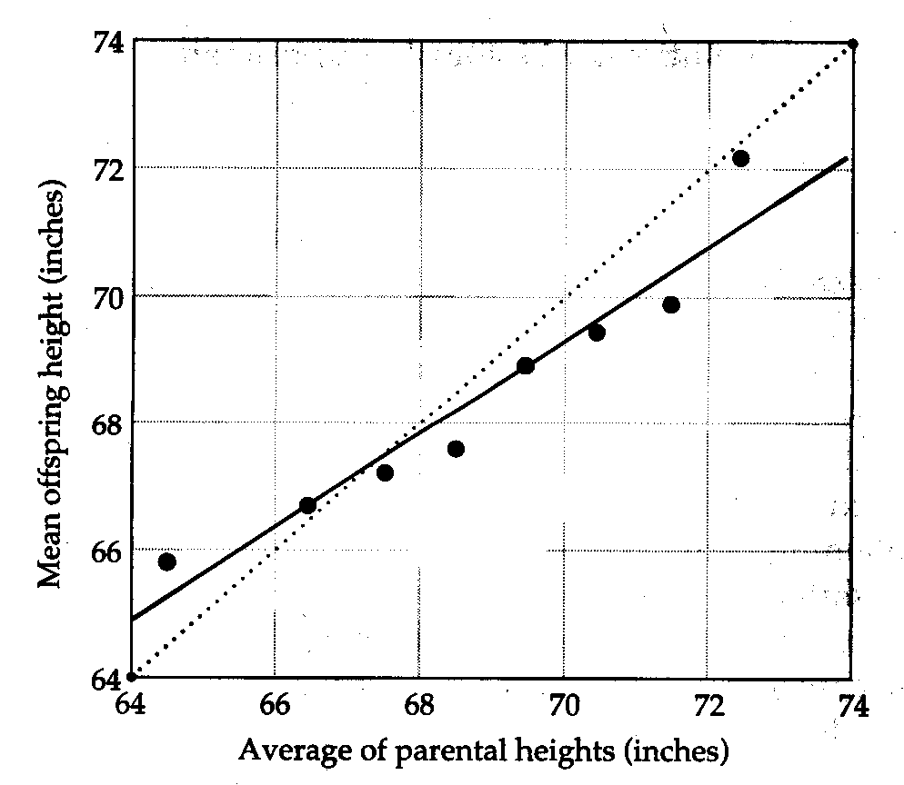
Regression
heritability
遗传率（遗传力）

Slide 10
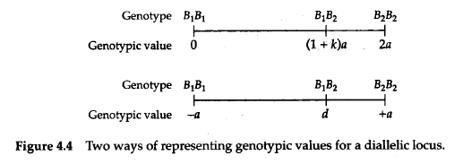
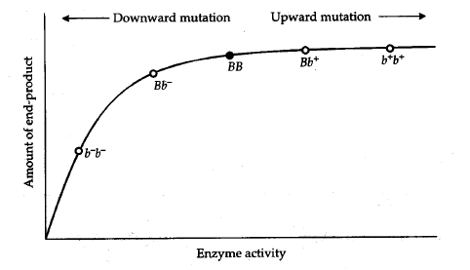
Source of variation

Slide 11
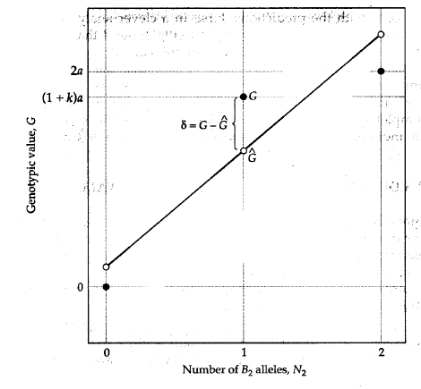

Least squares

Slide 13
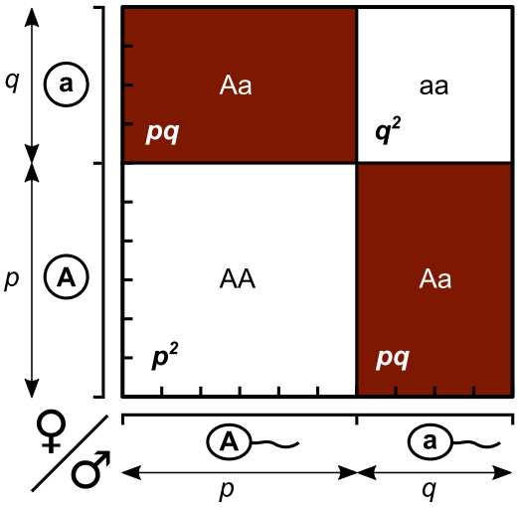
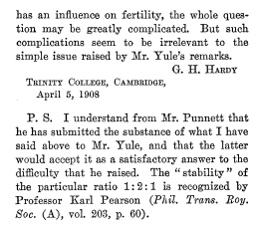
Hardy-Weinberg Equilibrium
Science, 1908, 28, 49:50
No mutation,
No assortative mating
No drift,
No selection

