Slide 1
Correlation and meta-analysis

Slide 2
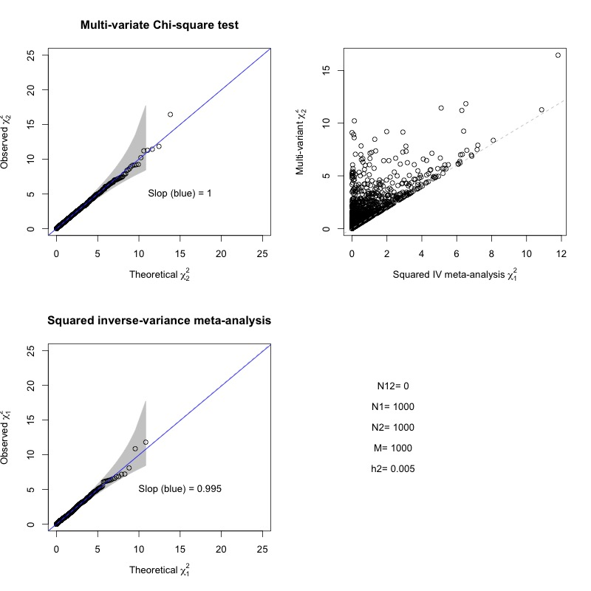
Fig 1 no-heritability no overlapping

Slide 3
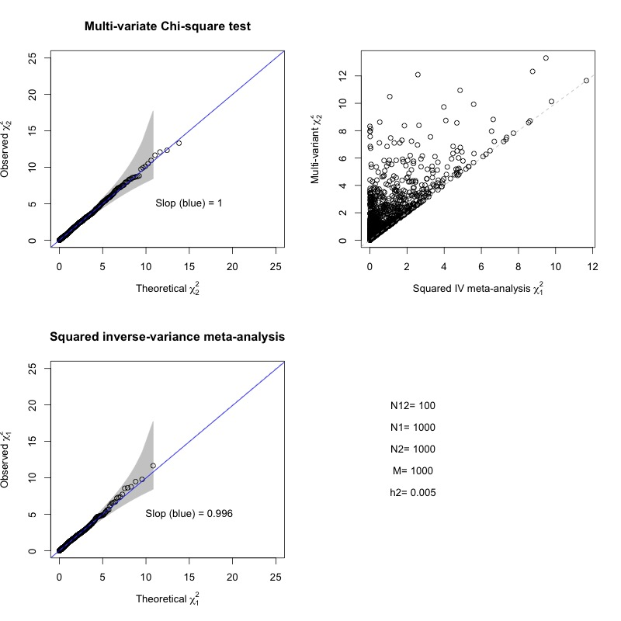
Fig 2 no heritability but overalpping (n12=100)

Slide 4
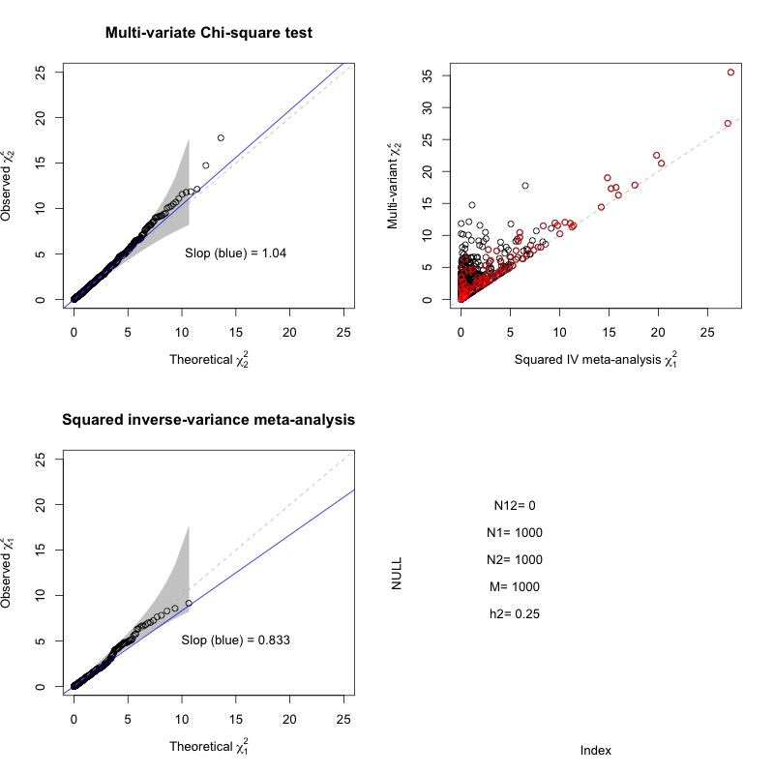
Fig 3 h2=0.25, no overlapping

Slide 5
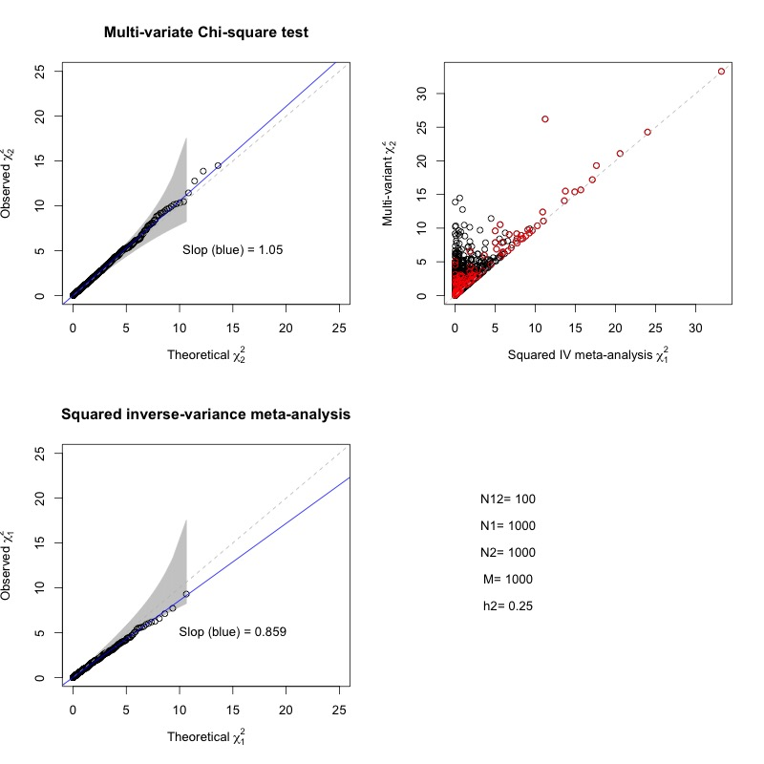
Fig 4: h2=0.25, n12=100

