Slide 1
Linear model implementation for multifactor dimensionality reduction
Guo-Bo Chen
chenguobo@gmail.com

Slide 2
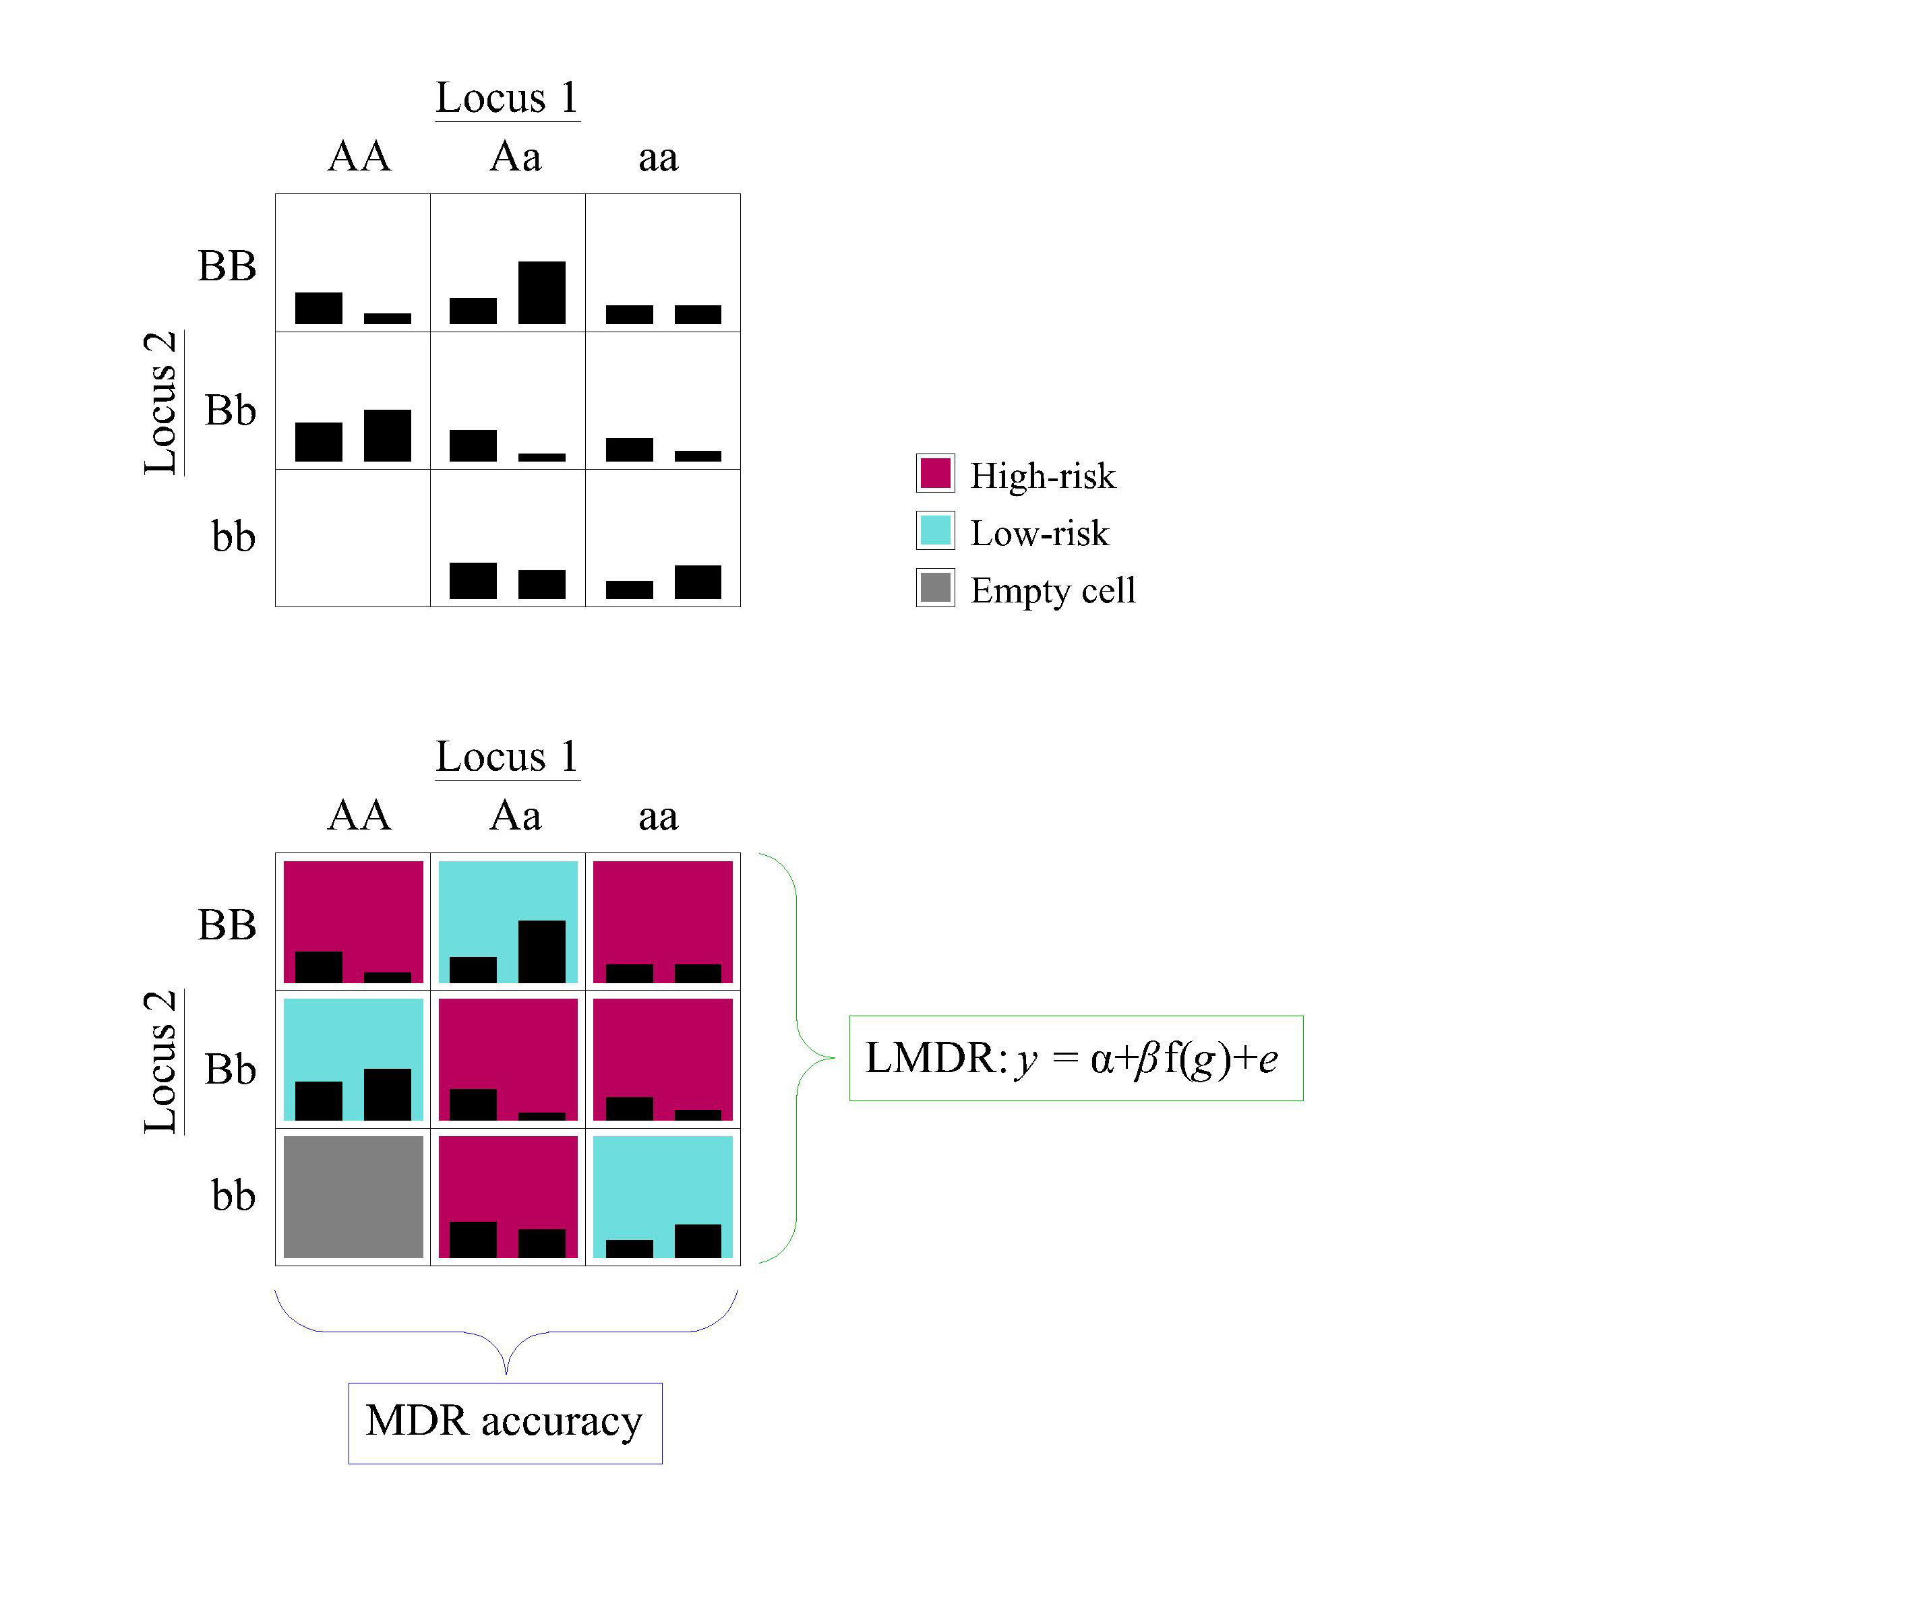
Figure 1 MDR and LMDR

Slide 3
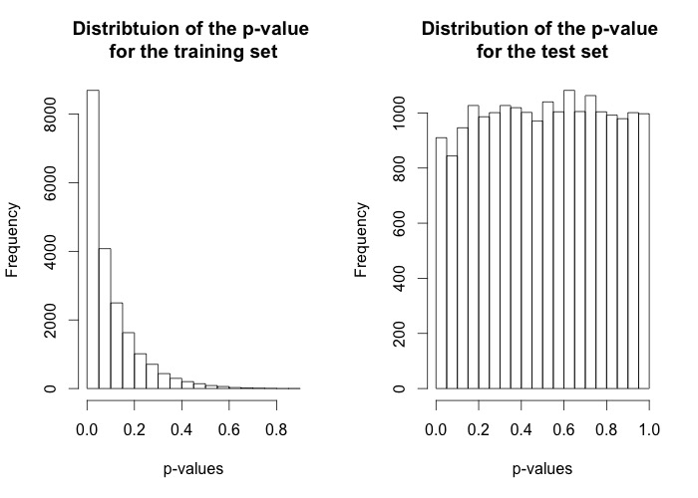
Fig Q1 Distribution for p-values
The distribution of the p-values for the LMDR regression coefficient. The left one is the distribution for the training set, showing over-fitting. The right one is for the test set, the distribution if nearly uniform, which reflects well-controlled type-I error rate.

Slide 4
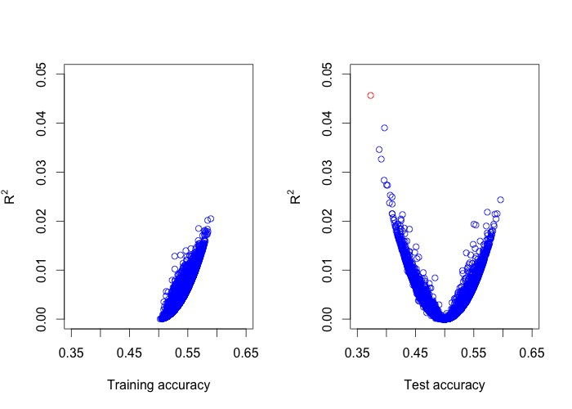
Fig Q2: Rsq and accuracy
The Rsq for training accuracy (left) and testing accuracy (right). Due to ascertainment, the training accuracy is always greater than 0.5.
The much higher accuracy for test set is due to smaller sample size (1000 for training, 500 for test)

Slide 5
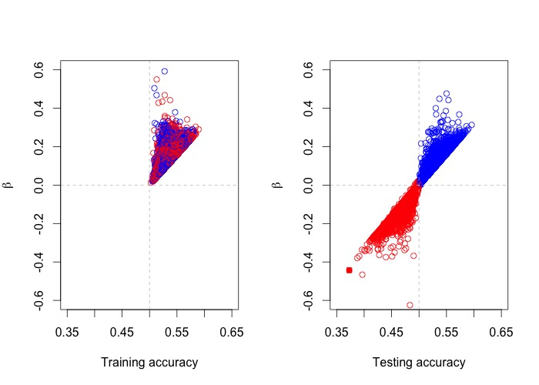
Fig Q3: LMDR regression coefficient and MDR accuracy
Regression coefficient and accuracy. Left: training accuracy and LMDR coefficient, red points are those that have testing accuracy less than 0.5; Right:

Slide 6
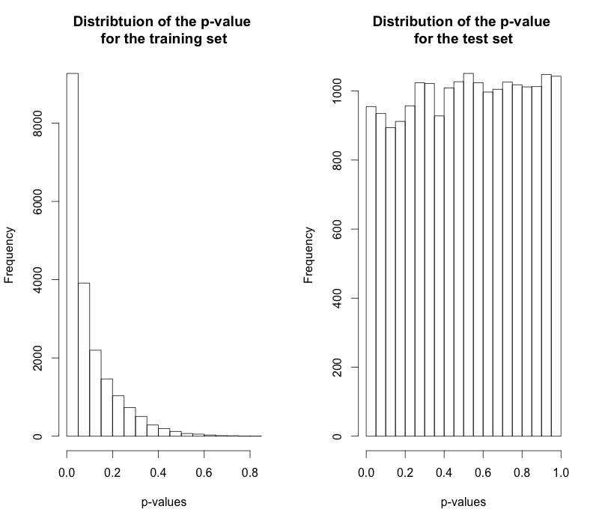
Fig C1 Distribution for p-values

Slide 7
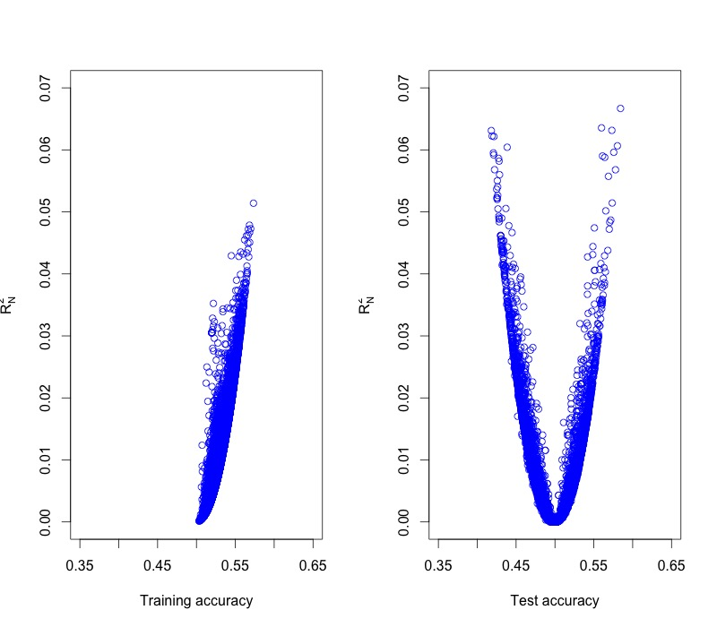
Fig C2 Rsq-accuracy
Left panel for training accuracy

Slide 8
Fig C3 Regression coefficient and accuracy

