Slide 1

ISDS 3105 – R programming T-TH 3.00–4.20 PM Room: 1835 BEC
Dario Bonaretti
Office Hours: T–TH 4.30–5.30 PM Room: 2400b BEC dbonar1@lsu.edu

Slide 2
VERSION CONTROL
MyAnalysis_01.R MyAnalysis_02.R
MyAnalysis_03.R MyAnalysis_withCharts_04.R …
MyAnalysis_withCharts_20.R

Slide 3
VERSION CONTROL WITH GIT/GITHUB
Git is a version control system. It means you can use it to track the current version of your folder (or repository or repo).
To create a snapshot of your repo at a certain point in time, you save the files you need to track and create a commit.

Slide 4
WHY WE USE GIT + GITHUB
+
It allows to retrieve prior version of our code
It allows to share our code and add narratives in the README.md
It has a nice renderer for many useful file extensions (e.g., .csv, .pdf, .jpg)
It enables collaborative coding other members of our group

Slide 5

NAVIGATING THROUGH COMMITS
Commit 1
Commit 2
Commit 3
Commit 4
git checkout Commit3
You can only see commits that precede the one you are currently at

Slide 6

NAVIGATING THROUGH COMMITS
Commit 1
Commit 2
Commit 3
Commit 4
MASTER
git checkout <Commit2>
BRANCH
git checkout -b <new-branch-name>

Slide 7
NAVIGATING THROUGH COMMITS
The dashed line represents what you commit
Anything outside the dashed line it’s simply saved Is there a way to checkout the red square once you commit stage 4?
Notes:
Is there a way I can checkout the red square once I commit the green one? No, thus if the red was the only code that worked you are screwed

Slide 8
NAVIGATING THROUGH COMMITS
To sync your local commits in Git with GitHub, you want to PUSH to your remote repo
Notes:
There is a diff between the commits you have on git and those on github

Slide 9
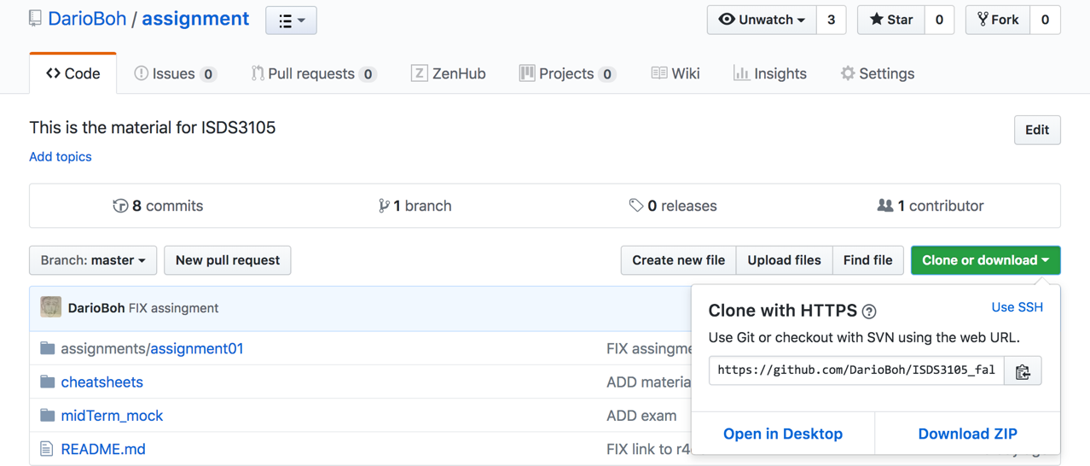
Click clone
Copy this URL

Slide 10
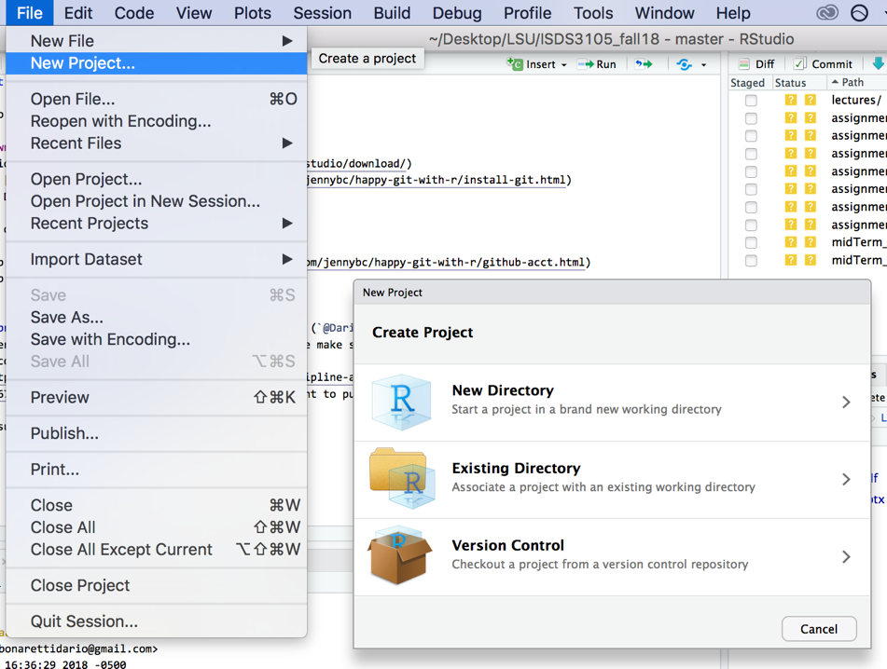

Slide 11
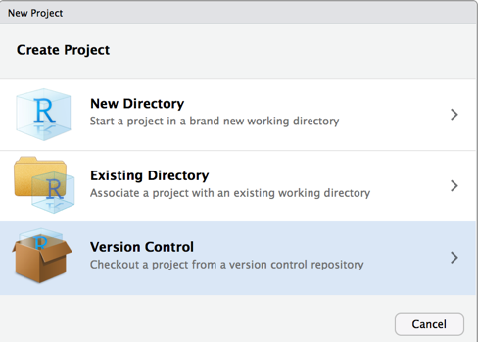
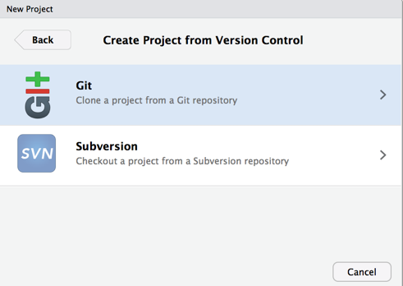
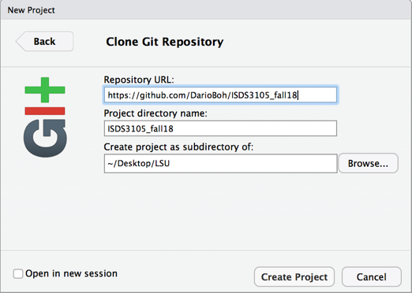
2
1
3
assignment
assignment
Use the link of your assignment repo

Slide 12
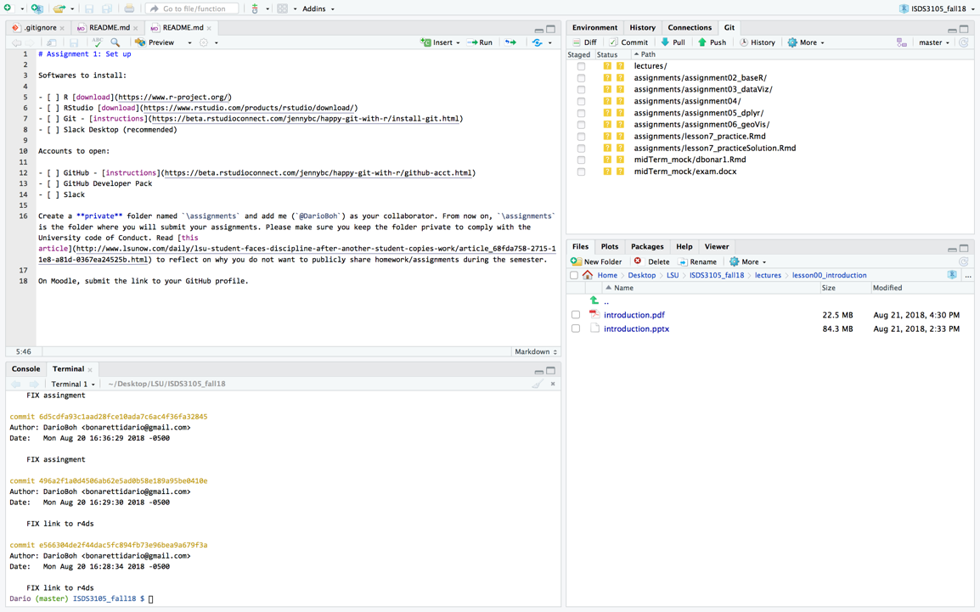

Slide 13
EXERCISE
Create a new R project from your assignment folder
Ad a README.md file with the list of your assignments ``` - [x] assingment 1 - [ ] assingment 2 - [ ] assignemnt 3 ```
Push to your repo

Slide 14
FORKING DarioBoh/ISDS3105_fall
A fork is a copy of a repo on your GitHub space. You want to use forks for:
Fork (copy) a repo
Make changes
Submit a pull request to the project owner
The project owner receives the pull request and can merge it into his repo.

Slide 15
FORKING DarioBoh/ISDS3105_fall
You (forked repo)
Me (owner)
But once you fork a repo it doesn’t mean it’s in sync with the owner’s repo!

Slide 16
FORKING DarioBoh/ISDS3105_fall
You (forked repo)
Me (owner)
This scenario is possible…

Slide 17
FORKING DarioBoh/ISDS3105_fall
You (forked repo)
Me (owner)
This scenario is also possible…

Slide 18
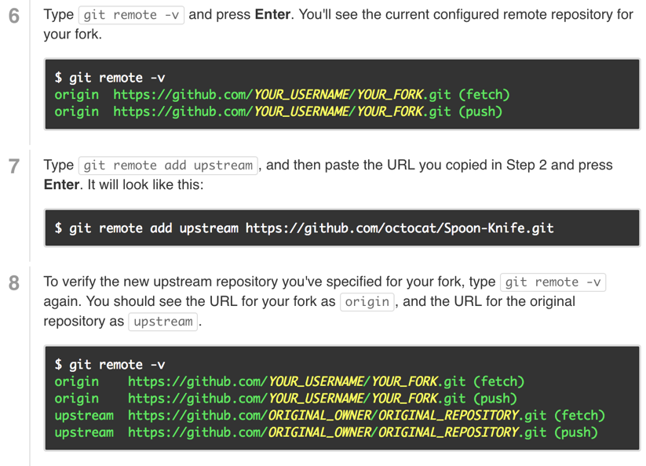
SYNC WITH DarioBoh/ISDS3105_fall
From GitHub documentation https://help.github.com/articles/fork-a-repo/

Slide 19
SYNC WITH DarioBoh/ISDS3105_fall
git pull upstream master
Your master branch
Notes:
one edits and I edit too I save and commit
He saves, commit, push and makes a pull request

