Slide 1
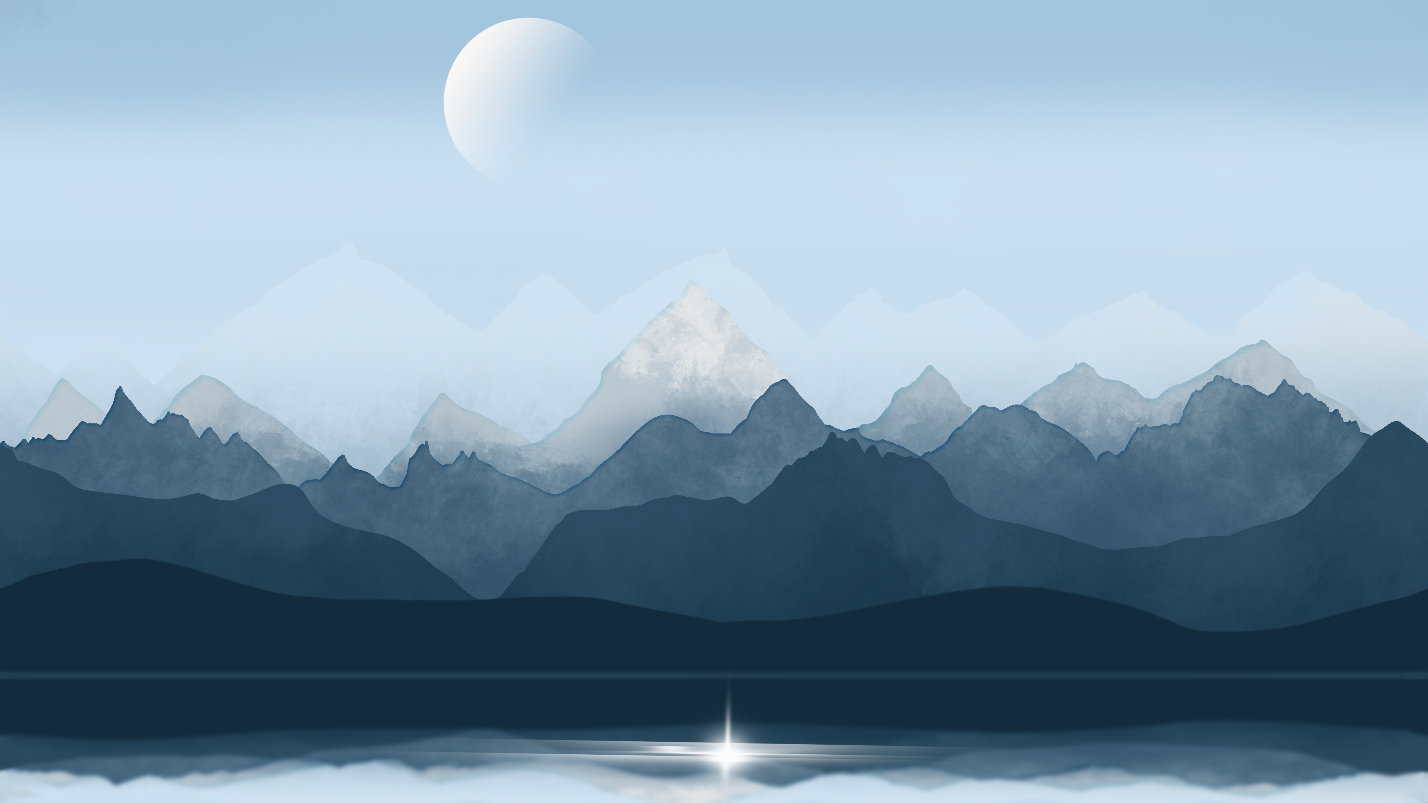

Georg Reichert, Dario Bruckner, Dominik Fohleitner, Amareldo Isufi, Aleksandar Jevtic

Slide 2
Idea
single-player 2D RPG game with separate world exploration and battle modes
world exploration in the style of a 2D side-scroll adventure
turn-based battles, that can involve a party of several characters and one or multiple enemies
characters can be equipped with different items (weapons, armor, utility items) and have different base-properties that can be modified through character advancement
we create the game using the Unity engine
we design and implement a system for character and enemy attributes and their interactions in combat
create a challenging decision-making system for enemy behavior
create basic sprites and/or adapt existing ones
basic physics will be implemented for world exploration
goal: playable Demo version that includes at least one map or dungeon to explore, with at least one boss fight and at least one step of character advancement.

Slide 3



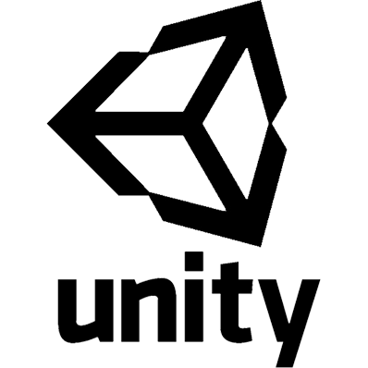

Tools
communication over discord
we used miro.com as our collaboration tool
VCS: GitHub Desktop (unity-template for .gitignore)
Unity editor v. 2021.1.1f1
visual studio 2019 with unity extension

Slide 4
Agile Development
modus: Scrumban
DoR and DoD on the board, visible for everyone
requirements engineering based on user stories
items on the board are a combination of well-defined user stories and simple post-it notes (for quick fixes etc.)
user stories/requirements from the product backlog are sorted by categories and importance
effort estimation: Fibonacci-numbers
WIP-limit of 2 items per person
sprint review protocols are visible for everyone on the board

Slide 5
Implementation – World & Menu design
Unity Editor v. 2021.1.1f1
created world with built-in tilemap editor with asset pack from unity asset store
additional Tilemap layer with background decorations
perspective camera with several background layers for parallax effect
UIs (menus, battle UI) made with Unity UI canvas
generated prefabs for reusable character, monsters and items

Slide 6
Implementation – Game logic
written in C# using Visual Studio 2019
turn based battle system utilizing System.Collections.Generic.Queue<T> for combat order
OOP: all character classes, monsters, items and abilities inherit from base classes for code reusability
WorldComponents script with static variables that have to be available throughout all levels and the battle scene
CharacterController and PatrolController scripts for movement of player and monsters in world

Slide 7
Implementation – Animations & Sound
character and monster sprites purchased on https://oco.itch.io/ for a small fee
separated different frames with Unity Sprite editor for animation
animated with Unity animation tool
controlled by Animator component and scripts
different background music for world and battle
jump sound during world exploration

Slide 8


Current status
single-player 2D RPG game with separate world exploration and battle modes
world exploration in the style of a 2D side-scroll adventure
turn-based battles, that can involve a party of several characters and one or multiple enemies
characters can be equipped with different items (weapons, armor, utility items) and have different base-properties that can be modified through character advancement
we create the game using the Unity engine
we design and implement a system for character and enemy attributes and their interactions in combat
create a challenging decision-making system for enemy behavior
create basic sprites and/or adapt existing ones
basic physics will be implemented for world exploration
goal: playable Demo version that includes at least one map or dungeon to explore, with at least one boss fight and at least one step of character advancement.

