Slide 1
Modelibra Software Family
  Dzenan Ridjanovic

Slide 2
About Modelibra
  Open Source Software
  Domain Models
  Dynamic Web Applications

Slide 3
Open Source Software
  Team Work
  Software Repository
  Quality Assurance

Slide 4
Domain Models
  Software Backbone
  User Concepts
  Concept Properties
  Concept Neighbors

Slide 5
Dynamic Web Applications
  Client Software vs. Server Software
  Java, XHTML & CSS
  Web Components

Slide 6
Modelibra Software Family
  ModelibraModeler
  ModelibraWicketSkeleton
  Modelibra
  ModelibraWicket

Slide 7
ModelibraModeler
  Graphical Design Tool
  Code Generation
  Domain Model XML Configuration
  Relational Database Schema

Slide 8
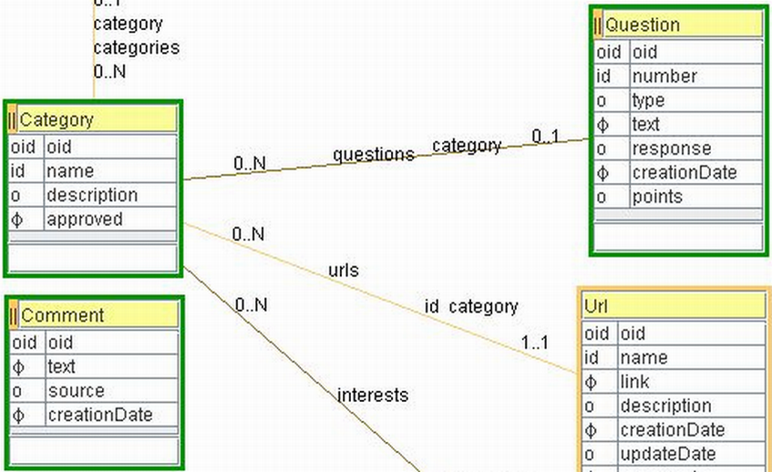
Graphical Model

Slide 9
ModelibraWicketSkeleton
  Eclipse Project
  Modelibra & ModelibraWicket Libraries
  CSS
  Code Generation Templates
  Domain Model Configuration
  Code Generation Context

Slide 10
Modelibra
  Java 6
  Domain Classes
  Model Classes
  Concept Classes
  Generic vs. Specific Classes
  Configuration Classes

Slide 11
Modelibra Model
  Domain Model Configuration
  Meta Model
  Model Entry Points
  Entities vs. Entity
  Retrieval, Selection & Order
  Add, Update, Remove

Slide 12
Modelibra Persistency
  Main Memory Restriction
  Persistency Layer
  XML Data Files
  JDBC Relational Database
  db4o Object Database

Slide 13
Modelibra Performance
  Load vs. Save
  Main Memory Indexes
  Add, Update, Remove
  Retrieval & Selection
  Actions vs. Transactions
  PolePosition Benchmark
  Session & Undo
  Export & Synchronization

Slide 14
ModelibraWicket
  Wicket Web Framework
  Wicket Model
  ModelibraWicket Component Framework
  ModelibraWicket Knows Domain Model
  Generic Programming
  Default Web Application
  Web Component Model
  Web Component View
  XHTML Code

Slide 15
Web Component Context
  Web Page:
  DmEducApp dmEducApp =
  (DmEducApp) getApplication();
  DmEduc dmEduc =
  dmEducApp.getDmEduc();
  WebLink webLink =
  dmEduc.getWebLink();

Slide 16
Web Component Model
  ViewModel commentsModel =
  new ViewModel(webLink);
  Comments comments =
  webLink.getComments();
  commentsModel.setEntities(comments);

Slide 17
Web Component View
  View commentsView = new View();
  commentsView.
  setWicketId(“commentTable”);

Slide 18
Web Component HTML
  <div wicket:id = “commentTable”>
  Dynamic data.
  </div>

Slide 19
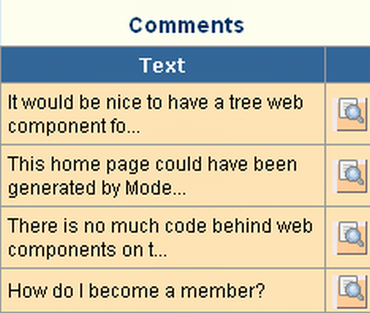
Web Component

Slide 20
Modelibra Productivity
  Graphical Domain Model
  Code Generation
  Generic vs. Specific Code
  Default XML Data File Persistency
  No Installation
  No Changes For Relational and Object Db
  Rich API
  Default Web Application
  Model Validation by Use
  Web Components Know Domain Model
  Modelibra Performance

Slide 21
Modelibra Future
  ModelibraSwing
  Modelibra & JHotDraw for ModelibraModeler
  Performance Benchmarking with p-unit
  Lazy Loading
  Hibernate Persistency
  Distributed Model with Terracotta
  Catalog of Concepts
  Catalog of Web Components
  Catalog of Web Applications
  AJAX Web Components
  View XML Configuration

