Slide 1
Conversational Business Intelligence
A Natural-Language SQL Agent over a Superstore Data Warehouse
Dario Karadzin
IT 501 Business Intelligence · Student ID 22003553
2026-09-06

Slide 2
Agenda
1. The problem & our objective
7. Superset dashboards
2. System architecture & data flow
8. Golden-query validation
3. The data warehouse (star schema)
9. Hidden business insights
4. ETL pipeline
10. Efficiency gains & trade-offs
5. The AI agent & MCP integration
11. Technical challenges
6. Error handling
12. Conclusion & future work

Slide 3
1. The Problem & Our Objective
The problem
Superstore dataset
Retail data lives in thousands of rows business users can't easily explore.
Getting answers means writing SQL — a skill most managers lack.
Every question ends up waiting on a data analyst.
9,994
order-line records
2014–2017
time span
Our objective
5,009
Let anyone ask questions in plain English.
An AI agent writes and runs the SQL on a clean warehouse.
Insights surface instantly through live dashboards.
distinct orders
$2.30M
total sales

Slide 4
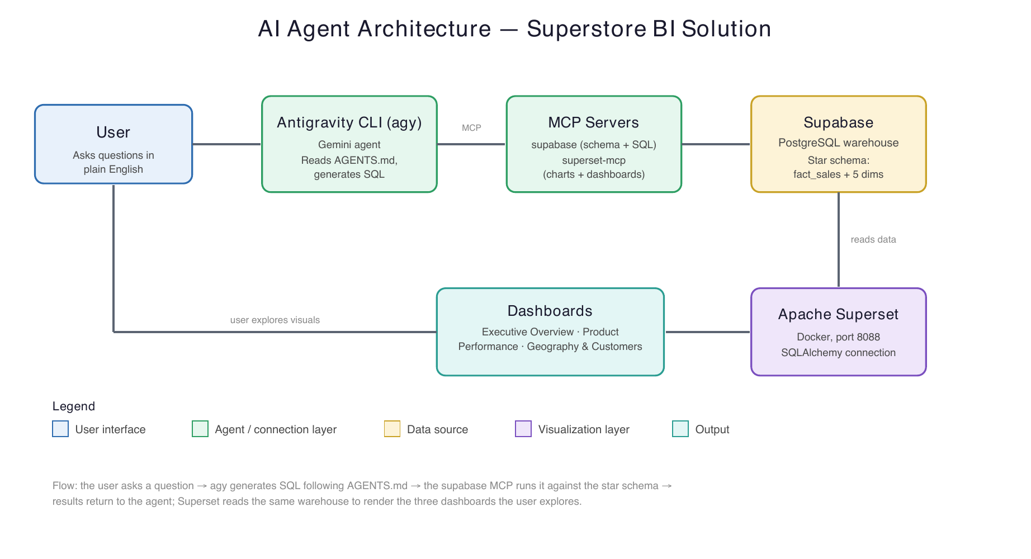
2. System Architecture & Data Flow
User asks in plain English → agy generates SQL → the supabase MCP runs it on the warehouse → Superset visualizes the same data.

Slide 5
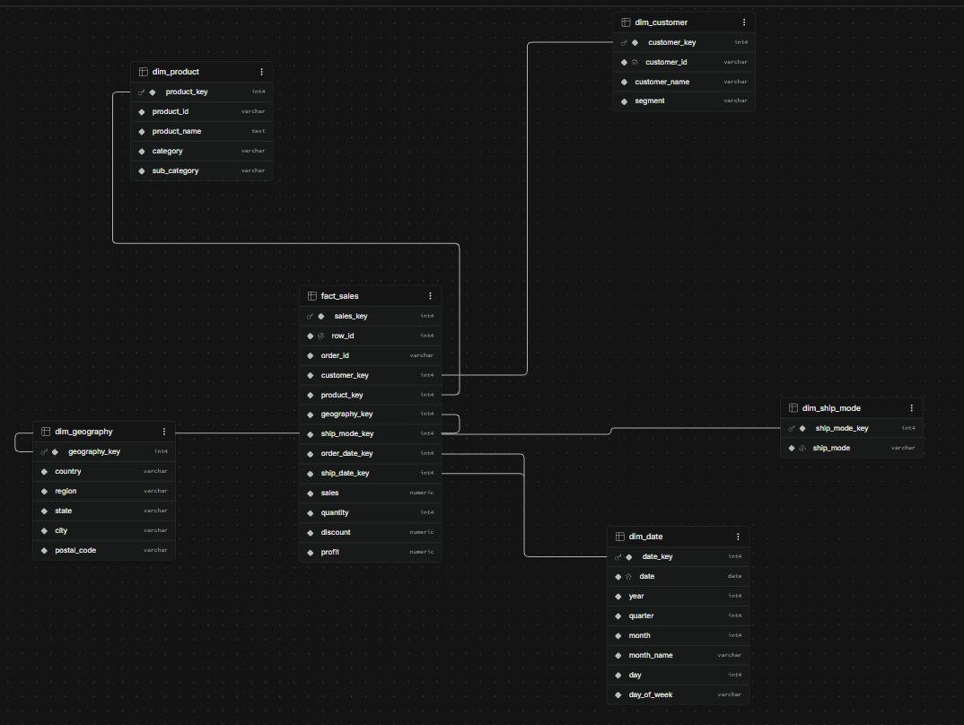
3. The Data Warehouse — Star Schema
fact_sales — one row per order line (the fact).
Five dimensions: customer, product, geography, ship mode, date.
Descriptive fields normalized out of the CSV into dimensions.
dim_date is role-playing (order date + ship date).
Surrogate keys; each dim joins 1:1 (grain stays 9,994).
Star schema in Supabase (PostgreSQL)

Slide 6
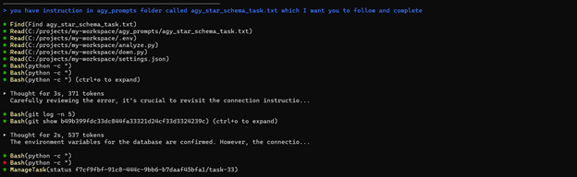
4. ETL Pipeline
1
Extract
2
Transform
3
Load
→
→
Read the Superstore CSV (latin-1, 9,994 rows) with Python.
Split into fact + dimensions, parse dates, de-duplicate keys.
Batch-insert into Supabase; map natural keys → surrogate keys.
Implemented as an idempotent Python script (build_star_schema.py) using psycopg2 — re-runnable, and it validates that the final fact row count equals 9,994.

Slide 7
5. The AI Agent & MCP Integration
Agent: Antigravity CLI (agy), a Gemini-powered agent.
Governed by AGENTS.md — auto-loaded system instructions.
Two MCP servers expose the system:
supabase MCP — introspects the live schema and runs SQL.
superset-mcp — builds datasets, charts and dashboards.
The agent reads the real schema at runtime — no hard-coded tables.
AGENTS.md — core SQL rules
Read-only SELECT statements only.
Measure from fact_sales; join dims for attributes.
COUNT(DISTINCT order_id) for orders.
Margin = SUM(profit) / NULLIF(SUM(sales),0).
Always LIMIT top-N; state assumptions.

Slide 8
6. Error Handling
The agent recovers from its own mistakes using the live schema.
First attempt — failed
Corrected — succeeded
SELECT category, SUM(sales)
FROM public.fact_sales
GROUP BY category;
SELECT p.category, SUM(f.sales)
FROM public.fact_sales f
JOIN public.dim_product p
ON f.product_key = p.product_key
GROUP BY p.category;
ERROR: column "category" does not exist
category lives on dim_product → the agent added the join and re-ran successfully.

Slide 9
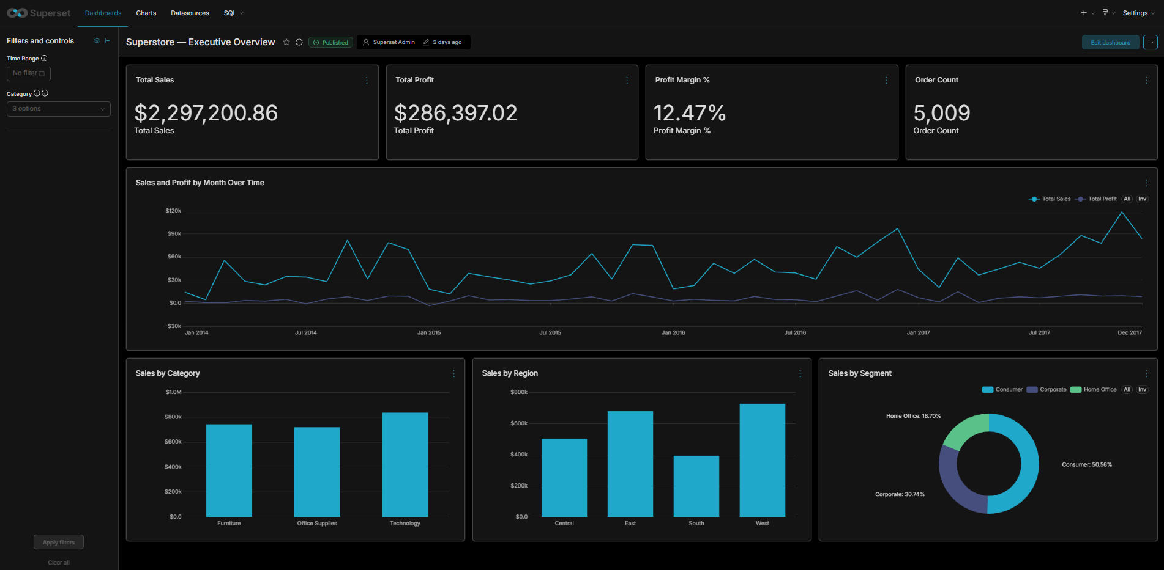
7. Superset Dashboards — Executive Overview
KPIs, monthly sales/profit trend, and breakdowns by category, region and segment

Slide 10
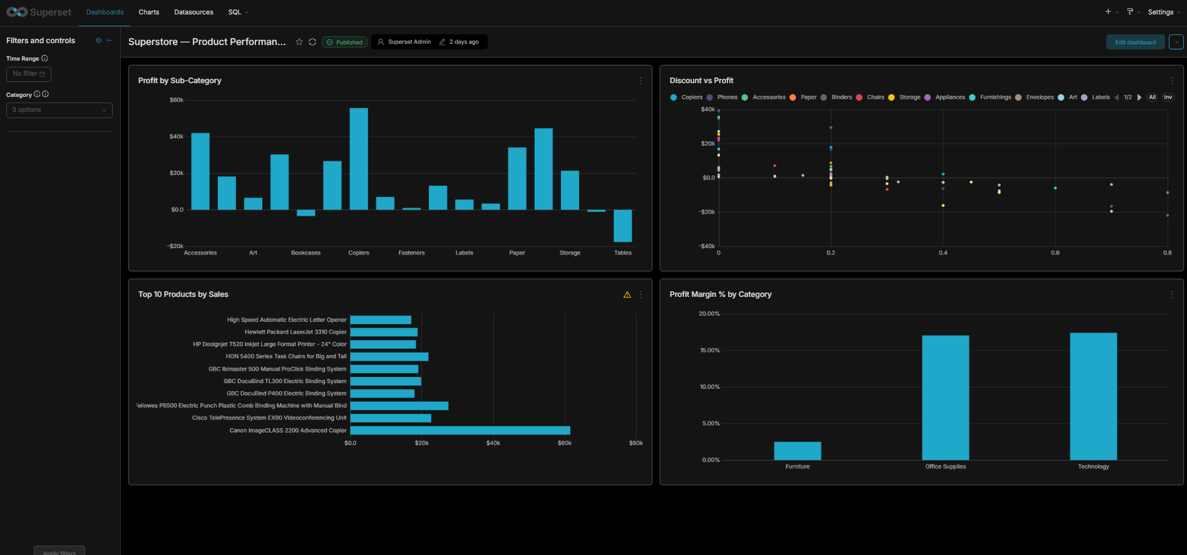
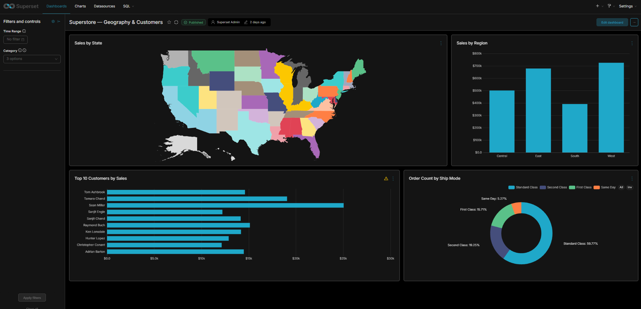
7. Superset Dashboards — Product & Geography
Product Performance
Geography & Customers
Three themed dashboards, each with a time-range and category filter.

Slide 11
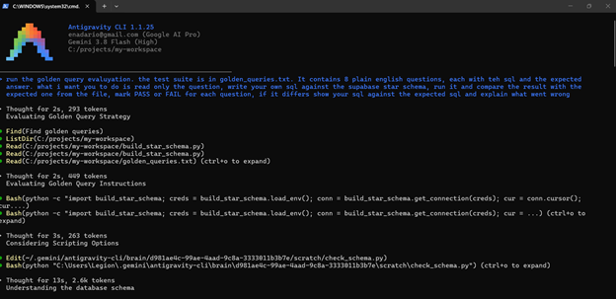
8. Golden-Query Validation
A benchmark of 8 questions, each with its expected SQL.
The agent reads the question, writes its own SQL, and runs it.
Its result is compared against the expected answer.
8 / 8
100%
queries passed
accuracy
Antigravity CLI running the golden-query evaluation

Slide 12
9. Hidden Insights — Business Value
Discounting drives losses
1
Loss-making order lines average a 48% discount vs. just 8% on profitable ones — depth of discount, not product mix.
A hidden loss leader
2
Furniture looks healthy overall, but the Tables sub-category alone loses ~$17,725 — more than Bookcases and Supplies combined.
Thin, concentrated margins
3
Furniture runs a ~2.5% margin while Technology and Office Supplies each run ~17% of sales.

Slide 13
10. Efficiency Gains & Trade-offs
Efficiency gains
Trade-offs — agent vs. manual SQL
Answers in seconds, no analyst in the loop.
Agent scaffolds the warehouse, ETL and dashboards.
Live schema introspection removes manual rewriting.
Self-service exploration for non-technical users.
Agent: fast & accessible, but must be governed and verified.
Manual SQL: precise & auditable, but slow and expert-only.
Non-deterministic output needs validation, not blind trust.
Best fit: agent to explore, curated SQL for reports of record.
Takeaway: the agent lowers the barrier to data; governance + a golden-query suite keep it trustworthy.

Slide 14
11. Technical Challenges
Supabase connectivity
The direct db.* host is IPv6-only and would not resolve on the network — connections failed at DNS. Fixed by switching to the IPv4 session pooler (eu-central-1).
Password URI encoding
The DB password contained reserved characters (! @ #) that broke the SQLAlchemy connection string until they were percent-encoded.
Tooling migration
Google's Gemini CLI was superseded by the Antigravity CLI (agy) mid-project; the MCP configuration format carried over, keeping the project on track.

Slide 15
12. Conclusion & Future Work
Conclusion
Future work
Built a Superstore star-schema warehouse in Supabase.
Integrated a Gemini agent via MCP for natural-language SQL.
Delivered three dashboards and an 8/8 golden-query suite.
Surfaced three non-obvious business insights.
Expand the golden-query suite; automate regression runs.
Add row-level security for multi-user access.
Cache frequent questions; add anomaly-alerting views.
Enrich with external data (returns, marketing spend).

Slide 16
Thank You
Questions & Discussion
Dario Karadzin
IT 501 Business Intelligence · Student ID 22003553
2026-09-06

