Slide 1
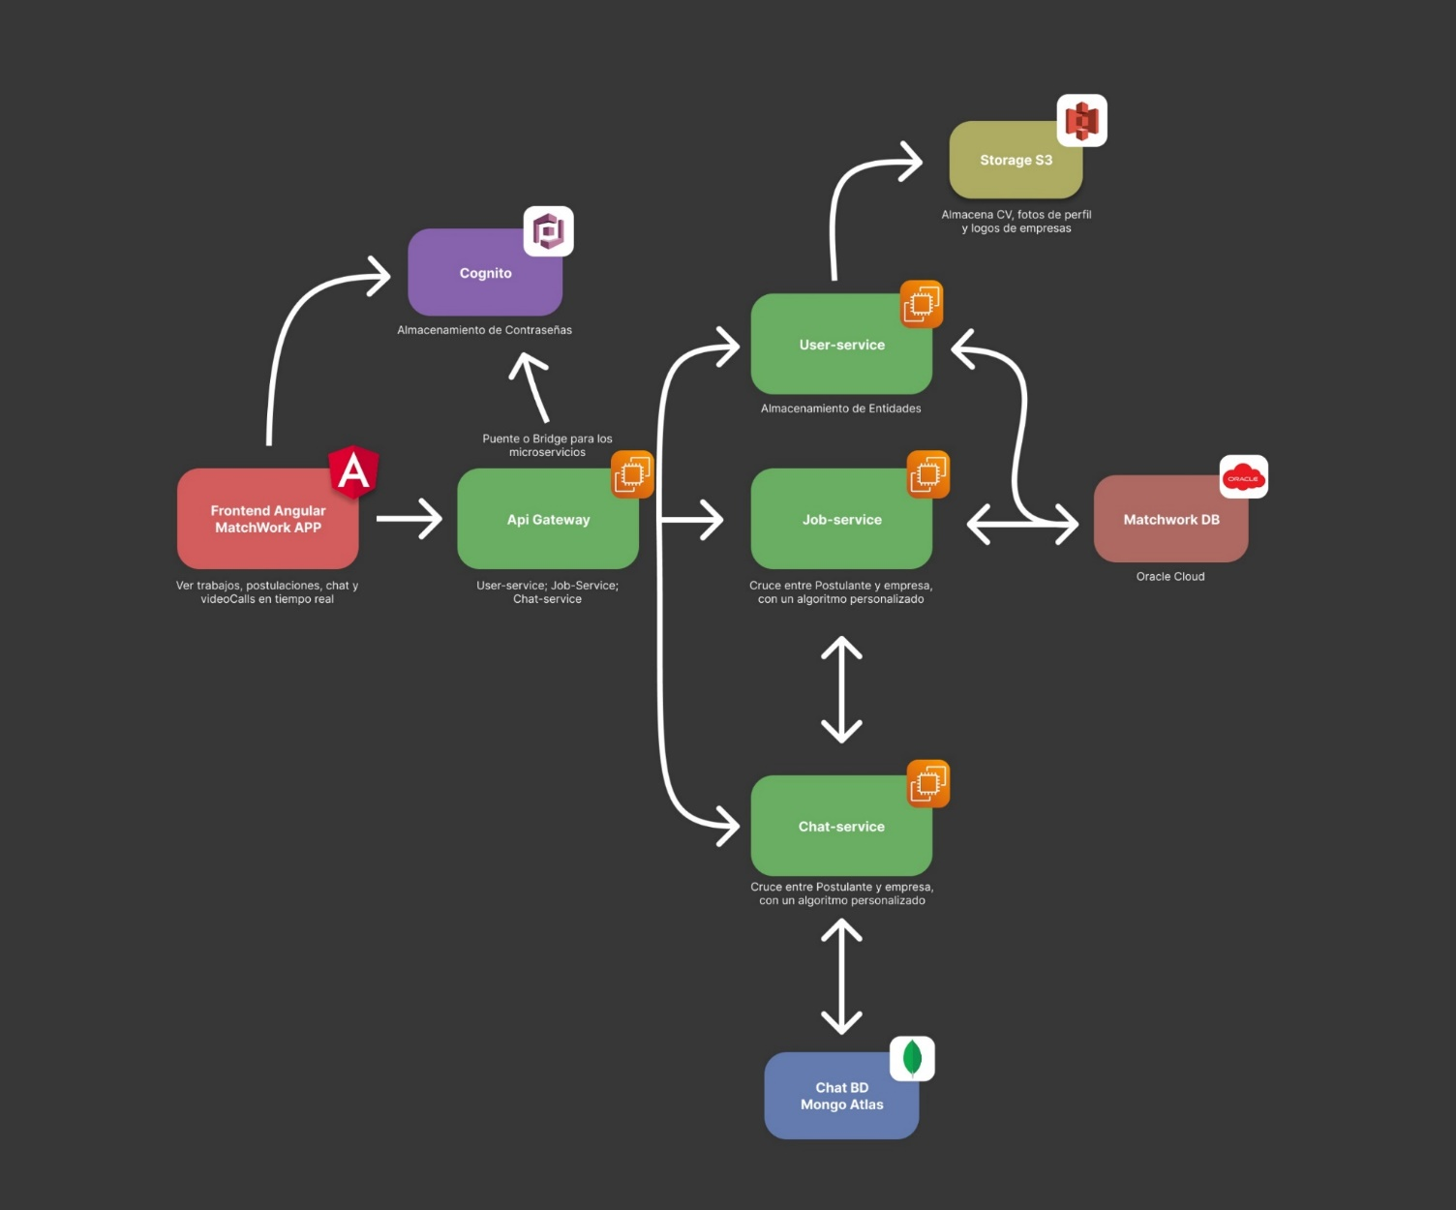
Arquitectura MatchWork

