Slide 1
ANALYZING CUSTOMER DATA FOR RISK MANAGEMENT
CA1 AIML – PART A : CLASSIFICATION
Name : Dario Prawara Teh Wei Rong
Class : DAAA / FT / 2A / 04
Notes:
Good morning Mr Wilson, I’m Dario and today, I’ll be analysing customer data for risk management for my classification task.

Slide 2
PROJECT OBJECTIVE & INFORMATION
From the perspective of risk management, the bank wants to build a classification model to predict which customer will have default payment in the next month.
credit_dataset.csv is a dataset collected from the bank. The dataset contains various customer information such as Gender, Education, Credit Limit, and Payment History.
Notes:
Here’s the objective. The bank aims to predict the number of customers who will default on their payment next month using a credit dataset, which contains key customer information such as Gender, Education, Credit Limit and Payment History to determine the defaults.

Slide 3
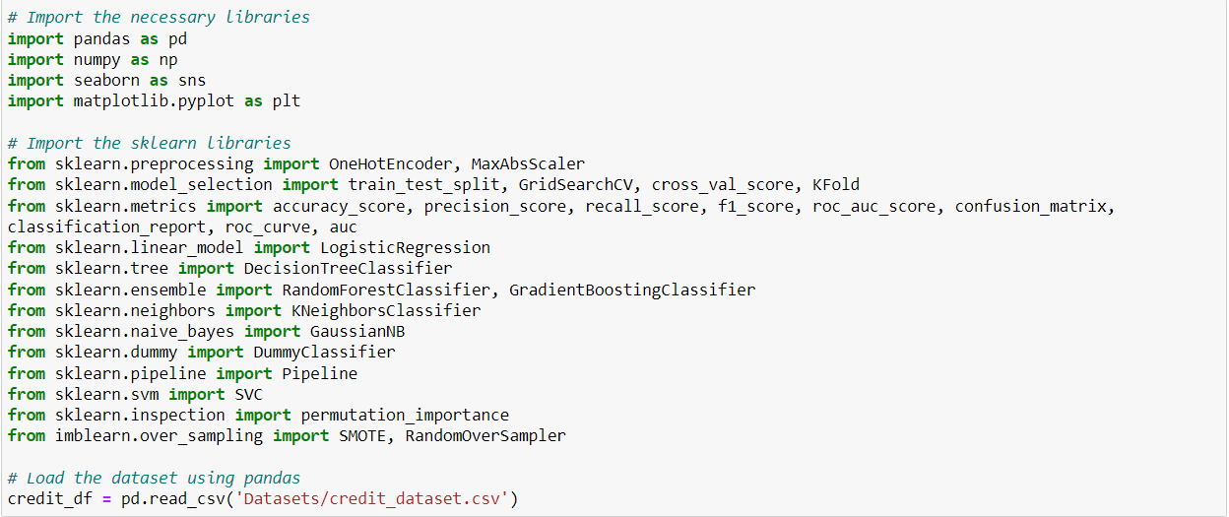
IMPORTING MODULES
Import the necessary modules for data exploration, preprocessing and model building.
Import csv credit dataset file and read file using pandas : pd.read_csv().
Notes:
First, I imported the relevant modules such as sklearn, imblearn, pandas and data exploration libraries, and read the data file using pd.read_csv().

Slide 4

PREDICTION OBJECTIVE
Prediction Task
To build a binary classification model that predicts whether a customer will default on their credit payment in the next month or not, to help the bank with risk management and decision-making.
Target / Output Variable
Default payment next month – Binary Variable
The output variable takes the value 1 if the customer defaults on their payment in the next month.
The output variable takes the value 0 if the customer does not default on their payment in the next month.
Notes:
Essentially, the prediction task is to build a binary classification model, predicting whether a customer will default on their credit payment in the next month.
The output variable is ‘Default payment next month’. This refers to a situation when a borrower fails to fulfil their obligation to repay a loan within the agreed time between the borrower and the bank. So, if a customer defaults, the result is 1, but if the customer repays their loan on time, the result is 0.

Slide 5
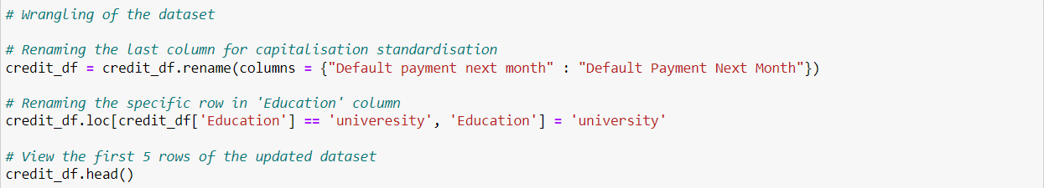
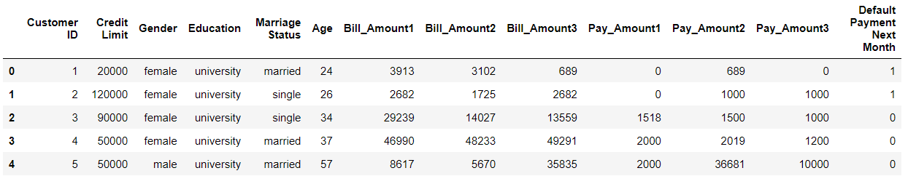
DATA PREPROCESSING
To wrangle the dataset, use pandas df.rename() to standardize column names and rectify spelling errors.
View the first 5 rows of the dataset using df.head() to get an overview of the dataset.
Notes:
Next, I performed pre-processing on the data by renaming the columns to standardize capitalization and modify spelling errors, as seen from ‘university’. I then gained an overview of the credit dataset using .head() to view the first 5 rows.

Slide 6
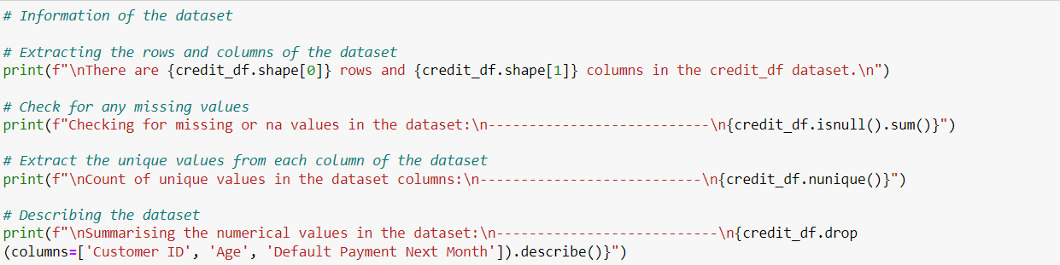
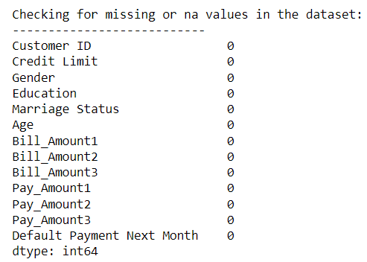
DESCRIBING THE DATA
Credit dataset contains 1600 rows and 13 columns.
Check that the dataset does not contain any NULL / NA values using df.isnull().sum().
Used .nunique() to retrieve the number of unique values in each data column.
Use .describe() for numerical columns and return values of descriptive statistics like count and mean.
Notes:
I analyzed the data and discovered it consists of 1600 rows and 13 columns, providing enough data for exploration and machine learning. There were no missing values, so data cleaning wasn't necessary. And, I obtained the number of unique values and descriptive statistics for each column to gain further insights into the data's range of values.

Slide 7
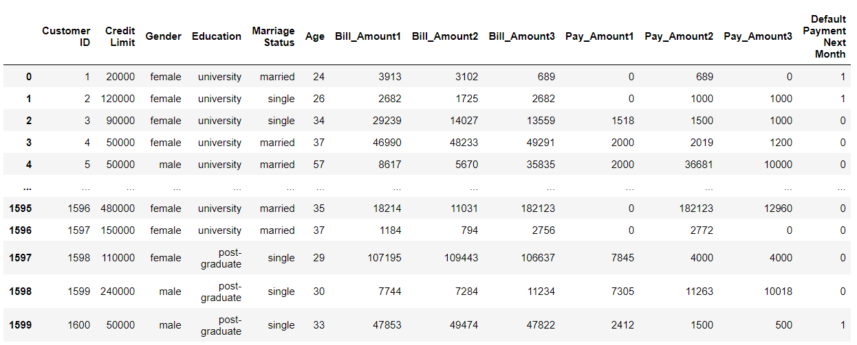
OVERVIEW OF FINAL DATASET
Notes:
Here is an overview of the final dataset upon pre-processing.

Slide 8
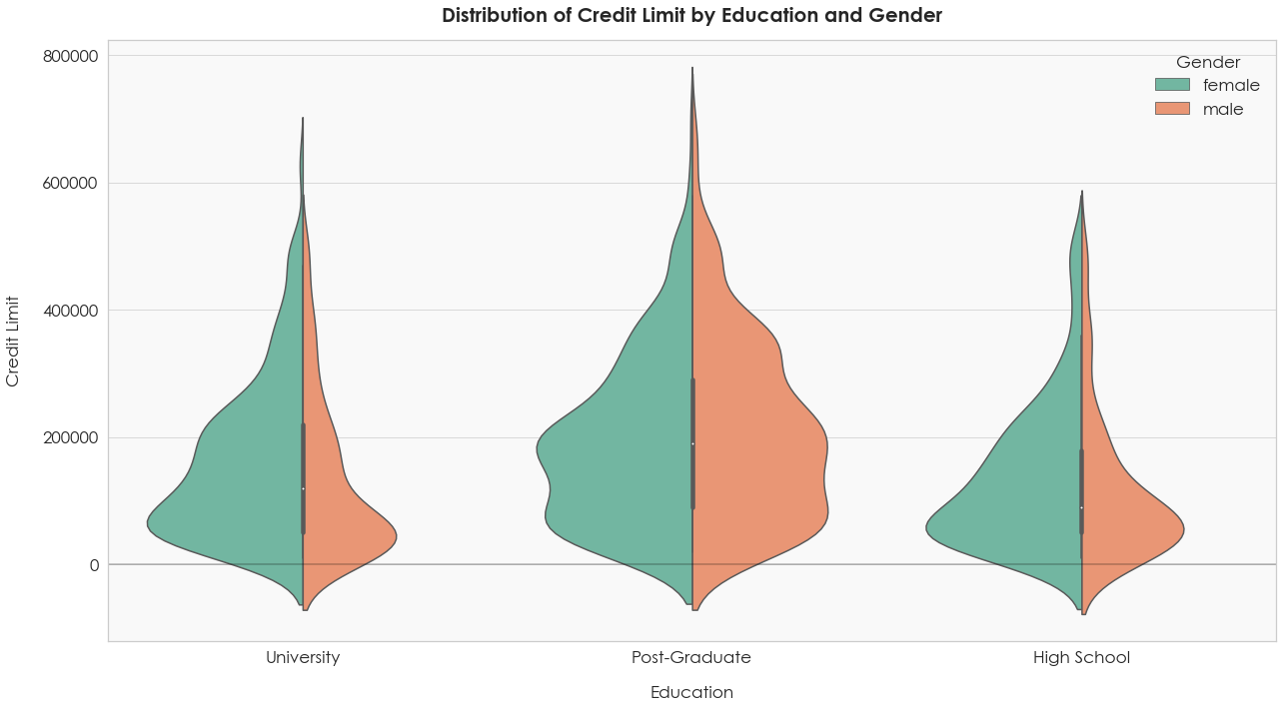
DATA EXPLORATION
The width of the violin plot indicates the variation in credit limits. Post-graduates show the largest width, suggesting a broader range of credit limits due to diverse financial profiles, creditworthiness, income levels, and credit history.
Higher median credit limits for post-graduates and lower limits for high schoolers are due to factors like income levels, job prospects, and lenders considering education as a positive creditworthiness indicator.
Among high-schoolers and university students, the violin plot width is larger for females than males, indicating greater diversity in credit limits for females, potentially due to financial independence or income disparity in those educational stages.
Notes:
Now, I performed some data exploration on the dataset.

Slide 9
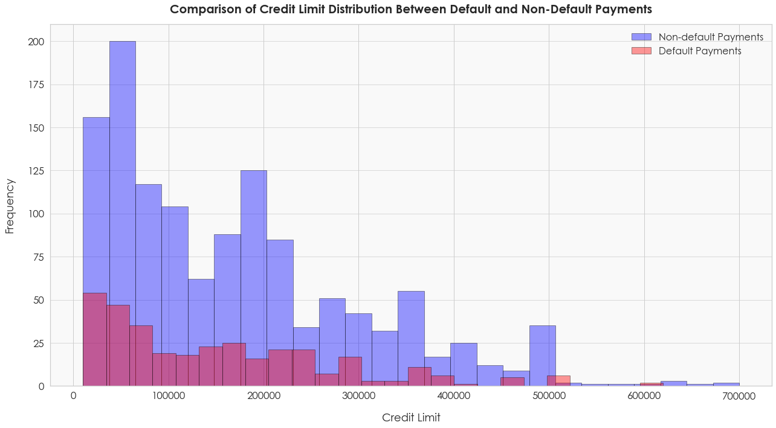
DATA EXPLORATION
The histogram shows that default cases are less frequent than non-default cases, indicating that the majority of customers successfully make their payments without defaults and are creditworthy.
However, for default payments, a higher frequency of defaults occurs among individuals with lower credit limits, suggesting that lower credit limits pose a higher risk of default.
In contrast, non-default payments have a wider distribution of credit limits, indicating greater variability in creditworthiness among successful borrowers. The narrower credit limit distribution for default payments suggests a more consistent level of credit risk and stricter lending criteria for customers prone to default.

Slide 10
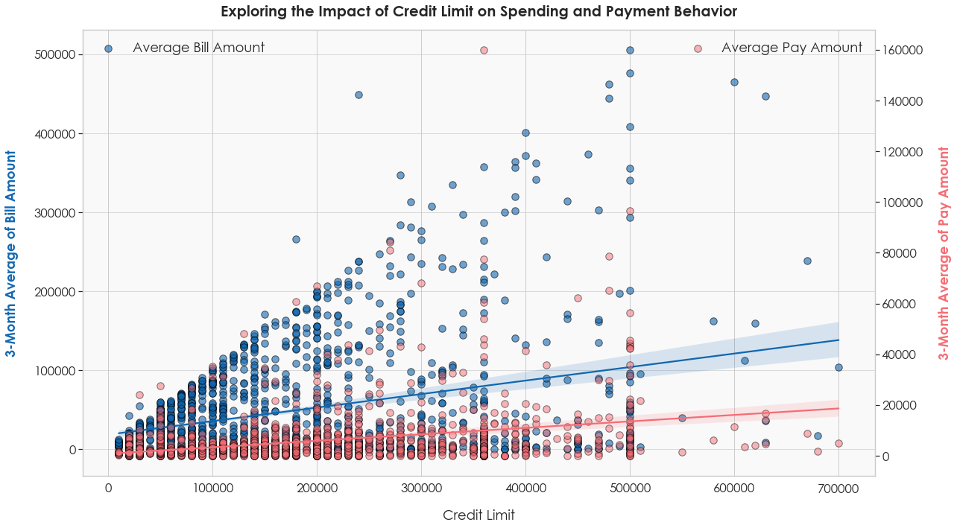
DATA EXPLORATION
The regression plot reveals a weak positive correlation between credit limit, bill amount, and payment amount.
Higher credit limits are associated with higher bill amounts and larger payments. However, numerous outliers exist above the trend line, suggesting individuals with substantial assets and higher-than-expected bill and payment amounts.
The trend line indicates that customers tend to accumulate higher bills compared to payment amounts, possibly due to factors like minimum payments or prioritizing certain expenses.
The presence of outliers emphasizes the diversity in financial behaviors and circumstances among the bank's customers.

Slide 11


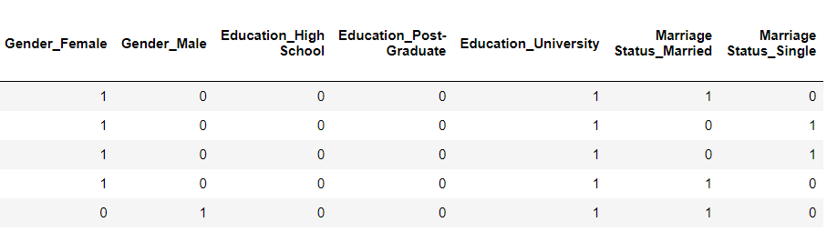
FEATURE ENGINEERING
From the final dataset, drop ‘Customer ID’ as it is unused and unnecessary in the training phase of the model.
Create dummy variables for categorical variables in the dataset using .get_dummies() to ensure numerical representation for the model to process.
Binary values (0 and 1) are created for the ‘Gender’, ‘Education’ and ‘Marriage’ columns.

Slide 12
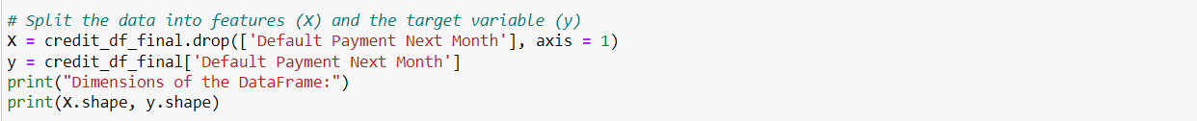
FEATURE ENGINEERING
Split the dataset into X (features) and y (target variable).
X – obtained by excluding the target variable ‘Default Payment Next Month’ using .drop() with axis = 1
Data is split into 4 sets : X_train (features for training), X_test (features for testing), y_train (target variable for training), and y_test (target variable for testing)
Allocate test_size = 0.2 to ensure sufficient data for testing and maintaining consistent data splits.
Use stratify = y to ensure proportional representation for both 0 and 1 classes – better generalization and representation

Slide 13

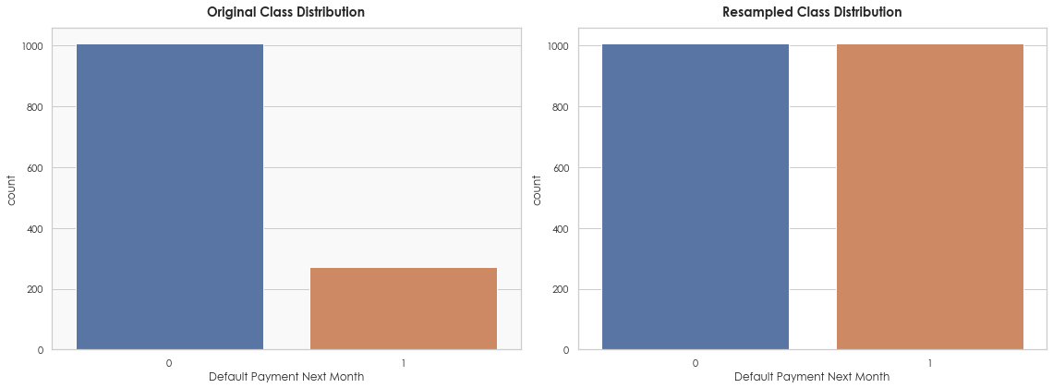
FEATURE ENGINEERING
Due to imbalanced data in ‘Class 1’, use RandomOverSampler with sampling_strategy = ‘minority’ to generate synthetic data samples for the minority class, ensuring balanced classes.

Slide 14
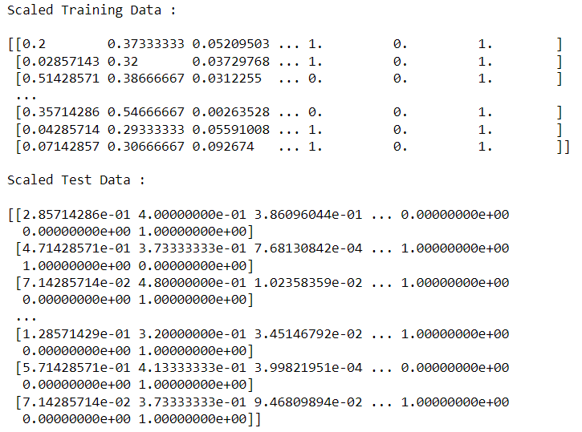
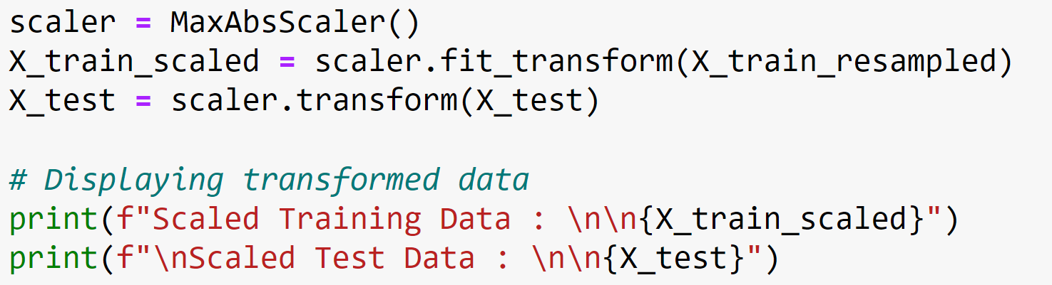
FEATURE ENGINEERING
For X_train data, scale and fit_transform using MaxAbsScaler().
For X_test data, scale and transform using MaxAbsScaler().
MaxAbsScaler() preserves the proportionality between features and scales the data to a range of [1, -1] -> suitable as there were negative and positive values in the dataset.

Slide 15
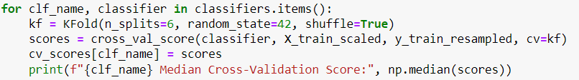
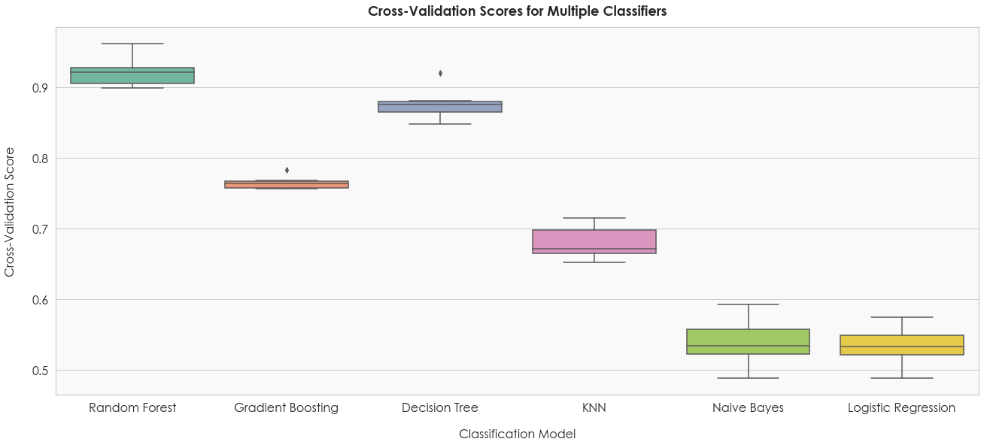
MODEL CROSS-VALIDATION
To identify the most suitable model, use cross-validation (cv = 6 KFolds) and retrieve the median score for each of the classifier tested.
Use cv=6 to obtain a robust estimate of the model’s performance and assess how well a model generalizes to unseen data.
From the boxplots, ‘Random Forest’ classifier is the best with a score of 92%.

Slide 16
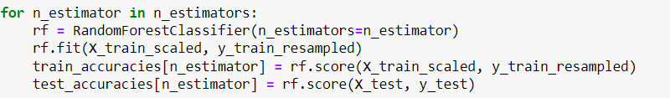
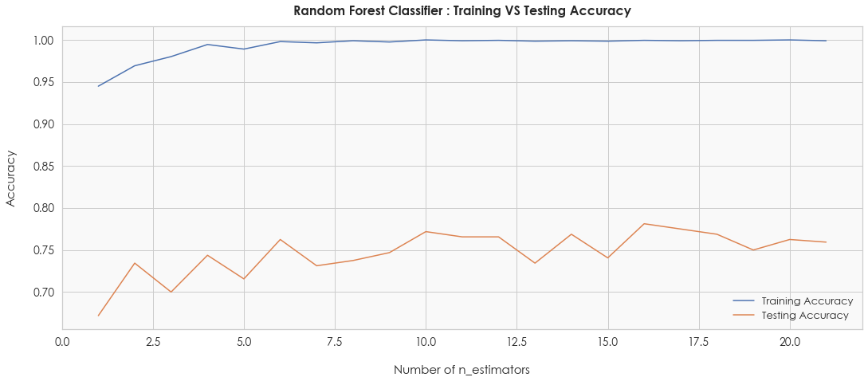
ASSESSING TRAIN / TEST ACCURACIES
To evaluate the train / test accuracies for the Random Forest model, fit X_train_scaled and y_train_resampled to the classifier.
Set n_estimators between a range of 1 – 22 to evaluate the changes in accuracy.
The accuracy for the training set ranges between 0.93 to 1.0, while the accuracy for the testing set ranges between 0.66 to 0.76.

Slide 17
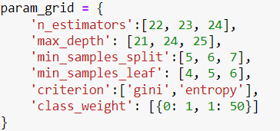
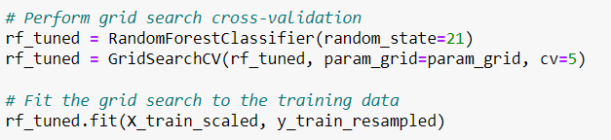
HYPERPARAMETER MODEL TUNING
Tune the Random Forest Classifier using GridSearchCV parameter grid :
n_estimators : Number of decision trees to be used in the Random Forest Ensemble
max_depth : Maximum depth allowed for each decision tree in the Random Forest
min_samples_split : Controls overfitting by preventing splits with a low number of samples
min_samples_leaf : Minimum number of samples required to be present in a leaf node
criterion : ‘Gini’ and ‘Entropy’ are used to evaluate the quality of a split in decision trees
class_weight : Used to adjust the importance for Class 0 and 1 and address imbalance issues
Fit the model and parameters to GridSearchCV -> cv = 5 : Model is trained and evaluated 5 times

Slide 18


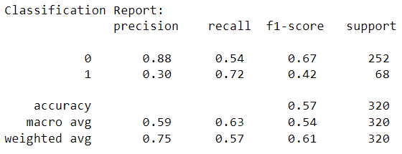
EVALUATING MODEL PERFORMANCE
Best Parameters :
To meet the bank's objective of identifying customers likely to default on payment (Class 1), recall is used. It measures the proportion of true positives among all positive cases.
By optimizing recall for Class 1, the model minimizes false negatives (misclassified defaults) and improves the detection of actual default cases, with a score of 0.72.
Recall for Class 1 is more crucial, as the consequences for misclassifying default cases are severe, leading to potential financial losses for the bank.
Obtain the accuracy, classification report and confusion matrix.

Slide 19
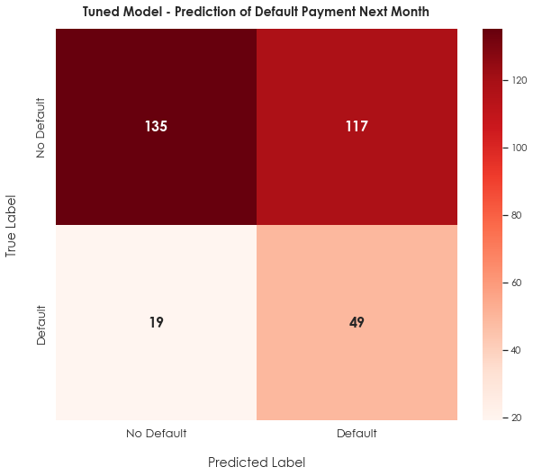
EVALUATING MODEL PERFORMANCE
Based on the confusion matrix, the model managed to correctly identify 49 instances of default cases (Class 1) of the total 68 actual defaults.
This indicates that the model has a good ability to capture majority of true positive cases and can identify customers who are likely to default.
However, the trade-off is the model incorrectly predicting a larger number of cases as default when it is not (False Positive Cases). But since the bank’s objective is to identify defaulted customers, this trade-off is justifiable and necessary for the bank to maintain its finances.

Slide 20

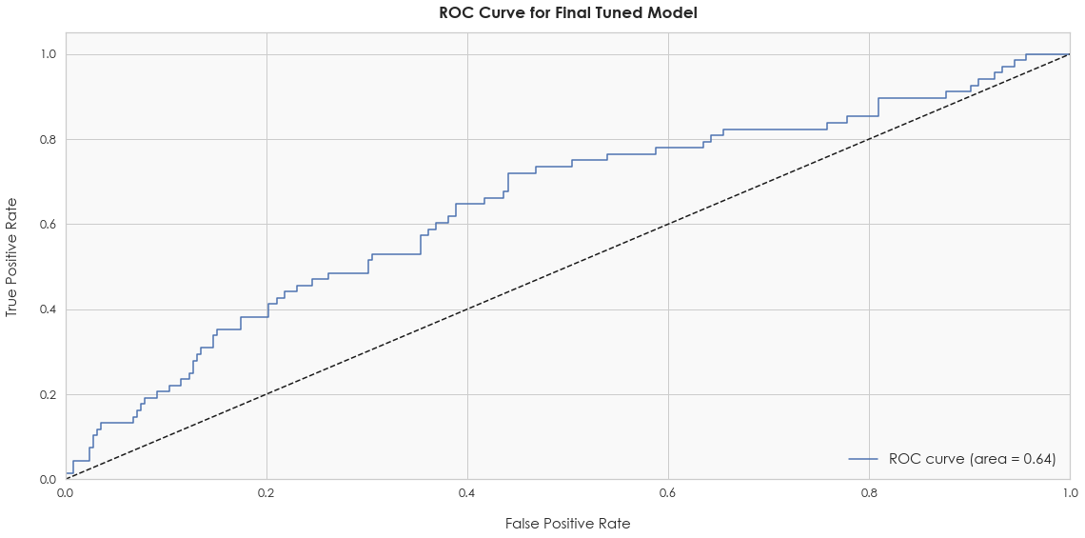
INTERPRETING THE ROC CURVE
This ROC Curve predicts the probabilities of the positive class (Class 1) for X_test data upon model tuning.
Based on the ROC Curve, the model provides an AUC (Area Under the Curve) of 0.64.
This indicates that the model has a fair discriminatory ability and can effectively differentiate between Class 0 and 1 to a reasonable extent.

Slide 21
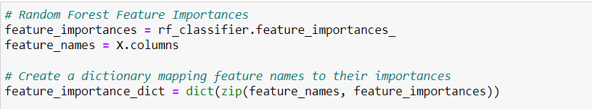
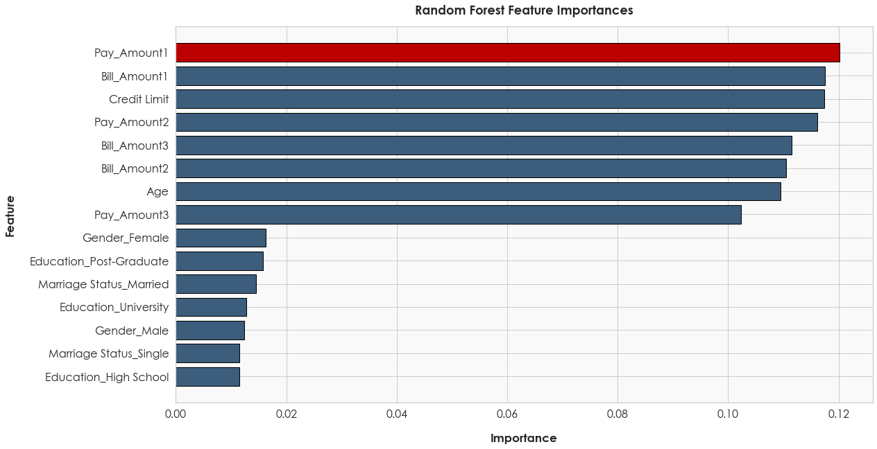
ASSESSING THE FEATURE IMPORTANCE
Using .feature_importances_, I could identify the most important features the model considers in its evaluation.
The most important feature is ‘Pay_Amount1’ (The amount customer paid 1 month ago), followed by Bill_Amount1, Credit Limit, Pay_Amount2 and the rest of the variables.
By identifying the important variables, it allows the bank to focus on monitoring and assessing the pay amounts from 1 month ago to identify customers at higher risk of defaulting.

Slide 22
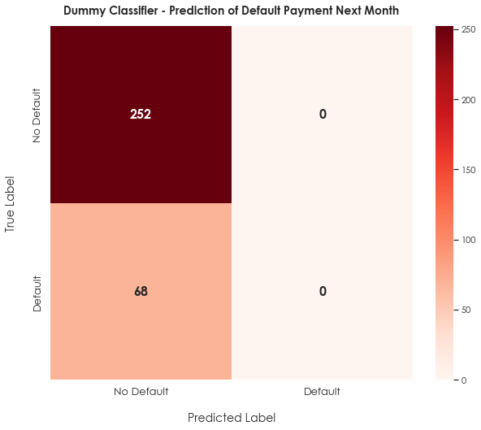
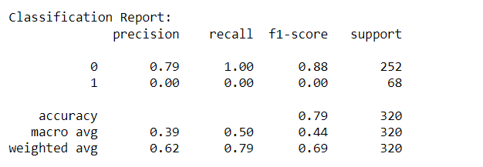
COMPARING TO A DUMMY BASELINE
Based on the dummy classifier, we see that our model performed better at identifying Class 0 for the ‘precision’ metric.
Since the dummy classifier only predicts the most frequent class (Class 0), it does not deal with class imbalance, thus produces slightly better results than our model for Class 0 but fails to predict for Class 1.

Slide 23
CONCLUSION
Best-performing model : Random Forest Classifier
From hyperparameter tuning, the best parameters were : {'class_weight': {0: 1, 1: 50}, 'criterion': 'entropy', 'max_depth’: 25, 'min_samples_leaf': 4, 'min_samples_split': 5, 'n_estimators’: 22}
Based on the recall score of 0.72, the model performed well in identifying and predicting customers who are likely to default, meeting the bank’s objective and helping in risk management and decision-making.
Despite a lower recall score for Class 0 (customers who did not default), it is more important for the bank to predict defaults, to prevent monetary losses, hence this trade-off is considered acceptable.

