Slide 1
CARVALUIFY
DOAA CA1
YOUR ONE-STOP CAR PRICE PREDICTOR WEBSITE
Name : Dario Prawara Teh Wei Rong
Class : DAAA / FT / 2B / 04
Admin Number : 2201858

Slide 2
PROJECT OBJECTIVE
Using regression modelling for car price prediction, predict car prices, given a set of input car feature data.
For our ‘100,000 UK Cars’ dataset, it contained extensive data on car model, car registration year, mileage, tax and more.

Slide 3
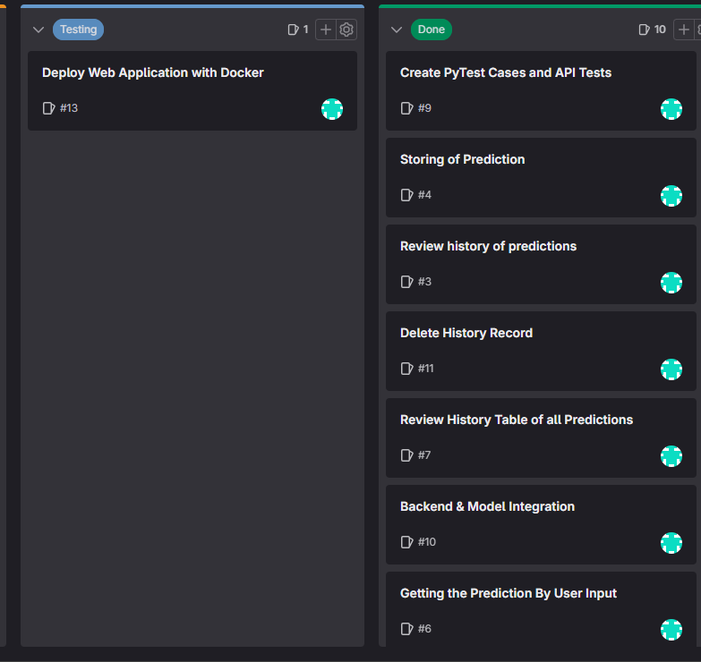
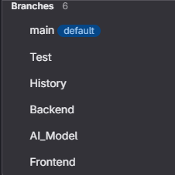
DEVOPS PROCESS
SETTING UP GITLAB AND SCRUM BOARD
Managed a scrum board to enable us to keep track of our web application development.
The scrum board contained 4 key labels, ‘To-Do’, ‘In Progress’, ‘Testing’, and ‘Done’.
Created 6 branches for frontend, backend, model building and testing for us to make changes to the folder in a controlled environment.

Slide 4
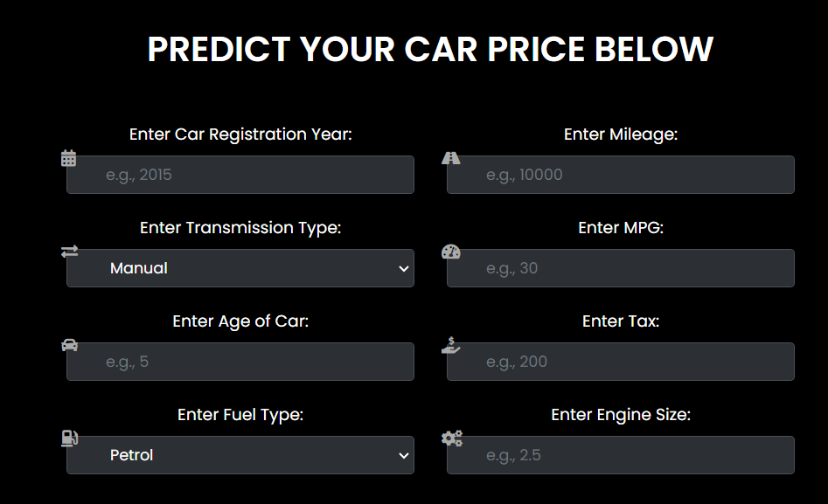
PRESENTING : CARVALUIFY
CARVALUIFY
CarValuify is a simple-to-use web application that enables you to predict your car prices & valuations through inputting your car details. Simply enter the necessary fields, and our AI algorithm will work out the rest!

Slide 5


GENERAL INFORMATION
Authentication required for non-public pages.
Bypassing the authentication by typing in direct link is addressed and is prevented.
Username : student
Password : student
Responsive + Flexible Website Design using Bootstrap 4 and TailwindCSS.
Webpage is viewable on multiple devices and is customizable to the screen size.

Slide 6
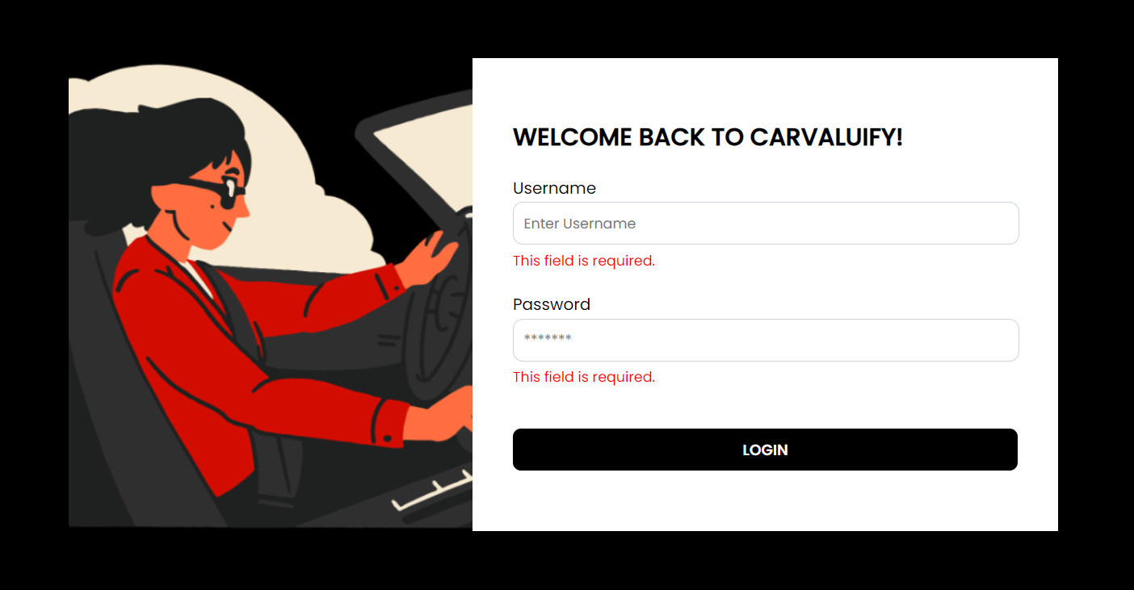
CARVALUIFY | CAR PRICE PREDICTOR
Login Page : Prompt users to enter the username and password before proceeding
Errors & validation checks are displayed using Flask’s flash() function.

Slide 7
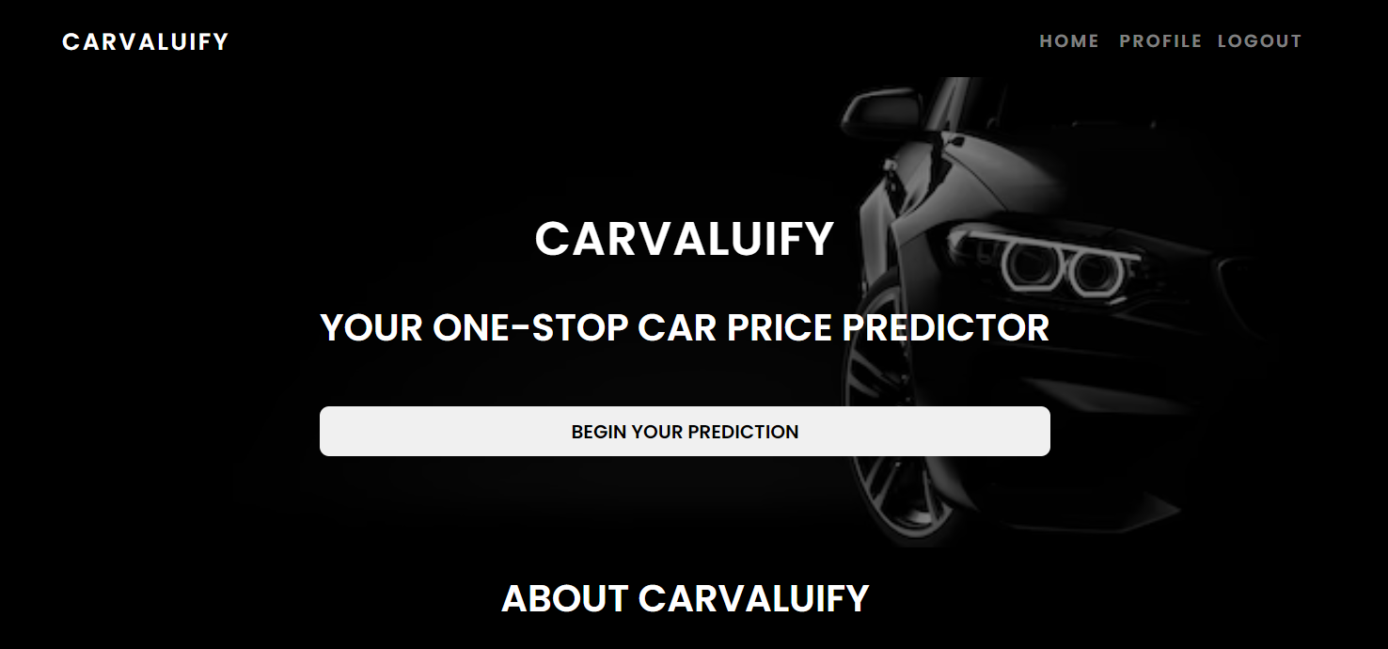
CARVALUIFY | CAR PRICE PREDICTOR
Responsive navbar to navigate to other pages
Interactive button to link to prediction section

Slide 8
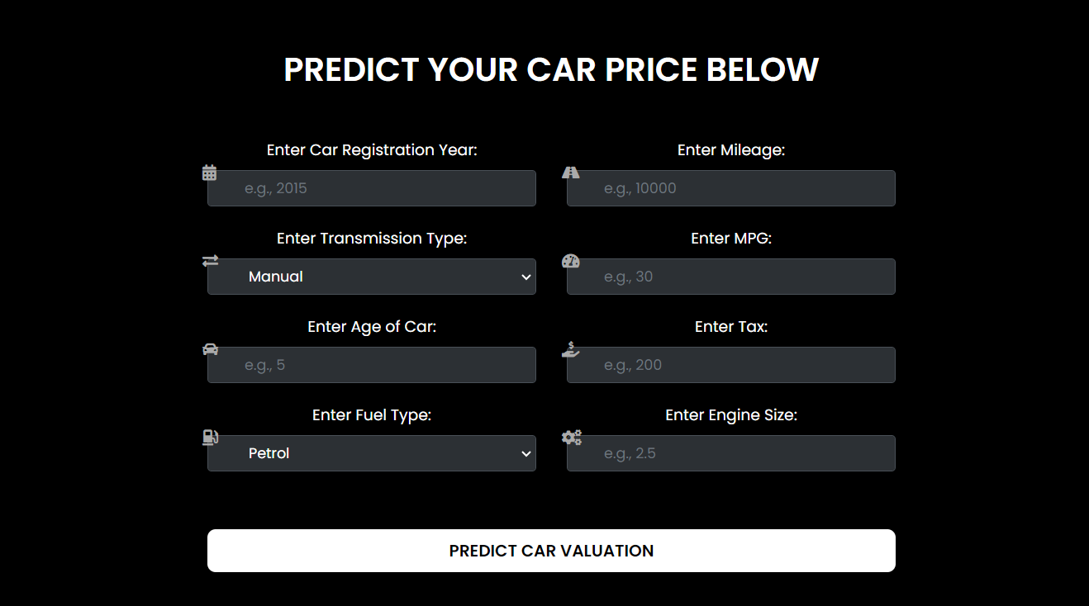
CARVALUIFY | CAR PRICE PREDICTOR
Added attractive icons for user engagement
Dropdown box options for easy selection for our user

Slide 9
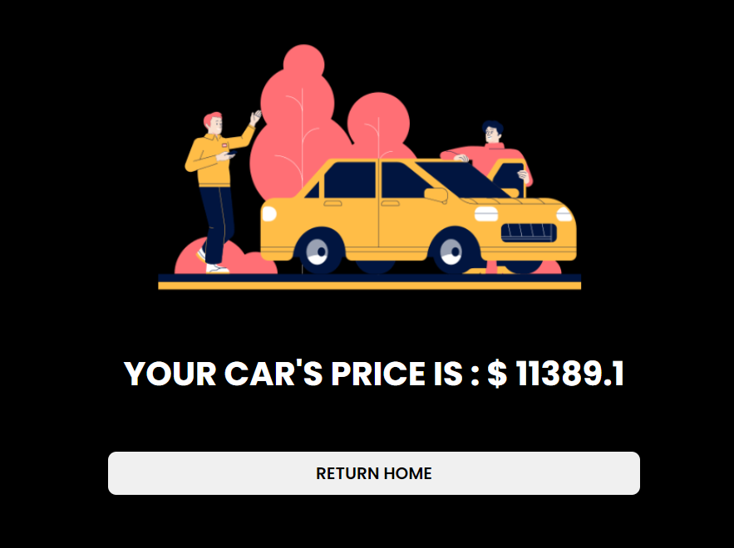
CARVALUIFY | CAR PRICE PREDICTOR
Attractive graphic for viewing of the predicted price
Simple ‘Return Home’ button to easily return to the home page

Slide 10
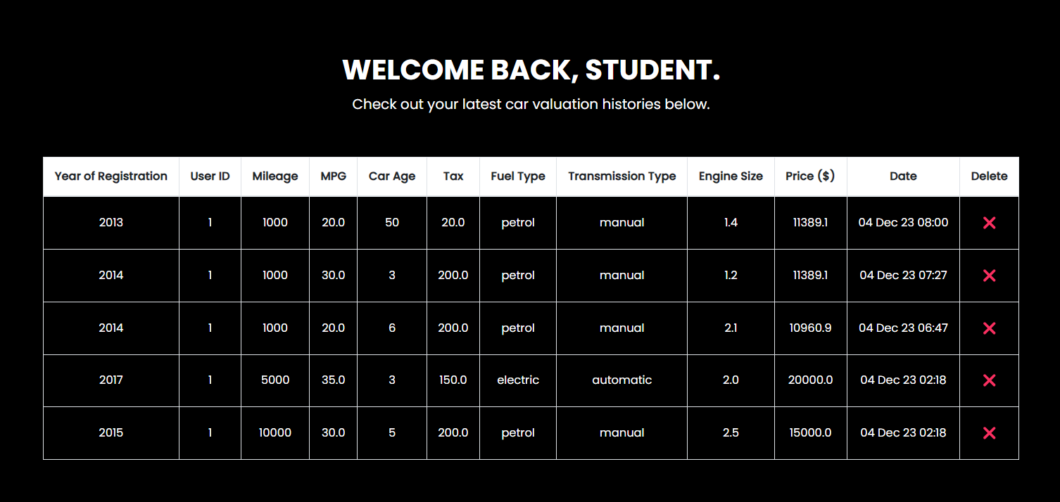
CARVALUIFY | CAR PRICE PREDICTOR
Profile Page for users to view prediction histories
Displays all the relevant columns and an ‘X’ for delete.

Slide 11
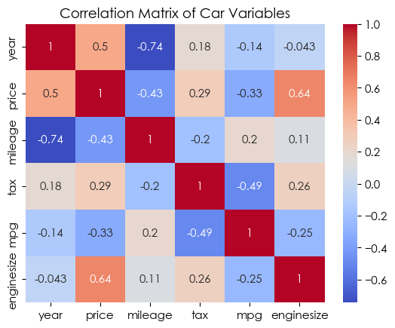
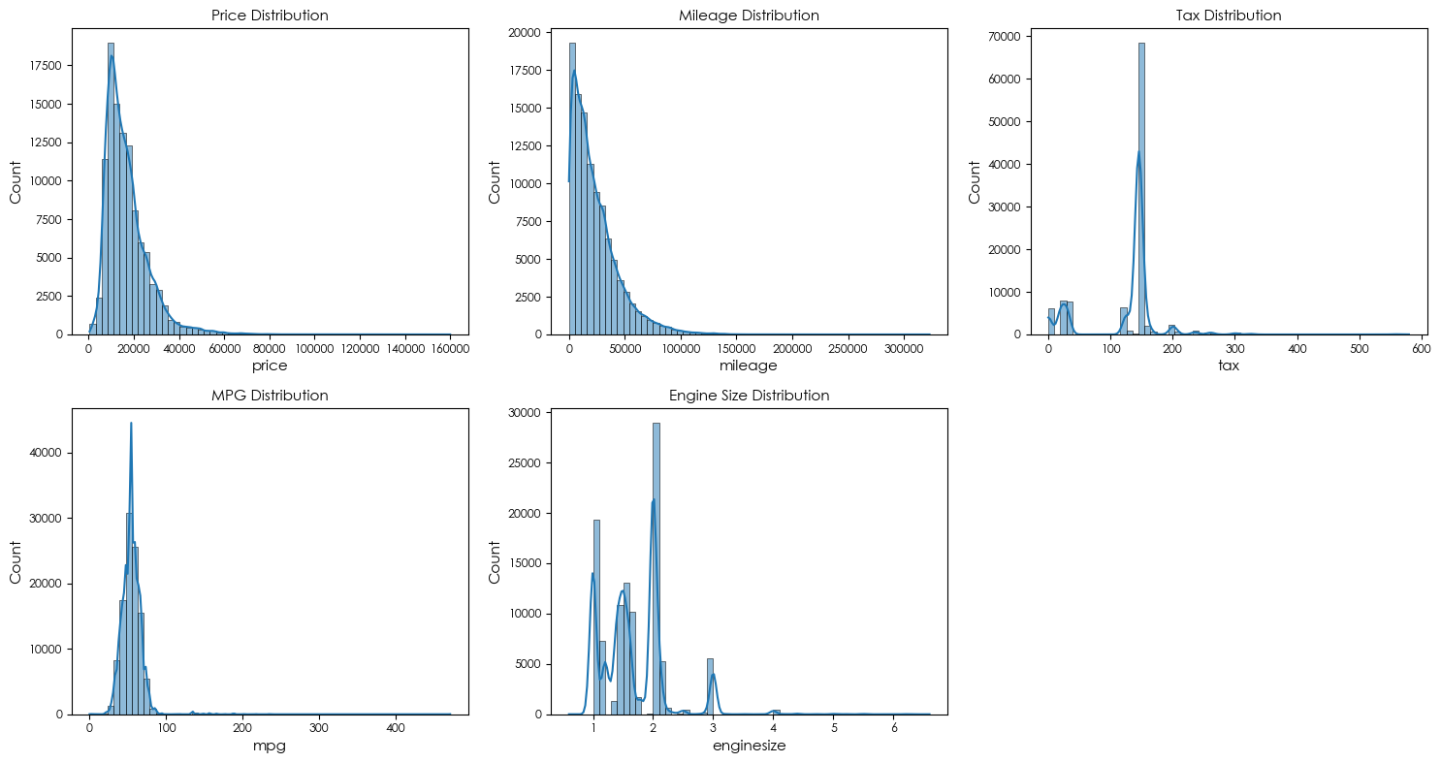
MACHINE LEARNING REGRESSOR
First, conducted extensive EDA on the dataset to discover insights and patterns in data.
Found moderate to high correlation between most of the car variables in dataset.
Most variables like Price and Mileage are slightly skewed (imbalanced distribution).

Slide 12

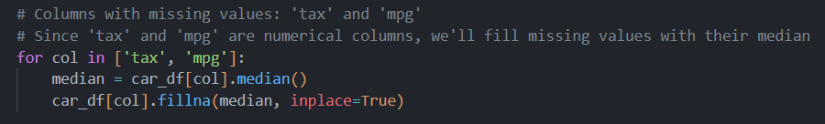

MACHINE LEARNING REGRESSOR
Dropped unnecessary columns not useful for the analysis.
Imputed missing values with MEDIAN to remove NULLS and prevent loss of data rows.
Dropped DUPLICATE rows of data to prevent biasness to certain groups of values.

Slide 13
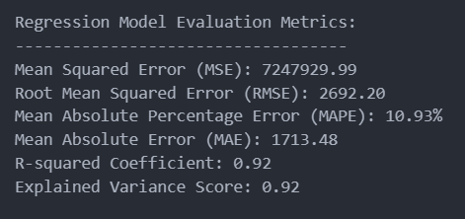
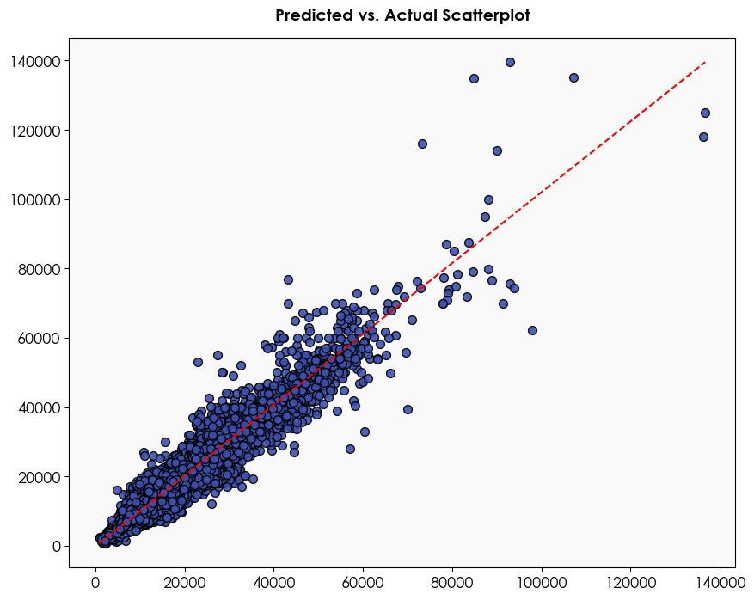
MACHINE LEARNING REGRESSOR
Feature Engineering Performed
Robust Scaling of Data
Added new column ‘Car Age’ (Now – Registration Year)
One-hot Encoded Labels
Train-Test Split X and Y
Cross-Validation Performance
Best-performing Model : RANDOM FOREST REGRESSOR
MAPE : 0.1156
RMSE : 2962.17
Hyperparameter Tuning – Randomized Search
R2 : 0.92
MAPE : 10.93%

Slide 14
WEB APIs DEVELOPED
POST
API/ADD
GET
API/GET
DELETE
API/DELETE
POST
API/PREDICT
API used to add a new prediction record to the database table.
Login is needed.
API used to get an existing prediction record from the database table.
Login is needed.
API used to delete an existing prediction record from the database table.
Login is needed.
API used to perform predictions and gain price insights on the car.
Login is needed.

Slide 15
54 TESTS
TESTING WITH PYTEST
VALIDITY TESTING
RANGE TESTING
CONSISTENCY TESTING
Tested on valid data to determine if ordinary data can be used. Ensured data entered was acceptable.
Extreme values for columns such as Year, MPG, Car Age and Mileage etc. Tested both lower and upper bounds.
Given identical inputs, checked if prediction and output prices are the same.
EXPECTED FAILURE TESTING
UNEXPECTED FAILURE TESTING
Tested XFAIL on:
Invalid Year of Registration
Invalid Mileage ( < 0)
Invalid MPG
Invalid Car Age
Invalid tax value
Tested invalid inputs on:
Year of Registration (Non-integer)
MPG (Less than 0)
Mileage (Negative value)

Slide 16
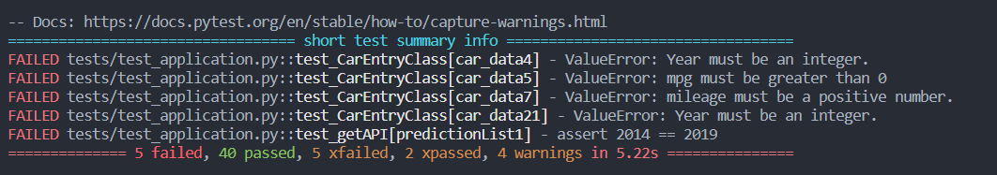
TESTING WITH PYTEST
52 TESTS DONE

Slide 17
THANK YOU!

