Slide 1
CIFAR-10 GAN
CA2 – DEEP LEARNING GENERATIVE ADVERSIAL NETWORK
DAAA / FT / 2B / 04
Lim Zhen Yang 2214506 | Dario Prawara Teh 2201858

Slide 2
Background Research
Conditional GANs
GANs
A GAN, or Generative Adversarial Network, is essentially a deep learning model with two neural networks, the Generator and the Discriminator, which are trained together in a competitive manner.
GANs were then extended to a conditional model by conditioning both the generator and discriminator on some extra information in the 2014 Mehdi Mirza and Simon Osindero. "Conditional Generative Adversarial Nets" paper.

Slide 3
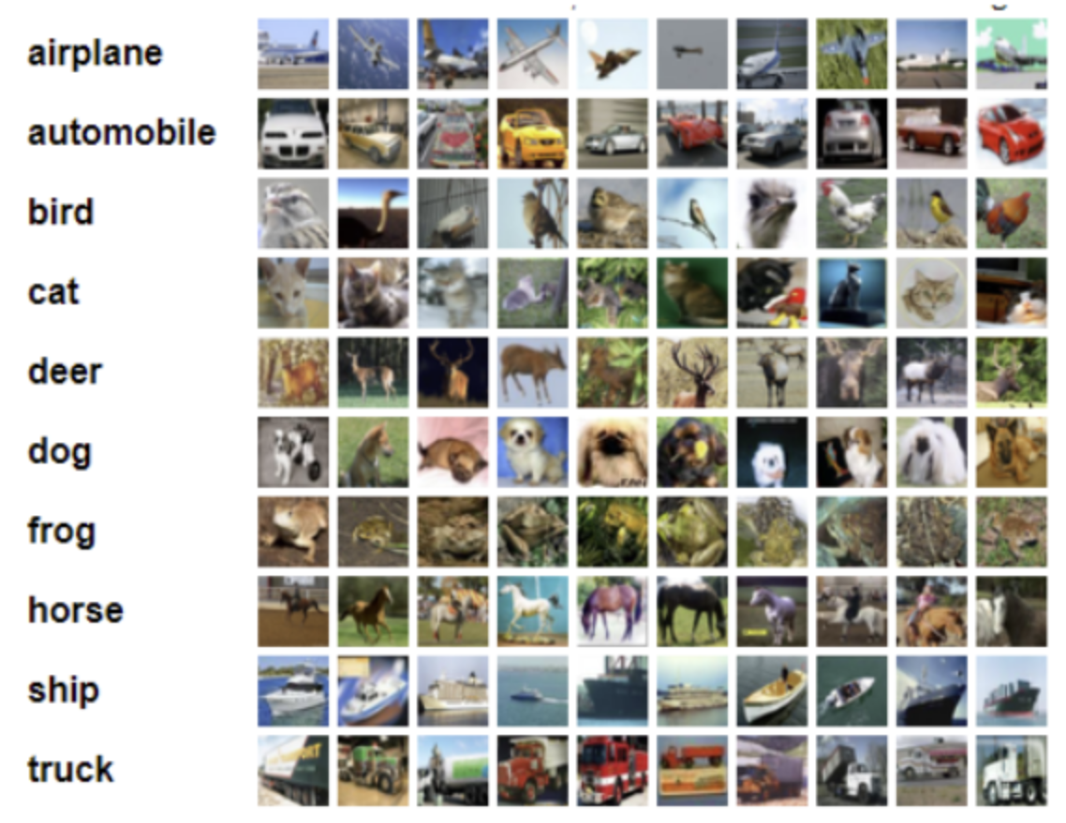
Project Objective
CIFAR-10
Apply some suitable GAN architectures to the problem of image generation using the CIFAR-10 dataset and generate 1000 small colour images.

Slide 4
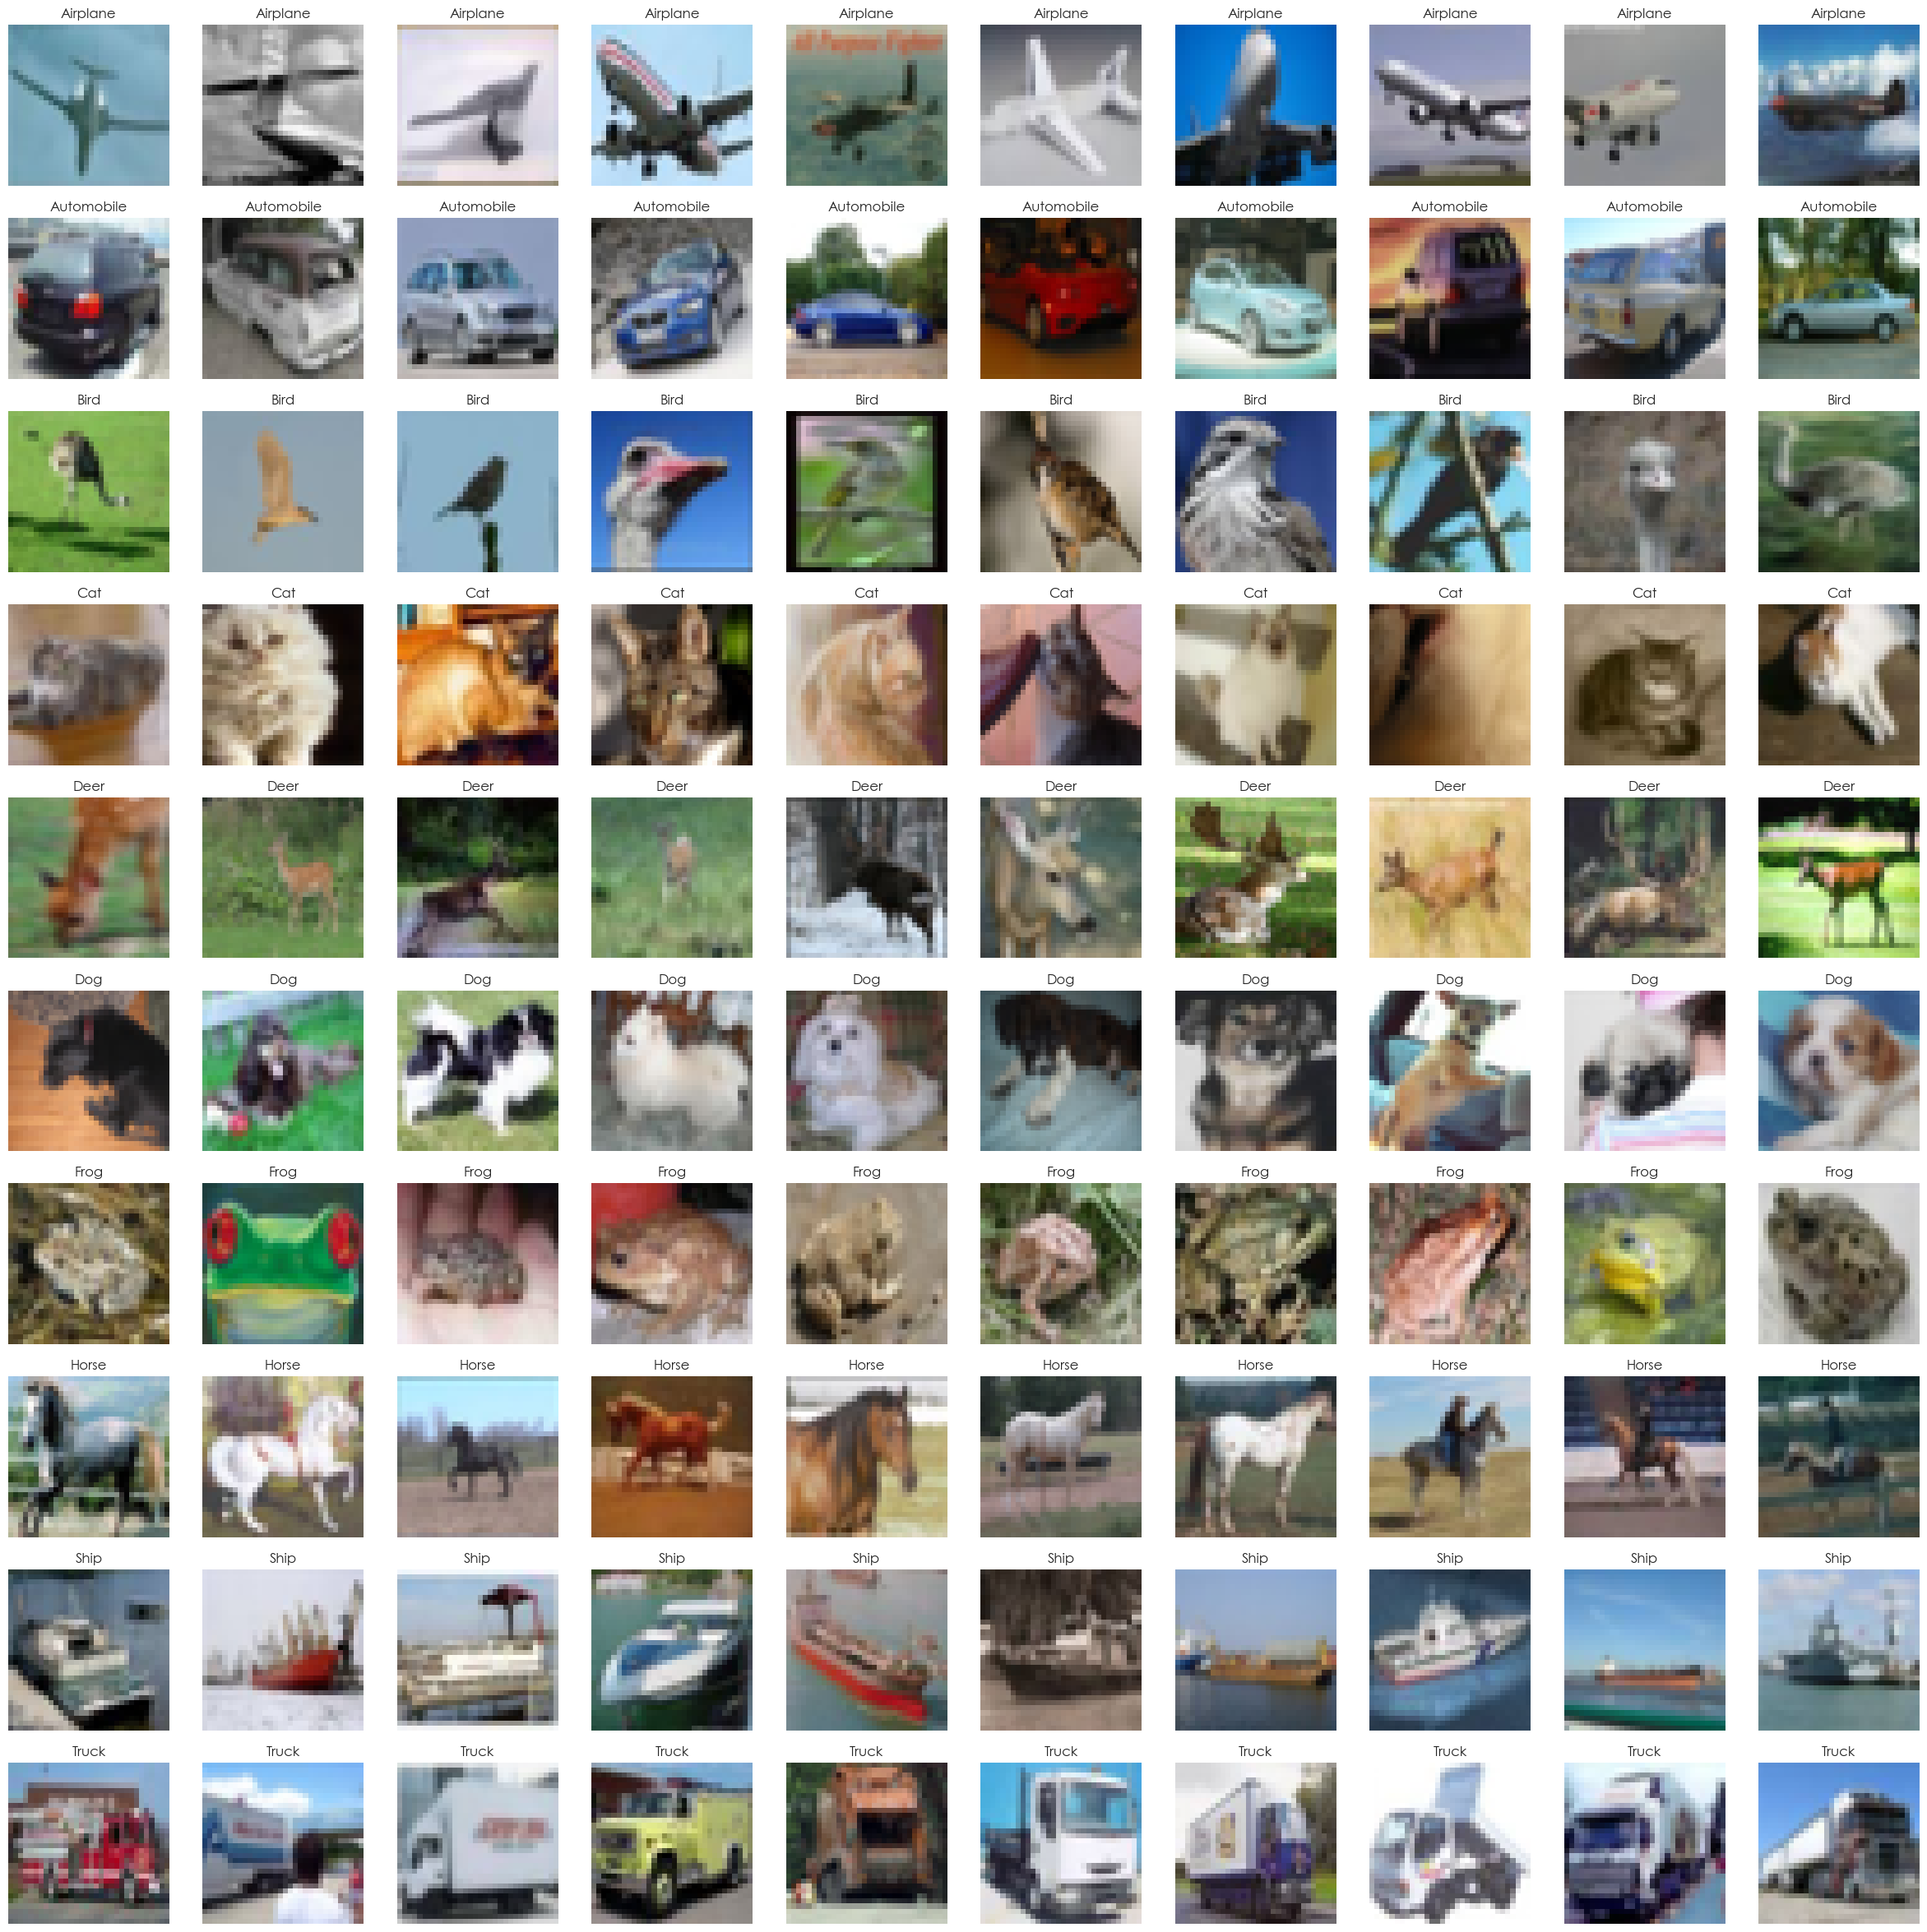
Data Exploration
Very small images of 32x32
Low resolution
Some images are difficult even for humans to discern
Main object is centered in the middle of the image

Slide 5
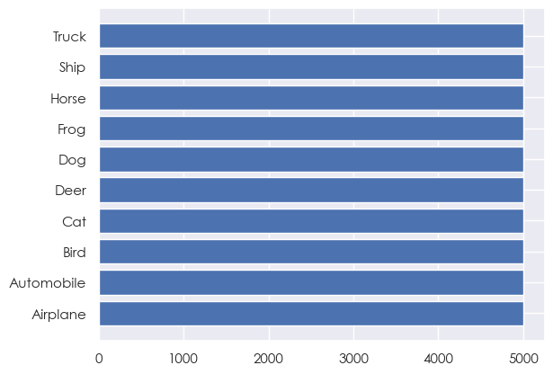
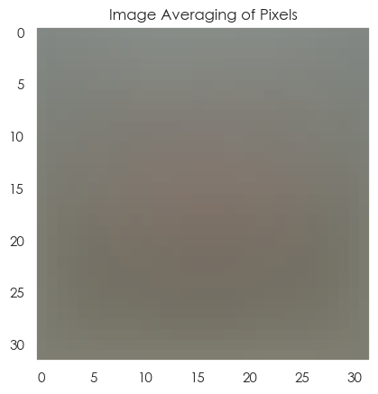
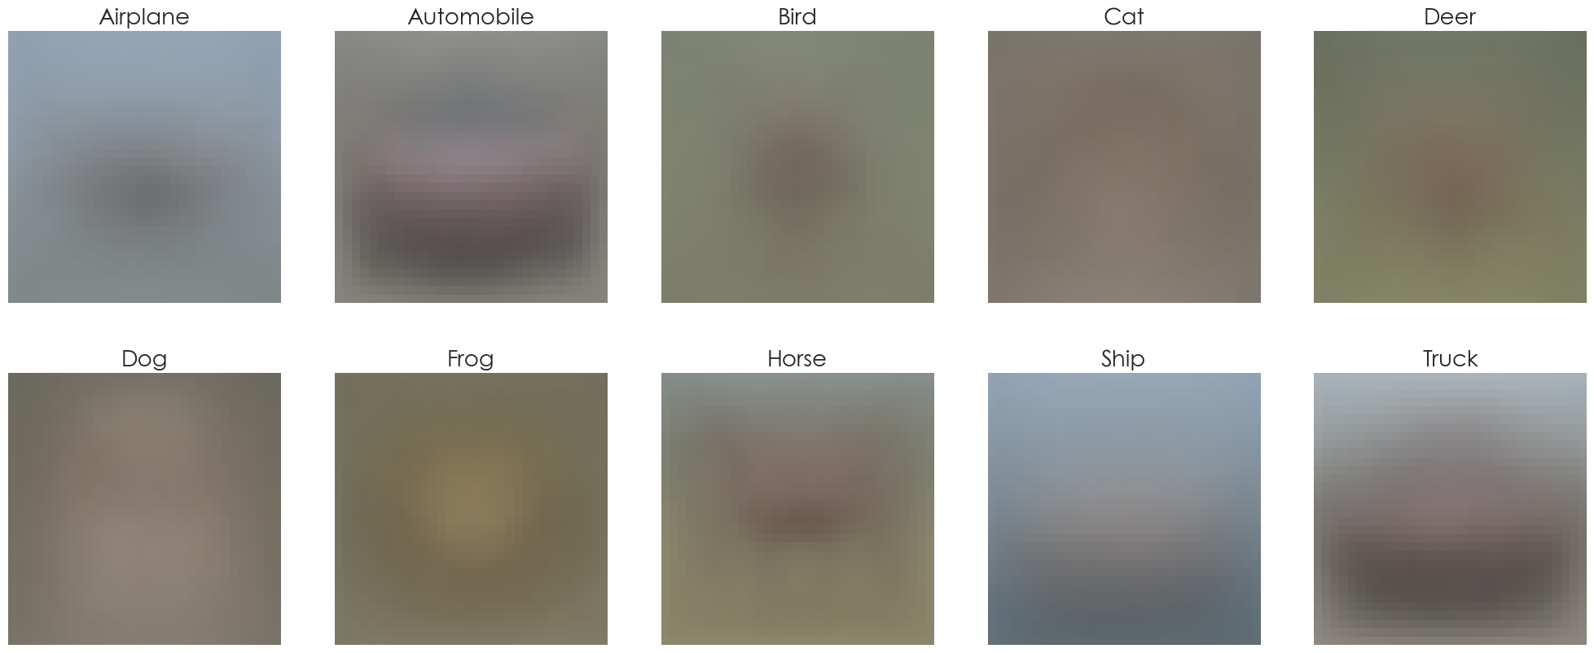
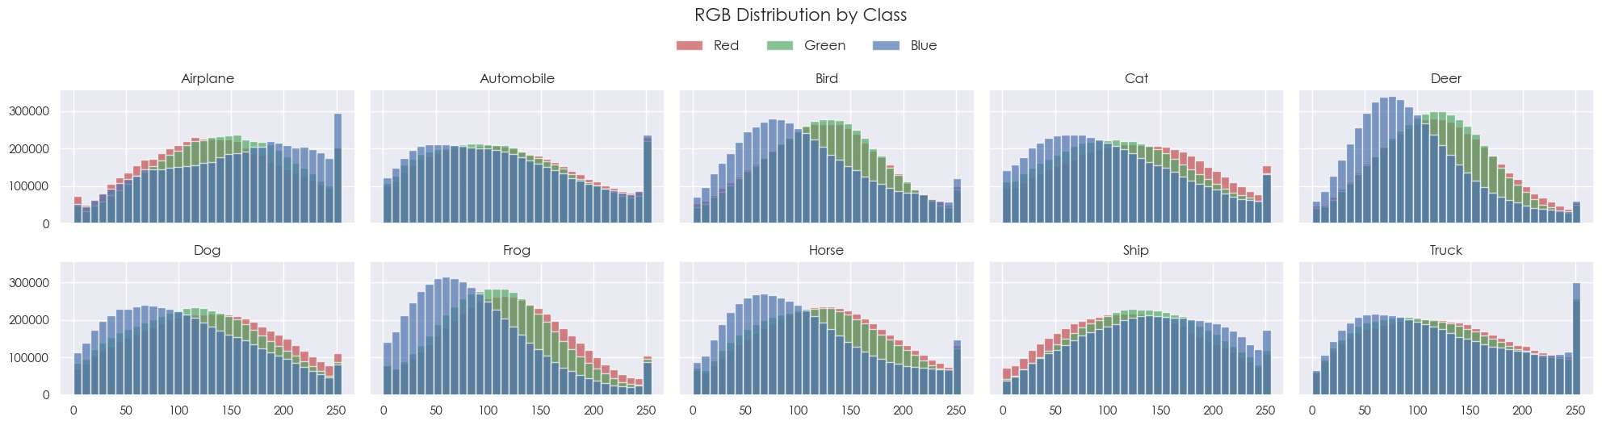
Data Exploration

Slide 6
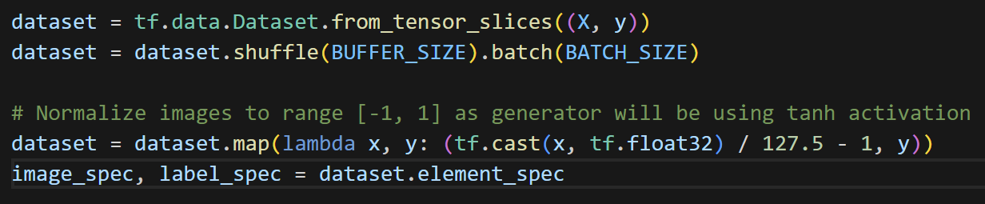
Feature Engineering
Convert images to a TensorFlow dataset for easier model training.
Normalizing pixel values to be between –1 and 1 because our generator is using tanh normalization.

Slide 7

Model Building
1
2
3
4
DCGAN
cDCGAN
SNGAN
ACGAN
Best KL Divergence: 4.92
Best FID: 217
Best IS: 3.36
Best KL Divergence: 4.57
Best FID: 209
Best IS: 2.71
Best KL Divergence: 4.90
Best FID: 225
Best IS: 2.91
Best KL Divergence: 0
Best FID: 220
Best IS: 2.87
Based on the 4 models tested, Conditional Deep Convolutional GAN achieved the highest FID and lowest KL Divergence
DCGAN performed significantly better in terms of Inception Score

Slide 8
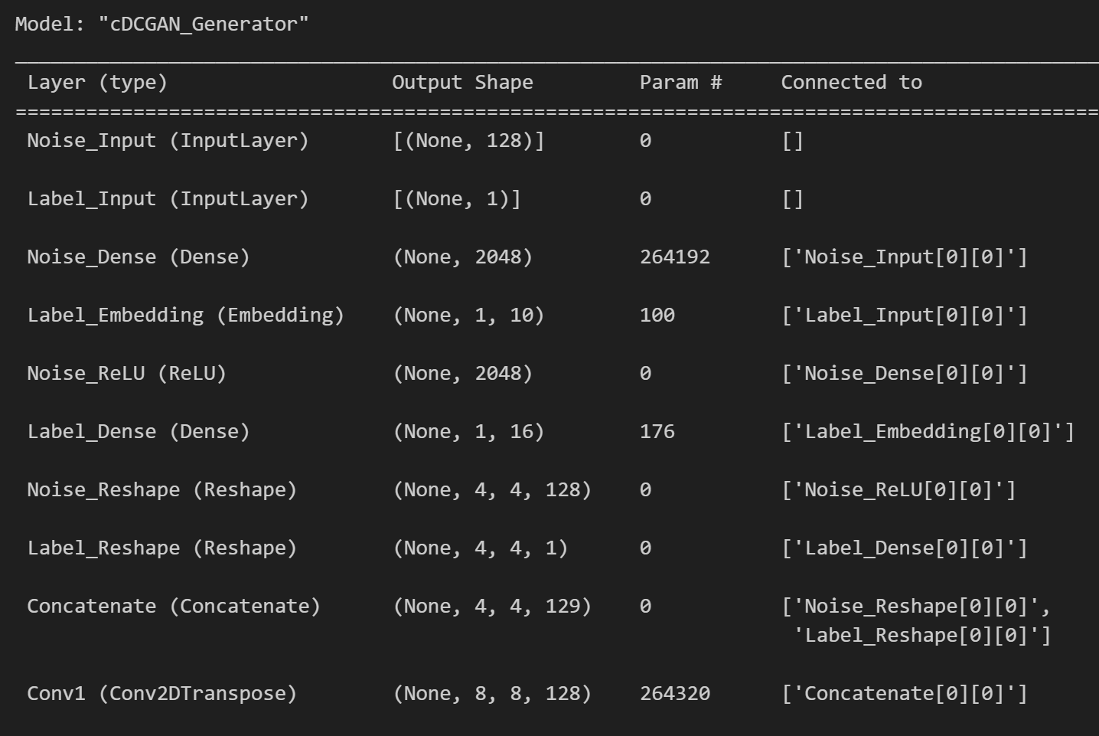
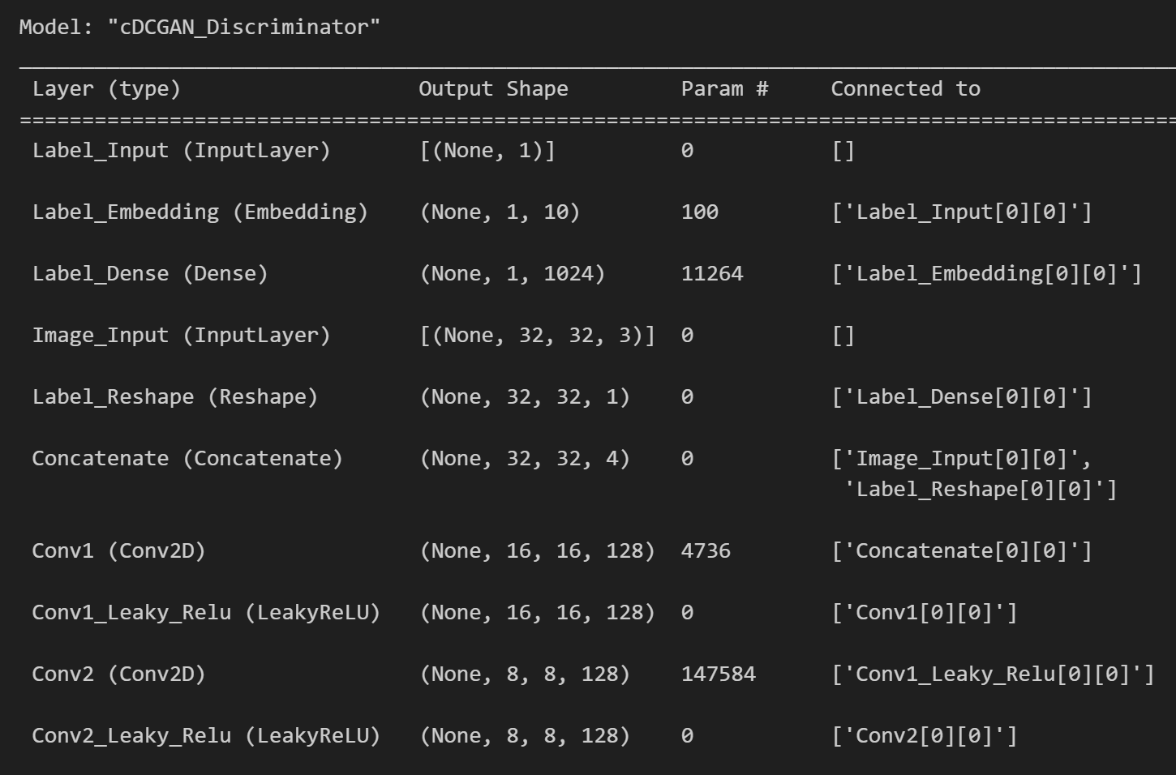
Model Building (cDCGAN)
Conditional GANs have the same architecture as DCGANs, except with an added embedding layer for class labels.
This allows us to control the output image generated.

Slide 9
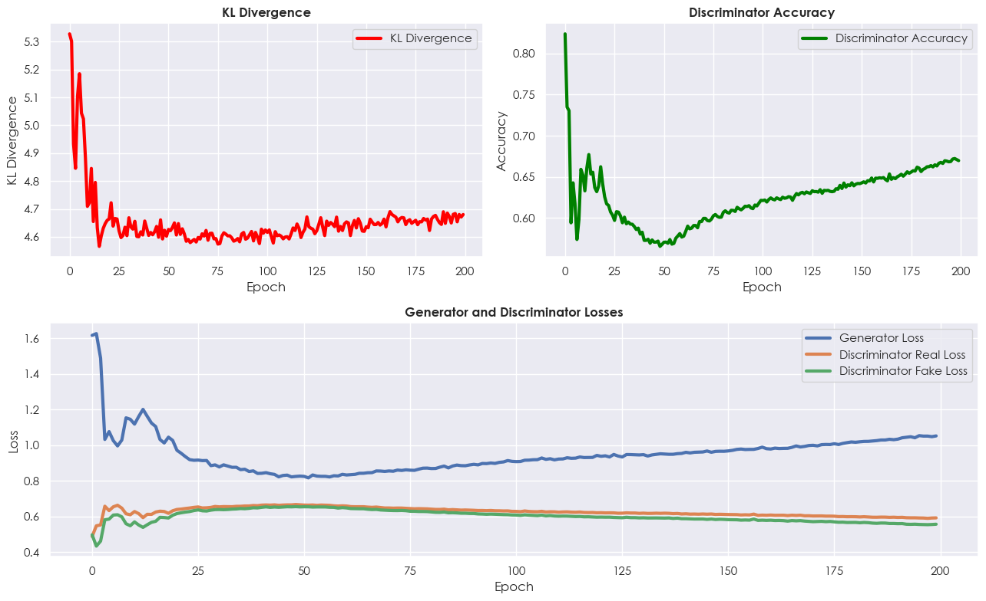
Model Training (cDCGAN)
KL Divergence starts high, sharply drops, then gradually declines, indicating model improvement.
Discriminator accuracy spikes initially, declines, then gradually improves.
Generator loss starts high, decreases but trends upwards, indicating a harder time fooling the discriminator.
Discriminator losses decrease sharply and level out, with limited improvement in fake image discrimination.

Slide 10
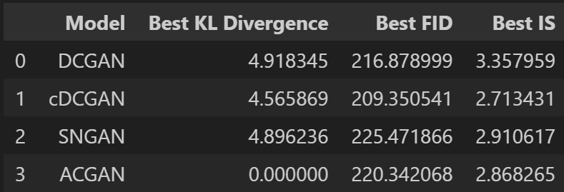
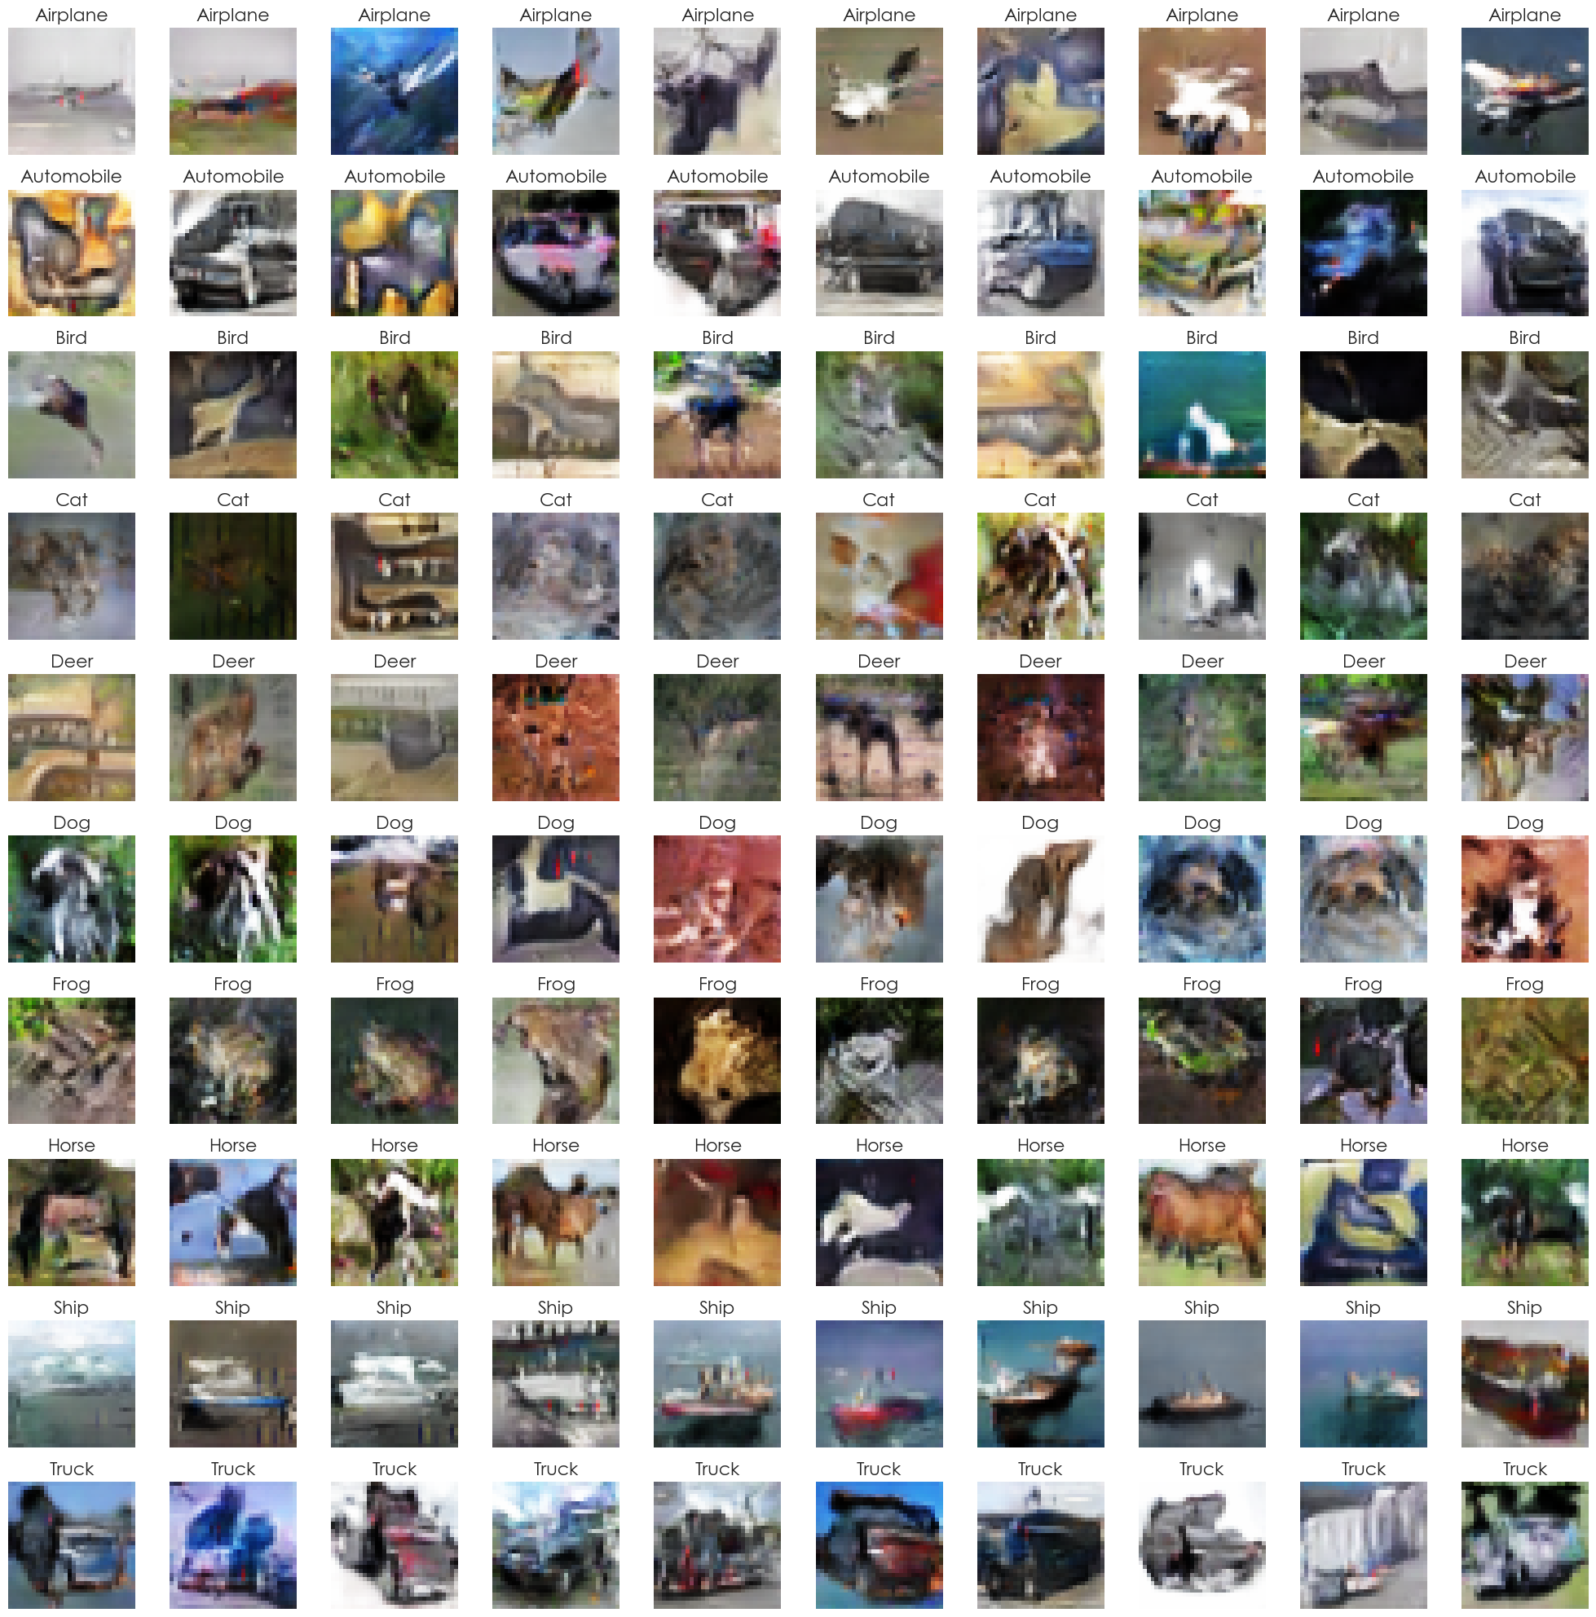
Model Evaluation (cDCGAN)
cDCGAN has the best FID
cDCGAN generated images

Slide 11

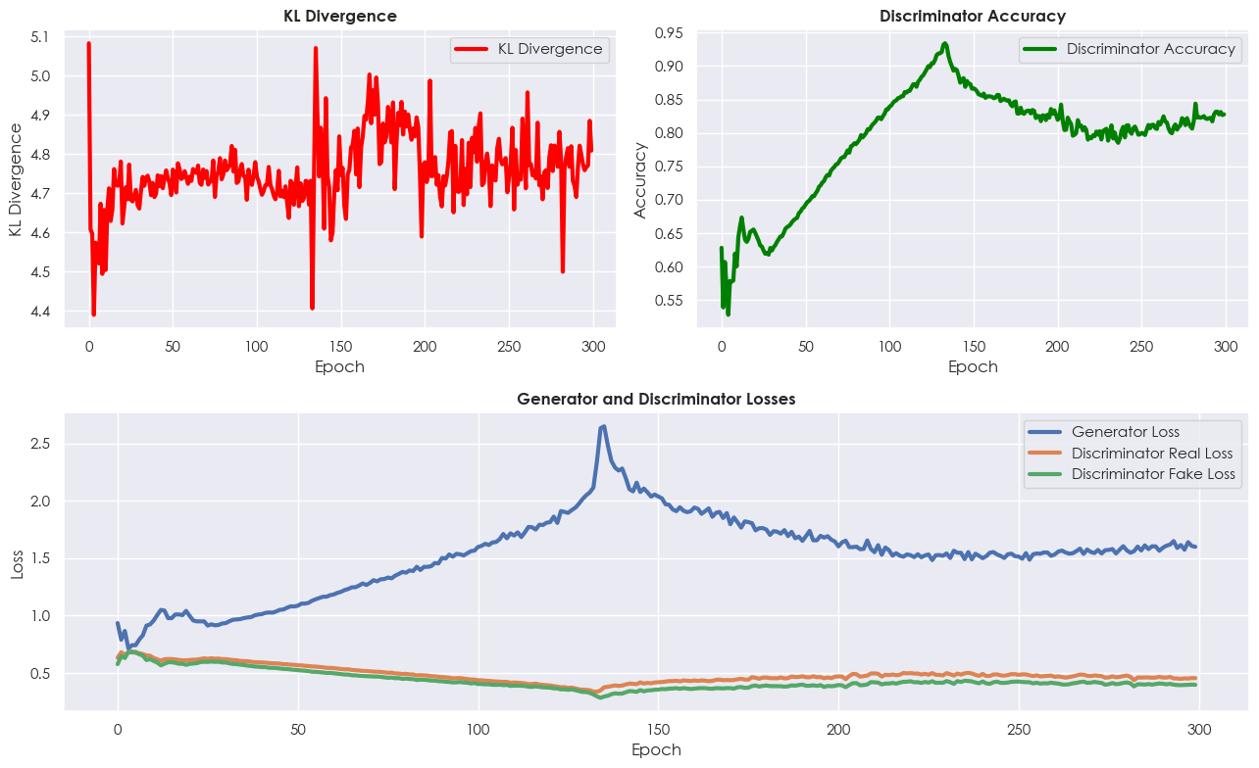
Model Improvement (cDCGAN)
cDCGAN After Improvement
cDCGAN Training Performance
cDCGAN Before Improvement

Slide 12
Thank you!

