Slide 1

CUSTOMER SEGMENTATION ANALYSIS FOR MALL CUSTOMERS
CA2 PART B – UNSUPERVISED LEARNING (CLUSTERING)
Name : Dario Prawara Teh Wei Rong
Class : DAAA / FT / 2A / 04

Slide 2
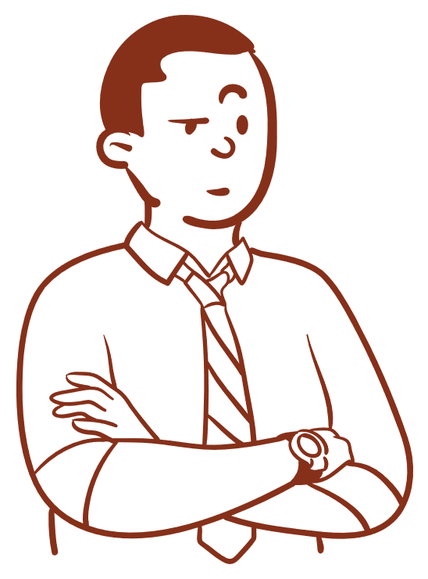
PROJECT OBJECTIVE
Objective of Clustering Analysis
Utilize unsupervised learning for customer segmentation based on age, gender, income, and spending score, identifying distinct clusters.
Describe each cluster's traits to pinpoint the most valuable customers, allowing the mall to retain them effectively.
Background Information of Analysis
You are running a shopping mall, and you are provided with data on your customers, like age, gender, income and spending score stored in Customer_Dataset.csv.

Slide 3
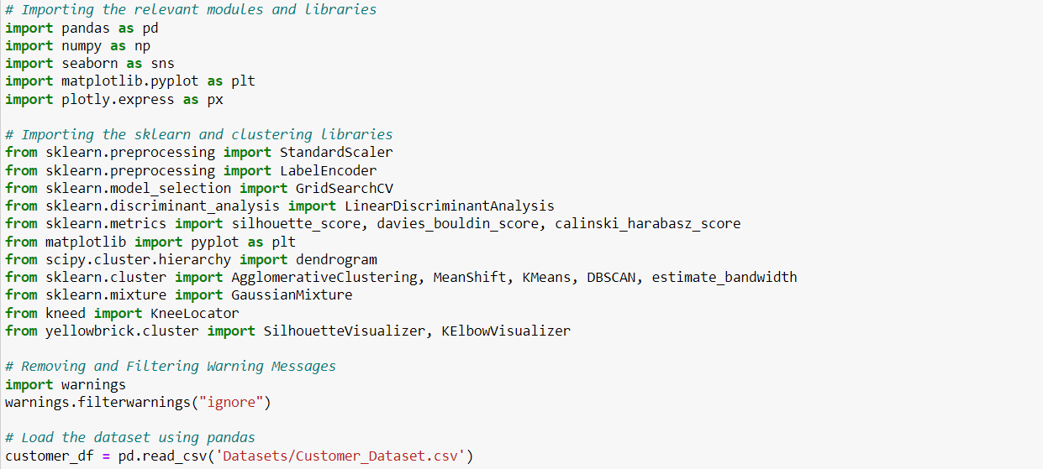
IMPORTING MODULES
Import the necessary modules for data exploration, preprocessing, and clustering models.
Import the csv customer dataset file using pandas : pd.read_csv.

Slide 4
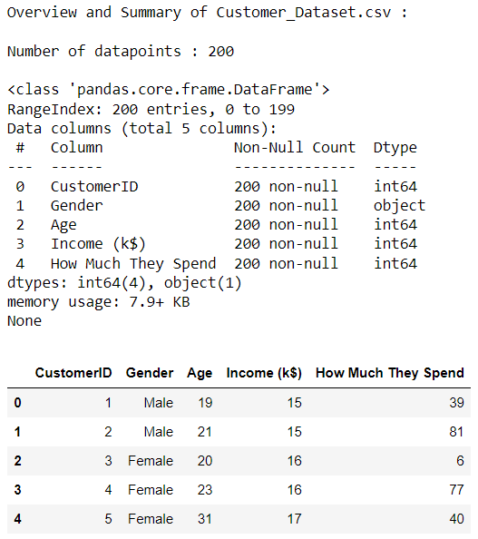
UNDERSTANDING THE DATA
To wrangle the dataset, apply the len() function to obtain the number of datapoints in the dataset : 200.
Use pandas function .info() to obtain information on the object and data structure (type, size, content) of the energy consumption dataset.
View the first 5 rows of the dataset using .head().
Based on the overview, ‘Gender’ is the only categorical column with an object datatype, hence encoding is needed to convert the column to binary variables for further analysis.

Slide 5
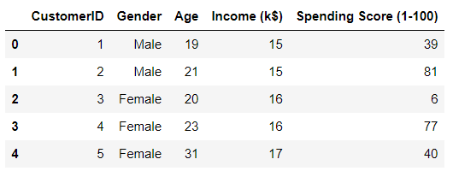
WRANGLING OF THE DATASET
To wrangle the dataset, modify the column ‘How Much They Spend’ to ‘Spending Score (1-100) using .rename() as the values in the column represent the score customers receive from the mall depending on their spending amounts.
Higher spending scores indicate that a customer has spent more on purchases made in the shopping mall.
Use .head() to view the first 5 rows of the updated dataset.

Slide 6
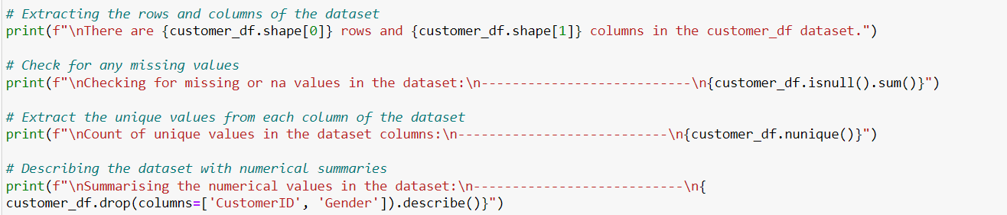
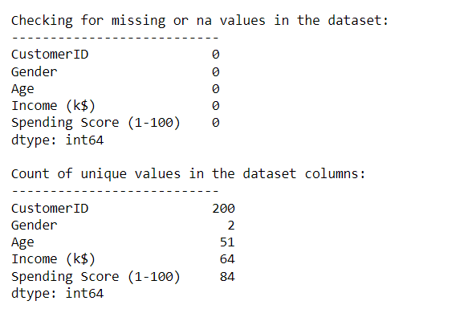
DESCRIBING THE DATA
Customer dataset contains 200 rows and 5 columns.
Check that the dataset does not contain any NULL / NA values using .isnull().sum().
Used .nunique() to retrieve the number of unique values in each data column.
Use .describe() for numerical columns and return values of descriptive statistics like count and mean.

Slide 7
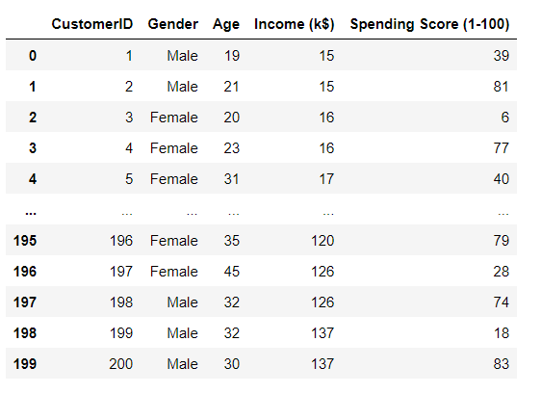
OVERVIEW OF FINAL DATASET

Slide 8
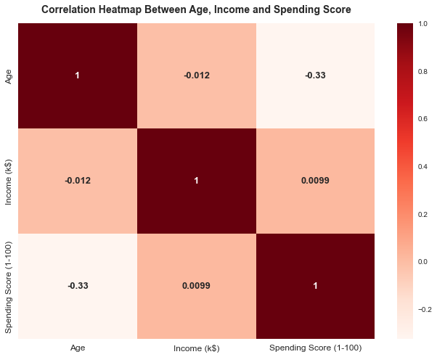
DATA EXPLORATION
Based on the heatmap, it shows that the correlation between age and income is negligible (-0.012), indicating that the customer’s age does not impact the income levels and how affluent the customer is.
Between income and spending score, the correlation is also minimal (0.0099), indicating that higher-income groups may not necessarily have higher spending expenditures, and vice-versa.
However, between age and spending score, The moderate correlation (-0.33) implies age does affect spending levels – could suggest that the younger generation spend more and incur more shopping expenses.

Slide 9
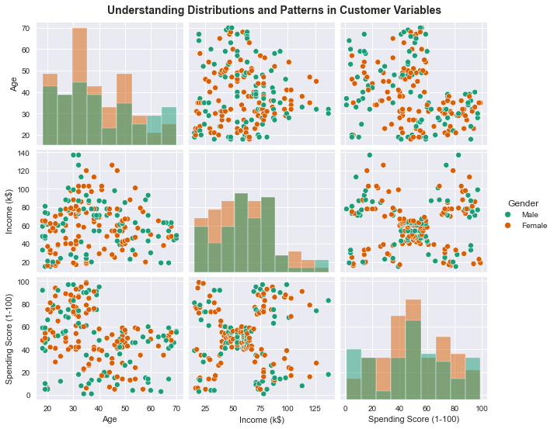
DATA EXPLORATION
From the scatterplots, it shows that :
Age & Income: Varied age groups show diverse income levels without a linear link.
Age & Spending Score: Various ages result in differing spending patterns, with no clear linear trend, underlining the complexity of purchasing patterns.
Income & Spending Score: No linear correlation while distinct clusters relate income to spending.
Histograms: Females generally have higher ages and spending score than males, mostly following normal distribution, except slightly right-skewed male income.

Slide 10
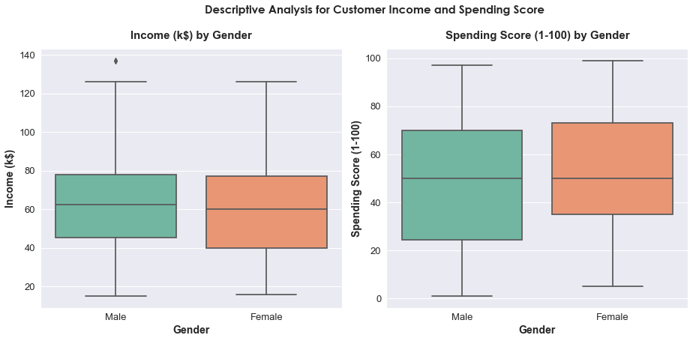
DATA EXPLORATION
Between income and gender, females exhibit slightly lower mean income with a broader distribution, while males have more consistent income levels. This suggests that females potentially have higher spending power and have more diverse financial profiles.
Between spending score and gender, the average spending score for females is roughly the same for males, yet females tend to have higher and more consistent limits for their spending scores, indicating that females could potentially spend more than males, hence have higher spending scores.

Slide 11

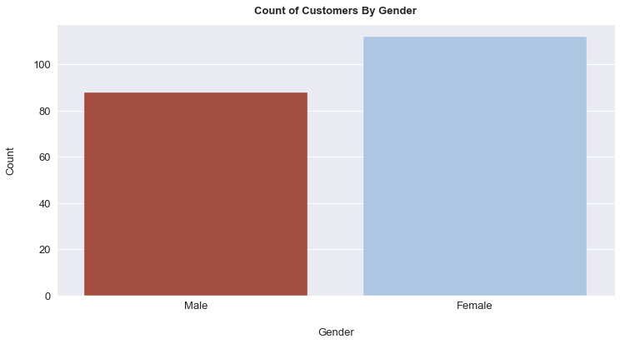
DATA EXPLORATION
Female customers slightly outnumber males (112 vs. 88), presenting balanced gender representation for inclusive marketing.
Similar male-female counts indicate potential for gender-specific promotions, and targeted advertising to engage and retain customers from both genders effectively.
Balanced gender distribution supports diversification of offerings, boosting sales and income through expanded customer base.

Slide 12
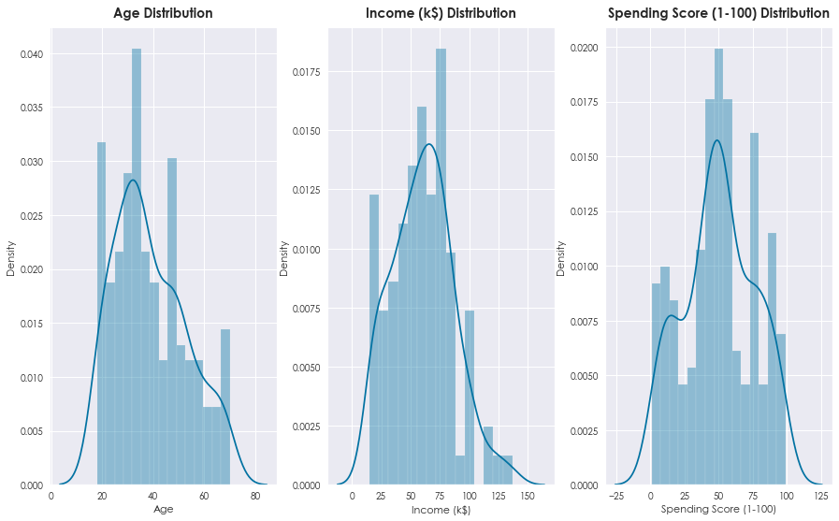
DATA EXPLORATION
Age Distribution: Most customers are aged 20s to 40s, peaking in the late 30s to early 40s, suggesting a young to middle-aged clientele. The older customer segment decreases beyond mid-40s, guiding targeted marketing approaches.
Income Distribution: Customer incomes are evenly spread, with a peak around $60,000. The mall appeals to diverse income groups, from middle to higher income, enabling a variety of product offerings.
Spending Score Distribution: Spending scores vary widely, with clusters at moderate 40-60/100, higher (up to 100/100), and lower levels (<20/100). This shows that the mall caters to budget-conscious and high-spending customers.

Slide 13
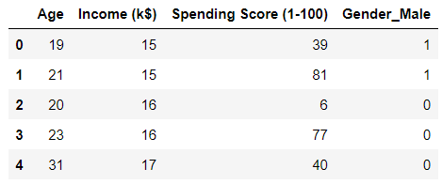
FEATURE ENGINEERING
From the final dataset, drop ‘Customer ID’ as it is unused and unnecessary for clustering of the mall customers.
Create a dummy variable for the categorical variable ‘Gender’ using .get_dummies() to ensure numerical representation for the model to process.
Binary values (0 and 1) are created for the ‘Gender’ column, such that 1 = ‘Male’ and 0 = ‘Female’ .

Slide 14
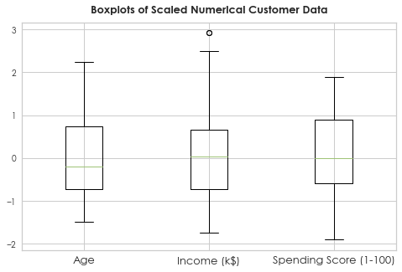
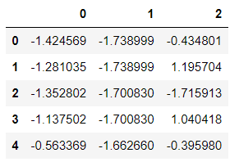
FEATURE ENGINEERING
Apply StandardScaler() to the numerical columns in the dataset using .fit_transform().
StandardScaler() standardizes the features, bringing them to a common scale with a mean of 0 and a standard deviation of 1, mitigating any potential bias that could arise from variations in the original scale of features.
From the boxplots, it shows a singular outlier value for the scaled values for ‘Income (k$)’, but it is ignored as it is insignificant as all the values are optimally scaled to similar magnitude.

Slide 15
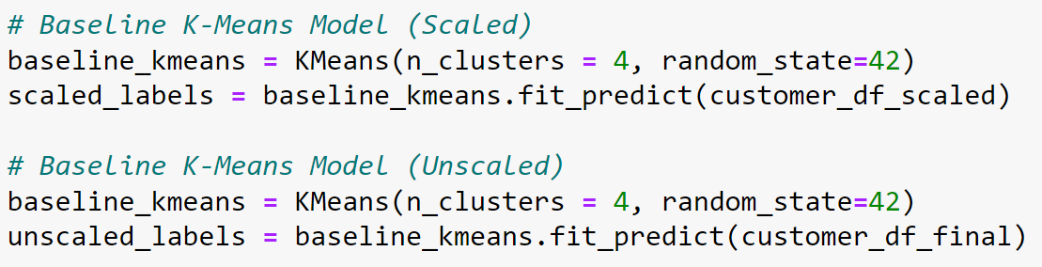
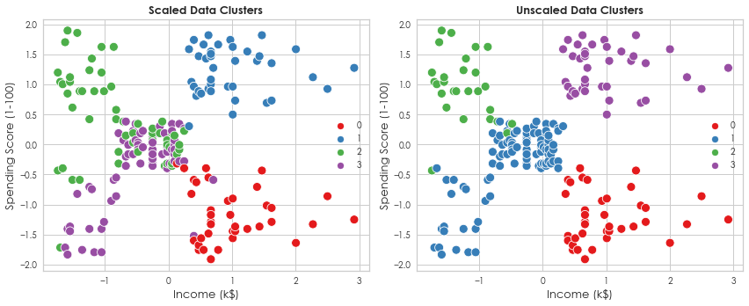
SCALED VS. UNSCALED DATA
Compare the quality of clusters and scores obtained with scaled and unscaled data to determine if scaling is necessary. Use a baseline K-Means Model with n_clusters set to 4.
By comparing the clusters with and without scaling, we notice that none of the clusters overlap for unscaled data, hence there is no ambiguity.

Slide 16
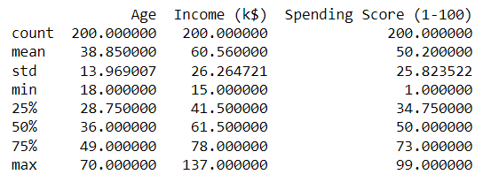
SCALED VS. UNSCALED DATA
Obtain silhouette scores for scaled and unscaled data to determine the type of data that returns a higher silhouette score → more well-defined clusters
The results show that unscaled data provides a higher silhouette score of 0.405 (0.5 increase), supporting the fact that unscaled data allows for higher scores to be obtained.
Descriptive Statistics: The age, income, and spending score exhibit limited variations and all have similar magnitudes and scales, hence the analysis would not be biased / unfair.
So, we will NOT scale the data.

Slide 17
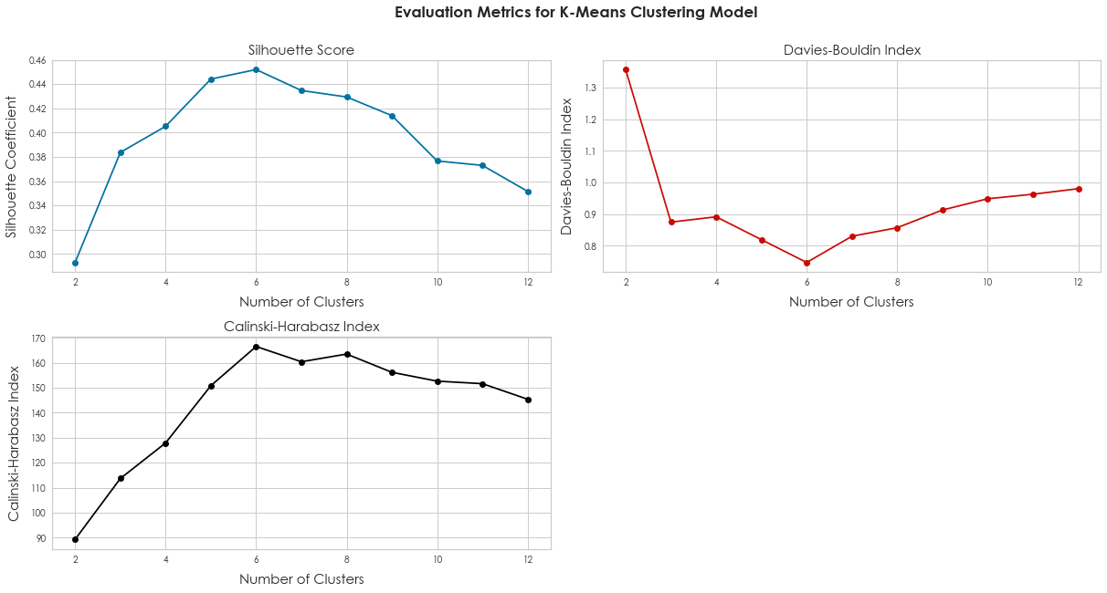
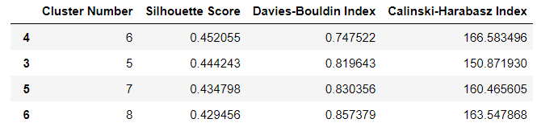
MODEL SELECTION
For K-Means, initialize n_clusters = k and .fit_predict() the model on the dataframe.
Based on the silhouette score, Davies-Bouldin Index and Calinski-Harabasz Index, n_clusters = 6 provides the best scores, with n_clusters = 5 not too far behind in terms of scoring.
K-MEANS CLUSTERING

Slide 18
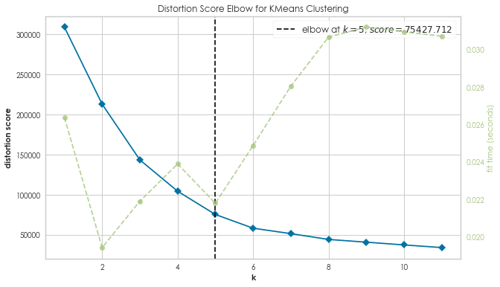
MODEL SELECTION
Fit the dataset to K-Means Model which is then fitted to KElbowVisualizer, which will plot the elbow plot.
K-MEANS CLUSTERING
However, based on the elbow plot, it suggests that the optimal n_clusters = 5 instead of 6.
This disparity in the optimal number of clusters will be further analysed should K-Means be chosen for further analysis and tuning.

Slide 19
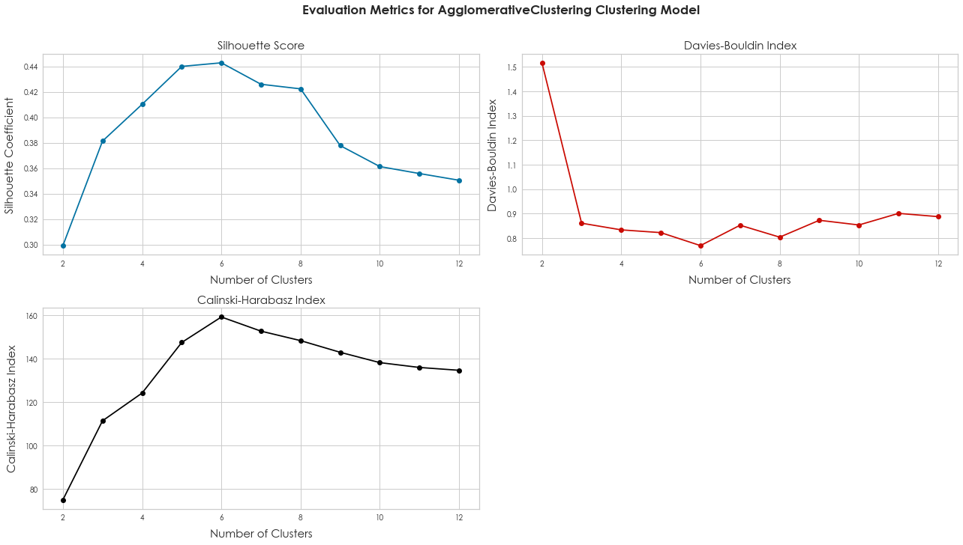
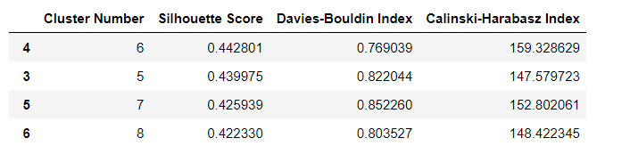
MODEL SELECTION
For Agglomerative Clustering, initialize n_clusters = k and set affinity = ‘euclidean’, linkage = ‘ward’.
Based on the silhouette score, Davies-Bouldin Index and Calinski-Harabasz Index, n_clusters = 6 provides the best scores, with n_clusters = 5 not too far behind in terms of scoring.
AGGLOMERATIVECLUSTERING CLUSTERING

Slide 20
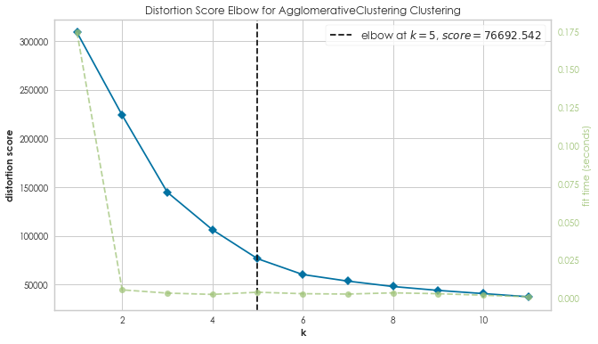
MODEL SELECTION
Fit the dataset to AgglomerativeClustering Model which is then fitted to KElbowVisualizer, which will plot the elbow plot.
AGGLOMERATIVECLUSTERING CLUSTERING
However, based on the elbow plot, it suggests that the optimal n_clusters = 5 instead of 6.
This disparity in the optimal number of clusters will be further analysed in the dendrogram plot for hierarchical clustering.

Slide 21
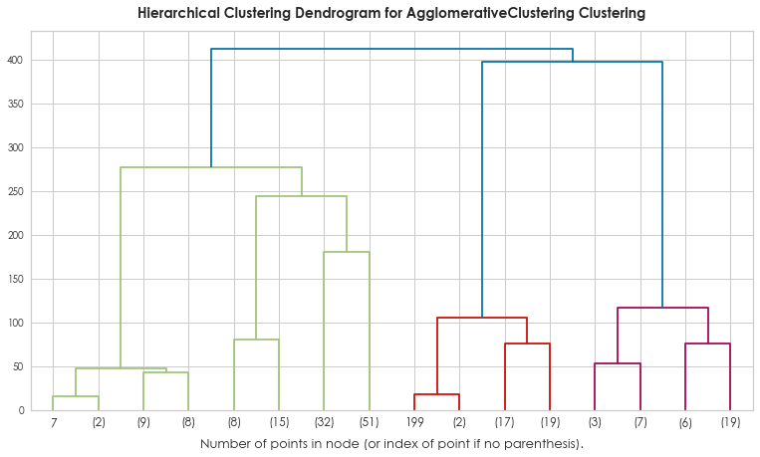
MODEL SELECTION
AGGLOMERATIVECLUSTERING CLUSTERING
Based on the dendrogram plotted, the reasonable number of clusters would be n_clusters = 6 as seen from the vertical lines.
From the plot, the vertical lines with the maximum distance is the blue line. So, we decide k =6 to cut the dendrogram.
Hence, since both silhouette score and dendrogram suggest k = 6 as the optimal number of clusters, this model will follow n_clusters = 6 instead of 5.

Slide 22
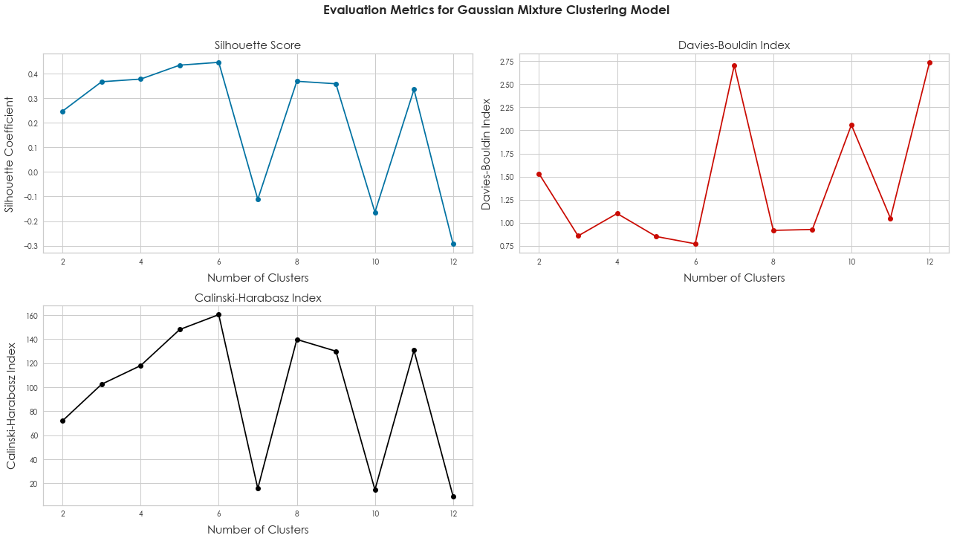
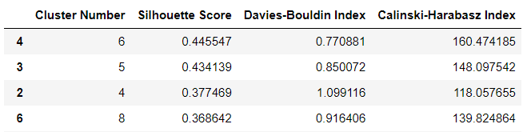
For Gaussian Mixture Clustering, initialize n_components = k, referring to the number of Gaussian distributions used to model the underlying data distribution.
Based on the silhouette score, Davies-Bouldin Index and Calinski-Harabasz Index, n_clusters = 6 provides the best scores for this model.
MODEL SELECTION
GAUSSIAN MIXTURE CLUSTERING

Slide 23
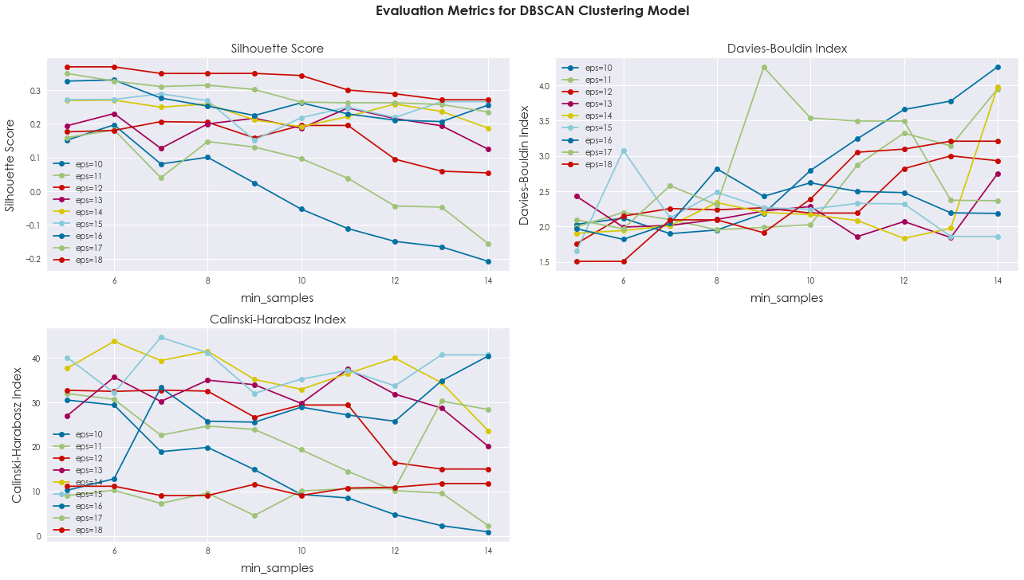
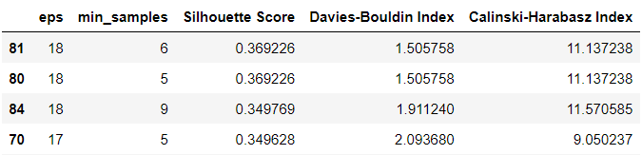
MODEL SELECTION
Initialize eps (radius for determining density around a data point) and min_samples (minimum number of points within eps radius).
DBSCAN CLUSTERING
Based on the silhouette score, Davies-Bouldin Index and Calinski-Harabasz Index, with the values tested, eps = 18 and min_samples = 6 provides the best silhouette score of 0.369.
Hence, these values will be used to plot the clusters.

Slide 24
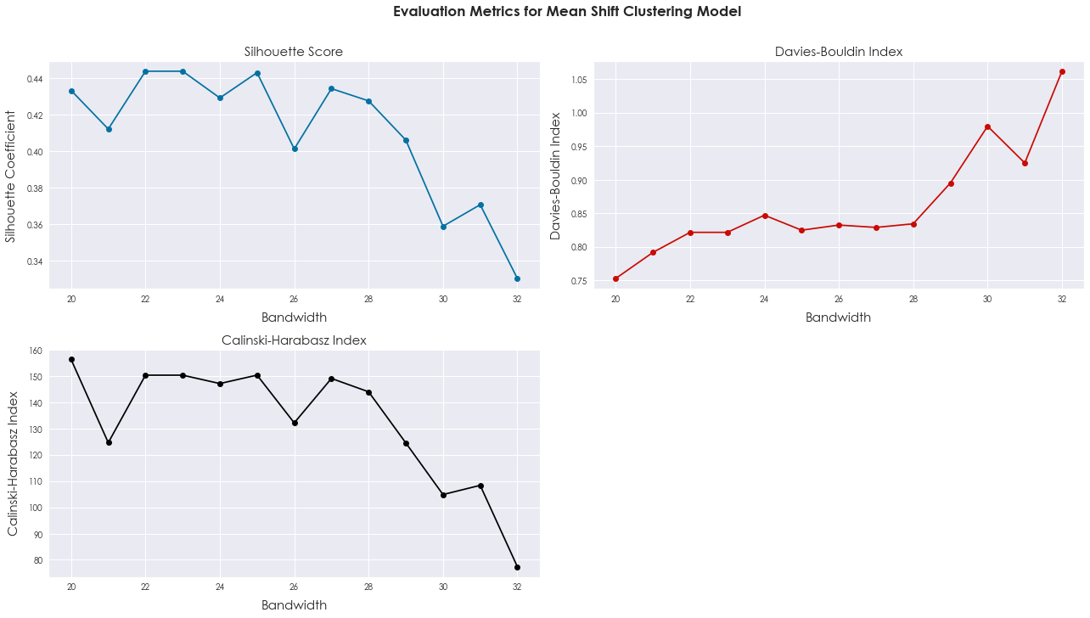
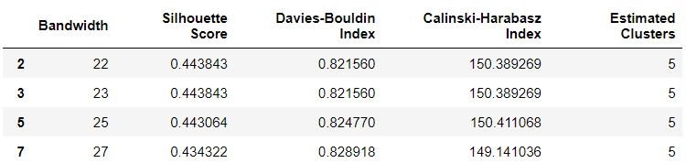
Bandwidth in clustering influences the granularity of clusters. Small bandwidth creates detailed, closely-packed clusters, while a larger bandwidth leads to fewer, larger clusters and could cause cluster merging. Hence, a trade-off is needed to prevent any cluster overlapping.
MODEL SELECTION
MEAN-SHIFT CLUSTERING
Based on the silhouette score, Davies-Bouldin Index and Calinski-Harabasz Index, bandwidth = 22 provides the best silhouette score, leading to n_clusters = 5 for this model.

Slide 25
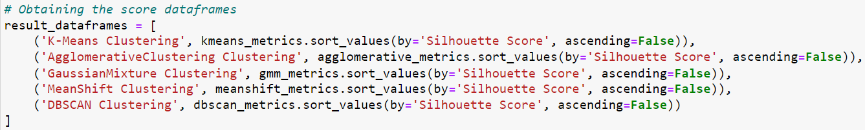
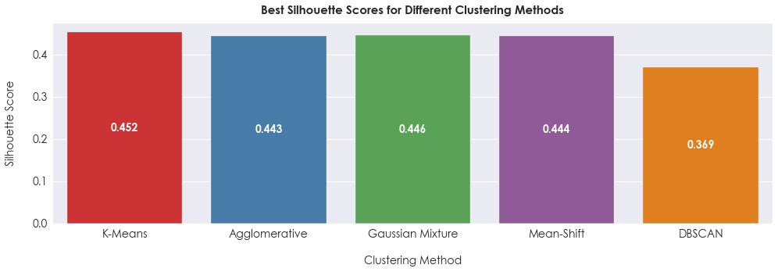
EVALUATING MODEL PERFORMANCE
To identify the model that provides the best silhouette score, use the metric data frames of different models and retrieve only the best silhouette score from each model.
From the scores, the best choice seems to be K-Means Clustering, providing a silhouette score of 0.452.

Slide 26
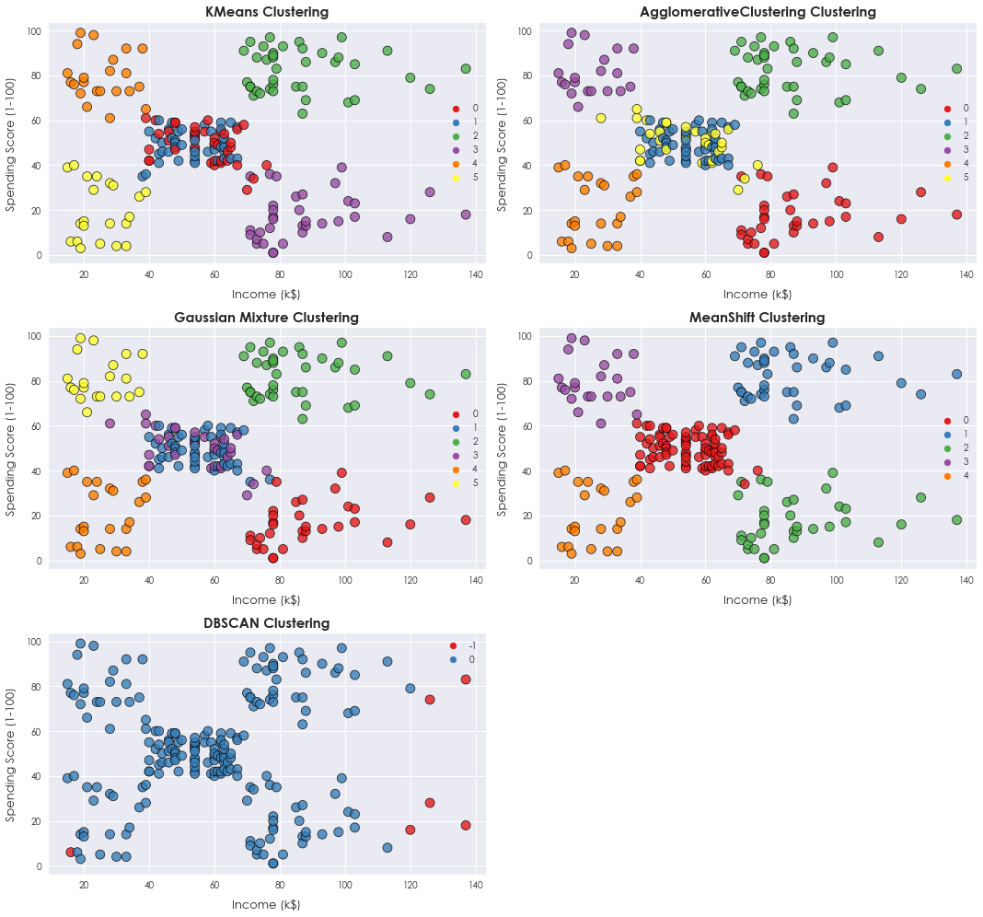
EVALUATING MODEL PERFORMANCE
K-Means : Overlap for Clusters 1 and 5 with 6 clusters, hence might potentially choose 5 clusters instead (2nd choice).
AgglomerativeClustering : Similar overlap issue between Clusters 1 and 5 in 6-cluster plot.
Gaussian Mixture : Overlap between Clusters 1 and 4 in 6-cluster plot, indicating lack of distinctiveness.
Mean-Shift : Well-defined clusters with no overlap for 5 clusters, but lower silhouette score than K-Means. (Refer to next segment)
DBSCAN: Poorly defined clusters, lacking clear pattern despite moderate silhouette scores.

Slide 27
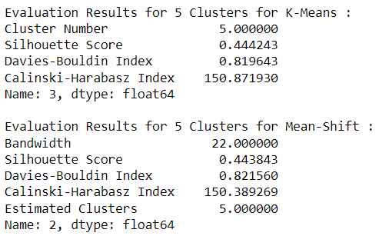
K-MEANS VS. MEAN-SHIFT MODEL
To determine which model performs better on the same number of clusters, we will compare their silhouette score, Davies-Bouldin Index and Calinski-Harabasz Index.
From the evaluation metrics, we see that K-Means Clustering Model performed slightly better than Mean-Shift Clustering on 5 clusters.
K-Means had a higher silhouette score of 0.444243, higher than Mean-Shift by 0.0004. While it may seem insignificant, it still proves that K-Means is able to form slightly more distinct clusters at k = 5.

Slide 28
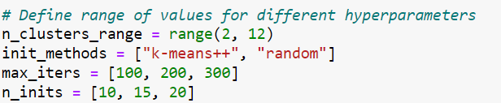
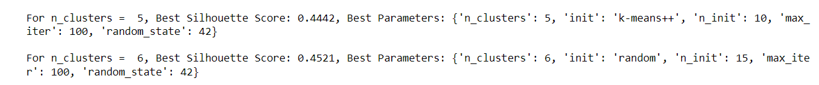
HYPERPARAMETER MODEL TUNING
Tune the K-Means Clustering Model with the following hyperparameters :
n_clusters : Defines a range of potential cluster numbers for K-Means Clustering
init : Determines how the initial cluster centroids are chosen in K-Means
max_iter : Specifies the maximum iterations K-Means performs to achieve convergence
n_init : Controls how many times K-Means is executed with different intializations
Retrieve the top 2 best results (5 Clusters and 6 Clusters) :

Slide 29
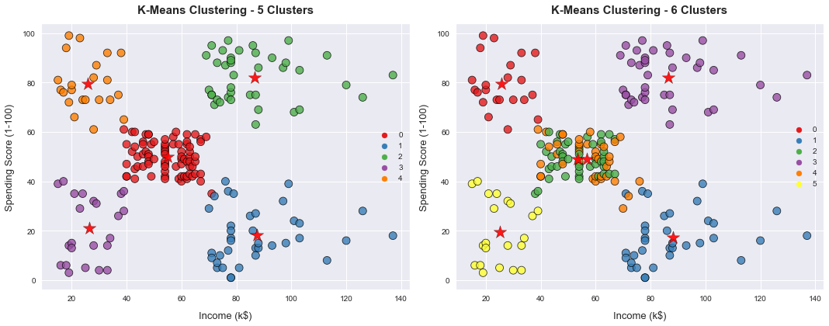
SELECTING BETWEEN 5 OR 6 CLUSTERS
Selecting 5 clusters yields distinct, separate groups on scatterplots without overlap. Cluster centers are evenly distributed, ensuring meaningful segmentation for effective customer grouping in mall customer segmentation. So, opting for 5 clusters is the optimal choice for this analysis.

Slide 30
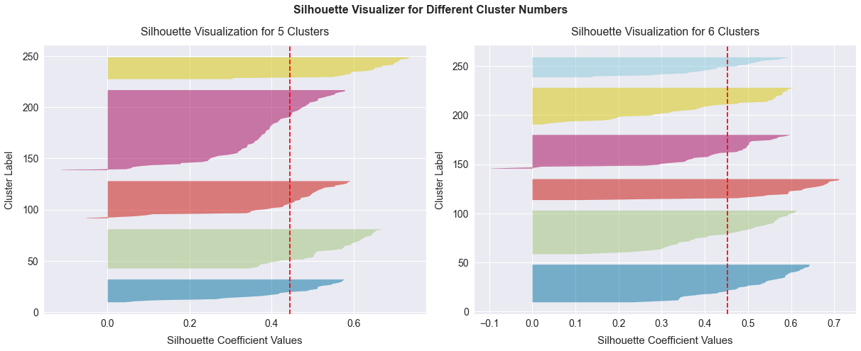
SELECTING BETWEEN 5 OR 6 CLUSTERS
The Silhouette Visualizers indicate that opting for 5 clusters, instead of 6, could be more significant. This choice captures a natural occurrence in malls where one cluster is slightly larger, likely representing a denser customer group. This configuration also allows for the emergence of distinct customer subgroups, with one standing out as more distinct.

Slide 31
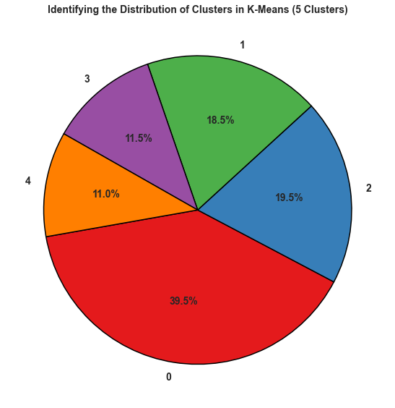
K-MEANS CLUSTER EVALUATIONS
From the distribution of clusters :
Distinct clusters reflect diverse customer behaviors, aiding targeted marketing.
Cluster 0 dominates with 39.5%, indicating that majority of the mall’s customers belong to cluster 0. Meanwhile, Clusters 1 and 2 are similar at 18.5% and 19.5%, hinting at shared traits. Clusters 3 and 4, smaller at 11.5% and 11%, likely represent specific customer subgroups.
Tailoring services based on clusters can also optimize layouts, events, and decisions, elevating satisfaction and customer engagement.
Additional analysis will uncover more unique characteristics and patterns.

Slide 32
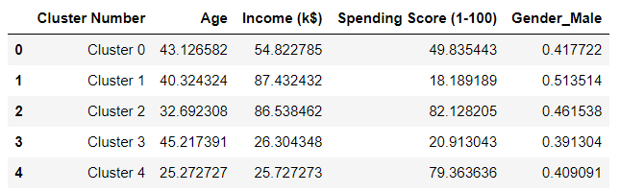
K-MEANS CLUSTER EVALUATIONS
Cluster 0 - Average Age : 43, Income : $54,823, Spending Score : 49. Male : 41.77%.
Balanced spenders, middle-aged males, potential for promotions.
Cluster 1 - Average Age : 40, Income : $87,432, Spending Score : 18. Male : 51.35%.
Higher income, conservative spending, middle-aged, needs marketing encouragement.
Cluster 2 – Average Age : 32, Income : $86,538, Spending Score : 82. Male : 46.15%.
Young, affluent, high spenders, potential for spending on luxury brands and events.
Cluster 3 – Average Age : 45, Income : $26,304, Spending Score : 20. Male: 39.13%.
Mature, lower spending, value-focused. Tailored campaigns to suit this group of customers.
Cluster 4 - Average Age: 25, Income: $25,727, Spending Score : 79. Male: 40.91%.
Young, high-spending, fashion-focused. Youth brands, vibrant experiences.

Slide 33
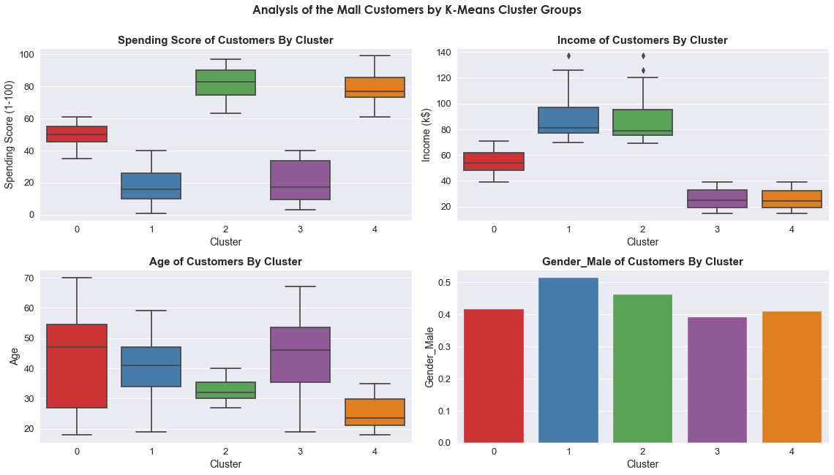
PROFILING OF MALL CUSTOMERS

Slide 34
PROFILING OF MALL CUSTOMERS
Cluster 0 : Frugal Diverse Shoppers
Heterogeneous income levels with modest differences, reflecting budget-conscious spending habits. Wide age distribution and balanced gender spread.
Cluster 1 : Mid-Life Savvy Spenders
Moderate income, spending balanced with moderate behavior, particularly budget-savvy. Targeted age group of around 35-48, skewed toward conservative male customers.
Cluster 2 : Affluent Shopping Enthusiasts
Affluent, high-income customers with high notable spending due to higher spending scores, focusing on shopping investments. Narrower age range in the 30s, with females leading in spending with more expenditure allowances.
Cluster 3 : Budget-Conscious Variates
Lower incomes, cautious spenders, age range varies across groups, and gender-neutral distribution.
Cluster 4 : Youthful & Frequent Shoppers
Lower incomes like Cluster 3, but relatively higher spending. Younger age group (20-30) with higher female spending dominance, explaining the high spending habit patterns.

Slide 35
WHICH CLUSTER IS THE MOST
VALUABLE TO THE MALL ?
CLUSTER 2 : AFFLUENT SHOPPING ENTHUSIASTS
AVERAGE AGE : 32, INCOME : $86,538, SPENDING SCORE : 82/100, GENDER : FEMALE
Cluster 2 emerges as the shopping mall's most valuable customer segment, encompassing young, high-income individuals characterized by their premium spending tendencies. With an average age range primarily in the 30s, this cluster represents a demographic with both purchasing power and a penchant for quality offerings.
Their significant disposable income and enthusiasm for spending position them as a prime target for revenue generation. Moreover, the cluster's skewed gender distribution towards females underscores their propensity for engaging in shopping activities, further amplifying their allure.
By strategically tailoring marketing campaigns and services to resonate with the preferences and aspirations of Cluster 2, the shopping mall can harness their robust spending behaviors and drive sales. Capitalizing on the unique attributes of this segment, the mall is poised to not only enhance its profitability but also establish a lasting and mutually beneficial relationship with these valuable patrons.

Slide 36
CONCLUSIONS GAINED
Best Clustering Model :
K-Means Clustering Algorithm
Best Value of K :
5
Most Valuable Group Of Customers :
Cluster 2 – Affluent Shopping Enthusiasts
Characteristics of Cluster 2 Customers :
Average Age : 32
Income : $86,538
Spending Score : 82 / 100
Gender : Female

