Slide 1

NEXT-WORD PREDICTOR USING RNN
DEEP LEARNING CA1 PART B : RECURRENT NEURAL NETWORK
Name : Dario Prawara Teh Wei Rong
Class : DAAA / FT / 2B / 04

Slide 2

OBJECTIVE OF ANALYSIS
Implement and build a next-word predictor, given a sequence of words using an RNN model or collection of models.
The input of the model can be a sequence of words of any length.
The output of the model should be a word that follows the sequence of input words.
The model should also be capable of producing different sequences of output texts, given the same input.

Slide 3
BACKGROUND INFORMATION
WHY RNN FOR TEXT GENERATION?
CHALLENGES IN RNN
RECENT ADVANCEMENTS IN RNN FOR TEXT GENERATION
RNNs have a sequential nature and stores the memory of past information via its looped architecture.
Difficulty learning long-range dependencies within a sequence.
Due to vanishing gradient problem, where gradients become too small for effective learning through long sequences.
To address vanishing gradient issues, LSTM and GRUs were developed.
These architectures introduce gates that regulate the flow of information, allowing the network to learn dependencies over longer sequences.

Slide 4

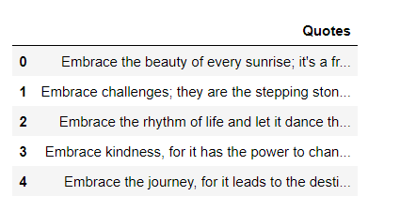
OVERVIEW OF DATASET
Based on the dataset,
There are 1000 quotes.
Based on the first 5 quotes, we can make an assumption that the quotes could be `inspirational` themed.

Slide 5
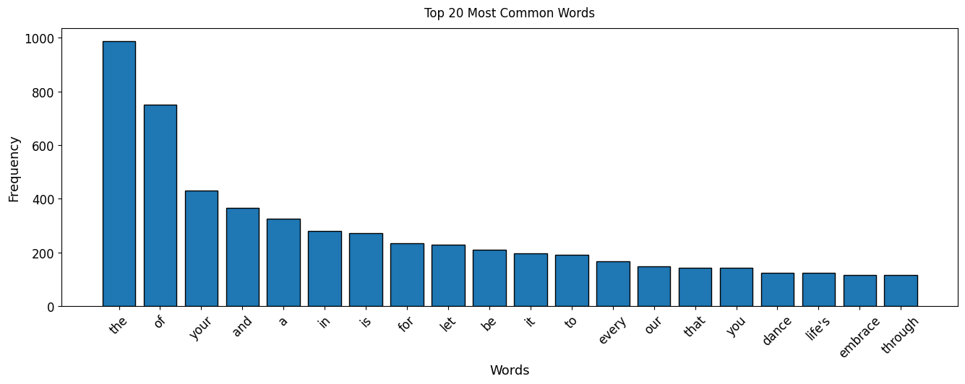
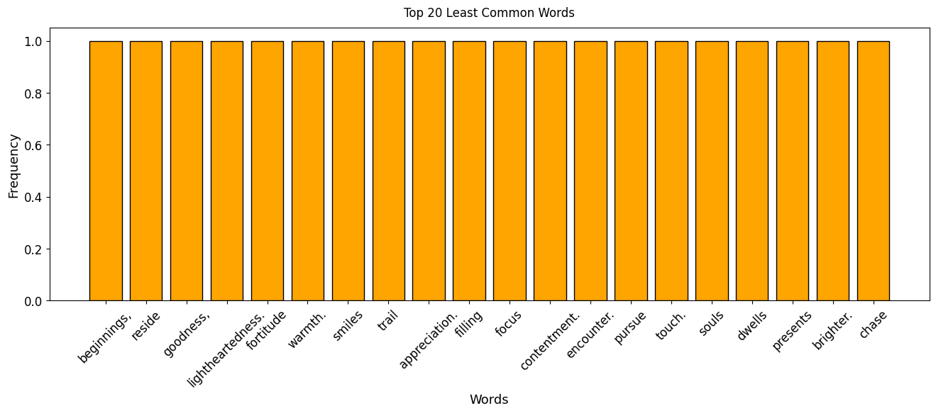
EXPLORATORY DATA ANALYSIS
These 2 charts visualizes the 20 most and least common words in the dataset.
‘the’, ‘of’, ‘your’ seem to be most commonly occurring in the quotes with the highest frequencies of above 400.
‘beginnings.’, ‘reside’, ‘goodness’ seem to be some of the least occurring words, with a frequency value of only 1.

Slide 6
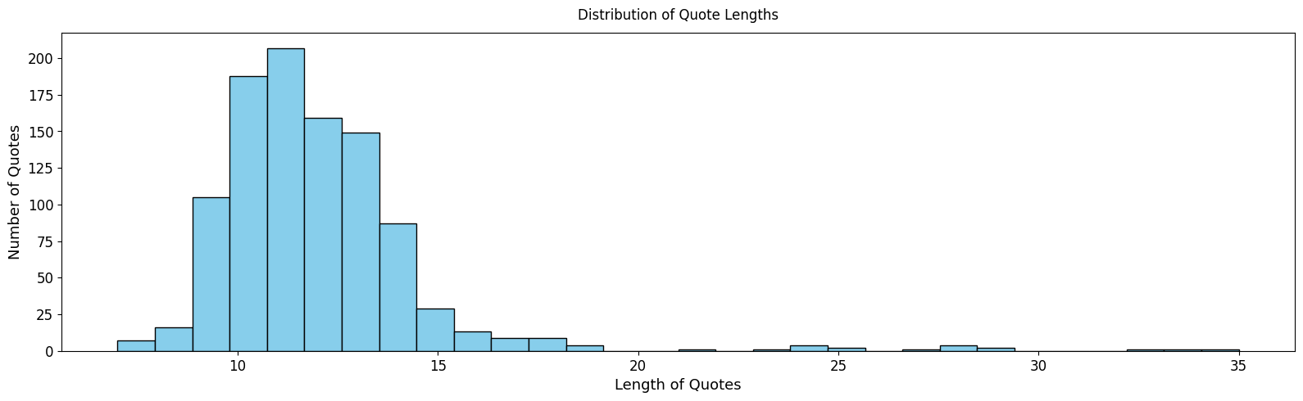
EXPLORATORY DATA ANALYSIS
The histogram shows distribution peaks of around the 10-15 word length interval, suggesting that most quotes are within that word length.
However, the frequency trails off as the length of quotes increase, indicating that the dataset contains more quotes with fewer word lengths.

Slide 7
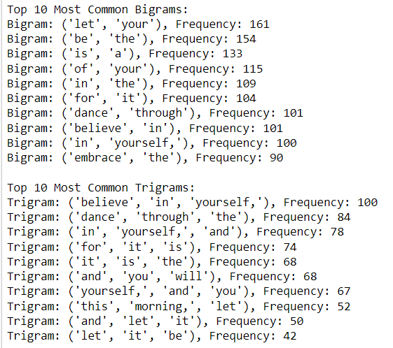
EXPLORATORY DATA ANALYSIS
For the bigrams, the pairs ('dance', 'through') and ('embrace', 'the’), suggest motivational or inspirational themes in the text.
For the trigrams, ('believe', 'in', 'yourself,’) has 100 occurrences, emphasizing a self-empowerment theme. The trigram ('dance', 'through', 'the') appears 84 times, further reinforcing the recurring theme of movement or progress.

Slide 8
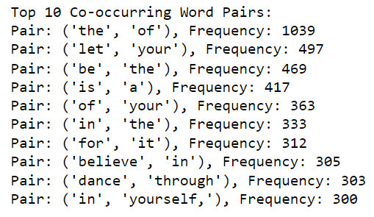
EXPLORATORY DATA ANALYSIS
The pair ('the', 'of') is the most common, occurring 1039 times.
The pair ('let', 'your') appears 497 times, which, along with other pairs like ('be', 'the'), ('is', 'a'), and ('of', 'your'), indicates a pattern of encouraging or instructive language.
Additionally, pairs like ('believe', 'in'), ('dance', 'through'), and ('in', 'yourself,') occur with significant frequency, pointing towards themes of empowerment, action, and self-confidence.

Slide 9
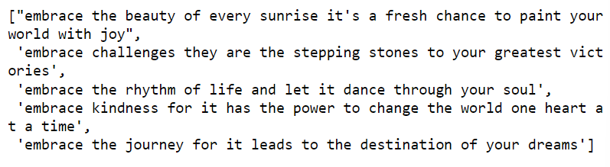

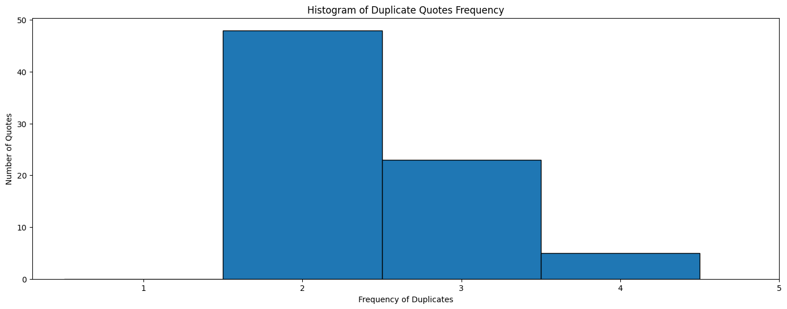
DATA PRE-PROCESSING
REMOVAL OF DUPLICATE QUOTES
CHECK AND FILTER FOR SPECIAL CHARACTERS / NUMBERS
Remove duplicate quotes from the dataset to prevent biasness where the model will predict that word more often than others.
To clean the text for tokenization, remove special characters like semicolons; periods; commas.
Keep only key characters like alphabetical letters and quotation marks.

Slide 10
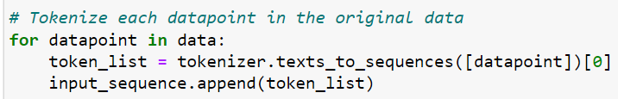
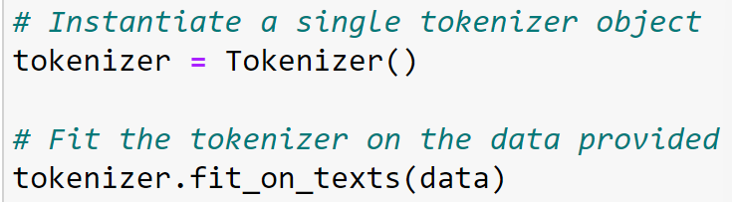
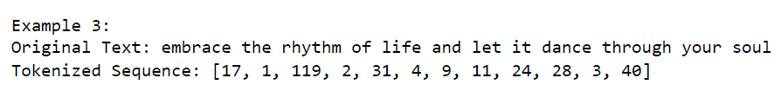

DATA PRE-PROCESSING
TOKENIZATION TO INDEX WORDS
TOKENIZE TEXT TO INTEGER SEQUENCES
Break down quote sentences into individual words using Tokenizer() to fit_on_texts().
Tokenizer starts from 1 as 0 is reserved for padding.
Using texts_to_sequences(), it assigns the texts in the sequence to an integer value to prepare it for input-output pair creation.
Example of Tokenized Text :

Slide 11
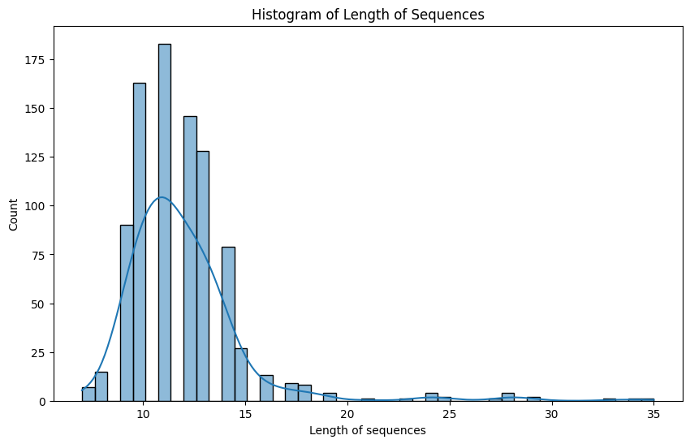
DATA PRE-PROCESSING
Based on the tokenized sequences, we see that the minimum length of sequences is 7 and maximum is 35.
Most sequences are not too long, as the mean length is around 11.9, indicating that sequence lengths are relatively short / moderate.

Slide 12
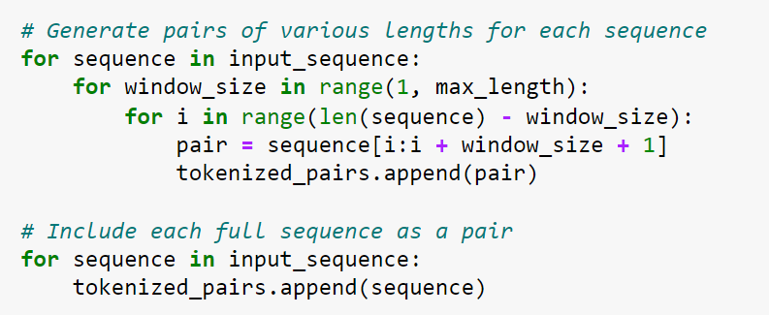
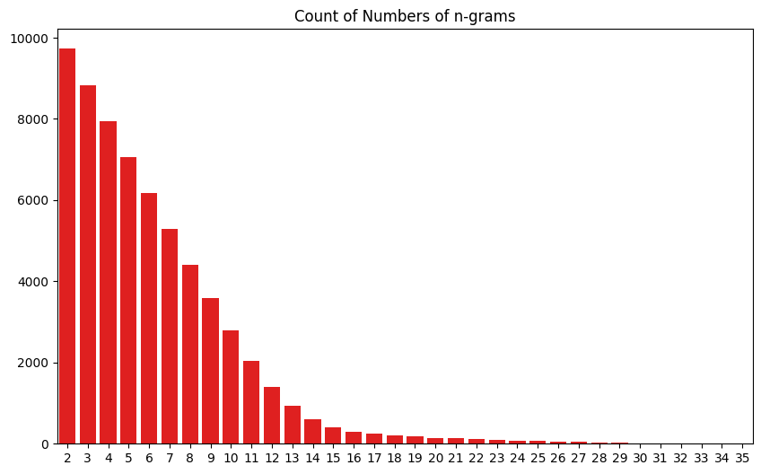
CREATING INPUT-OUTPUT PAIRS
After Input-Output Pair Generation
How input-output pairs were split :
Generate pairs where each input is a subsequence of the tokens and output is the token after.
Kept complete sequences and split them as a pair, allowing the model to learn from both subsequences and full, complete sequences.
Based on the chart, we see that number of n-grams decreases as n increases.
Since the rest of the original sequences are also included, the count of n-grams span to 35 (longest quote length).

Slide 13

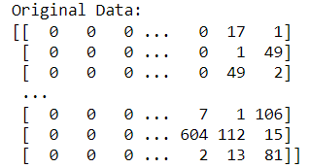
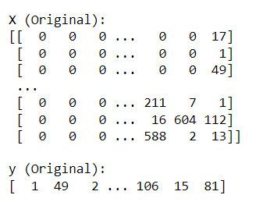
DATA PRE-PROCESSING
SEQUENCING & PADDING
SLICING AND SPLITTING INTO X AND Y
Use np.array() to pad sequences to ensure they are all the same length.
X : Input sequence (All elements except for the last)
y : Output (Contains the last token for the model)

Slide 14
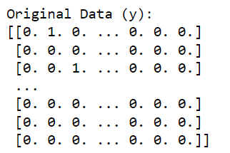
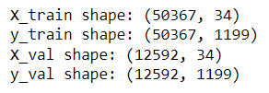
TRAIN-VALIDATION DATA SPLIT
ONE-HOT ENCODE ‘Y’ VARIABLE
TRAIN-VALIDATION SPLIT
Use to_categorical() to one-hot encode target variable ‘y’.
To ensure the training data does not overfit, split the data into 80-20 ratio to leave some data for validating the model’s performance on unseen data.

Slide 15

MODEL BUILDING & DEVELOPMENT
Optimizer : Adam – Adapts learning rate for each parameter, helping to tackle vanishing gradients or exploding gradients.
1
2
3
4
5
LONG SHORT-TERM MEMORY MODEL (LSTM)
GATED RECURRENT UNIT MODEL
SIMPLERNN
MODEL
BI-DIRECTIONAL
LSTM
BI-DIRECTIONAL
GRU
Train Loss : 1.09
Val Loss : 1.15
Train Loss : 0.85
Val Loss : 0.96
Train Loss : 0.84
Val Loss : 0.96
Train Loss : 0.84
Val Loss : 1.04
Train Loss : 0.90
Val Loss : 0.95
STACKED LSTM
Train Loss : 2.18
Val Loss : 1.79
STACKED GRU
Train Loss : 1.20
Val Loss : 1.02
STACKED
BRNN-LSTM
Train Loss : 0.96
Val Loss : 1.13
STACKED
BRNN-GRU
Train Loss : 0.86
Val Loss : 0.99
SIMPLIFIED LSTM
Train Loss : 0.86
Val Loss : 0.96
Experimented and tested various models, with GRU as the model with the lowest validation loss.

Slide 16
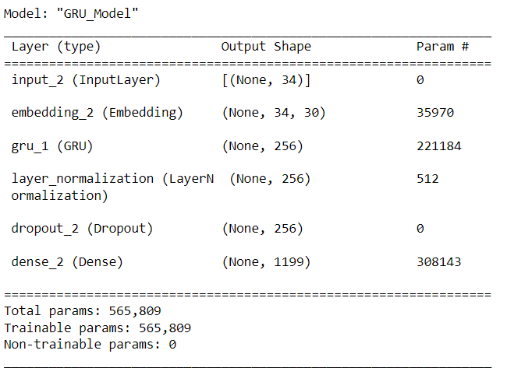
MODEL BUILDING : GRU MODEL
For our GRU model :
Embedding Layer : Converts inputs to dense vectors
GRU Layer : Processes sequences and maintains a memory for dependencies
LayerNormalization() : Stabilizes training, normalizes layer outputs.
Dropout Layer : Prevents overfitting by disabling random neurons.
Fully Connected Layers : Output Dense Layer

Slide 17
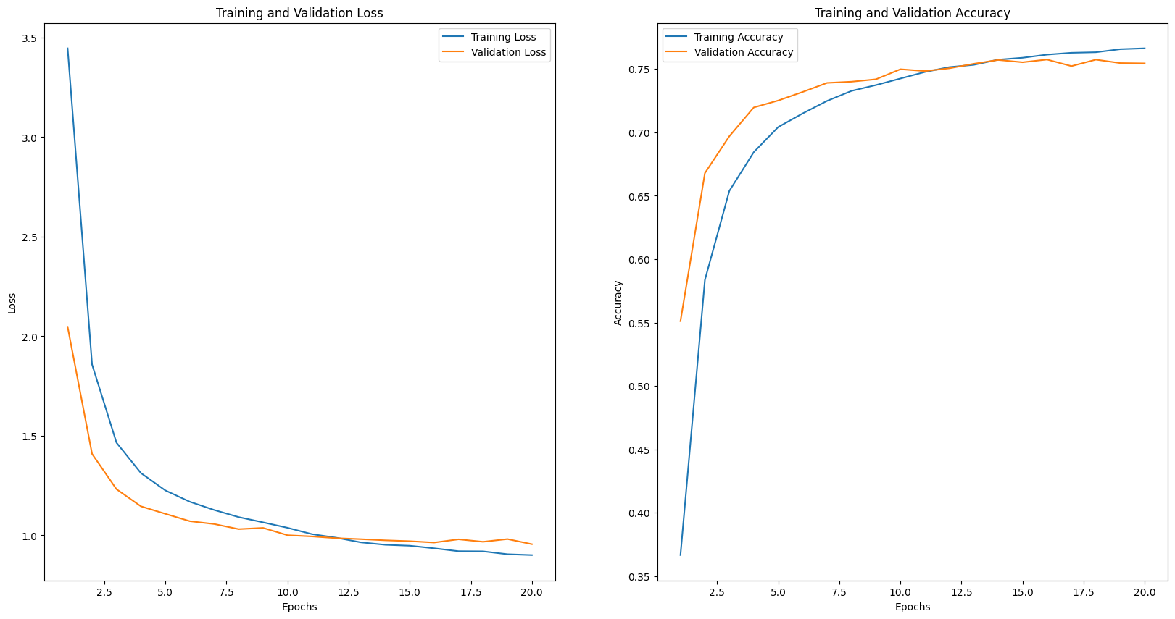
MODEL BUILDING : GRU MODEL
NO OVERFIT
Train Loss : 0.90
Validation Loss : 0.95
Train Accuracy : 0.76
Validation Accuracy : 0.75
NO OVERFIT

Slide 18
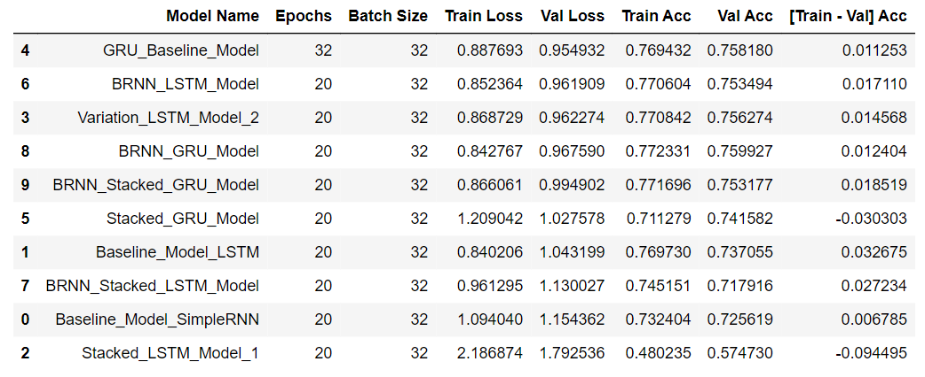
MODEL EVALUATION & SELECTION
Based on the various models tested, it is clear that the GRU Baseline Model performed the best in terms of achieving the lowest validation loss, indicating good generalization.

Slide 19
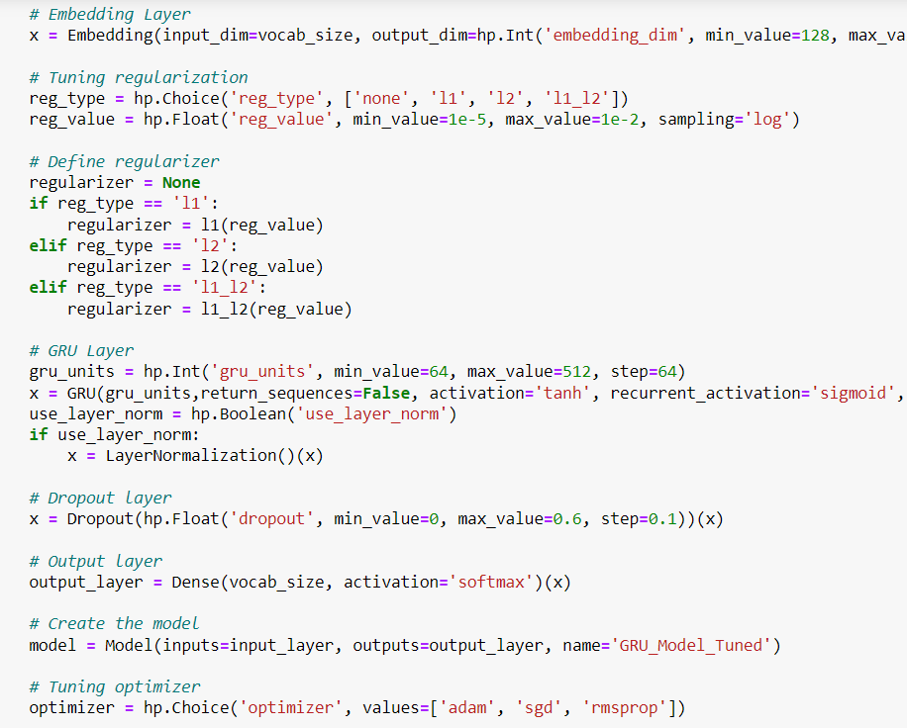
MODEL IMPROVEMENT
KERAS TUNER RANDOM SEARCH
Aside from model improvements made earlier, we further tuned the following parameters over 3 trials, such as :
Embedding Size (Output)
Regularization
Units in GRU Layer
Optimization Type
Dropout Rate
LayerNormalization()

Slide 20
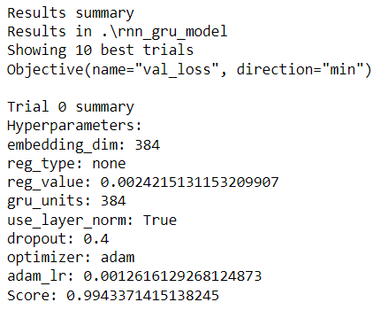
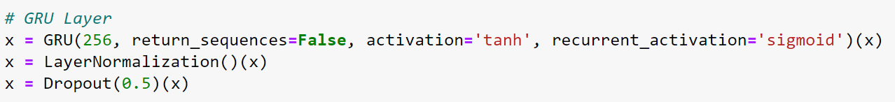
MODEL IMPROVEMENT
Based on the best trial, we see that Keras Tuner did not provide better results as compared to manual testing with various model architectures.
Loss : 0.99 (Higher than original GRU model)
Hence, still based on manual tuning done earlier, it is clear that the :
GRU 256 Units + LayerNormalization + Dropout
is the best option for model evaluation and testing.

Slide 21
MODEL EVALUATION
METRICS USED FOR EVALUATION
VALIDATION LOSS
VALIDATION PERPLEXITY
HUMAN EVALUATION
Quantifies how surprised the model is by the actual data
Assesses fluency, coherence and relevance in RNN tasks
Identifies if RNN model is learning and improving

Slide 22
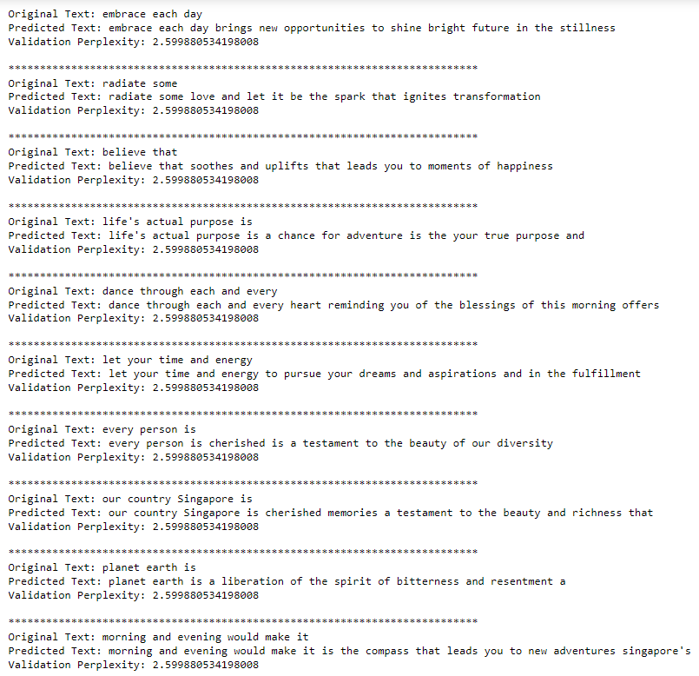
MODEL EVALUATION
Evaluating the GRU Model :
Final GRU model achieved the best validation loss of 0.95 out of all the models.
Final GRU model provided the best validation perplexity score of 2.59, indicating that the model is fairly confident of its predictions.
However, a minority of the sentences generated on the final model can still be further improved upon to generate more meaningful outputs.

Slide 23
DISPLAYING OUTPUT TEXTS
From the model, here are some of the output texts that were generated well as these texts met the 3 criteria for evaluation stated earlier.

Slide 24
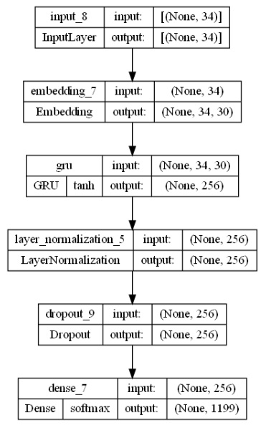
CONCLUSION OF ANALYSIS
BEST MODEL : BASELINE GATED RECURRENT UNIT MODEL
For RNN analysis, aside from calculated metrics, one must also make use of human evaluation to determine how well the model is able to generate new texts.
For model evaluation, do a `trial-and-error` with differing model architectures to determine which one is the optimal one + make use of existing tuners such as Keras Tuner.
Improvements can still be made by experimenting with more GRU layers, units and building models with attention mechanisms in the future.

Slide 25
THANK YOU!

