Slide 1
SINGAPORE’S LAND PUBLIC TRANSPORTATION ANALYSIS
Name : Dario Prawara Teh Wei Rong Class : DAAA / FT / 1B / 04
Notes:
Good morning, Mr. Lee. Today, I’ll be presenting my analysis on Singapore’s Land Public Transportation.

Slide 2

OBJECTIVE
Ms Luna is a data analyst working for the Land Transport Authority.
She was tasked with these two objectives, relating to Singapore’s Land Public Transport :
1 : To identify the most used modes of public transportation and determine the popular mode for long or short commutes.
2 : Study the fare structures and the value of concession passes for MRTs and LRTs in Singapore
Based on these objectives, she will need to produce engaging visualizations to support her analysis and make insightful conclusions to gain deeper insights into Singapore’s Land Public Transport industry.
Notes:
My objective. As a data analyst working for the Land Transport Authority, Ms Luna wanted to gain deeper insights into the most frequently utilized public transportation modes and their popularity for long or short commutes and examine fare structures and value of concession passes for trains in Singapore.

Slide 3
DATA DICTIONARY
Dataset 1 : Ridership Numbers for Public Transportation ( 88 rows x 3 cols )
Column Name | Description | Data Type
year | Year of ridership numbers (e.g. 1995) | Date
type_of_public_transport | Modes of public transport types (Taxis, Buses, MRTs, LRTs) | Object
average_ridership | Mean number of commuters travelling on respective modes of public transports. | Float
Dataset 2 : Average Trip Distances by Type of Public Transportation ( 44 rows x 3 cols )
Column Name | Description | Data Type
year | Year of trip made (e.g. 1995) | Date
mode | Modes of public transport types (Taxis, Buses, MRTs, LRTs) | Object
ave_distance_per_trip | Mean distance travelled per trip made for each type of public transportation. | Float
Notes:
I used four datasets for my analysis. Dataset 1 provides insights into ridership numbers for public transportations over time, with 88 rows and 3 columns. Dataset 2 contains data on average trip distances by type of public transportation, with 44 rows and 3 columns

Slide 4
DATA DICTIONARY
Dataset 3 : Fare Structures for MRTs and LRTs ( 390 rows x 4 cols )
Column Name | Description | Data Type
fare_type | Year of fares (e.g. 1995) | Date
applicable_time | Time frames for applicable fare rates. | Object
distance | Range of distances travelled by the MRT/LRTs to determine fare price. | Object
fare_per_ride | Fare amounts per ride made. | Integer
Dataset 4 : Concession Fares for Public Transportations ( 7 rows x 4 cols )
Column Name | Description | Data Type
cardholders | Groups of people holding concession passes. | Object
bus_price | Bus prices when monthly concession pass is used. | Float
train_price | Train prices when monthly concession pass is used. | Float
hybrid_price | Bus and train prices when monthly concession pass is used. | Float
Notes:
Dataset 3 contains data on fare structures by timing and fare types for trains, with 390 rows and 4 columns. And dataset 4 provides data on concession fares for public transportation by cardholder type, with 7 rows and 4 columns.

Slide 5
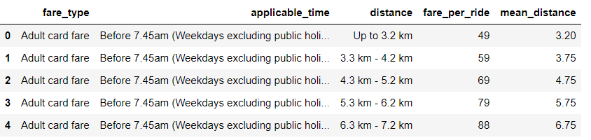
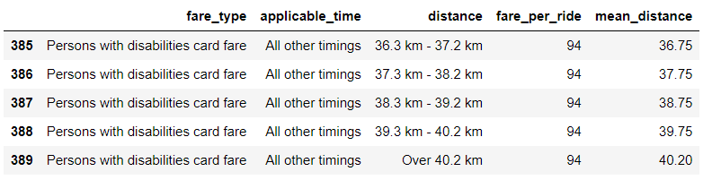
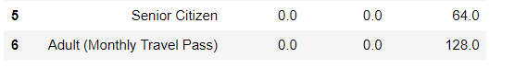
PECULARITIES IN DATA
Peculiarity # 1 : In Dataset 3
For applicable_time, there are only two unique values :
Before 7.45am (Weekdays excluding public holidays)
All other timings
"All other timings" refers to any time after 7:45 AM when commuters utilize public transportation.
Why ? → MRTs offer pre-peak hours discounts to commuters before 7.45am (Public Transport Council, 2020).
Peculiarity # 2 : In Dataset 4
Senior Citizens and Adults only own hybrid monthly concession passes (trains and buses).
For individual Bus and Train concession passes, the values are 0.0 as they are unavailable for these 2 groups of cardholders, while other groups of cardholders have access to all 3 concession passes.
Notes:
In my analysis, I observed two interesting findings. Dataset 3 showed that the 'Applicable Time' column only had two values: Before 7:45 am on weekdays excluding public holidays, and All other timings. This is because MRTs only offer pre-peak discounts before 7:45 am, per Public Transport Council. My second finding is in dataset 4, as senior citizens and adult cardholders only have hybrid monthly concession passes for trains and buses, unlike others who have access to all three.

Slide 6
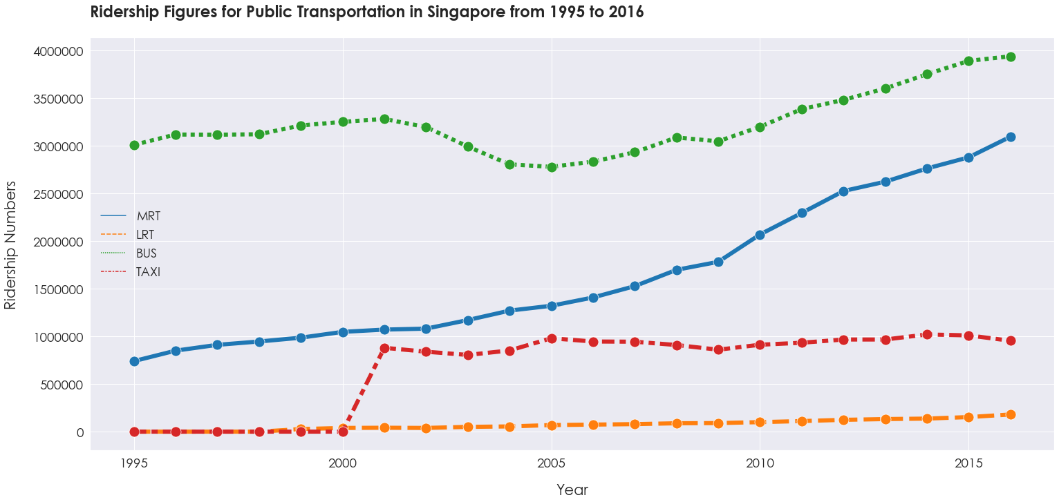
Objective 1 : Identify the preferred public transportation modes and distinguish the ones favored for long or short commutes.
From the line chart, it is clear taking a bus is the most popular form of public transport, with the highest ridership numbers, ranging from 3000000 to 3980000, while LRTs is the least popular mode.
Buses offer more versatility for both long and short commutes, making them a more convenient choice for commuters compared to LRTs, which are typically designed for short trips.
Taxis are less favored, usually due to higher fares, while MRT stations are mainly in central areas in Singapore, while bus stations usually reach extensively throughout the neighborhood.
Notes:
Now, for the first objective. I first analysed ridership figures for public transportations over time. The line chart shows that buses are the most used form of public transportation, with ridership ranging from 3 to 3.98 million per year. LRTs have the least ridership. Buses are preferred due to their flexibility for both long and short commutes, while LRTs lack prominence and accessibility, and are typically for shorter trips. Taxis are less popular due to high fares, reducing affordability for lower socio-economic groups. MRTs also have lower ridership due to their limited central district locations, compared to bus stations that serve various neighbourhoods.

Slide 7
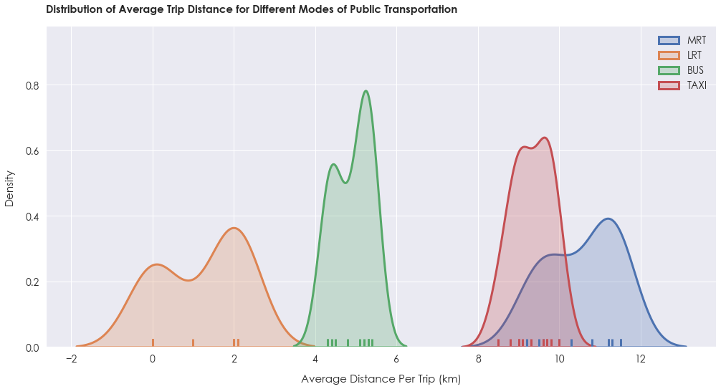
Objective 1 : Identify the preferred public transportation modes and distinguish the ones favored for long or short commutes.
The KDE-rugplot reveals that most trips taken by buses and taxis have a similar and concentrated average distance, with a high-density value. → Buses and taxis have fixed routes and schedules, leading to limited variability in their travel distances.
LRTs and MRTs have a wider spread in average distances per trip, with LRTs covering shorter distances ranging from 1-2 km, while MRTs tend to travel much longer distances of 8-12 km. → MRT stations are usually located in the major city areas, and commuters likely take MRTs travel longer distances.
Notes:
Next, I analysed the distribution of average trip distances made by the various public transportation modes. The KDE-rugplot shows that buses and taxis have similar, closely concentrated average trip distances with high density values due to their fixed routes and schedule timings, which limits variability in their travel distances. Meanwhile, LRTs and MRTs cover a wider spread in average distances per trip with LRTs covering 1-2 km while MRTs travel longer distances of 8-12 km. As MRT stations are usually located further apart in major districts, it would make it more preferable for commuters to utilize the MRT for longer distances.

Slide 8
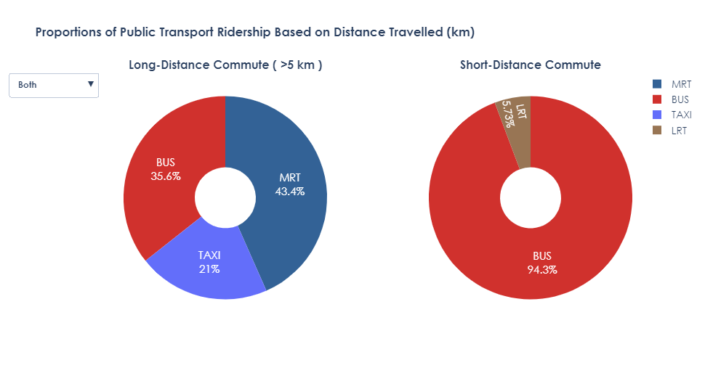
Objective 1 : Identify the preferred public transportation modes and distinguish the ones favored for long or short commutes.
The pie charts show that buses and LRTs are mostly used for short-distance trips of less than 5km, while MRTs are commonly utilized for longer journeys.
For short-distance commuting, buses account for 94.3% of the total ridership, with LRTs accounting for only 5.73%. → Buses have an extensive network of bus stops that are widely available in Singapore.
For long-distance commuting, MRTs are the preferred choice for 43.4% of the riders, while buses and taxis account for 35.6% and 21% respectively. → MRTs are typically located in major areas of Singapore, making it a popular option for long-distance travel.
Notes:
To determine the preferred mode of public transportation for either long or short commutes, the pie charts show that buses and LRTs are mostly used for short commutes of less than 5km, while MRTs and taxis were preferred for longer commutes. According to ResearchGate, short distance trips are any trips 5 kilometres or less. Buses dominate 94.3% of total riderships for short commutes, due to extensive networks of bus stops widely accessible across Singapore. For long commutes, MRTs is clearly the preferred choice, accounting for 43.4% of total riderships, followed by buses 35.6% and taxis 21%. MRTs are favoured for longer commutes due to fewer stops in between and more major station locations.

Slide 9
RECOMMENDATIONS & CONCLUSIONS
Conclusions :
Generally, buses are the preferred mode of transportation among commuters, as they are used for both short and long trips.
Compared to LRTs and MRTs, buses and taxis have more consistent average distances per trip, as their routes and schedules are fixed.
For longer trips, MRTs are usually favored by commuters as they are typically located in major areas of Singapore. For shorter trips, buses are more popular due to the vast network of bus stops that are closely located, making it more convenient.
Recommendations :
Singapore Government: Invest more capital in improving and upgrading bus infrastructure, providing more efficient facilities for commuters to encourage further growth in ridership.
SMRT: To reach a wider network of people, expand and build more MRT stations in neighborhood regions of Singapore. E.g Thomson East-Coast Line, provides MRT accessibility to the East Coast Area. This enables more areas in Singapore to gain access to convenient travel.
Notes:
So, for Ms Luna’s first objective, she concludes that buses are the most popular mode of transport for both short and long commutes. Buses and taxis have stable average trip distances due to fixed routes and schedules. MRTs are favoured for longer trips due to locations in major districts, while buses are preferred for shorter trips because of the extensive network of nearby bus stops. She recommends the Singapore Government invest more capital into upgrading bus infrastructure and facilities, encouraging further growth for bus riderships. And SMRT should expand and build more MRT stations in neighborhood regions. For example, the Thomson East-Coast Line enables MRT accessibility to the East Coast, enabling greater access to convenient travels for longer commutes.

Slide 10
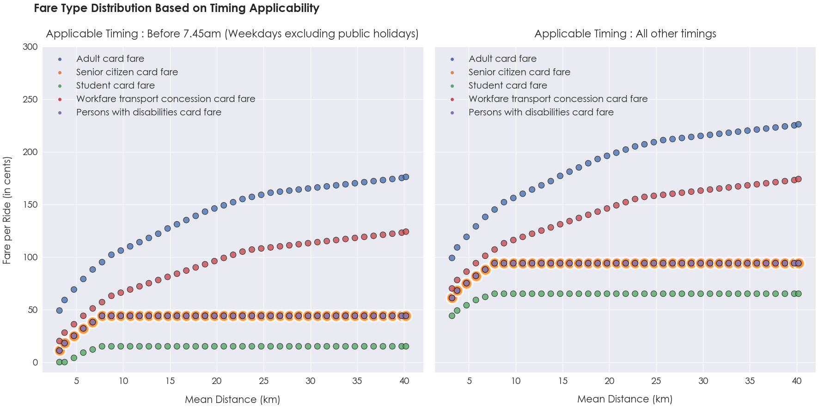
Objective 2 : Study the fare structures and the value of concession passes for MRTs and LRTs in Singapore
From the scatterplot, ‘Adult card fare’ has the highest fare rates per ride and fare value increases per km travelled. ‘Student card fare’ have the lowest fares per ride and remains generally constant after 7km travel distance.
Fares per ride tend to be higher after 7.45am → MRTs offer a pre-peak discount to commuters before 7.45am, resulting in lower fare charges.
Fare rates are equal for senior citizens and persons with disabilities → Remain affordable, reduce worry over expensive transport fees, as seen from the lower fare per km travelled.
Notes:
For the next objective, to study fare structures for MRTs and LRTs, adults have the highest fare per ride while students have the lowest and remaining fairly constant after 7km due to student fare discounts, ensuring affordability. Post-7.45am fares are higher due to pre-peak discounts of 50 cents offered by MRTs for rides before 7.45am. Senior citizens and disabled persons have significantly lower fares equal to each other to ensure affordability. These fare structures benefit commuters traveling to work in the morning and prevent peak hour congestion, providing travel ease and comfortability, as well as provide financial relief for senior citizens and disabled persons who may be less economically active.

Slide 11
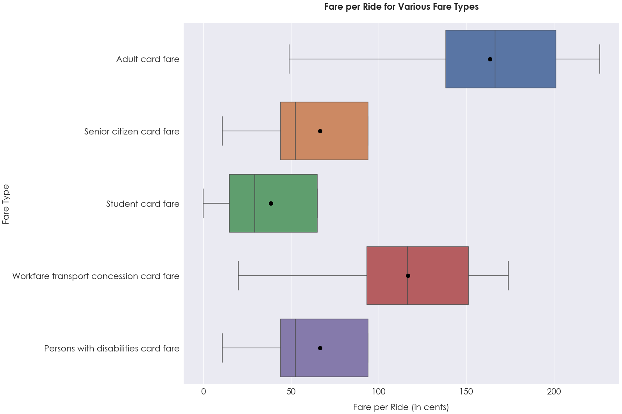
Objective 2 : Study the fare structures and the value of concession passes for MRTs and LRTs in Singapore
The Adult card fare has the largest range of fares per ride, with prices being more dispersed. Ensure fairness in pricing mechanism as adults typically have greater financial capability to afford transportation costs.
Fares for students are the most uniform and the mean fare value is the lowest among all fare types. → Student fares are generally more affordable with consistent pricings, hence MRT/LRT trips will remain cheap. → Meets the needs of students who usually rely on limited allowances.
Fares for senior citizens and persons with disabilities → similar variability, with relatively lower and consistent prices, aimed at creating affordability. → Encourage the elderly and disabled to stay active and make more trips outside their home. (Today Magazine, 2017).
Notes:
Next, I analysed the distribution of fares per ride for different fare types. From the boxplots, the adult card fare has the largest fare range per ride, reflecting financial capability, and access to more ticket options, including for greater distances and varying travel times. Student fares are the most uniform, with the lowest mean fare value, encouraging students to use rail transports to reduce road congestion and catering to their limited allowances. Senior citizen and disability fares are also kept low with similar variability as seen from the interquartile range, as according to Today Magazine, it aims to encourage these groups to keep active and make more trips outside their home.

Slide 12
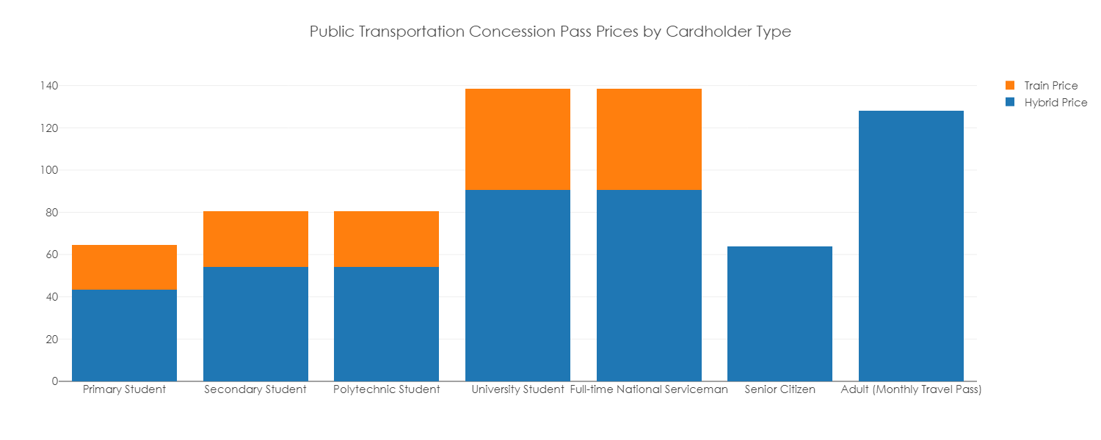
Objective 2 : Study the fare structures and the value of concession passes for MRTs and LRTs in Singapore
Typically, the cost of concession passes goes up as the age of the cardholder increases.
Concession fares for university students and NS men tend to be roughly double the cost compared to primary, secondary, and polytechnic students → younger students with limited personal income can afford the passes → easy access to public transportation.
However, for hybrid passes (bus and train), prices usually rise with age, except for senior citizens, as there is likely financial aid provided that helps offset the cost of transportation → prevents worrying over expensive transportation costs.
Notes:
Now, to study the pricing of concession passes for rail transports, the stacked bar chart shows that the prices of concession passes increases with age. Concession passes for university students and NS men are roughly twice the cost compared to primary, secondary, and polytechnic students, due to higher income brackets, with increased usage, while younger students only have limited personal income. Adults and senior citizens only receive hybrid passes for buses and trains, possibly due to age and income restrictions. But these passes offer affordability and accommodates to varying travel distances, benefitting senior citizens the most.

Slide 13
RECOMMENDATIONS & CONCLUSIONS
Conclusions :
Commuters using the ‘Adult Card Fare’ are typically charged higher fare amounts while students enjoy cheap MRT fares when travelling. Fares before 7.45 am are generally lower → pre-peak discounts offered by MRTs.
Younger students and senior citizens can obtain concession passes for much lower prices compared to other cardholders, so they can take advantage by purchasing concession passes while they are eligible for the lower prices.
Fares structure in MRTs and LRTs are generally considered fair, considering different age groups and needs, and appropriately ranging fare prices per trip to meet the needs of all commuters taking public transport.
Recommendations :
Singapore Government: Continue rolling out more financial aids and discounts applicable to Primary, Secondary, Polytechnic students and Senior Citizens to maintain affordability and accessibility of public transportation.
MRT Agencies (SMRT) : Increase the range of applicable timings for lower fare values (extend before 7.45am). Further offsets the fare pricing for MRTs and LRTs, to ensure that travel rates remain affordable for all groups of commuters riding the MRT or LRT lines, incentivizing higher ridership numbers in MRTs and LRTs.
Notes:
For Ms Luna’s second objective, she concludes that Adults pay higher fares on MRTs compared to students who benefit from lower fares. To prevent congestion, MRTs offer 50 cent pre-peak discounts before 7.45am. Concession passes are cheaper for younger students and senior citizens, saving them money by purchasing concession passes at lower prices. Thus, the fare structure in MRTs and LRTs is fair, offering different prices to meet the needs of all commuters. She recommends the Singapore Government offer more financial aids and discounts for students and senior citizens to keep transport affordable and MRT agencies to extend lower fare timings to increase ridership and affordability for all commuters.

Slide 14
DATASET REFERENCES
Dataset 1 : https://data.gov.sg/dataset/public-transport-utilisation-average-public-transport-ridership
Dataset 2 : https://data.gov.sg/dataset/public-transport-utilisation-average-trip-distance
Dataset 3 : https://data.gov.sg/dataset/fare-structure-mrts-and-lrts
Dataset 4 : https://data.gov.sg/dataset/monthly-concession-passes
Notes:
These are the URLs to my datasets. Thank you!

Slide 15

THANK YOU !

