Slide 1
PREDICTING US HOUSING PRICES WITH REGRESSION
CA1 AIML – PART B : REGRESSION
Name : Dario Prawara Teh Wei Rong
Class : DAAA / FT / 2A / 04

Slide 2
PROJECT OBJECTIVE & INFORMATION
housing_dataset.csv is a dataset to make predictions regarding the housing price in US based on various factors such as city, house area, No. of bedrooms and toilets, renovation status, etc.

Slide 3
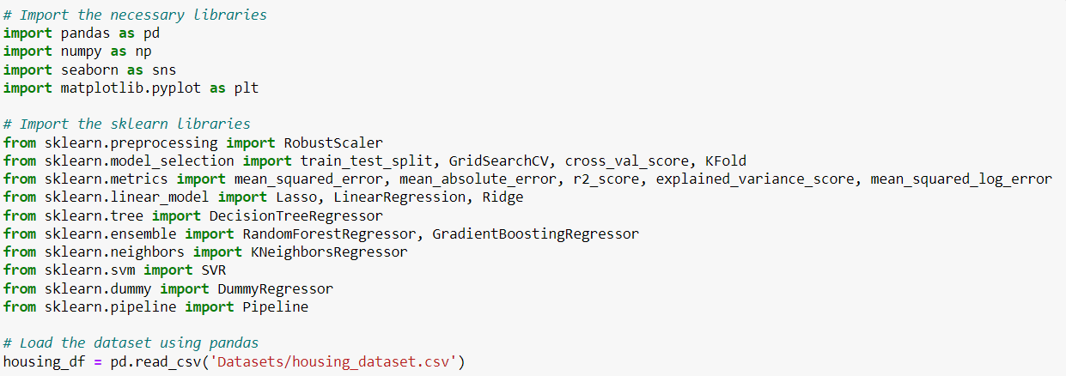
IMPORTING MODULES
Import the necessary modules for data exploration, preprocessing and model building.
Import csv housing dataset file and read file using pandas : pd.read_csv().

Slide 4

PREDICTION OBJECTIVE
Prediction Task
To build a regression model that predicts the housing price in US based on various factors such as City, House Area, No. of Bedrooms and Toilets, Renovation Status, etc.
Target / Output Variable
Price ($) – Numerical Variable
The output variable represents the predicted or estimated price of a house based on the given input features.

Slide 5
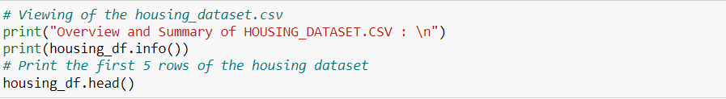
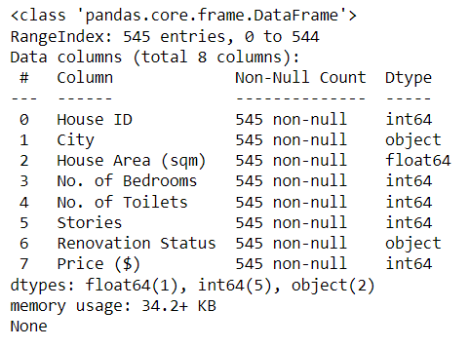
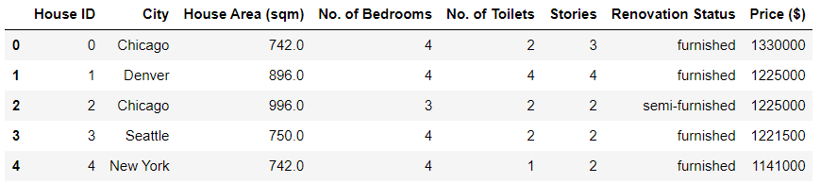
UNDERSTANDING THE DATA
To wrangle the dataset, use the pandas function .info() to obtain information about the object and data structure (type, size, content) of the housing dataset.
View the first 5 rows of the dataset using df.head() to get an overview of the dataset.

Slide 6
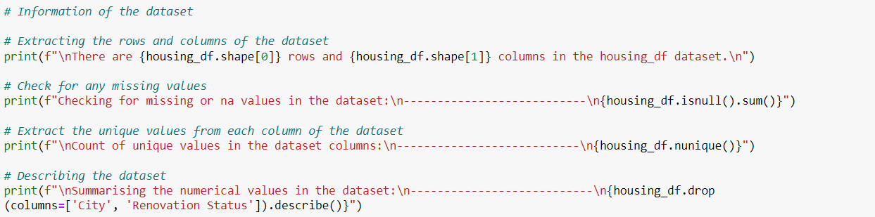
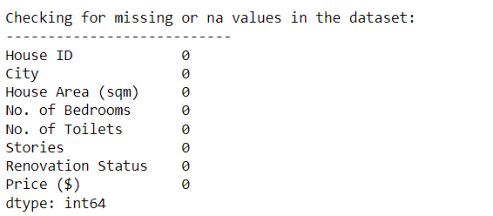
DESCRIBING THE DATA
Housing dataset contains 545 rows and 8 columns.
Verify that the dataset does not contain any NULL / NA values using df.isnull().sum().
Used nunique() to retrieve the number of unique values in each data column.
Used .describe() for numerical columns, returning values of descriptive statistics like count and mean.

Slide 7
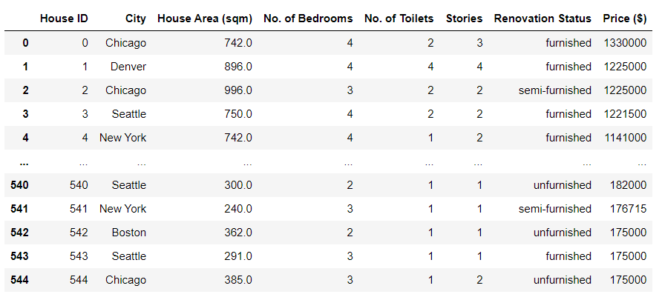
OVERVIEW OF FINAL DATASET

Slide 8
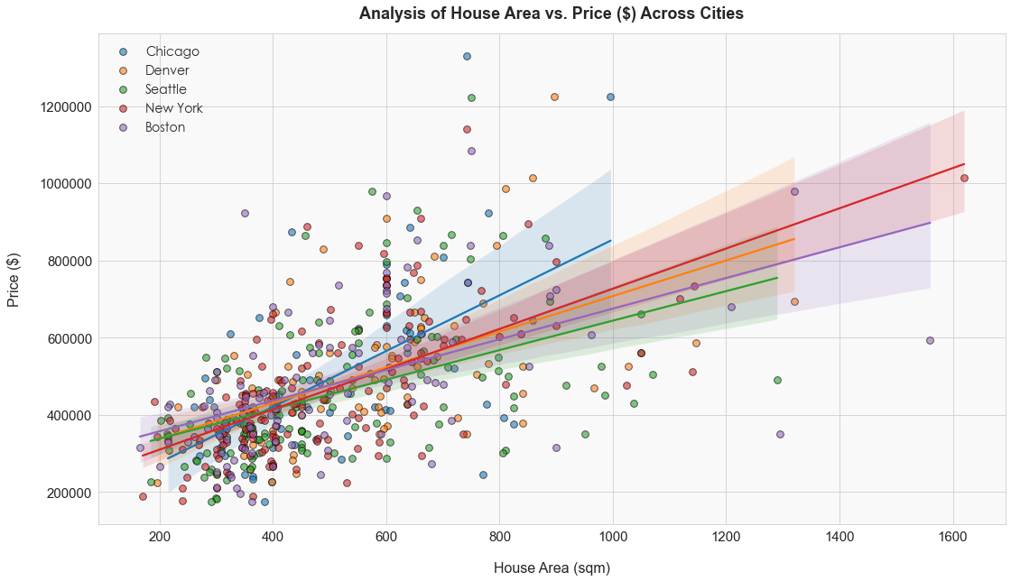
DATA EXPLORATION
There are notable price disparities among the cities. Chicago generally has higher house prices compared to the other cities, while Seattle and Denver appear to have relatively lower prices for a given house area.
The slopes of the regression lines indicate varying degrees of price sensitivity to house area. Seattle and Denver tend to offer relatively more affordable housing options compared to Chicago, New York, and Boston, which tend to offer more luxury homes.
There is a positive linear relationship between house area (sqm) and price ($), indicating that price increases as the area of the house in square meters increases.

Slide 9
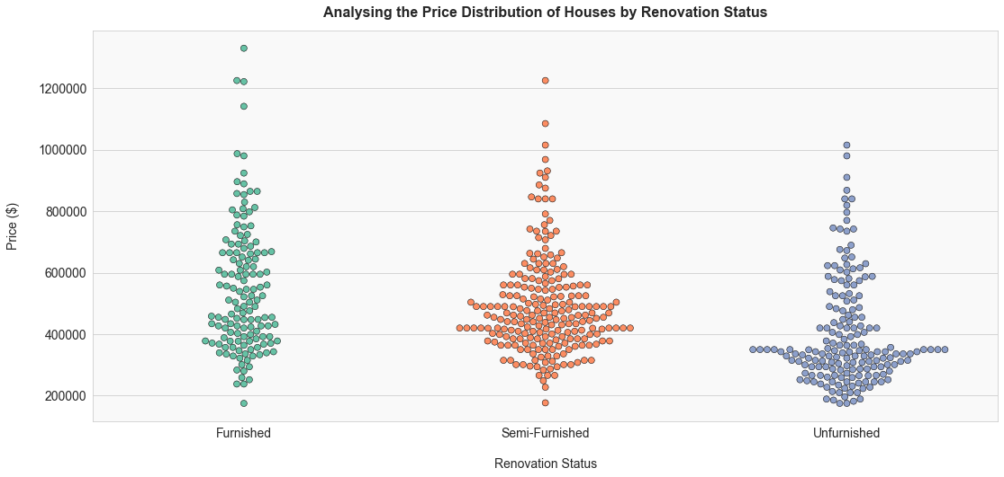
The swarm plots reveal that semi-furnished homes generally exhibited the widest horizontal spread, suggesting that valuations of semi-furnished homes are roughly kept the same from $400,000 to $500,000.
In the case of furnished homes, the price range spans from $190,000 to $1,380,000, reflecting differences in furniture quality, features, and potential customization options that may incur extra expenses.
In contrast, unfurnished homes generally conform to a standardized market, offering basic structure and amenities. This objective valuation contributes to a narrower price spread for this category.
DATA EXPLORATION

Slide 10
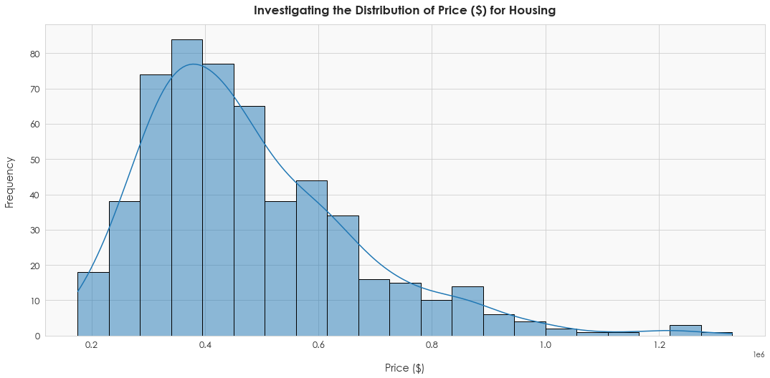
DATA EXPLORATION
The histogram shows that distribution of housing prices across the 5 cities are skewed to the right, indicating that majority of houses in the dataset are affordable, with fewer properties in the high-price range.
There is also a concentration of housing prices between $350000 and $600000, potentially indicating that there is a higher demand for houses in this price segment with increased competition.
The skewness indicates that the distribution of prices is not normalized, and there are properties with extreme high values, that imbalances the price distribution.

Slide 11

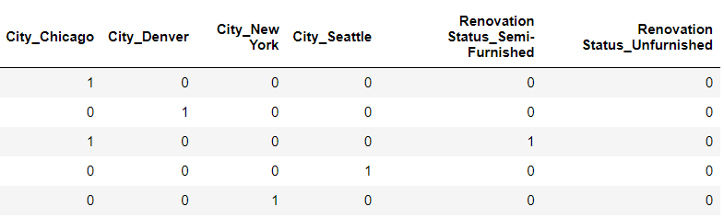
FEATURE ENGINEERING
From the final dataset, drop ‘House ID’ as it is unused and unnecessary in the training phase of the model.
Create dummy variables for categorical variables in the dataset using .get_dummies() to ensure numerical representation for the model to process.
Binary values (0 and 1) are created for the ‘City’ and ‘Renovation Status’ columns.

Slide 12
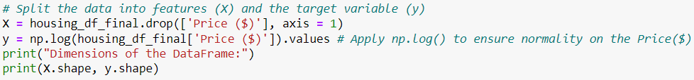
FEATURE ENGINEERING
Split the final dataset into X (features) and y (target variable).
Apply np.log() to the y-variable to normalize housing prices and reduce skewness in price distribution.
Data is split into 4 sets : X_train (features for training), X_test (features for testing), y_train (target variable for training), and y_test (target variable for testing)
Allocate test_size = 0.3 to ensure sufficient data for testing and maintaining consistent data splits.
Do not use stratify = y for regression as splitting is done to predict a continuous variable.

Slide 13
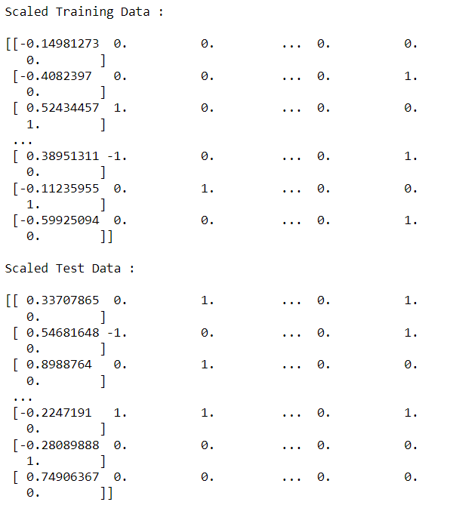

FEATURE ENGINEERING
For X_train data, scale and fit_transform using RobustScaler().
For X_test data, scale and transform using RobustScaler().
RobustScaler() is used due to outliers found in the Price column, and this scaler is less sensitive to outliers, enabling it to be less influenced by extreme values, as well as preserve the shape of distribution provided by the data, leading to a more accurate scale of values provided.

Slide 14
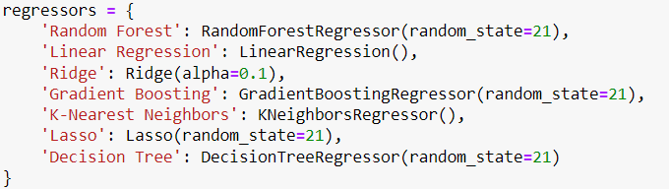
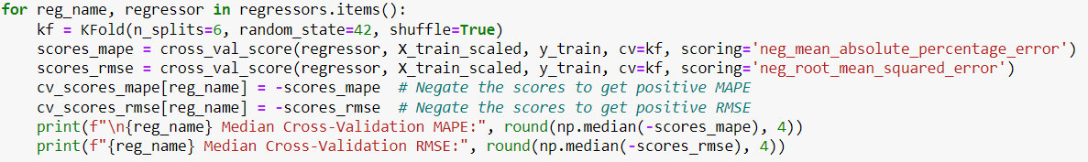
MODEL CROSS-VALIDATION
To identify the best regression model, use KFold split of 6 and retrieve the median value of all the folds for each model based on the respective scorings.
Use ‘neg_mean_absolute_percentage_error’ and ‘neg_root_mean_squared_error’ as the scorings, so the model with the lowest MAPE and lowest RMSE score is the best.
To ensure that the scores retrieved are positive, indicate a negative sign for the MAPE and RMSE scores to convert it back to a positive value.

Slide 15
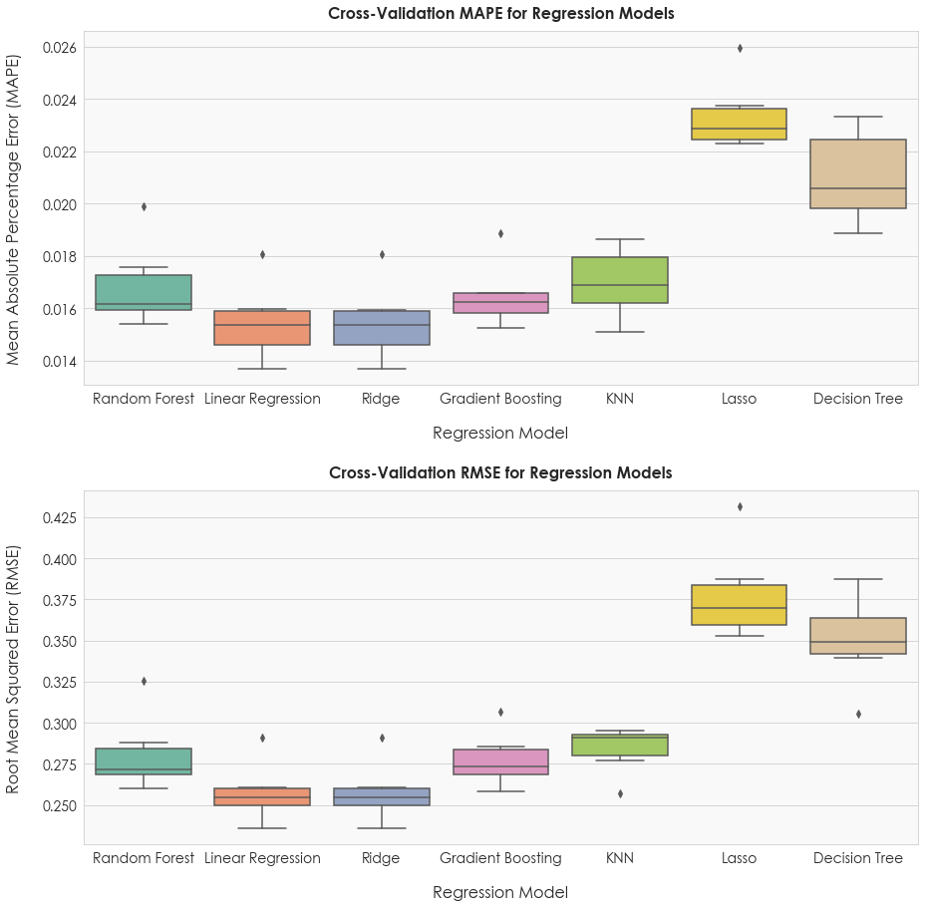
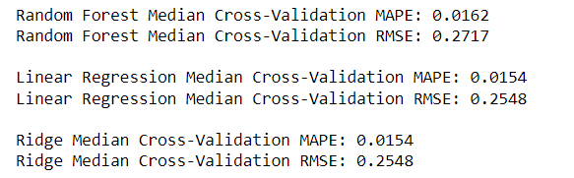
MODEL CROSS-VALIDATION
Based on the boxplots, we can see that the models with the lowest MAPE and RMSE are Ridge and Linear Regression models.
However, there are other models that performs almost as well as the above 2 models, with the 3rd best model being ‘Random Forest’.
So, we also consider ‘Random Forest’ when tuning hyperparameters as it is more robust to outliers in housing price, enabling it to potentially achieve better evaluation scores and make more accurate predictions overall.

Slide 16
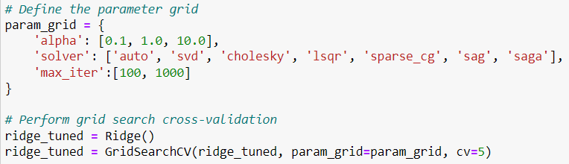
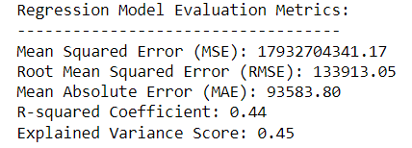
EVALUATING MODEL PERFORMANCE
RIDGE REGRESSION MODEL
Tune the Ridge Regression Model using GridSearchCV :
alpha : Regularization strength to prevent overfitting
solver : Type of algorithm used to solve the optimization problem
max_iter : Maximum number of iterations performed for the solver to find the optimal solution
Based on the metric obtained, we can see that the Ridge Regression model only explains up to 44% of the variation in housing prices, indicating there is still a substantial amount of prices that the model was unable to capture and explain.

Slide 17
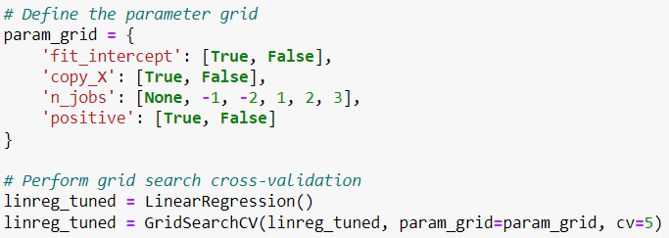
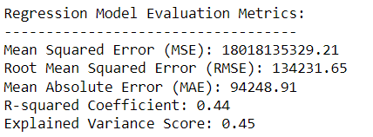
EVALUATING MODEL PERFORMANCE
LINEAR REGRESSION MODEL
Tune the Linear Regression Model using GridSearchCV :
fit_intercept : Determines whether an intercept term should be included
copy_X : Determines whether a copy of the input features should be made
n_jobs : Specifies the number of parallel jobs for fitting and processing
positive : Specifies whether to constraint the coefficients to positive
Based on the metric obtained, we can see that the Linear Regression model only explains up to 44% of the variation in housing prices, similar to the Ridge Regression model.

Slide 18
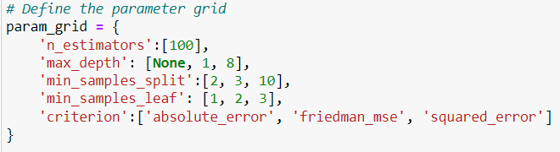
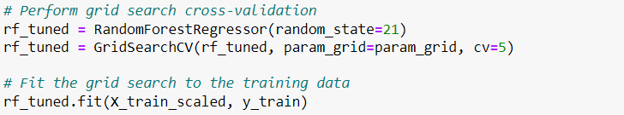
EVALUATING MODEL PERFORMANCE
RANDOM FOREST REGRESSOR MODEL
Tune the Random Forest Regressor Model using GridSearchCV :
n_estimators : Number of decision trees to be used in the Random Forest Ensemble
max_depth : Maximum depth allowed for each decision tree in the Random Forest
min_samples_split : Controls overfitting by preventing splits with a low number of samples
min_samples_leaf : Minimum number of samples required to be present in a leaf node
criterion : Used to evaluate model accuracy
Fit the model and parameters to GridSearchCV -> cv = 5 : Model is trained and evaluated 5 times

Slide 19
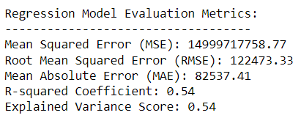
EVALUATING MODEL PERFORMANCE
RANDOM FOREST REGRESSOR MODEL
Based on the Random Forest Model, we can see that the model is able to predict approximately 0.54% of the variance in house prices, a big improvement as compared to the previous 2 models.
Best Parameters :
Obtain the metrics for MSE, RMSE, MAE, R2 and Variance:
However, the system still makes errors in prediction as the scores for MSE, RMSE and MAE are rather high even after hyperparameter tuning.
This is likely due to a weak correlation / relationship between the features and the output variable - Price ($), making it harder for the model to make more accurate predictions.
But this is still an improvement when compared to the scores from cross-validation.

Slide 20
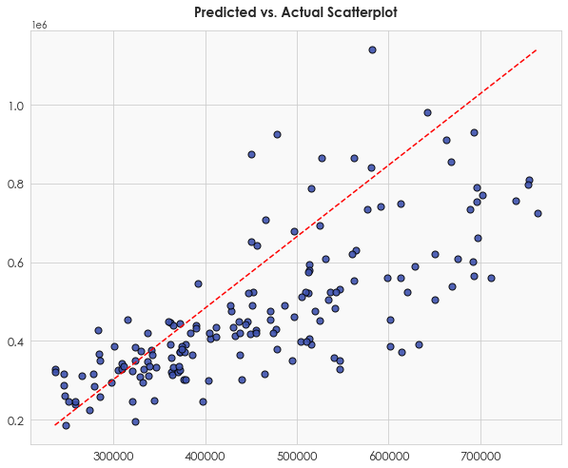
ANALYZING THE MODEL ERRORS
From the scatterplot, we can see that the points for predicted values do not follow a strong linear pattern, even though it shows a positive correlation.
The predicted points are scattered around the red line, with some outlier points further away from the red dotted line, indicating that the correlation coefficient is moderate and not particularly strong.
This suggests that there is a weaker correlation between the predicted and actual values, and the model was unable to capture the best relationship.

Slide 21
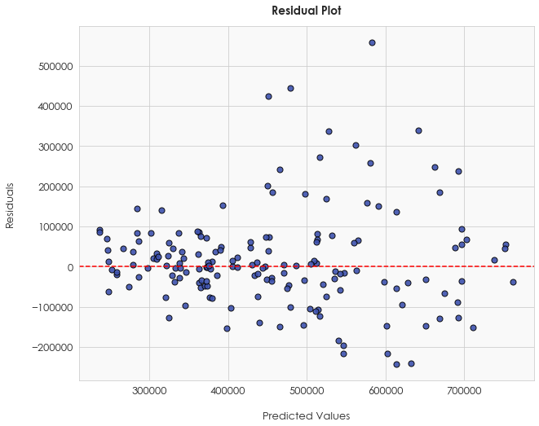
ANALYZING THE MODEL ERRORS
From the residual plot, we see that there is a subtle lack of a discernible pattern among residuals and are randomly scattered among the y=0 line.
There is a relatively large spread in residuals, with a substantial number of data points with large residuals and outliers.
This indicates that the model is not effectively capturing the underlying patterns and data relationships, hence explains why the R2 score is only moderate.

Slide 22
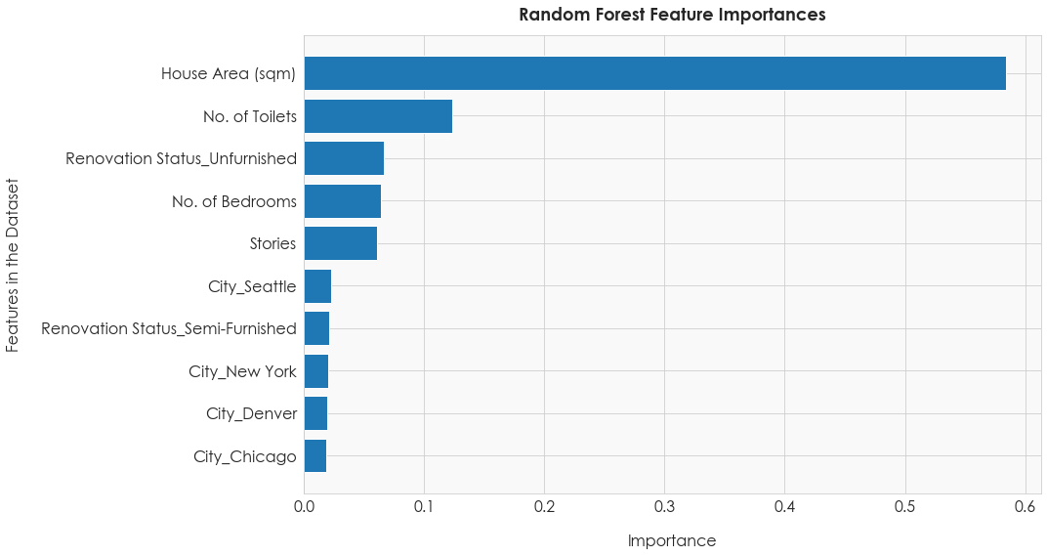
ASSESSING THE FEATURE IMPORTANCE
Based on the feature importance, the most important feature is ‘House Area (sqm)’, indicating that it has a significant influence on the price of housing.
However, the level of importance only suggests a moderate rather than a strong relationship. This is evident from the relatively shorter bars in the feature importance chart, indicating a moderate correlation between house area and price.

Slide 23
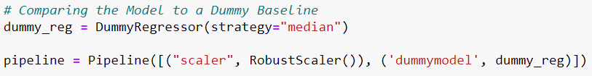
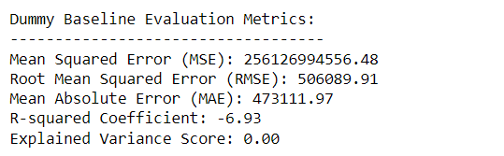
COMPARING TO A DUMMY BASELINE
For the Dummy Regressor, ‘median’ is used as the strategy as it is less affected by outliers compared to mean, providing a prediction that is less sensitive to outliers in the target variable.
Based on the Dummy Regressor, the scores indicate that our tuned model is performing much better than a dummy, due to significantly higher R2 scores and lower MSE, RMSE and MAE scores.
Use MSE, RMSE, MAE, R2 and Explained Variance to evaluate the dummy model.

Slide 24
CONCLUSION
Best-performing model : Random Forest Regressor
From hyperparameter tuning, the best parameters were : {'criterion': 'absolute_error', 'max_depth': 8, 'min_samples_leaf': 2, 'min_samples_split': 10, 'n_estimators': 100}
Based on the R2 correlation score of 0.54, the model performed moderately in predicted house prices. But its performance was negatively impacted by the skew in prices and the weak correlation between the features and target variable.
However, the Random Forest still made significant improvement in its predictive ability upon tuning, hence was able to achieve a moderate prediction score.

