Slide 1
VEGGIELENS
DEVOPS AND AUTOMATION FOR AI CA2
YOUR ONE-STOP AI VEGGIE PREDICTION WEBSITE :
Name : Dario Prawara Teh Wei Rong
Class : DAAA / FT / 2B / 04
Admin No : 2201858

Slide 2

PROJECT OBJECTIVE
Develop a Deep Learning web application, using GitLab and Flask Framework, incorporating the 3 DevOps best practices.
To use an image dataset with 15 classes of vegetable images and two CNN models to predict the class the images belong to.

Slide 3
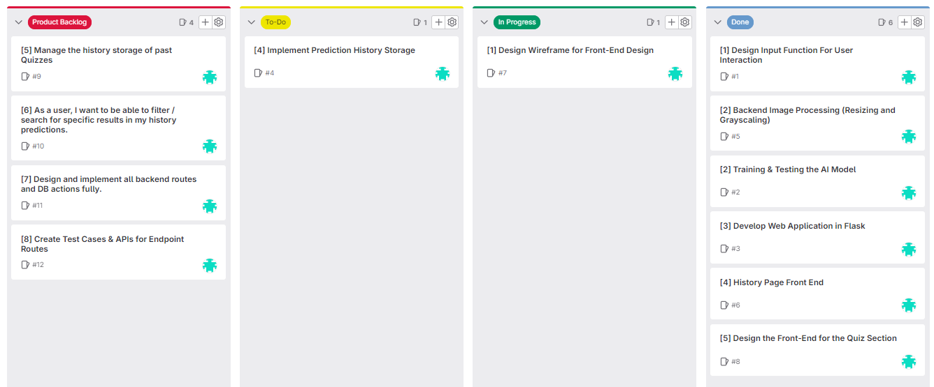
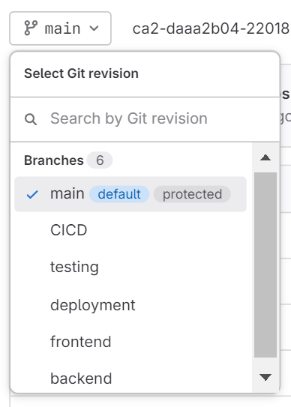
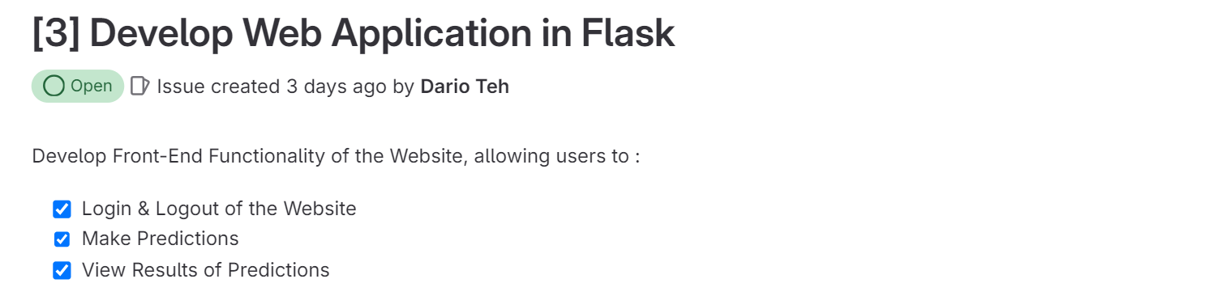
GITLAB & SCRUM PROCESSES
Labels for product backlog, to-do, in progress, and done to track web development.
Created user stories, using user objectives to fulfil issues and project tasks along the way.
Set up 6 branches for different development purposes.

Slide 4



GENERAL INFORMATION
ONLINE DEPLOYMENT
LOGIN AUTHENTICATION
MULTIPLE DEVICE RESPONSIVENESS
Website is deployed successfully on Render at : https://veggielens.onrender.com/
Bypassing authentication by typing in the direct link is addressed and prevented.
The user can either log in or sign up for an account.
Responsive web design using Tailwind CSS and JavaScript.

Slide 5
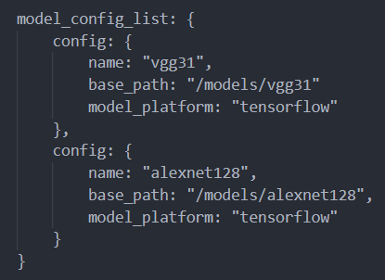


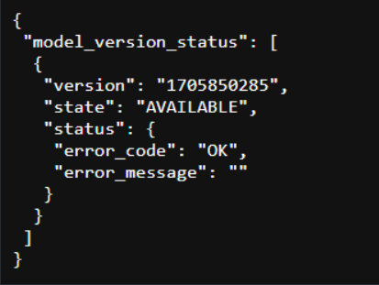
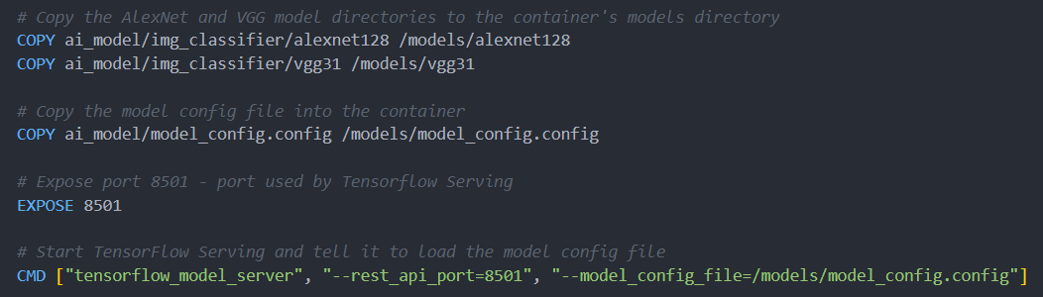
MODEL DEVELOPMENT
DEEP LEARNING MODELS USED
31 x 31 px Images : Custom VGG Model (vgg31)
128 x 128 px Images : Custom AlexNet Model (alexnet128)
DEPLOYMENT PROCESS
Both models were deployed together on the local DockerFile into the same Render URL.
Checked that server is set up correctly by checking the model status from /v1/models.
Model Config & Docker Files

Slide 6
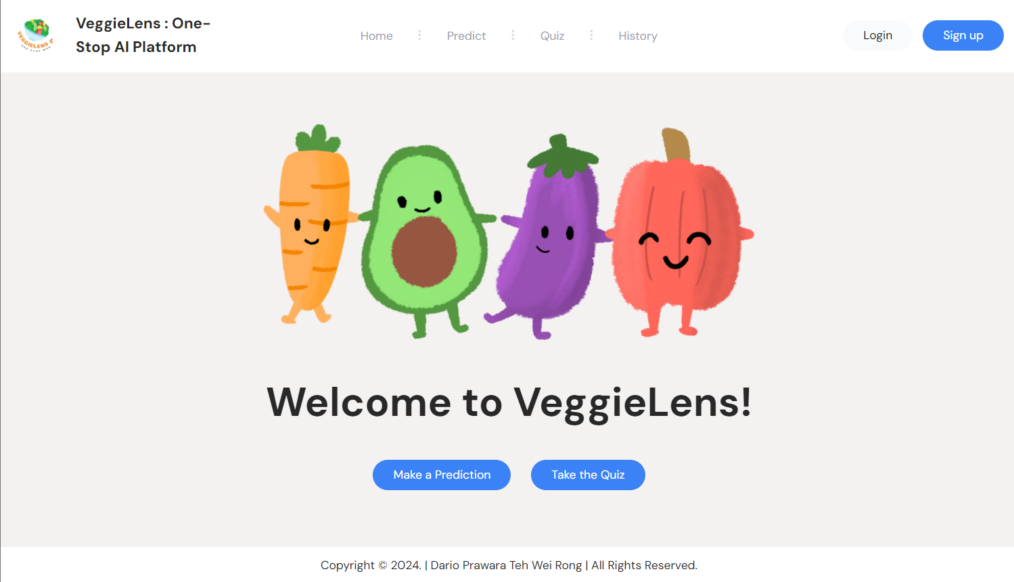

INTRODUCING…VEGGIELENS!
https://veggielens.onrender.com/
VeggieLens is an AI web application where users can predict vegetable images & compete in a quiz with our AI in a mini competition.
Users can also view history to review their mistakes to and improve for future quizzes.

Slide 7
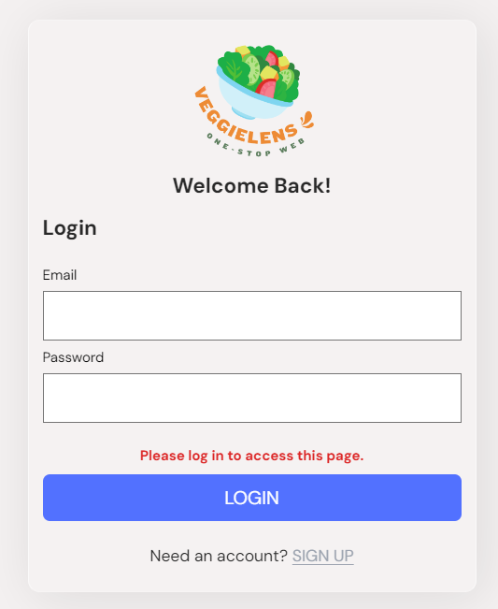
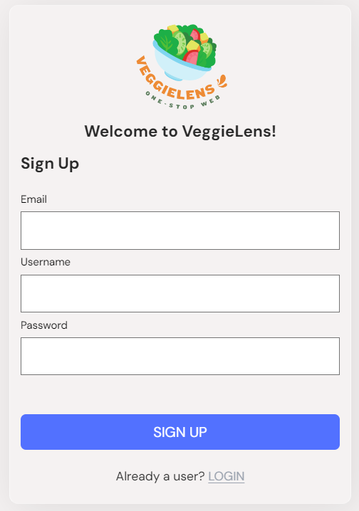
VEGGIELENS – LOGIN / SIGNUP
Users can either login or sign up (create a new account) to the web application.
When the user signs up, it redirects them to the login page to enter credentials.

Slide 8
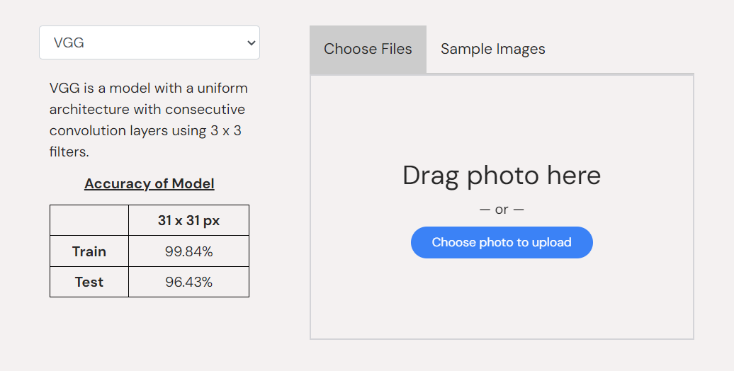
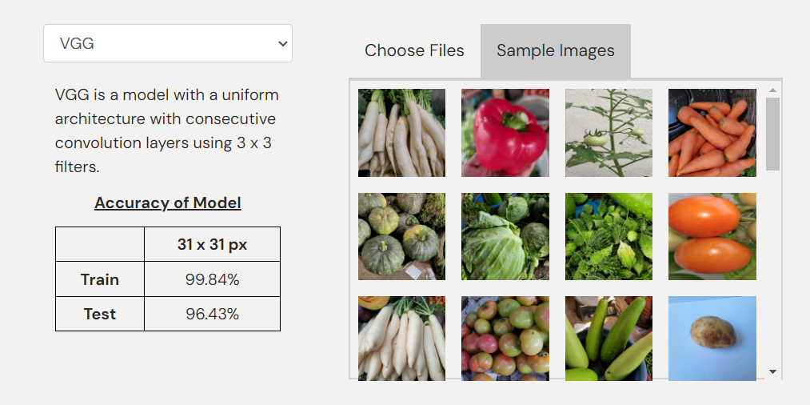
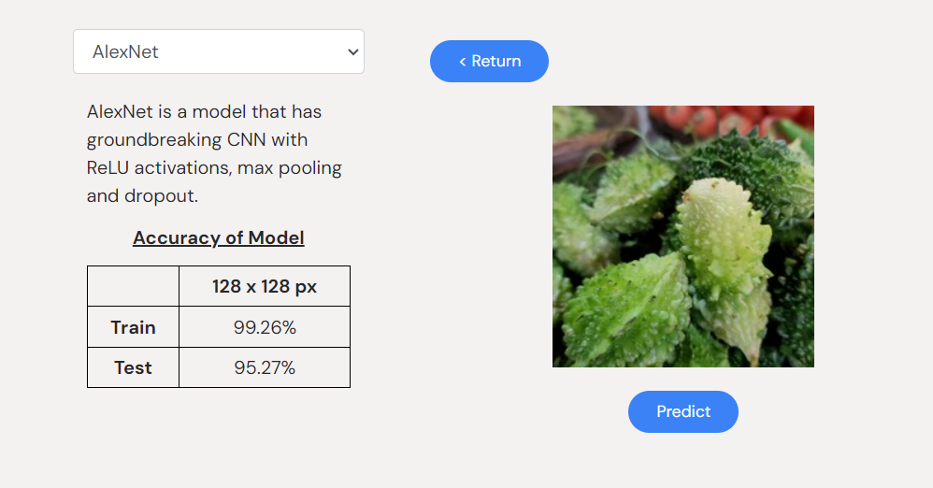
VEGGIELENS – PREDICTION PAGE
HOW DOES THE USER MAKE PREDICTIONS
Either upload an image or choose from pre-loaded images.
Select model type (VGG for 31px or AlexNet for 128px images) with information on each model.
After uploading the image, a ‘Predict’ button appears for the user to predict.

Slide 9
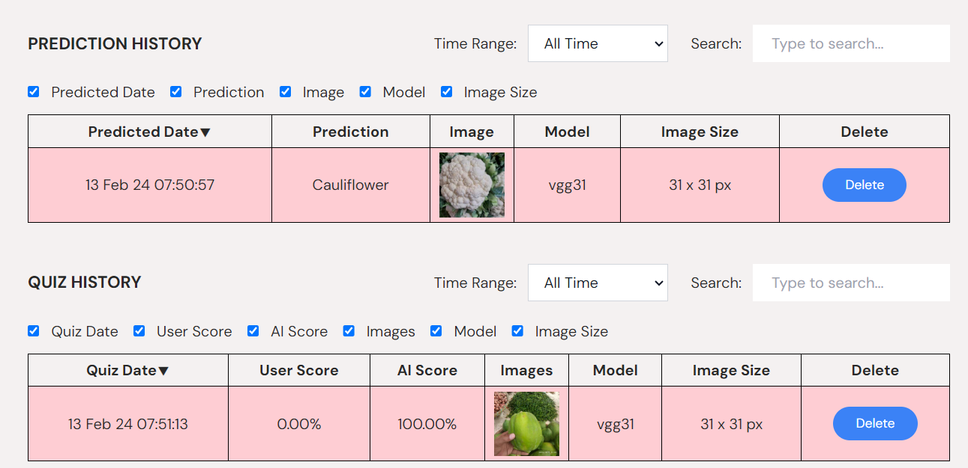
VEGGIELENS – HISTORY PAGE
Filter options : Time Range & Columns to Display
Search & sort options : Search / Sort by any column (except Delete & Image(s))
Dynamic filtering & searching functionality (updates as it changes).
Able to view past histories for predictions and quizzes.

Slide 10
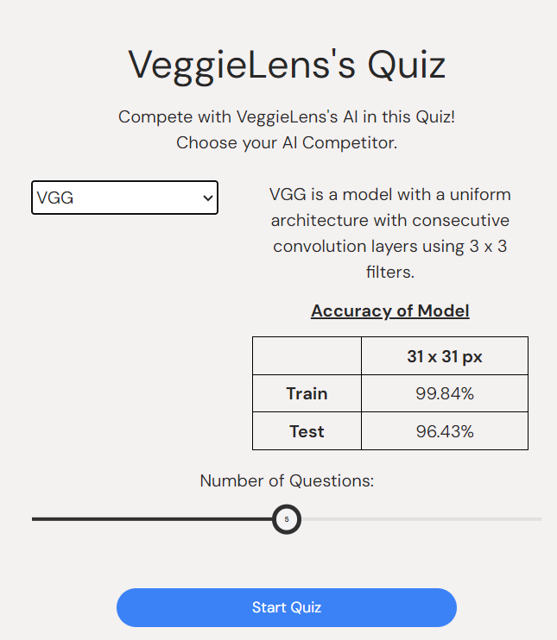
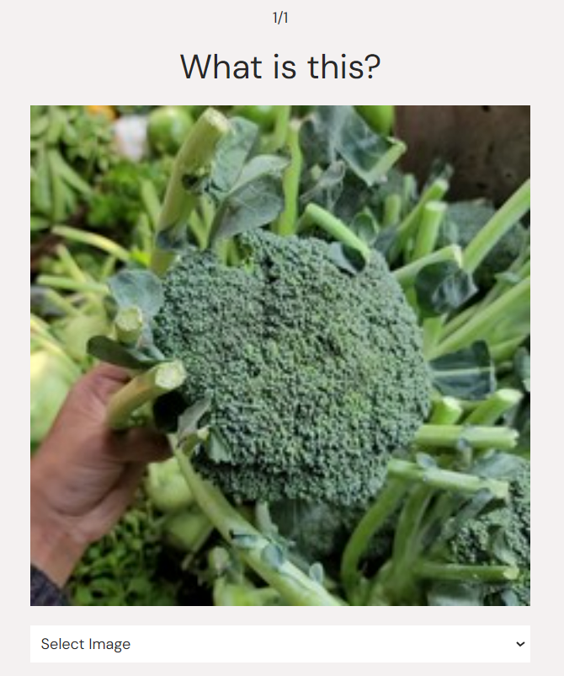
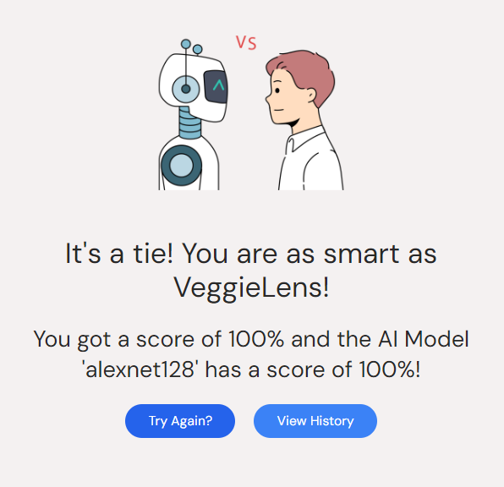
VEGGIELENS – QUIZ
The user can choose the AI model and number of questions for the quiz.
A sample image and a dropdown allows users to select the class the image best belongs to.
Results are shown to display both the user’s score as well as the AI Model’s score.

Slide 11
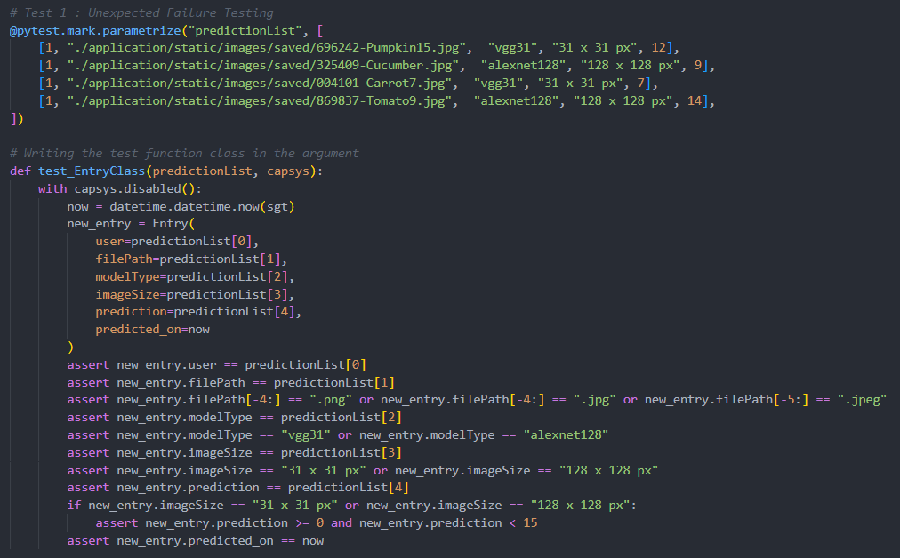

UNEXPECTED FAILURE TESTING
Created a test for unexpected failure testing for data sent to the SQLite Database.
All results PASSED as no failure was expected from the parameters inputted.
Results :

Slide 12
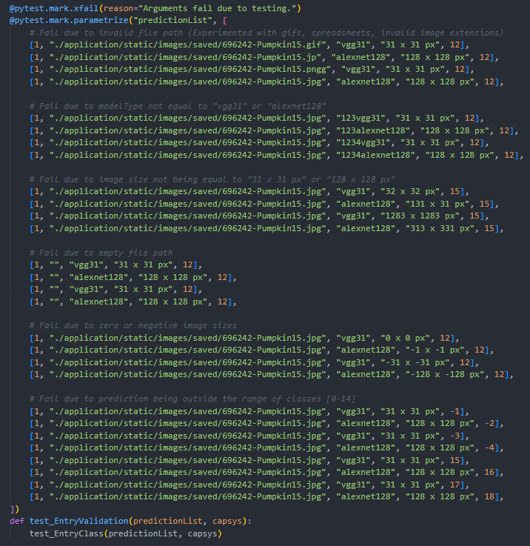
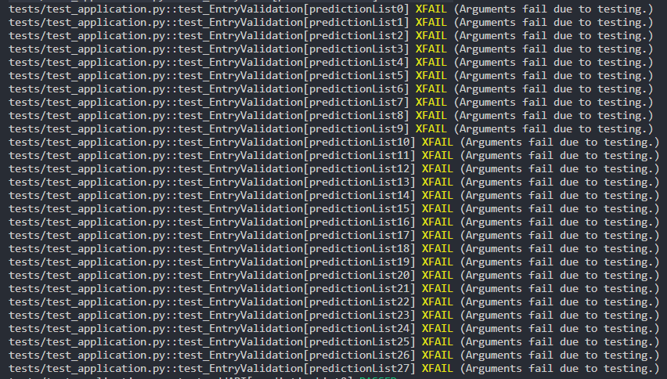
EXPECTED FAILURE TESTING
For expected testing, the following were checked :
Invalid file path
Invalid model type (not VGG or AlexNet)
Invalid image size processed
Empty file paths
Zero or negative image sizes
Prediction out of the class range – 0 to 14

Slide 13
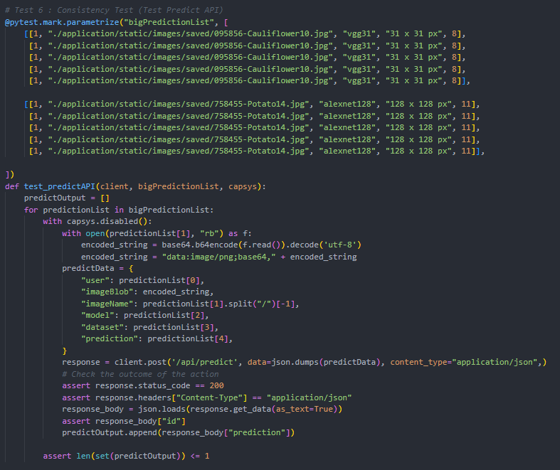
CONSISTENCY TESTING
Results :
Given identical inputs, it checks if the predictions are the same as each other.
Grouped 2 arrays with random indexing, for Cauliflower and Potato, to test if the output predictions are consistent.

Slide 14
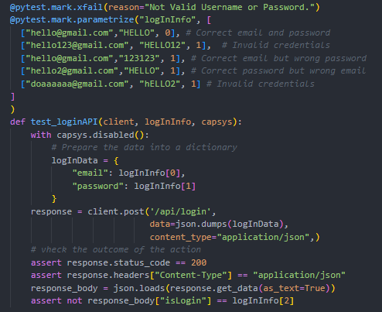

VALIDITY TESTING
Results :
Tests on valid data to determine if ordinary data can be used. [Expected & Valid Working Data]
Since the first parameter is a valid email and password, it returns XPASS, and the rest returns XFAIL as they are all invalid.

Slide 15
ENDPOINT API TESTING
POST
/API/LOGIN
POST
/API/SIGNUP
DELETE
/API/DELETE/{id}
API used to perform authentication of users based on email & password credentials.
API used to manage user registration and account creation within the system.
Given the ID of the history, delete the record for the user.
GET
/API/GET/{predictionList[0]}
POST
/API/ADD
POST
/API/PREDICT
API used to retrieve information of a specific result given the ID.
API used to add a new prediction record into the database.
API used to perform prediction and retrieve result of class predicted.

Slide 16
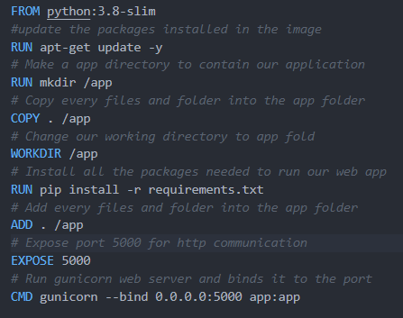
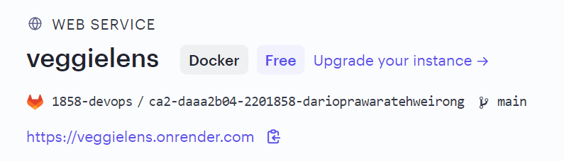

MLOPS - DEPLOYMENT
Use Render Web Service to deploy the model & website to the internet.
Render runs the Dockerfile that uses gunicorn as the WSL Server to host the website online.
Dockerfile
Gunicorn File

Slide 17
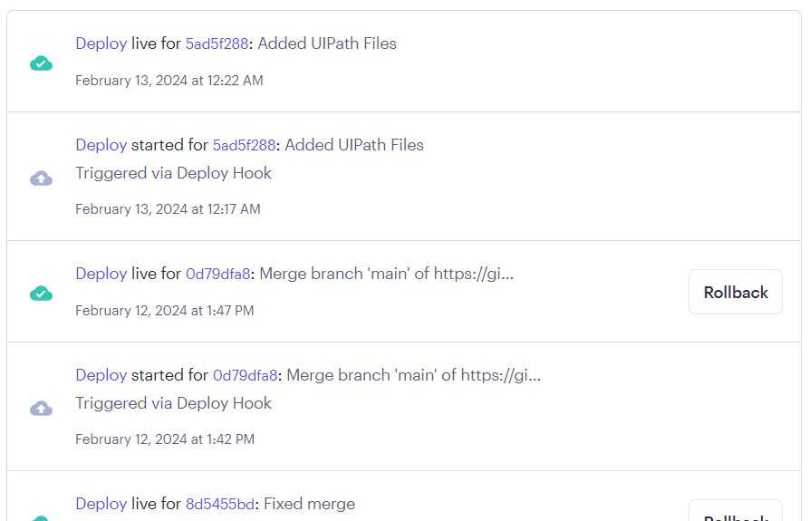
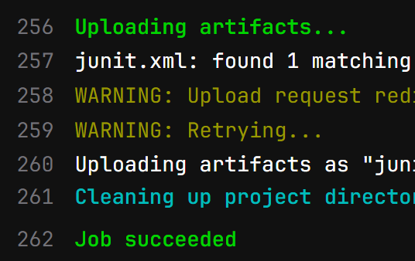

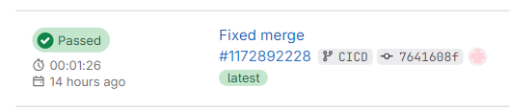
MLOPS - CI / CD
Linked to GitLab’s main branch
Changes are automatically deployed on Render
Pipeline jobs are successful – all passed
Successfully integrating features to the main branch in GitLab

Slide 18
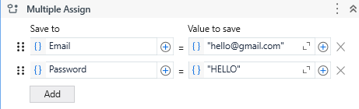
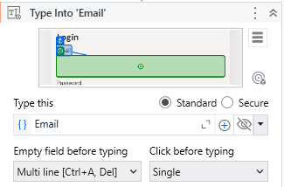
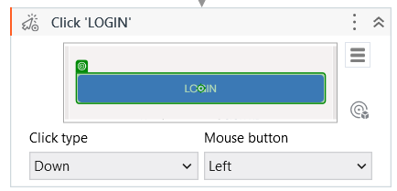
UIPATH – LOGIN RPA
Assign and provide multiple assignments to the bot so that it knows what to type in the input boxes.
Use “Type Into” activities to type into the input boxes. Allow the bot to click on the login button using the “Click” activity.

Slide 19
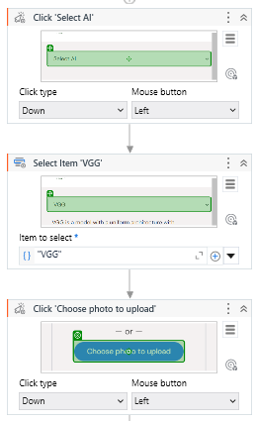
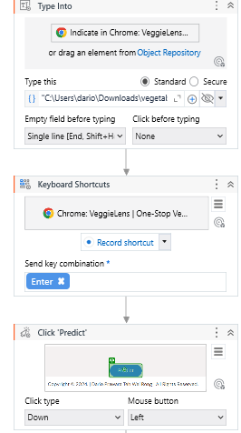
UIPATH – PREDICT RPA
Use VGG model for demonstration. Apply click type and item select for the bot to select the model.
Use the “Click” activity to upload photo, and “Type Into” to input the file path to the image.
Apply the “Enter” key combination and another “Click” activity to predict the image.

Slide 20
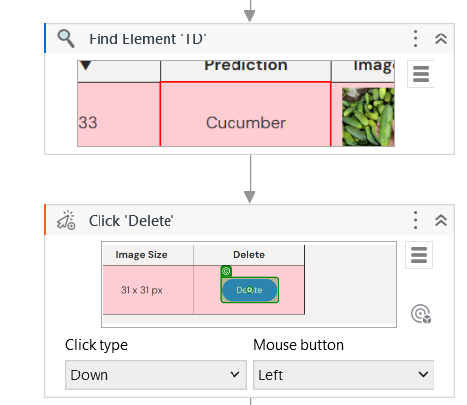
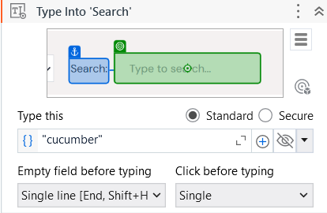
UIPATH – SEARCH & DELETE RPA
DELETE
SEARCH
Use a combination of “Type Into” and “Type this” activities to enter (cucumber) into the search bar.
Use the “Find Element” activity to locate the element in the page and delete the relevant entry using “Click” activity.

Slide 21

THANK YOU!

