Slide 1


Experience the Risks
Risk
Reward

Slide 2

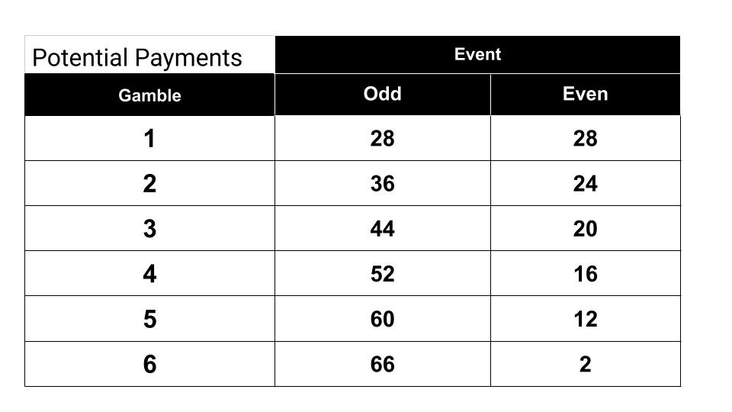
Procedure
Gamble Choice 1
12 Realizations with Preselected choices
Gamble Choice 2
Exit Survey
12 Realizations with Free choices

Slide 3
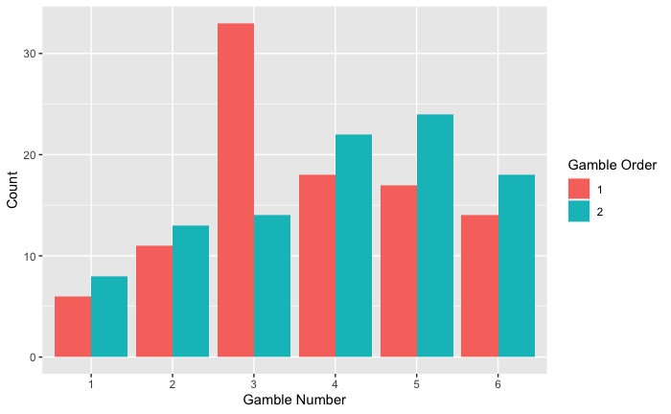
REsults

