Slide 1
Quantifying Errors in Muscle Length Approximations Utilizing a Modified Integrator-Backstepping Controller to Understand Dynamic Requirements on Muscles
Daniel A. Hagen
Brain-Body Dynamics Lab
May 7, 2018

Slide 2
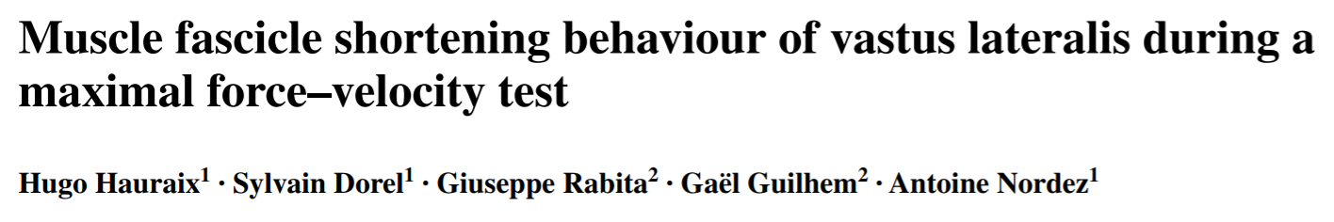
Previous Work
“Muscle fascicles shortening velocity increased linearly with the increase in knee joint velocity up to the maximal joint velocity.¹”
“Contribution of muscle fascicles to the muscle–tendon unit shortening velocity was much higher for the vastus lateralis in this study compared to the gastrocnemius medialis in two previous studies.¹”
“Contrary to the results obtained for plantar flexions… the muscle fascicle shortening velocity plateaued for joint velocities above 240° s⁻¹, suggesting an increase in the tendinous tissues contribution with the increase in knee extension velocity [which] may be associated with different mechanical tendon properties.¹”
Linear relationship for VL during unloaded movements.
This relationship changes across muscles.
Tendon properties could induce nonlinear relationships
¹Hauraix, H., Dorel, S., Rabita, G., Guilhem, G. and Nordez, A., 2017. Muscle fascicle shortening behaviour of
vastus lateralis during a maximal force–velocity test. European journal of applied physiology, 117(2), pp.289-299.
Notes:
ultrasound sam- pling frequency was set between 500 and 2000 Hz,

Slide 3
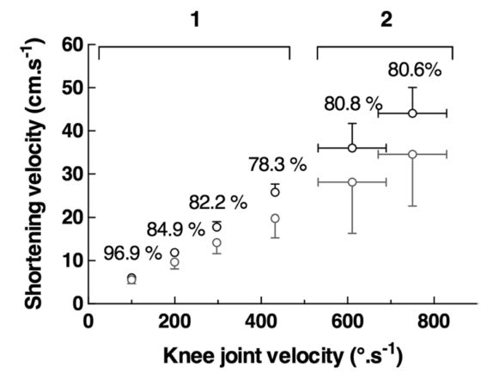
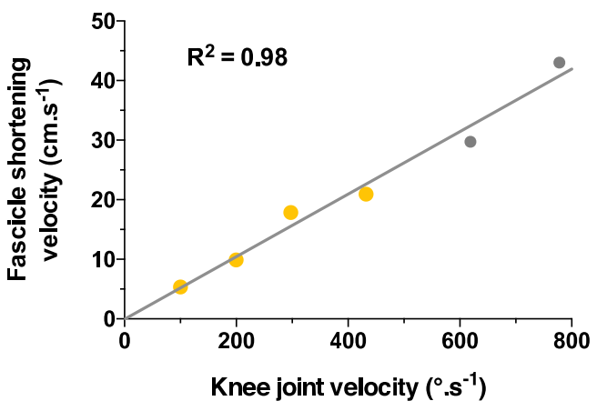


Previous Work
Regardless of the condition tested,
contributions of muscle and tendon
to the muscle–tendon unit shortening velocity
were almost constant.
Musculotendon Velocity
vs.
Muscle Velocity
$$r_{i,j}\left(θ_{j}\right)≈\frac{∂l_{m,i}}{∂θ_{j}}$$
¹Hauraix, H., Dorel, S., Rabita, G., Guilhem, G. and Nordez, A., 2017. Muscle fascicle shortening behaviour of
vastus lateralis during a maximal force–velocity test. European journal of applied physiology, 117(2), pp.289-299.
Notes:
Yellow and gray points corresponded to isokinetic and isoinertial conditions, respectively.

Slide 4
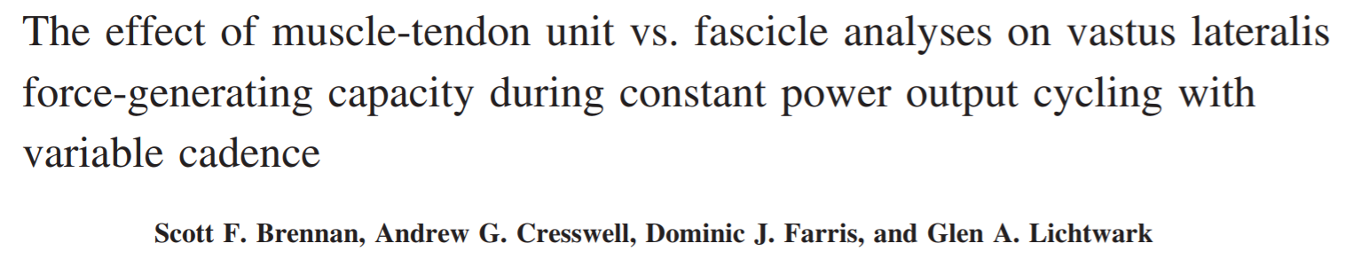
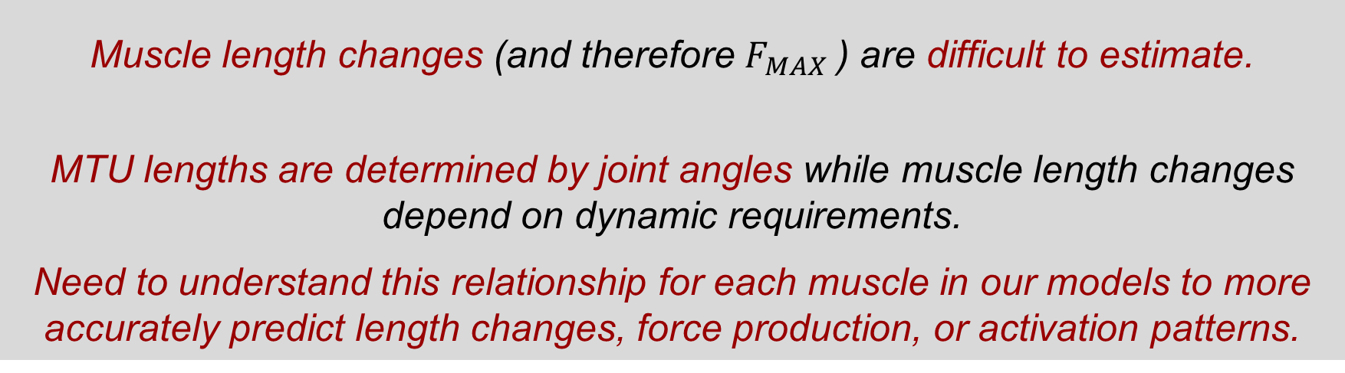
Previous Work
“Muscle-tendon unit (MTU) length changes can be estimated from joint kinematics; however, contractile element length changes are more difficult to predict during dynamic contractions… these differences would affect the predicted force capacity of the muscle.²”
“[There was a] significant increase in fascicle shortening as cadence decreased … whereas there were no significant differences in MTU lengths across any of the cycling conditions.²”
“These results reinforce the need to determine muscle mechanics in terms of separate contractile element and connective tissue length changes during isokinetic contractions, as well as dynamic movements like cycling.²”
Muscle length changes (and therefore $F_{MAX}$) are difficult to estimate.
MTU lengths are determined by joint angles while muscle length changes depend on dynamic requirements.
Need to understand this relationship for each muscle in our models to more accurately predict length changes, force production, or activation patterns.
²Brennan, S.F., Cresswell, A.G., Farris, D.J. and Lichtwark, G.A., 2018. The effect of muscle-tendon unit vs fascicle analyses on vastus lateralis force generating capacity during constant power output cycling with variable cadence. Journal of Applied Physiology.
Notes:
We demonstrate that vastus lateralis (VL) muscle tendon unit (MTU) length changes do not adequately reflect the underlying fascicle mechanics during cycling. When examined across different pedaling cadence conditions, the force-generating potential measured only at the level of MTU (or joint) overestimated the maximum force capacity of VL compared with analysis using fascicle level data.

Slide 5
Previous Work
For exercises involving concentric contractions, muscle/tendon interactions:
Enhance the work produced by the muscle–tendon unit (Ishikawa and Komi 2004; Kawakami et al. 2002; Finni et al. 2001)
Improve efficiency (Lichtwark and Barclay 2010)
Reduce muscle fiber stretching to limit risk of strain/injury (Guilhem et al. 2016; Konow et al. 2012) ¹
¹Hauraix, H., Dorel, S., Rabita, G., Guilhem, G. and Nordez, A., 2017. Muscle fascicle shortening behaviour of
vastus lateralis during a maximal force–velocity test. European journal of applied physiology, 117(2), pp.289-299.
Notes:
Yellow and gray points corresponded to isokinetic and isoinertial conditions, respectively.

Slide 6
Question:
How do these relationships change for the muscles of the arm across different dynamical constraints?
Notes:
Yellow and gray points corresponded to isokinetic and isoinertial conditions, respectively.

Slide 7
Hypothesis:
Approximations of muscle lengths vs. muscle lengths obtained by forward dynamical simulation will deviate in (1) a task dependent and (2) state dependent fashion.
Tendon lengthening vs. muscle lengthening will have (1) well-defined and (2) task-depended relationships.
Notes:
For a given isokinetic elbow rotation task, the difference of the estimated MTU velocity and the measured muscle velocity will be calculated to determine what relationship, if any, these two quantities share.
Possible relationships include:
Compensating: after a certain threshold, the tendon takes on more of the length change to aid muscle proficiency.
Linear: for unloaded tasks, the difference between MTU and muscle velocity is linear.
Saturating: after a certain threshold, the tendon cannot lengthen any further and all length change is taken up by the muscle.

Slide 8
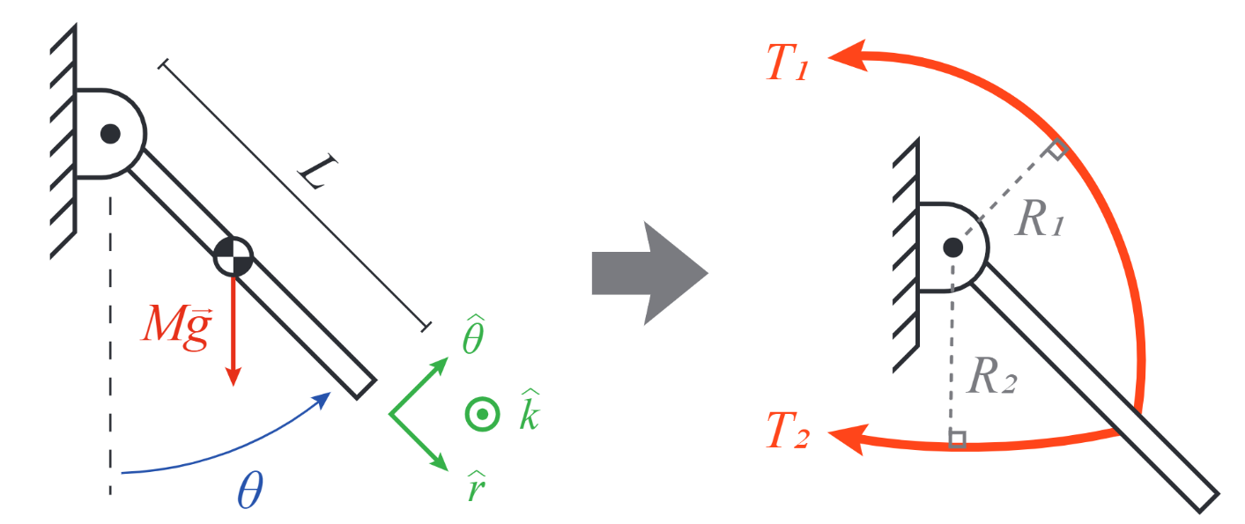
Simplified Model of Elbow:
Notes:
Yellow and gray points corresponded to isokinetic and isoinertial conditions, respectively.

Slide 9
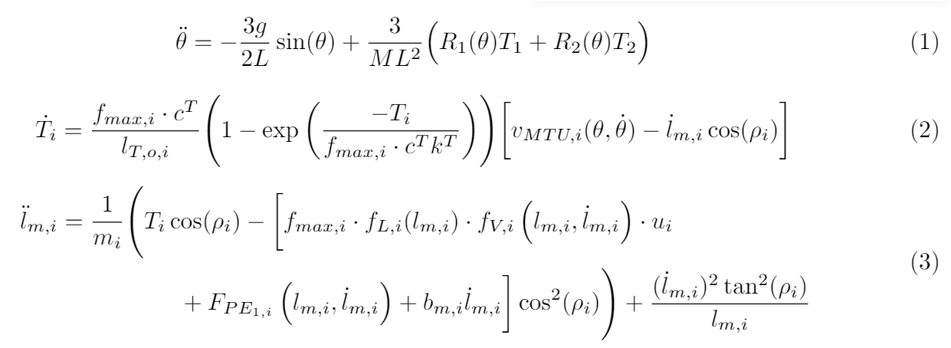
Simplified Model of Elbow:
Notes:
Yellow and gray points corresponded to isokinetic and isoinertial conditions, respectively.

Slide 10
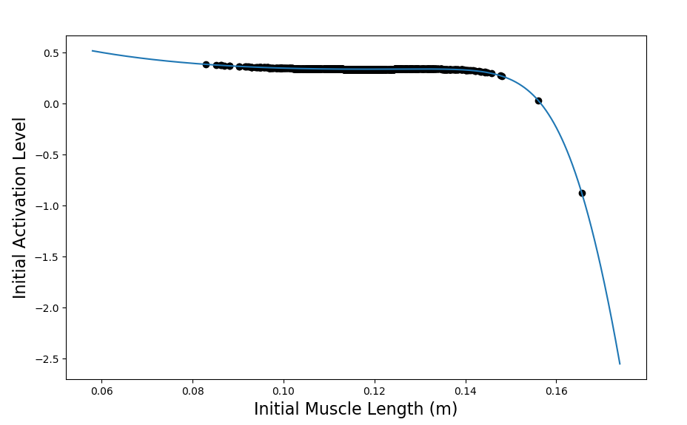
Assumptions:
IB constraint reduces dimensionality of allowable next activation levels to one. Therefore, a random point along the constraint was chosen from a normal distribution around the nearest point to the previous input values.
Trials were rejected if the nearest point to the previous input values was too far away for the system to make a physiologically feasible transition.
Trials were initialized by finding equilibrium values for states when the system was at rest. This lead to the discovery of a function that relates initial values muscle length, muscle activation, and tendon tension.
Notes:
For a given isokinetic elbow rotation task, the difference of the estimated MTU velocity and the measured muscle velocity will be calculated to determine what relationship, if any, these two quantities share.
Possible relationships include:
Compensating: after a certain threshold, the tendon takes on more of the length change to aid muscle proficiency.
Linear: for unloaded tasks, the difference between MTU and muscle velocity is linear.
Saturating: after a certain threshold, the tendon cannot lengthen any further and all length change is taken up by the muscle.

Slide 11
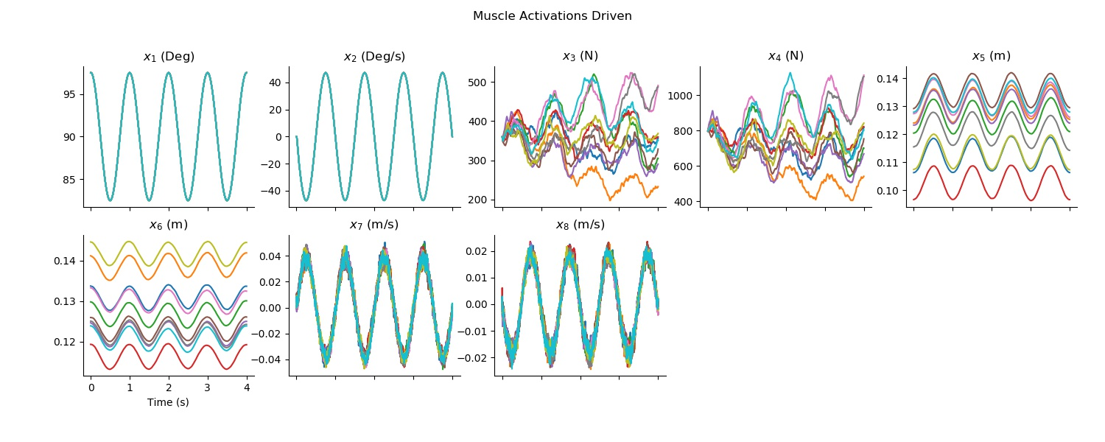
Results:
Notes:
For a given isokinetic elbow rotation task, the difference of the estimated MTU velocity and the measured muscle velocity will be calculated to determine what relationship, if any, these two quantities share.
Possible relationships include:
Compensating: after a certain threshold, the tendon takes on more of the length change to aid muscle proficiency.
Linear: for unloaded tasks, the difference between MTU and muscle velocity is linear.
Saturating: after a certain threshold, the tendon cannot lengthen any further and all length change is taken up by the muscle.

Slide 12
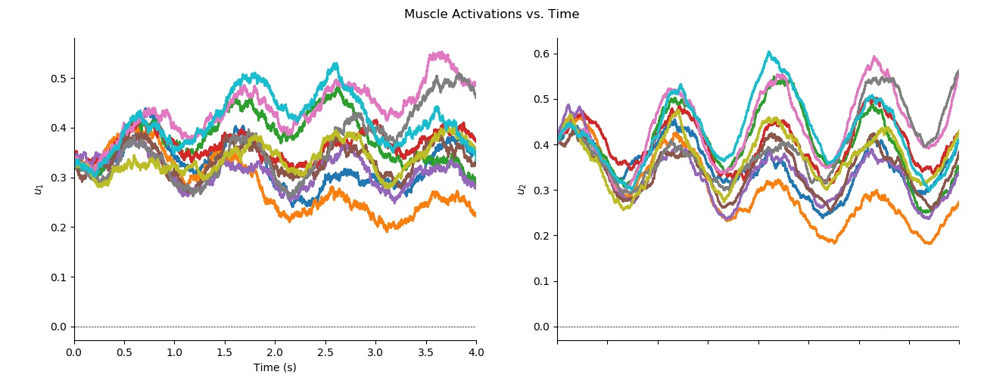
Activations:
Notes:
For a given isokinetic elbow rotation task, the difference of the estimated MTU velocity and the measured muscle velocity will be calculated to determine what relationship, if any, these two quantities share.
Possible relationships include:
Compensating: after a certain threshold, the tendon takes on more of the length change to aid muscle proficiency.
Linear: for unloaded tasks, the difference between MTU and muscle velocity is linear.
Saturating: after a certain threshold, the tendon cannot lengthen any further and all length change is taken up by the muscle.

Slide 13
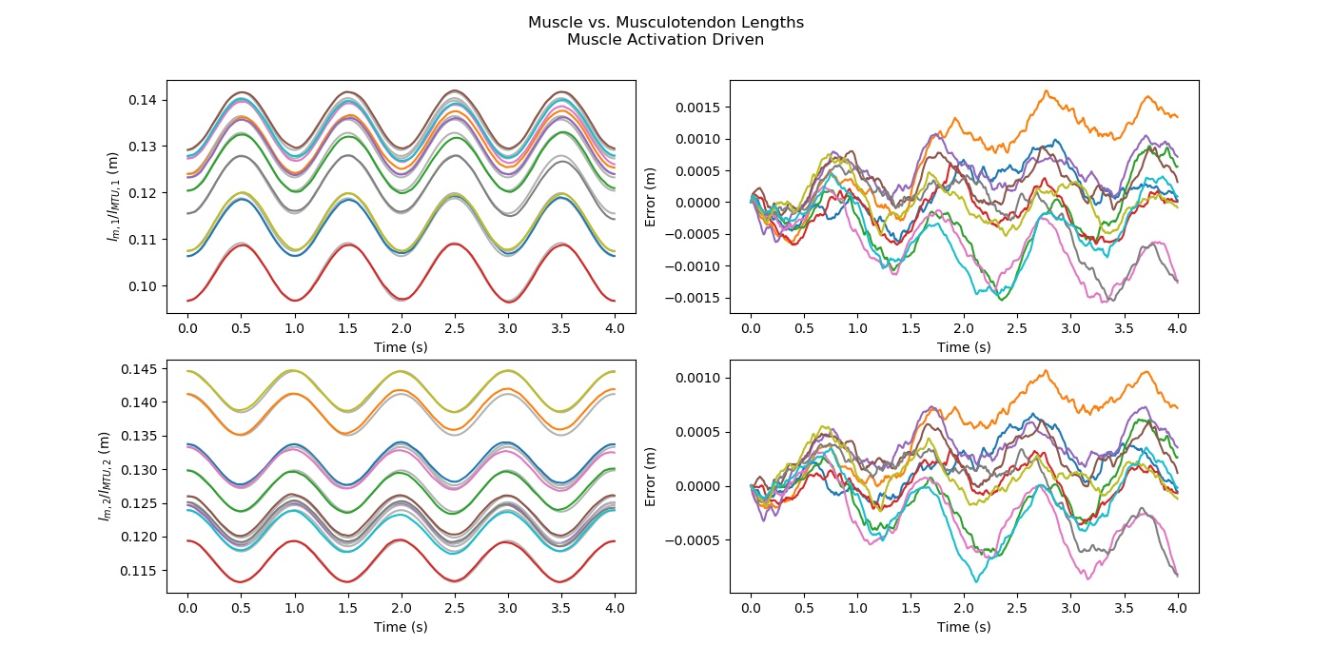
Muscle Length vs. Approx. Muscle Length:
Notes:
For a given isokinetic elbow rotation task, the difference of the estimated MTU velocity and the measured muscle velocity will be calculated to determine what relationship, if any, these two quantities share.
Possible relationships include:
Compensating: after a certain threshold, the tendon takes on more of the length change to aid muscle proficiency.
Linear: for unloaded tasks, the difference between MTU and muscle velocity is linear.
Saturating: after a certain threshold, the tendon cannot lengthen any further and all length change is taken up by the muscle.

Slide 14
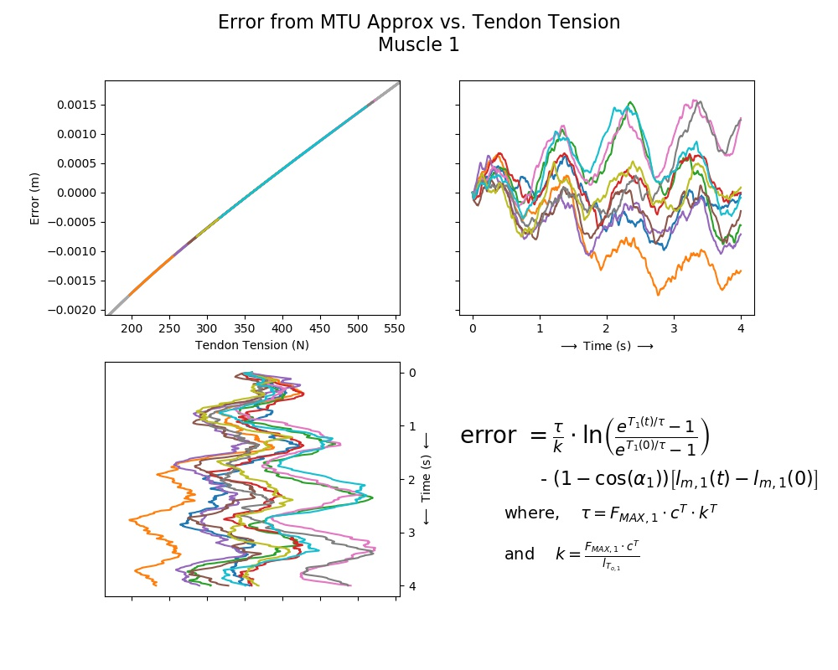
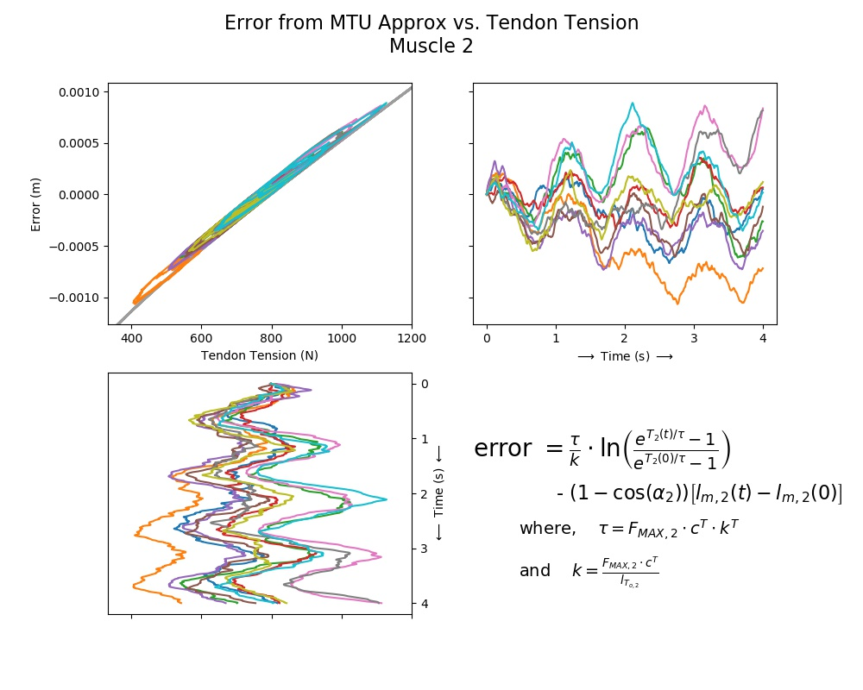
Muscle Length vs. Approx. Muscle Length:
Notes:
For a given isokinetic elbow rotation task, the difference of the estimated MTU velocity and the measured muscle velocity will be calculated to determine what relationship, if any, these two quantities share.
Possible relationships include:
Compensating: after a certain threshold, the tendon takes on more of the length change to aid muscle proficiency.
Linear: for unloaded tasks, the difference between MTU and muscle velocity is linear.
Saturating: after a certain threshold, the tendon cannot lengthen any further and all length change is taken up by the muscle.

Slide 15
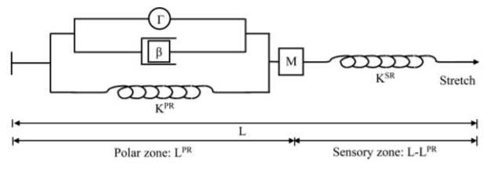

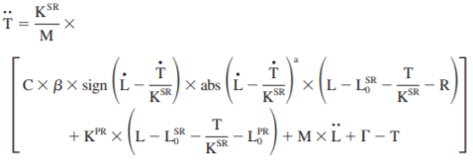
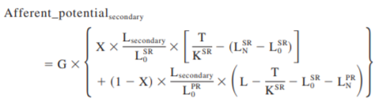
Comparing Ia Output
Notes:
For a given isokinetic elbow rotation task, the difference of the estimated MTU velocity and the measured muscle velocity will be calculated to determine what relationship, if any, these two quantities share.
Possible relationships include:
Compensating: after a certain threshold, the tendon takes on more of the length change to aid muscle proficiency.
Linear: for unloaded tasks, the difference between MTU and muscle velocity is linear.
Saturating: after a certain threshold, the tendon cannot lengthen any further and all length change is taken up by the muscle.

Slide 16
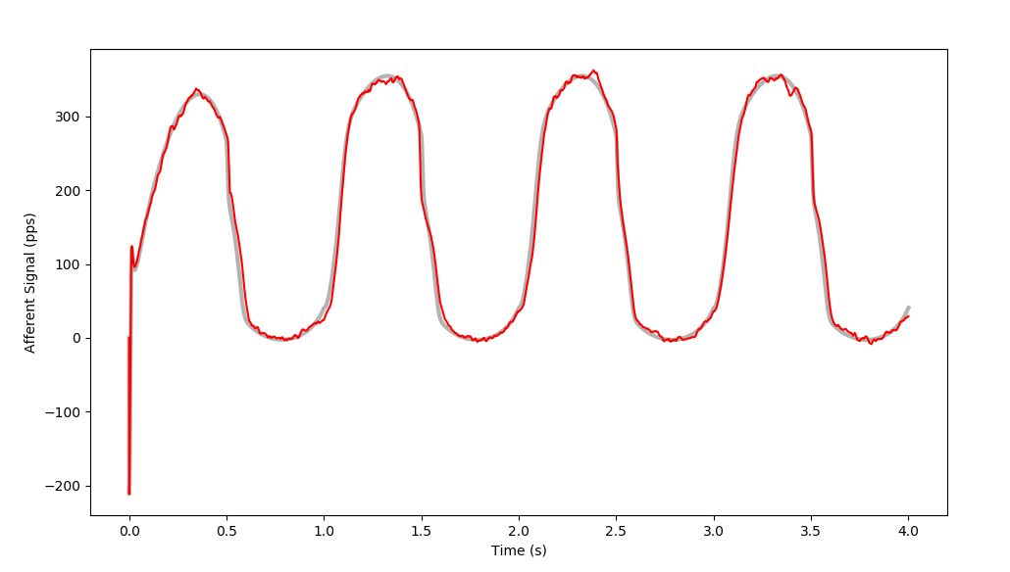
Comparing Ia Output
Gamma Dynamic Gain = 136.316
Notes:
For a given isokinetic elbow rotation task, the difference of the estimated MTU velocity and the measured muscle velocity will be calculated to determine what relationship, if any, these two quantities share.
Possible relationships include:
Compensating: after a certain threshold, the tendon takes on more of the length change to aid muscle proficiency.
Linear: for unloaded tasks, the difference between MTU and muscle velocity is linear.
Saturating: after a certain threshold, the tendon cannot lengthen any further and all length change is taken up by the muscle.

Slide 17
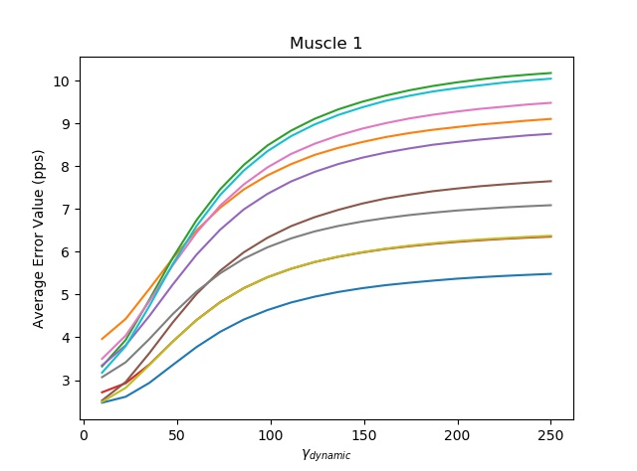
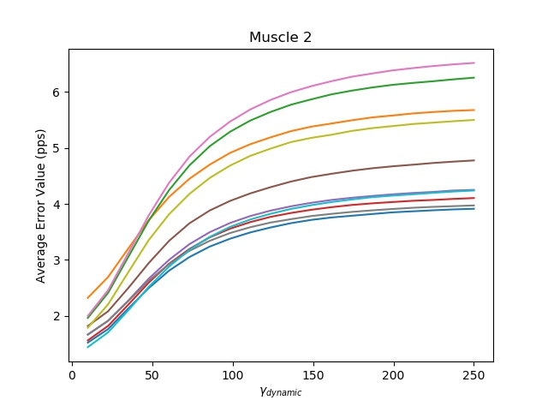
Comparing Ia Output
Gamma Dynamic Gains swept from 10 to 250.
Notes:
For a given isokinetic elbow rotation task, the difference of the estimated MTU velocity and the measured muscle velocity will be calculated to determine what relationship, if any, these two quantities share.
Possible relationships include:
Compensating: after a certain threshold, the tendon takes on more of the length change to aid muscle proficiency.
Linear: for unloaded tasks, the difference between MTU and muscle velocity is linear.
Saturating: after a certain threshold, the tendon cannot lengthen any further and all length change is taken up by the muscle.

Slide 18
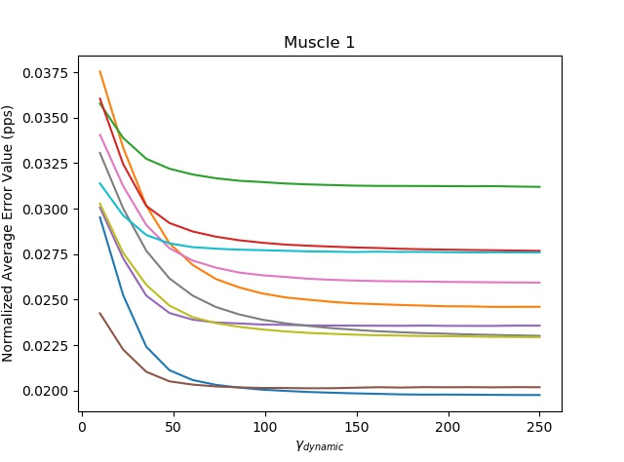
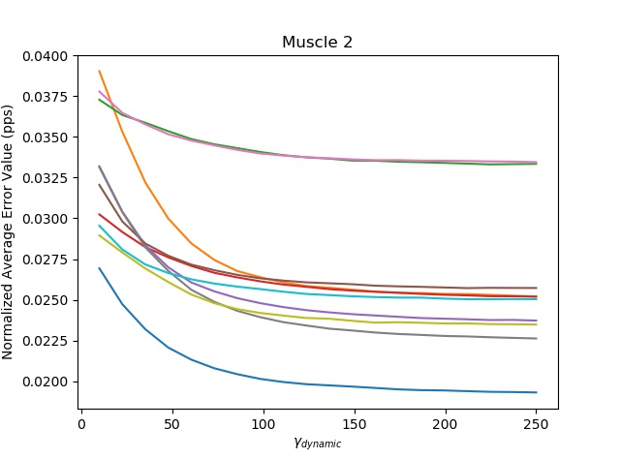
Comparing Ia Output (Normalized)
Error normalized to average peak-to-peak amplitude for one period.
Notes:
For a given isokinetic elbow rotation task, the difference of the estimated MTU velocity and the measured muscle velocity will be calculated to determine what relationship, if any, these two quantities share.
Possible relationships include:
Compensating: after a certain threshold, the tendon takes on more of the length change to aid muscle proficiency.
Linear: for unloaded tasks, the difference between MTU and muscle velocity is linear.
Saturating: after a certain threshold, the tendon cannot lengthen any further and all length change is taken up by the muscle.

Slide 19
Implications
Utilizing the musculotendon approximation for muscle length produce errors. These errors appear to be functions of the tension on the tendon as well as the muscle length itself.
Understanding how and when these approximations fail can lead to more accurate estimations/simulations that do not require the use of computationally exhaustive dynamics.

