Slide 1
Discussion - Week 6
Toey: Tue, 4-5.30pm
Gunce, Thu, 12.30-1.50pm

Slide 2
BME 423 Discussion - Week 6
Outline
independentSamplesTTest()
oneSampleTTest()
posthocPairwiseT()
Bonferroni correction
Holm correction
Notes:
In the Mon. lecture, we will show this slide so the students know what is coming up in that week’s discussion and so we can connect the lecture and discussion.

Slide 3

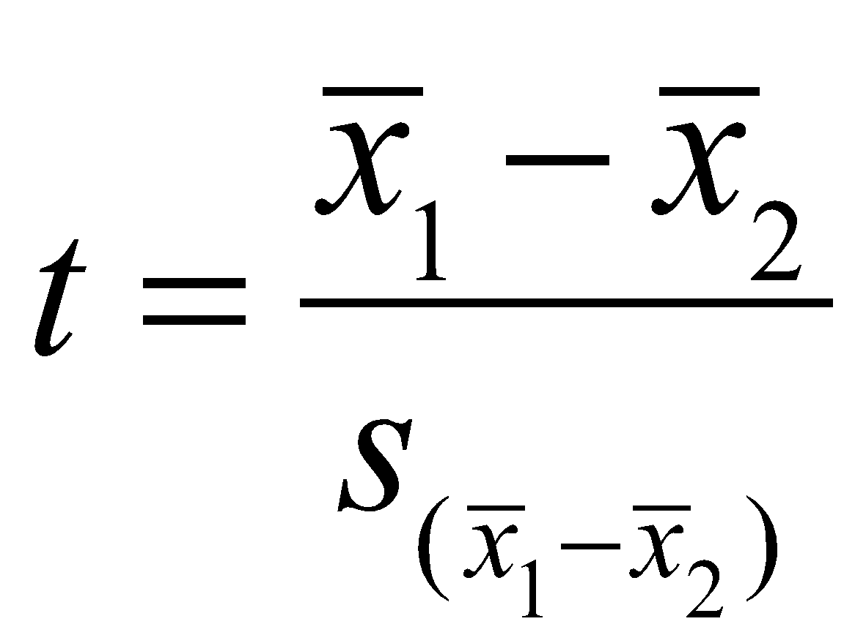
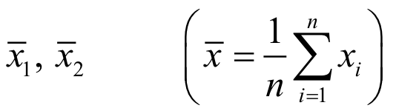
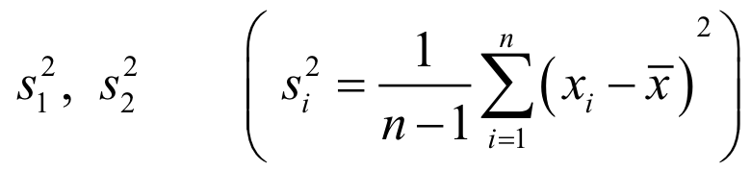
Recap (lecture) : Independent t-Test
If we have an experimental design where participants are randomly allocated to one of two groups, and we want to compare the two groups’ mean performance on some outcome measure, then an independent samples t-Test (rather than a paired samples t-Test) is what we’re after.
Define a new statistic: t
Notes:
Diuratic increase urine production

Slide 4
Recap (lecture) : Assumption of t-Test
Data are interval data
Samples must be independent
Samples must be randomly selected
Populations must be Normally distributed
Variances of each population must be equal

Slide 5
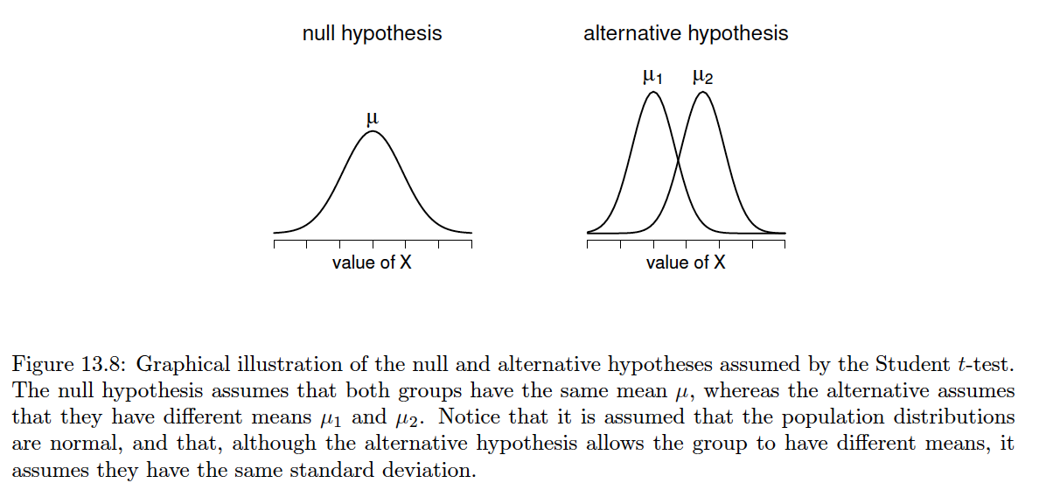
Independent t-Test

Slide 6
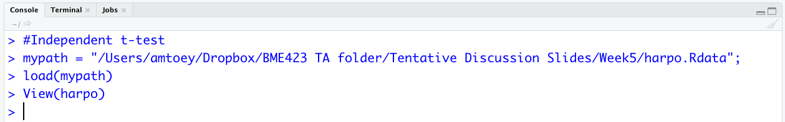
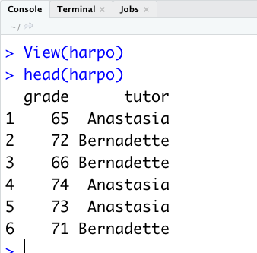
Sample data : Harpo
Suppose we have 33 students taking Dr Harpo’s statistics lectures. There are two tutors for the class, Anastasia and Bernadette.
There are N1=15 students in Anastasia’s tutorials, and N2=18 in Bernadette’s tutorials.
Question: whether Anastasia or Bernadette is a better tutor, or if it doesn’t make much of a difference.
Single data frame with two variables, grade and tutor.
grade: numeric vector, containing the grades for all N=33 students taking Dr Harpo’s class
tutor: a factor that indicates who each student’s tutor was.
Notes:
Suppose we have 33 students taking Dr Harpo’s statistics lectures. There are two tutors for the class, Anastasia and Bernadette.
There are N1 “ 15 students in Anastasia’s tutorials, and N2 “ 18 in Bernadette’s tutorials. The research question I’m interested in is whether Anastasia or Bernadette is a better tutor, or if it doesn’t make much of a difference.

Slide 7
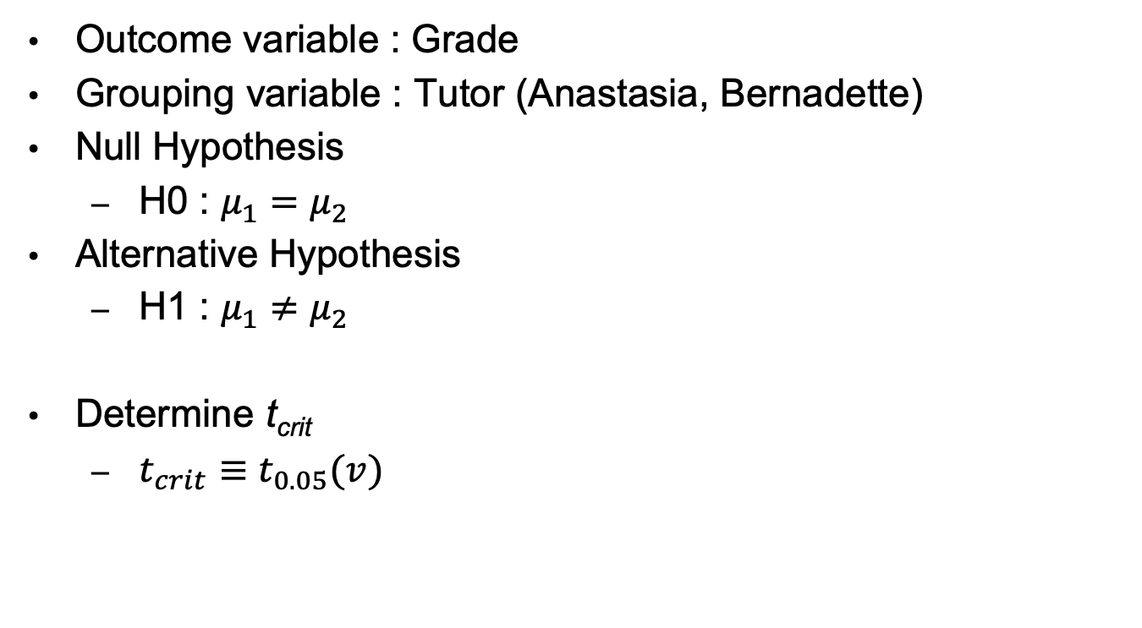
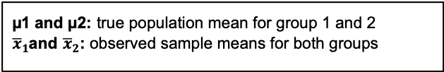
Student t-Test set-up : Are the student mean grades different between two tutors?
Group 1
Group 2
0.05 - Significance level
What is t_{crit} ?

Slide 8
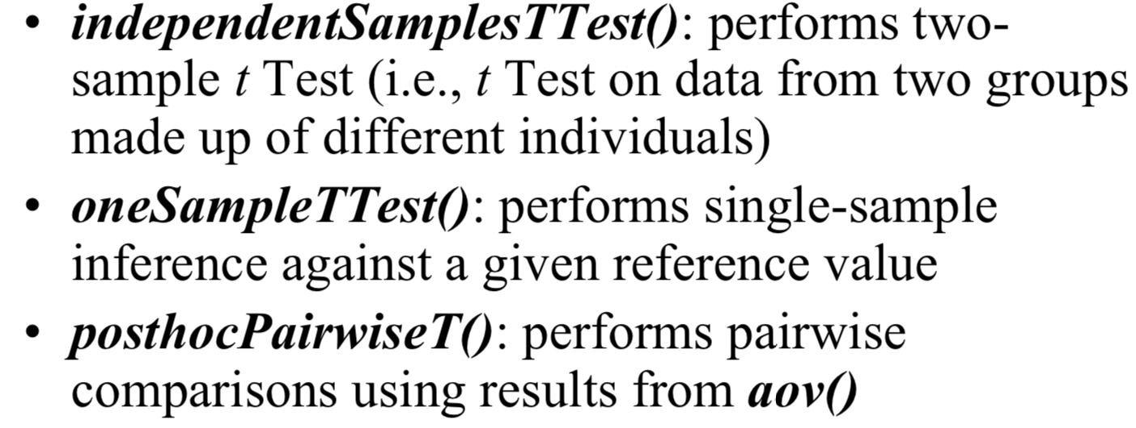
t-Test functions in R
R comes with a function called t.test()
very flexible (it can run lots of different kinds of t-Tests)
somewhat terse (the output is quite compressed).
may require more arguments
We will rely on some simpler functions in the "lsr” package.

Slide 9
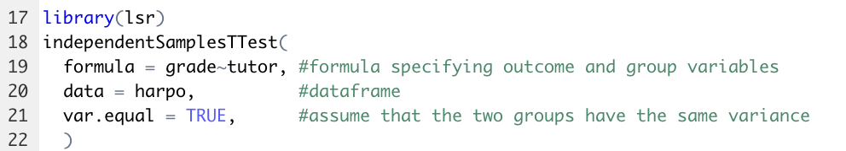
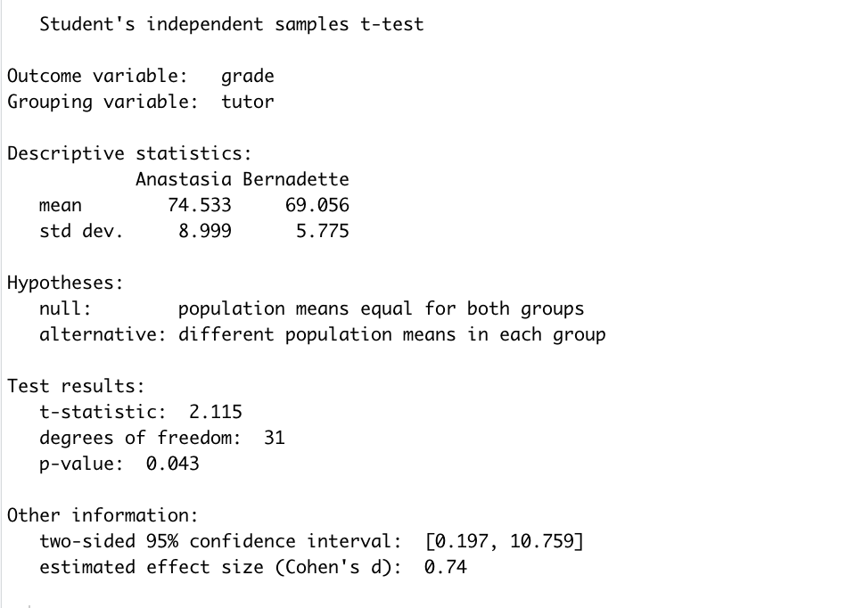
Guided Tour : independentSamplesTTest()
Source
By saying var.equal = TRUE -> telling R to use Student independent samples t-Test
Console
Notes:
Mention that a more general t.test()function exists that you can also use; may require more arguments
You can tell them to ignore the “other information” section for now, but we will cover confidence intervals later in the semester (we do not cover Cohen’s d in this class)

Slide 10
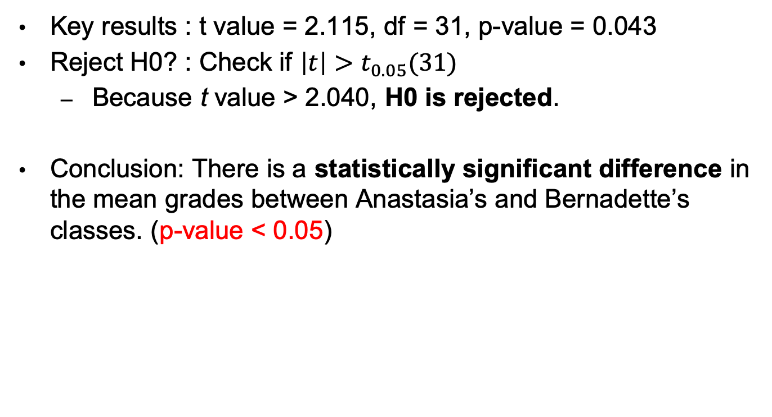
Guided Tour : independentSamplesTTest() -Conclusion-

Slide 11

Sign of the t-statistic
Negative values for the t-statistic → very common
If “mean 1” is larger than “mean 2” → t statistic will be positive,
If “mean 2” is larger → t statistic will be negative
Look at the actual group means!
The sign does not matter for the two-tailed version of the t-test!

Slide 12
In-class exercise : Female height vs. Male height (1/3)
Alldata_2019.csv
Assume Normality
Test the difference in the mean heights for females and males.
Assumptions of t Test
Data are interval data
Samples must be independent
Samples must be randomly selected
Populations must be Normally distributed
Variances of each population must be equal

Slide 13
In-class exercise : Compare height of female and male students in R (2/3)

Slide 14
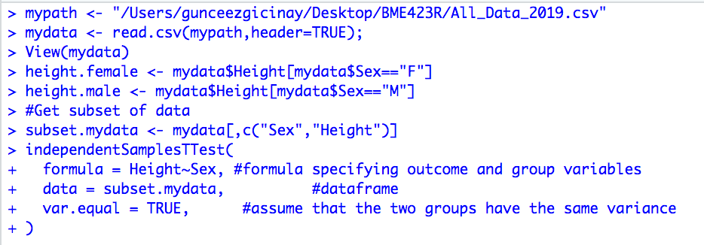
In-class solution

Slide 15
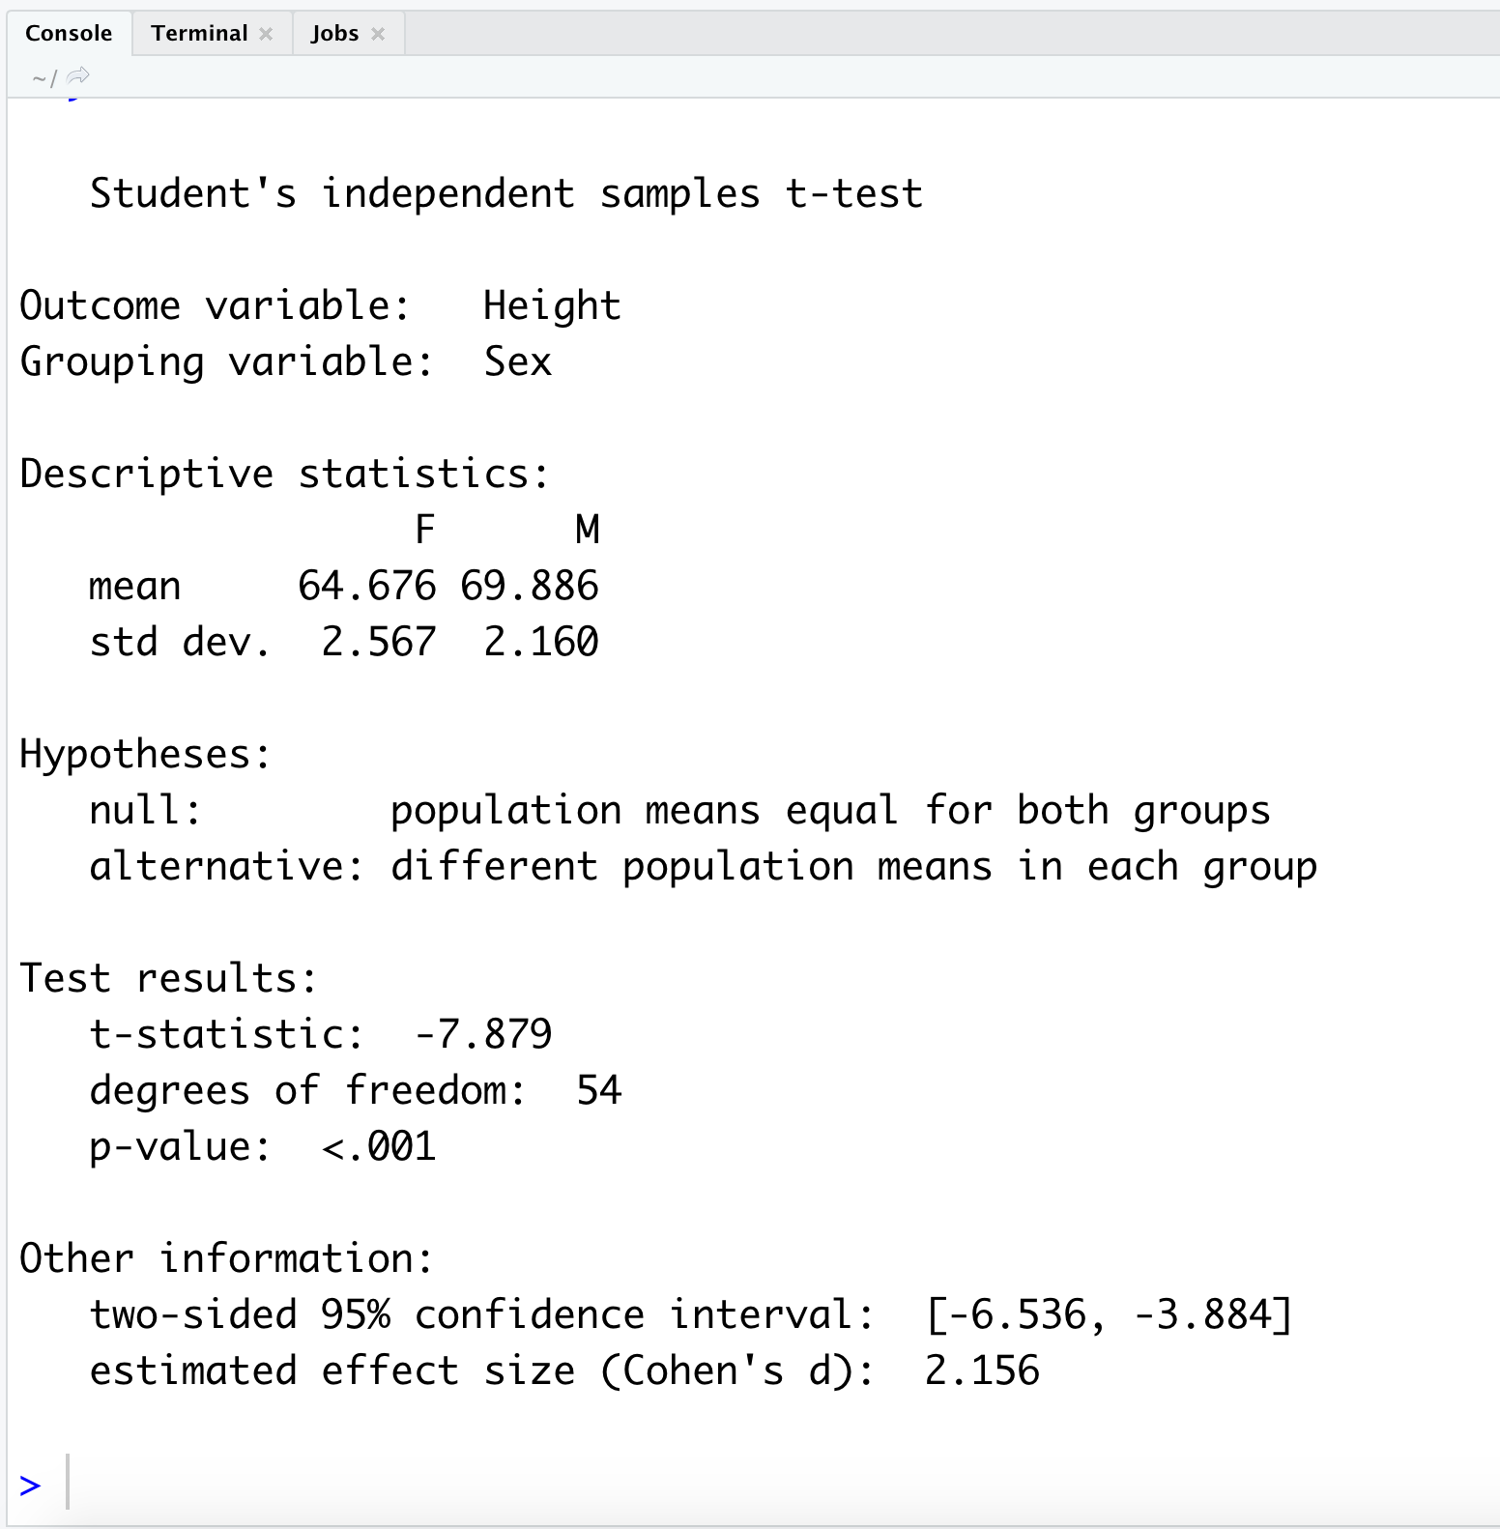
In-class solution

Slide 16
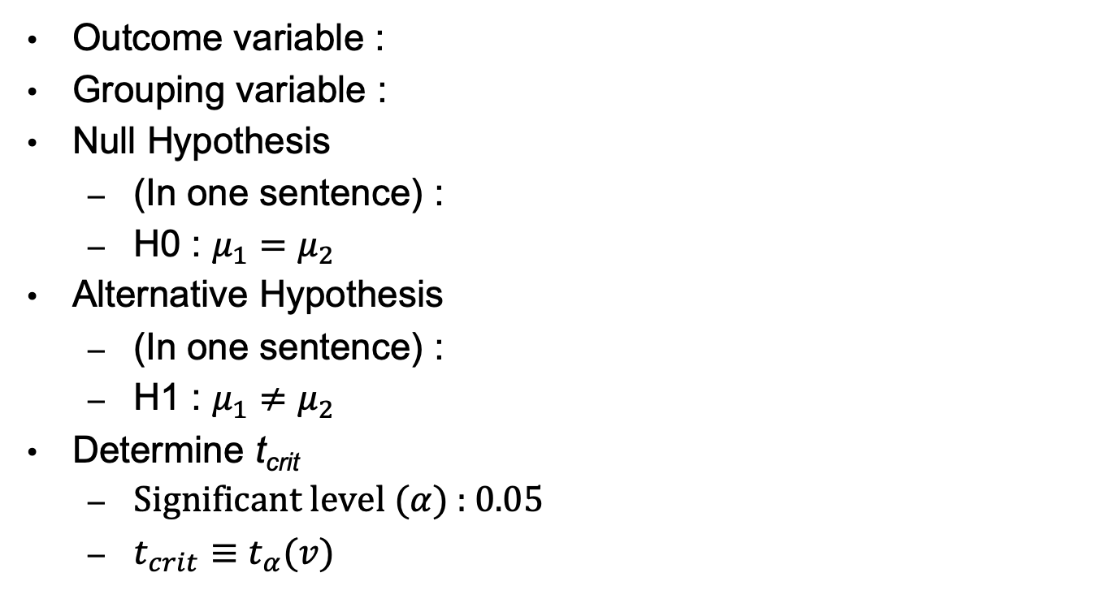
In-class exercise : Compare height of female and male students (3/3)

Slide 17
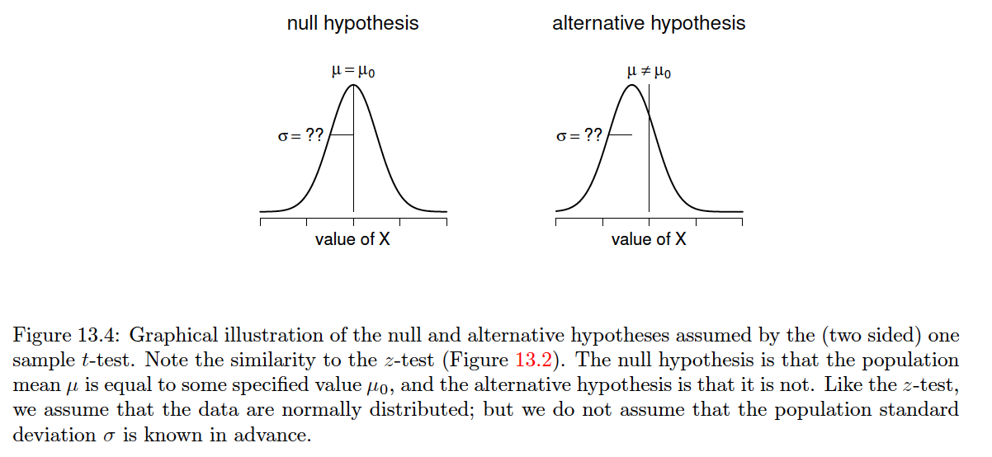
One-sample t-Test

Slide 18
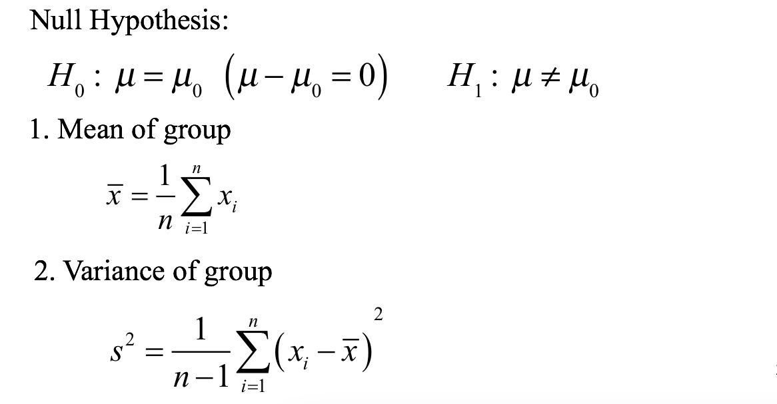
Recap (lecture) : One-sample t-Test

Slide 19
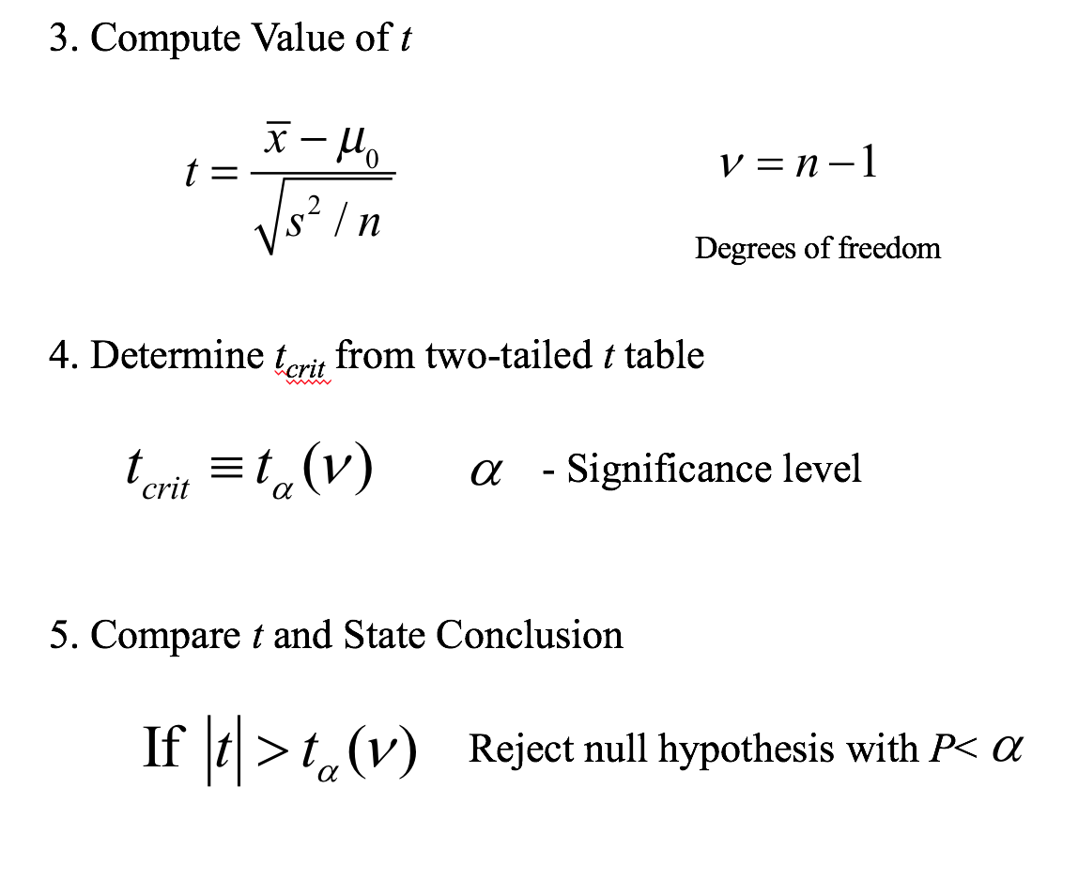
Recap (lecture) : One-sample t-Test

Slide 20
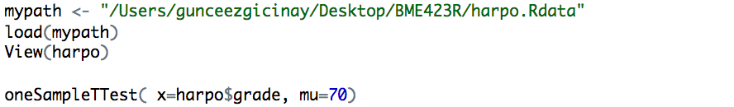
OneSampleTTest()
If you want to run a one-sample t-Test → use the oneSampleTTest() function!
x: the variable containing the data,
mu: the true population mean according to the null hypothesis (i.e., the reference value you are comparing your sample against).
Let’s set the null hypothesis as: the mean of the grades for all students is 70
oneSampleTTest( x=variable being examined, mu=70 )

Slide 21
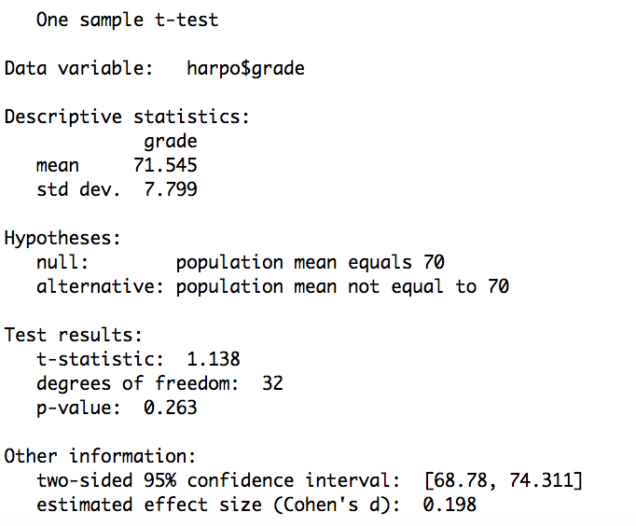
OneSampleTTest()
Notes:
You can tell them to ignore the “other information” section for now, but we will cover confidence intervals later in the semester (we do not cover Cohen’s d in this class)

Slide 22
In-class exercise : Check if the mean height of female students is different from 64

Slide 23

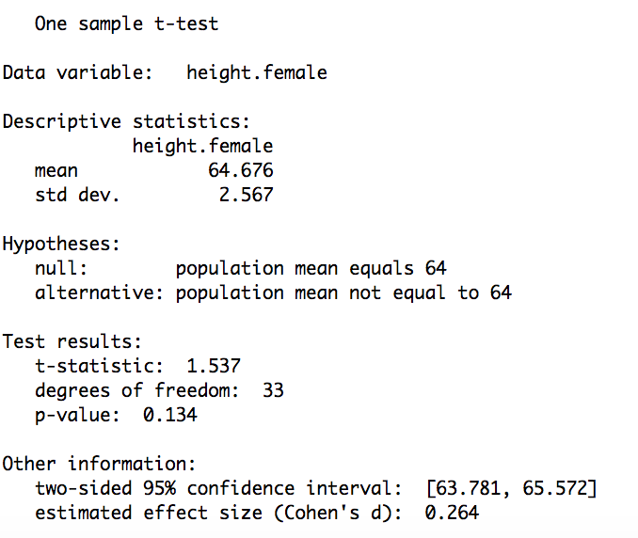
In-class exercise Solution

Slide 24
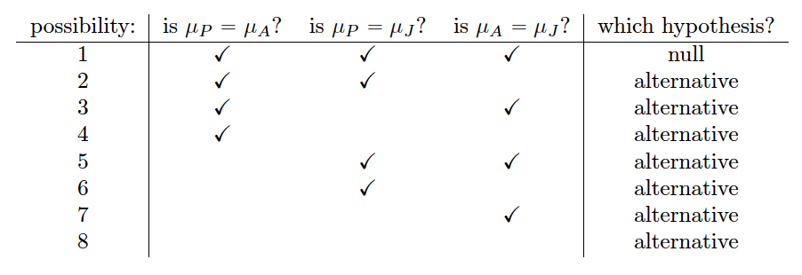
Multiple comparisons and post hoc tests
Any time you run an ANOVA with more than two groups, and you end up with a significant effect, the first thing you’ll probably want to ask is which groups are actually different from one another.
In last week’s drugs example (placebo, Anxifree and Joyzepam), the null hypothesis was that all three drugs have the exact same effect on mood
The null hypothesis is actually claiming three different things all at once:
µP = µA , µP = µJ , µA = µJ
If we’ve rejected our null hypothesis → we’re thinking that at least one of those things isn’t true.
Which one of these 7 alternative hypotheses do we think is right? → RUN SOME TESTS

Slide 25
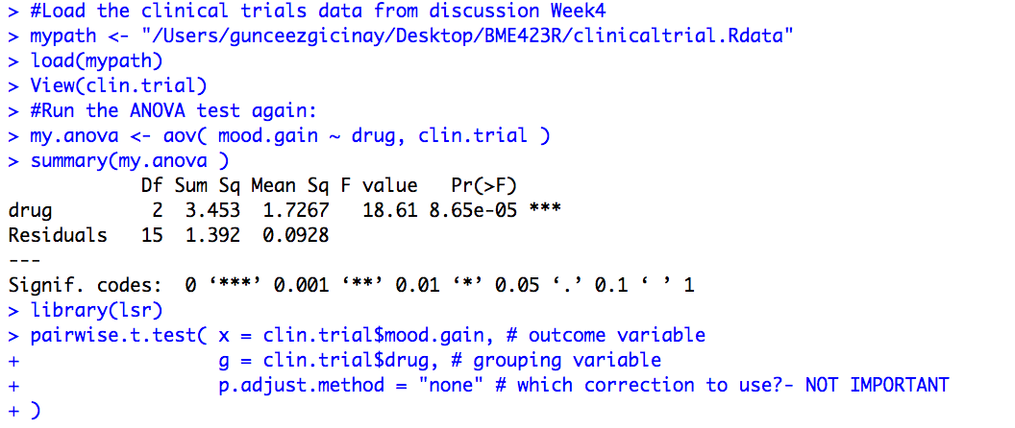

Slide 26
pairwise.t.test()
How might we go about solving our problem?
We’ve got three separate pairs of means to compare → run three separate t-Tests and see what happens.
One method would be to construct new variables corresponding to the groups you want to compare and then run a t-Test on these new variables:
This “lots of t-Tests idea” isn’t a bad strategy, but there are some problems with it.
Instead, R provides a function called pairwise.t.test() that runs all of the t-Tests for you.
There are three arguments that you need to specify,
x: the outcome variable
g: the group variable,
p.adjust.method argument: can “adjust” the p-value in many different ways (we will use: "none", “bonferroni", or ”holm" in this class)

Slide 27
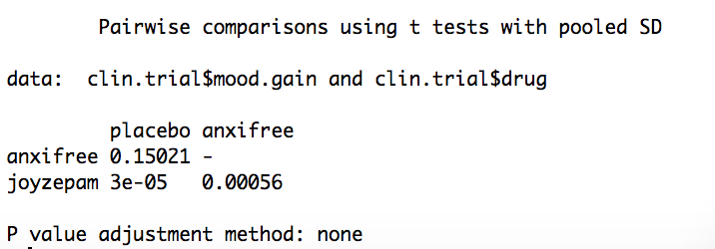
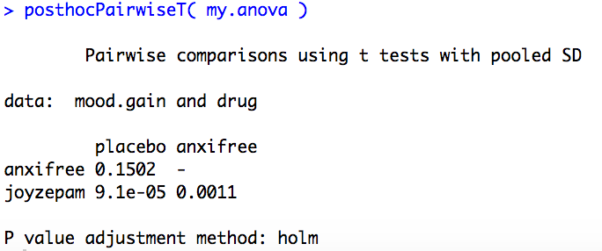
posthocPairwiseT()
posthocPairwiseT() function in the “lsr” package → you can just input the aov object itself, and then get the pairwise tests as an output.
posthocPairwiseT() is a simple way of calling pairwise.t.test() function,

Slide 28
Correction for multiple comparisons
Problem with just running lots and lots of t-Tests: “fishing expedition”: we’re running lots and lots of tests without much theoretical guidance, in the hope that some of them come up significant.
This kind of theory-free search for group differences is referred to as post hoc analysis (“post hoc” in Latin: “after this”).
The principle behind null hypothesis testing: controlling our Type I error rate → but now that I’m running lots of t-Tests at once, chances of Type I error increases
Type I error is the rejection of a true null hypothesis ("false positive" finding).
The usual solution to this problem is to introduce an adjustment to the p-value: correction for multiple comparisons.
Different ways of doing this adjustment:
1. Bonferroni corrections
2. Holm corrections

Slide 29
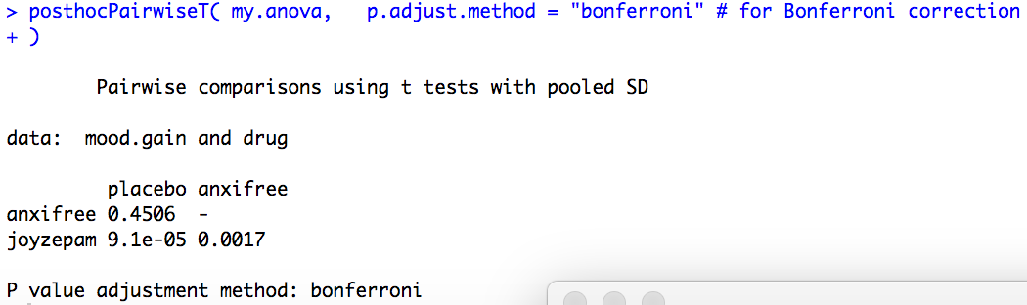
Bonferroni corrections
To use the Bonferroni correction in R , you can use the posthocPairwiseT() function, making sure that you set p.adjust.method = "bonferroni" .

Slide 30
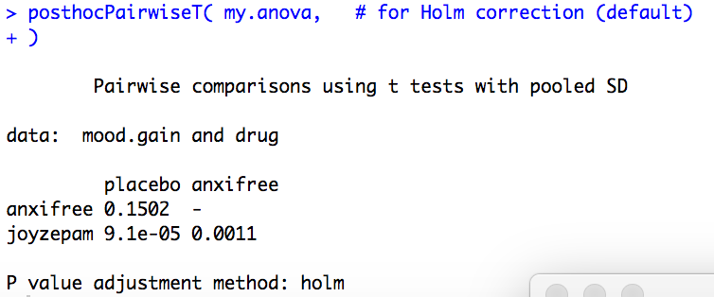
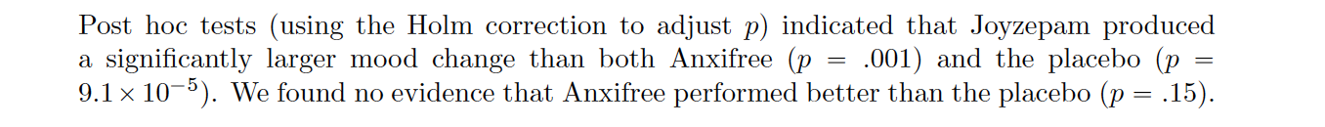
Holm corrections
Refer to the Supplementary section of these slides to see how Holm corrections work
Conclusion:
Notes:
If students are confused on how to decide whether or not to reject each H0, have them read p447 in DN
They will need to compare the calculated/corrected P-value for each pairwise comparison against the overallsignificance level being used

Slide 31
Supplementary

Slide 32


Holm corrections
The idea behind the Holm correction is to pretend that you’re doing the tests sequentially; starting with the smallest (raw) p-value and moving onto the largest one. For the j-th largest of the p-values, the adjustment is either
OR
whichever one is larger

Slide 33
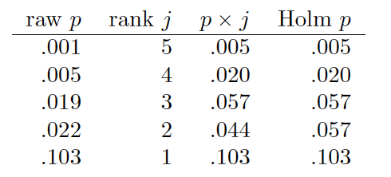
Holm corrections
Here’s what the Holm correction does. First, you sort all of your p-values in order, from smallest to largest. For the smallest p-value all you do is multiply it by m, and you’re done. However, for all the other ones it’s a two-stage process. For instance, when you move to the second smallest p-value, you first multiply it by m-1. If this produces a number that is bigger than the adjusted p-value that you got last time, then you keep it. But if it’s smaller than the last one, then you copy the last p-value. To illustrate how this works, consider the table below, which shows the calculations of a Holm correction for a collection of five p-values:

Slide 34
Holm corrections
Although it’s a little harder to calculate, the Holm correction has some very nice properties: it’s more powerful than Bonferroni (i.e., it has a lower Type II error rate), but it has the same Type I error rate. As a consequence, in practice there’s never any reason to use the simpler Bonferroni correction, since it is always outperformed by the slightly more elaborate Holm correction. Because of this, the Holm correction is the default one used by pairwise.t.test() and
posthocPairwiseT(). To run the Holm correction in R, you could specify p.adjust.method = ”holm" if you wanted to, but since it’s the default you can just use posthocPairwiseT( my.anova )

Slide 36
Discussion Assignment #2
Due: October 4, 2019 @5pm (online submission)
For both questions:
Show your R code
State the outcome variable, grouping variable, H₀, H₁, critical t value, and your conclusion (i.e., reject or do not reject H₀, make a concluding sentence, and provide the P value if appropriate)
Questions:
Using Alldata_2019.csv,
Compare heart rate of female and male students
Check if the mean heart rate of male students is different from 65

