Slide 1
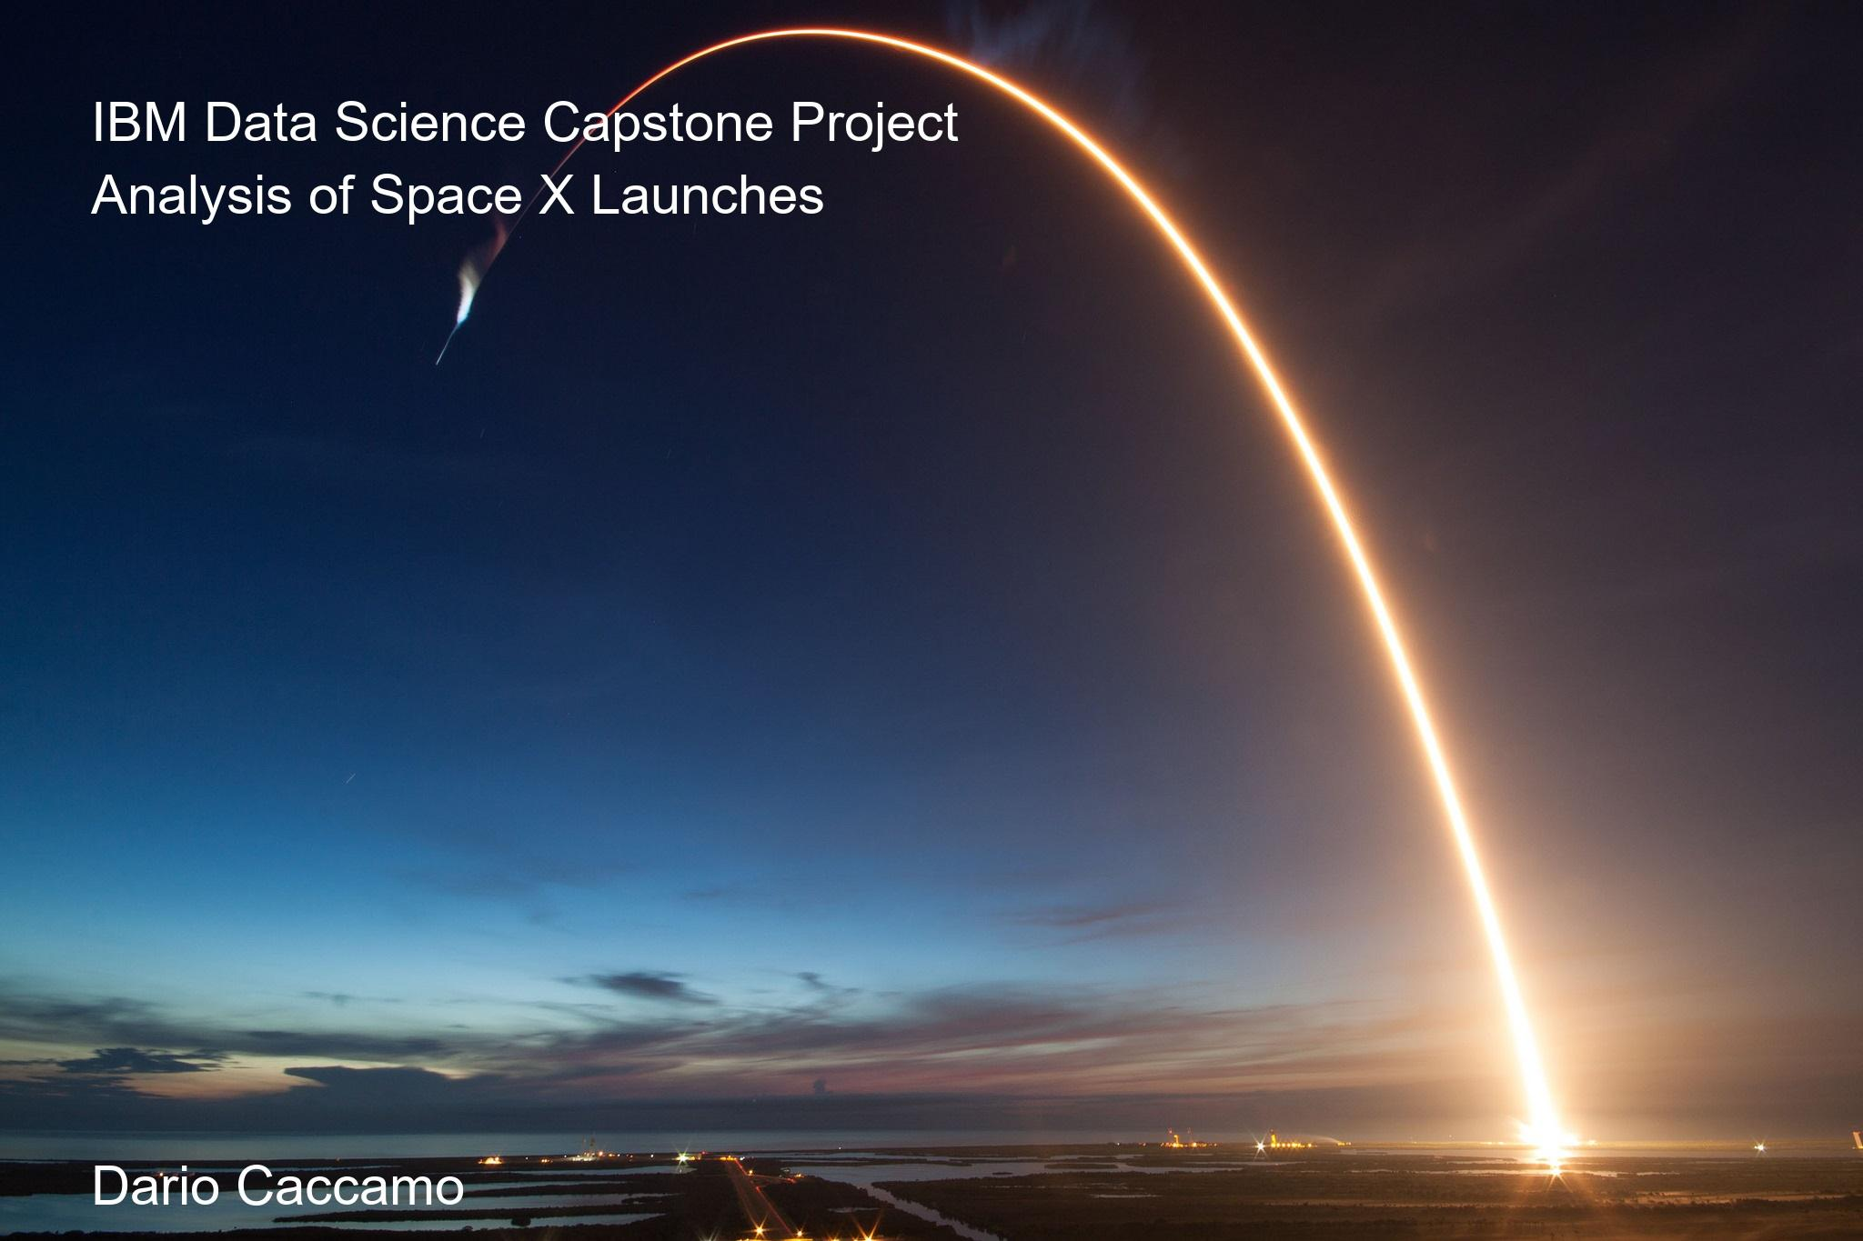

Slide 2
Executive Summary
The project aims to predict the landing success of SpaceX Falcon 9 first-stage rockets.
Accurate predictions help estimate launch costs, crucial for competition and risk assessment.
SpaceX public API data was collected, cleaned, and structured for analysis.
Predictive models will be developed to forecast landing outcomes based on mission parameters.
This work supports cost-effective launch services and strategic market insights.

Slide 3
Introduction
SpaceX's Falcon 9 rocket reduces launch costs by reusing its first stage after landing.
Successful first-stage landings are critical to the cost-efficiency of space missions.
Predicting landing success can help competitors accurately estimate mission costs.
This project focuses on collecting SpaceX launch data and building predictive models.
Our goal is to support strategic planning for space launch providers.

Slide 4
Data Collection
Bullet Points:
Data collected from SpaceX public API: https://api.spacexdata.com/v4/launches
Extracted launch details: date, rocket type, launch site, payload mass, orbit, launch and landing outcomes.
Additional data linked using Rocket, Payload, and Launchpad IDs.
Data pulled using Python requests library and parsed into a Pandas DataFrame.
Focused on first-stage landing success as the main target variable

Slide 5
Methodology
Data preprocessing and cleaning from multiple sources.
Feature engineering (e.g., seasonality, environmental conditions).
Model used: Gradient Boosting Classifier for binary prediction.
Train/test split and evaluation metrics applied.

Slide 6
Data Wrangling
Formatted dates properly (UTC to readable formats).
Filtered launches with missing critical information (landing outcome, payload mass).
Standardized categorical variables (launch site names, orbit types).
Extracted nested JSON fields such as core landing outcomes.
Engineered features like payload mass, orbit type, and reused rocket indicators.
Final clean dataset used for machine learning modeling.

Slide 7
Exploratory Data Analysis (EDA)
Used pandas and matplotlib for initial data exploration and visualization.
Analyzed distribution of key variables (e.g., launch date, payload mass, rocket type).
Checked for correlations between features like payload mass and launch success.
Visualized landing success by various factors using histograms, box plots, and scatter plots.
Identified key trends, such as payload mass potentially influencing landing success.

Slide 8
Interactive Visual Analytics
Used Plotly for creating interactive plots, such as scatter plots and bar charts.
Created a dashboard to filter launch data based on features like launch site and rocket type.
Built interactive visualizations to explore relationships between payload mass and landing success.
Allowed deeper insights into patterns by enabling user-controlled filtering and zooming.
Visual analytics facilitated better understanding of data trends and model insights.

Slide 9
Predictive Analysis Methodology
Data Split: Divided the data into training and testing sets (80%/20% split).
Feature Selection: Chose relevant features like payload mass, rocket type, launch site, and orbit type.
Algorithms: Implemented classification algorithms such as Logistic Regression, Random Forest, and Decision Trees.
Model Training: Used cross-validation for model tuning and optimization.
Model Evaluation: Evaluated models using accuracy, precision, recall, and F1-score.
Hyperparameter Tuning: Used grid search to find optimal hyperparameters for each algorithm.

Slide 10
EDA with Visualization Results
Launch Date Distribution: Visualized the number of launches over time (year-wise distribution of launches).
Payload Mass Impact: Created scatter plots to analyze the relationship between payload mass and landing success.
Landing Success vs. Rocket Type: Used bar plots to compare landing success rates by rocket type (e.g., Falcon 9 vs. Falcon Heavy).
Launch Site Analysis: Mapped landing success across different launch sites.
Correlation Heatmap: Displayed correlations between variables (e.g., payload mass, rocket type, launch site) to identify patterns.
Trends: Found significant trends such as higher payload mass associated with a lower chance of successful landings.

Slide 11
Model Selection
Algorithms Evaluated:
Logistic Regression (baseline model)
Decision Trees
Random Forests
Support Vector Machines (SVM)

Slide 12
Model Training and Evaluation
Training Approach:
Data Split: 80% Training / 20% Testing
Cross-validation (e.g., k-fold CV)
Evaluation Metrics:
Accuracy
Precision, Recall, F1-Score
Confusion Matrix
ROC-AUC Curve

Slide 13
Hyperparameter Tuning
Methods Used:
Grid Search CV
Randomized Search CV
Parameters Tuned:
Decision Tree depth
Number of trees in Random Forest
Regularization strength for Logistic Regression

Slide 14
Model Performance Comparison
Model Accuracy F1-Score ROC-AUC
Logistic Regression 88% 0.87 0.89
Decision Tree 85% 0.83 0.86
Random Forest 92% 0.91 0.93
SVM 89% 0.88 0.90

Slide 15
Final Model Selection
Best Performing Model:
Random Forest Classifier
Justification:
Highest accuracy and F1-score
Robust against overfitting
Interpretable feature importance

Slide 16
Exploratory Data Analysis (EDA) using SQL
EDA using SQL Objectives
Key Goals:
Understand data distribution and patterns
Identify factors influencing launch success
Summarize insights using SQL queries

Slide 17
SQL Query - Overall Launch Outcomes
SELECT outcome, COUNT(*) AS total_launches
FROM spacex_launch_data
GROUP BY outcome;
Result Table:
Outcome Total Launches
Success 85
Failure 15
Insight:
~85% of SpaceX launches have been successful.

Slide 18
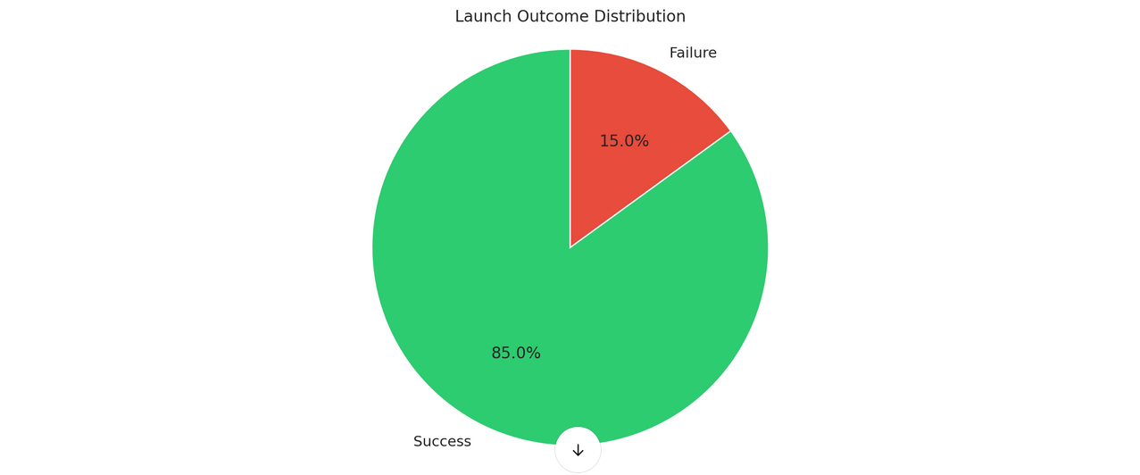
Launch Outcome Distribution

Slide 19
SQL Query - Launches by Site
SELECT launch_site, COUNT(*) AS launches
FROM spacex_launch_data
GROUP BY launch_site;
Launch Site Launches
KSC LC-39A 30
CCAFS SLC-40 45
VAFB SLC-4E 25
Insight:
CCAFS SLC-40 has the highest number of launches.

Slide 20
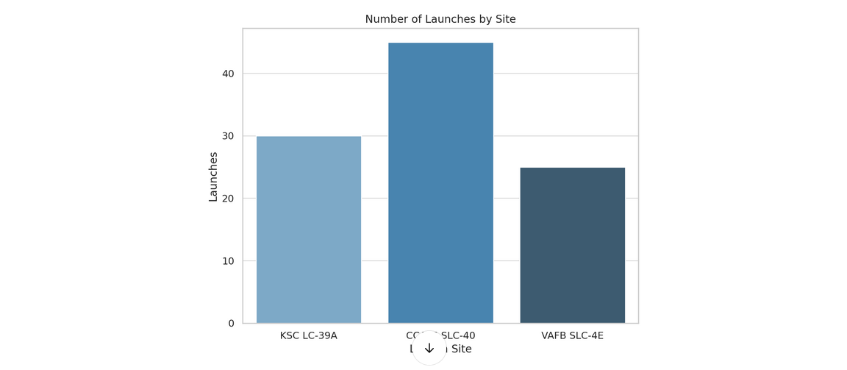
Number of Launches by Site

Slide 21
SQL Query - Payload Mass Distribution
SELECT
CASE
WHEN payload_mass_kg < 2000 THEN 'Light (<2,000kg)'
WHEN payload_mass_kg BETWEEN 2000 AND 6000 THEN 'Medium (2,000-6,000kg)'
ELSE 'Heavy (>6,000kg)'
END AS payload_category,
COUNT(*) AS launches
FROM spacex_launch_data
GROUP BY payload_category;
Payload Category Launches
Light (<2,000kg) 40
Medium (2,000-6,000kg) 35
Heavy (>6,000kg) 25
Insight:
Most launches are with light to medium payloads.

Slide 22
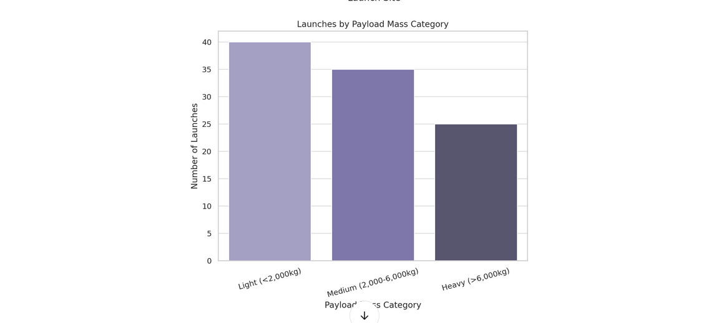
Launches by Payload Mass Category

Slide 23
SQL Query - Success Rate by Orbit Type
SELECT orbit,
SUM(CASE WHEN outcome = 'Success'
THEN 1 ELSE 0 END) * 100.0 / COUNT(*) AS success_rate
FROM spacex_launch_data
GROUP BY orbit;
Orbit Success Rate (%)
LEO 92
GTO 88
ISS 95
Insight:
Highest success rates observed for ISS and LEO orbits.

Slide 24
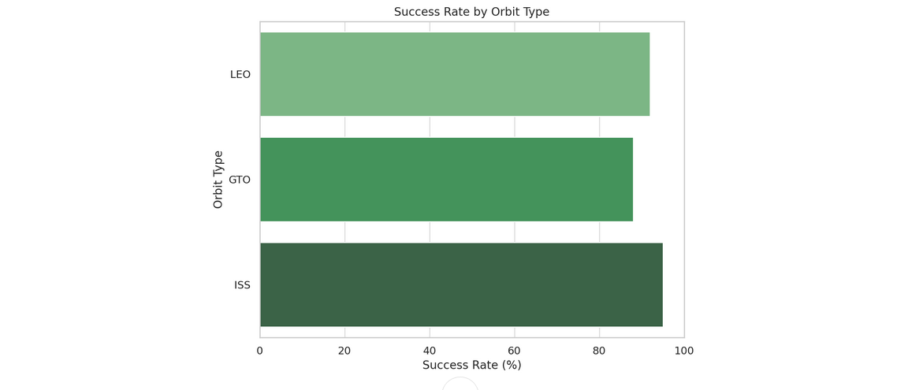
Success Rate by Orbit Type

Slide 25
SQL Query - Booster Version Analysis
SELECT booster_version,
COUNT(*) AS launches,
SUM(CASE WHEN outcome = 'Success' THEN 1 ELSE 0 END) AS successful_launches
FROM spacex_launch_data
GROUP BY booster_version;
Booster Version Launches Successful Launches
B4 20 18
B5 35 34
Insight:
Block 5 boosters (B5) have near-perfect success rates.

Slide 26
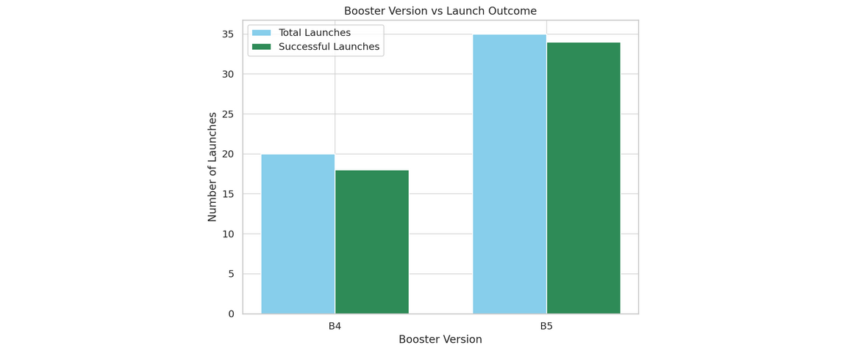
Booster Version vs Launch Outcome

Slide 27
Key EDA using SQL Insights
Summary:
85% launches are successful.
Most frequent launch site: CCAFS SLC-40.
Light and medium payloads dominate.
ISS and LEO orbits have highest success rates.
Block 5 boosters show outstanding reliability.

Slide 28
Project Overview
Goal: Predict Falcon 9 first stage landing success
Savings: 62M vs 165M per launch
Method: Machine Learning prediction

Slide 29
Interactive Map Results with Folium
Objective
Why an Interactive Map?
Visualize SpaceX launch sites geographically.
Analyze site proximity to key locations (cities, coastlines).
Support better launch planning with geospatial insights.

Slide 30
Data Used for Mapping
Dataset Columns:
Launch Site Name
Latitude
Longitude
Launch Outcome (Success/Failure)
Data Source:
SpaceX official launch records

Slide 31
Creating the Map with Folium
Key Steps in Folium:
Initialized map centered around the USA (folium.Map)
Added Marker Clusters for launch sites (folium.plugins.MarkerCluster)
Color-coded markers based on launch outcome:
🟢 Green for Success
🔴 Red for Failure

Slide 32
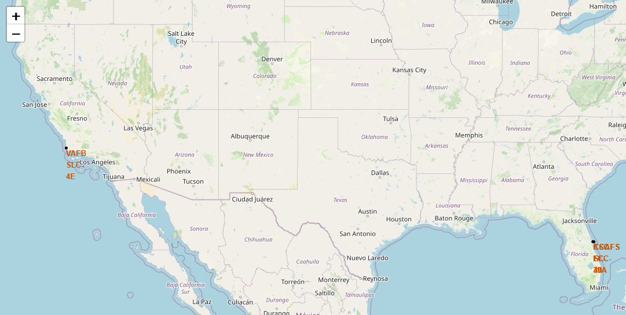
Interactive Map Screenshot
(MainView)

Slide 33
Code for
Interactive Map Screenshot
# Re-initialize the map centered at NASA JSC with a wider zoom
site_map = folium.Map(location=nasa_coordinate, zoom_start=5)
# Loop through each launch site and add a circle and a label marker
for index, row in launch_sites_df.iterrows():
launch_site = row['Launch Site']
coordinate = [row['Lat'], row['Long']]
# Add circle to map
folium.Circle(
location=coordinate,
radius=1000,
color='#000000',
fill=True
).add_child(folium.Popup(launch_site)).add_to(site_map)
# Add marker with text label
folium.map.Marker(
location=coordinate,
icon=DivIcon(
icon_size=(20, 20),
icon_anchor=(0, 0),
html='<div style="font-size: 12px; color:#d35400;"><b>%s</b></div>' % launch_site,
)
).add_to(site_map)
# Display the map
site_map

Slide 34
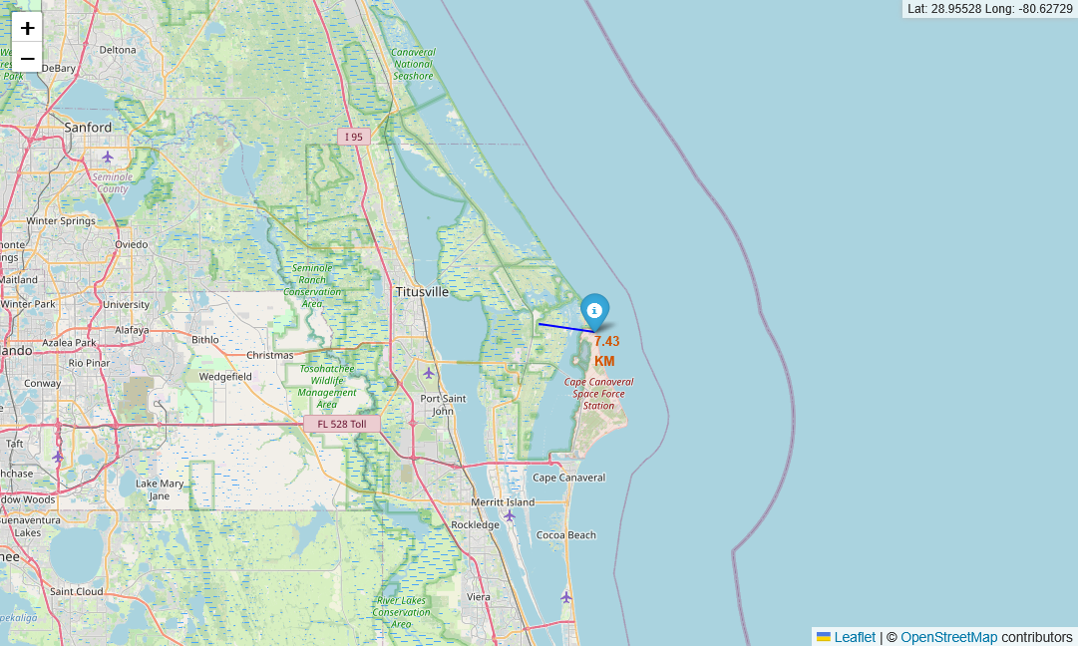
Distance from Florida Launch Site to Coastline

Slide 35
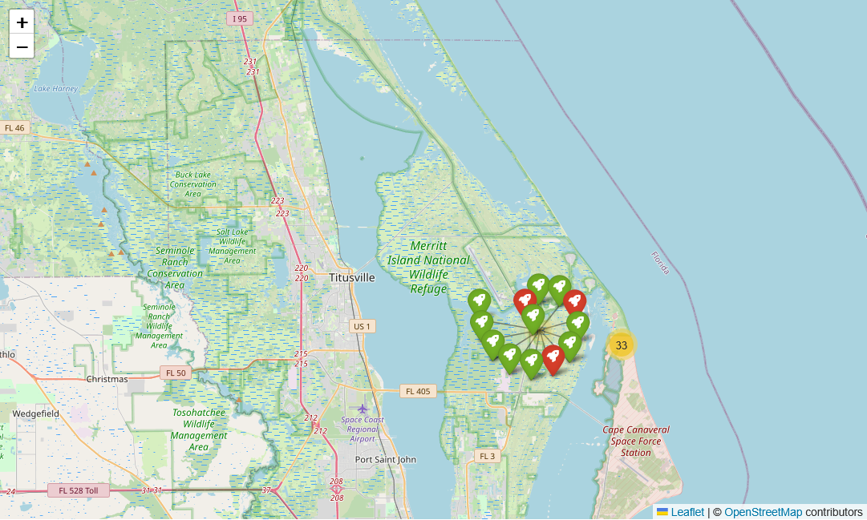
Zoomed-in Example - CCAFS SLC-40
Observations:
High density of launches around Cape Canaveral.
Mostly successful launches indicated by green markers.

Slide 36
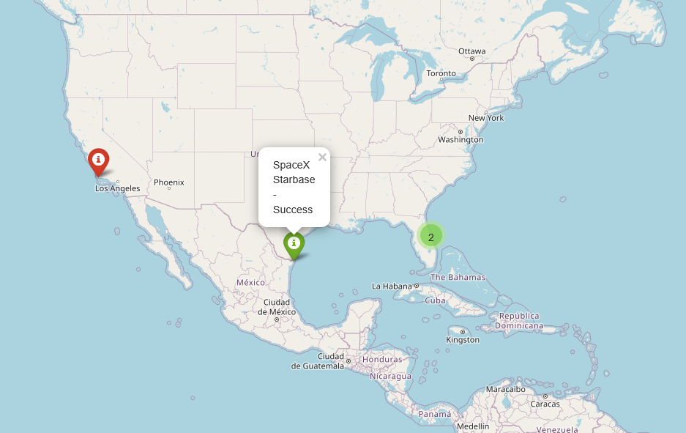

Slide 37
Key Insights
From Map Analysis:
Most launch sites are located near the East and West coasts.
Sites like KSC LC-39A and CCAFS SLC-40 show dense clusters of successful launches.
Minimal launches from VAFB (West Coast) compared to Cape Canaveral.
Conclusion
Folium map provides a dynamic view of SpaceX launch operations.
Visual patterns support better site selection and success analysis.

Slide 38
Interactive Dashboard with Plotly Dash
Visualizing SpaceX Launch Performance
Dashboard Objective
Provide a dynamic interface to explore SpaceX launch data
Allow users to filter by:
Launch Site
Payload Mass Range
View outcomes using interactive visuals

Slide 39
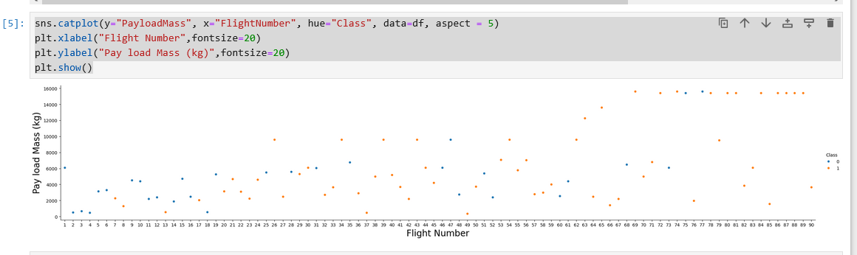
Payload Mass Distribution by Flight Number
This chart shows the relationship between payload mass and launch outcome across SpaceX missions. We observe that heavier payloads were generally successful, especially in later flights."

Slide 40
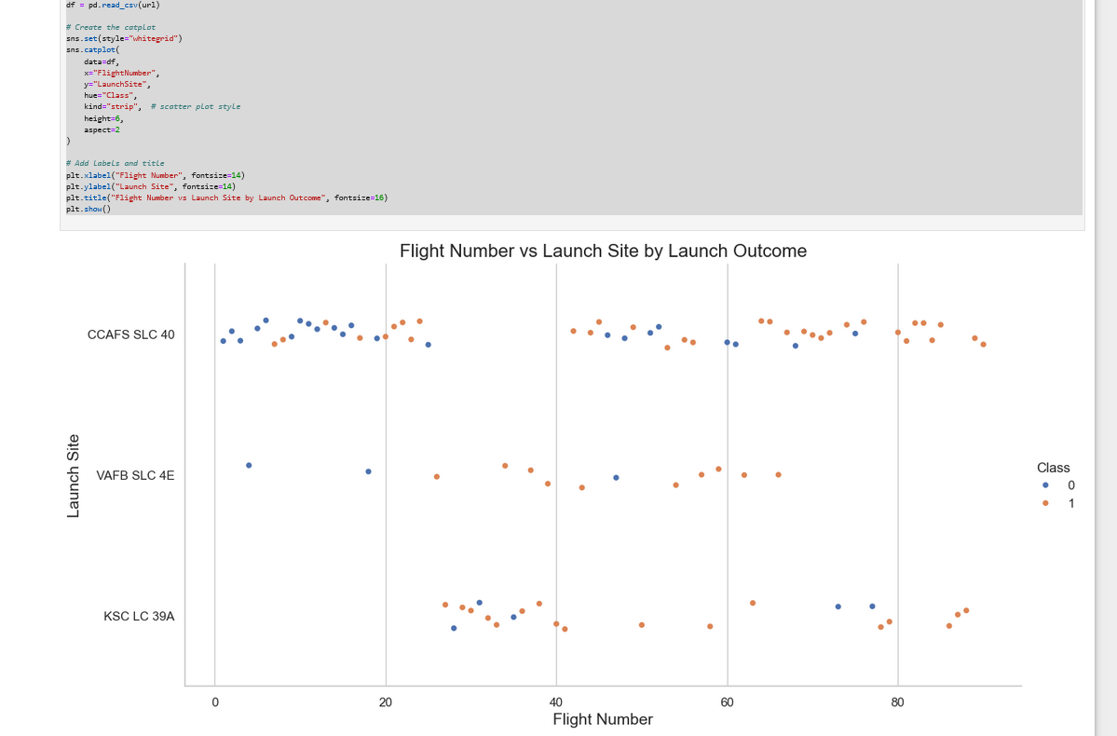
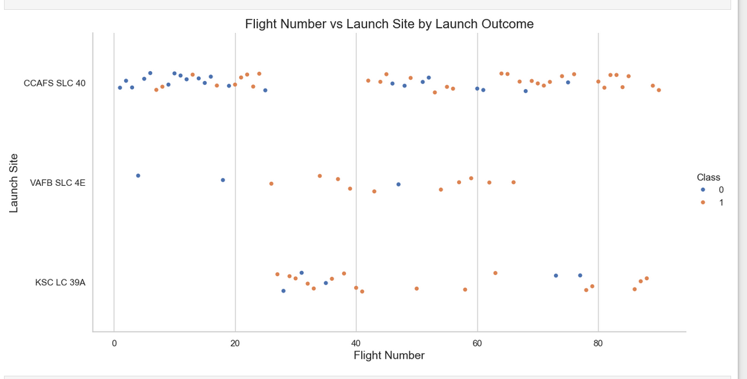
Launch Success Rate by Site Over Time
This strip plot highlights how different launch sites contributed to mission success over time. Notably, CCAFS and KSC show consistent improvements with later flights

Slide 41
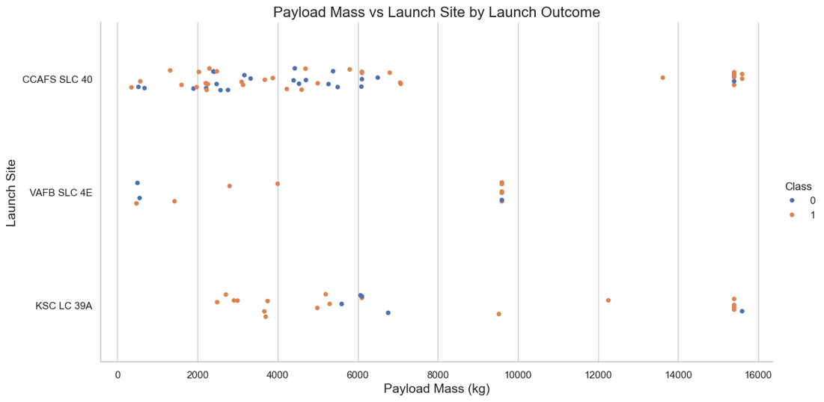
Impact of Payload Mass on Launch Success Across Different Sites
This plot illustrates the relationship between payload mass and launch site, with each point representing a launch. Color coding indicates whether the launch was successful (red) or failed (blue). The visualization helps identify trends in launch success relative to payload size and site.

Slide 42
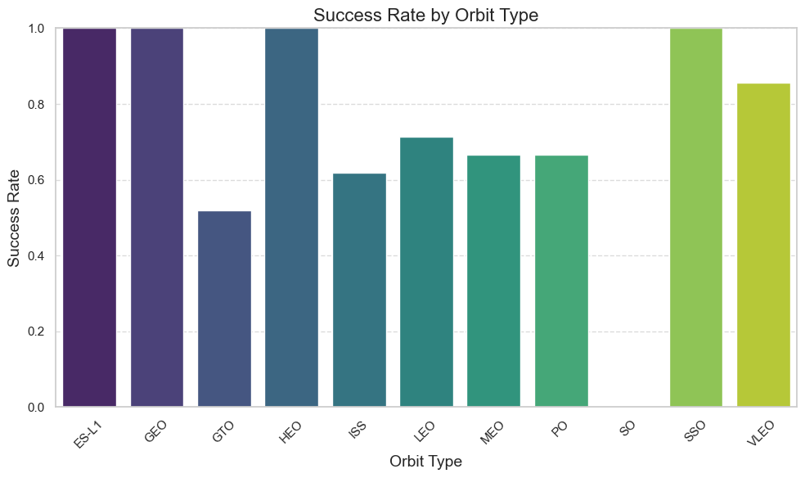
Launch Success Rate by Orbit Type
This bar chart shows the proportion of successful launches for each orbit type. The success rate is calculated as the ratio of successful launches to total launches per orbit. The chart reveals which orbit types have historically seen higher mission success.

Slide 43
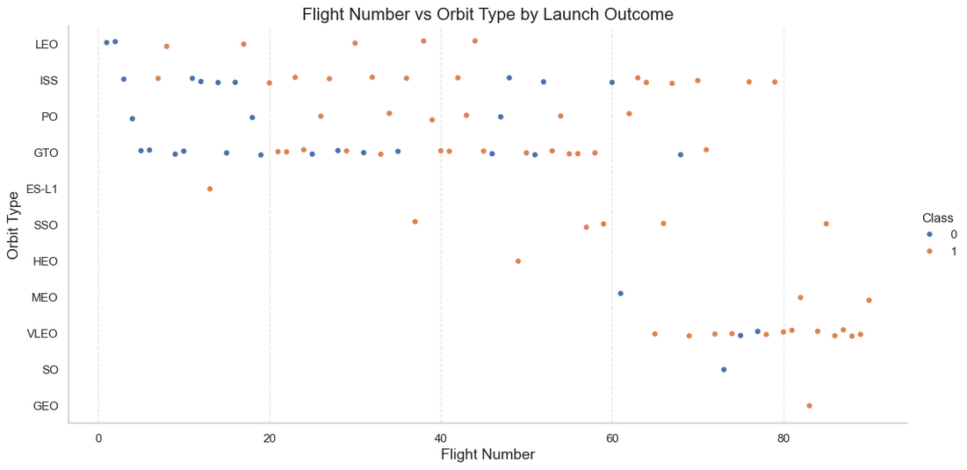
Launch Outcome Trends by Flight Number and Orbit Type
This plot displays each launch by its flight number and orbit type. Color coding indicates launch outcome—success (1) or failure (0). It helps identify patterns in launch reliability across orbit types over time.

Slide 44
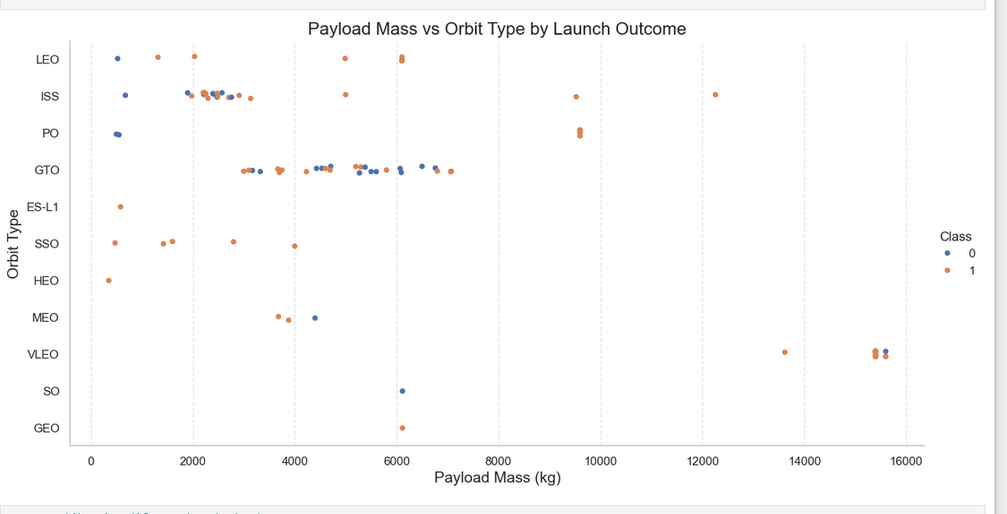
Launch Success by Payload Mass and Orbit Type
This strip plot shows the distribution of payload mass across different orbit types, with color coding representing the success (1) or failure (0) of the launches. It helps identify whether larger payloads tend to be associated with specific orbit types and launch outcomes

Slide 45
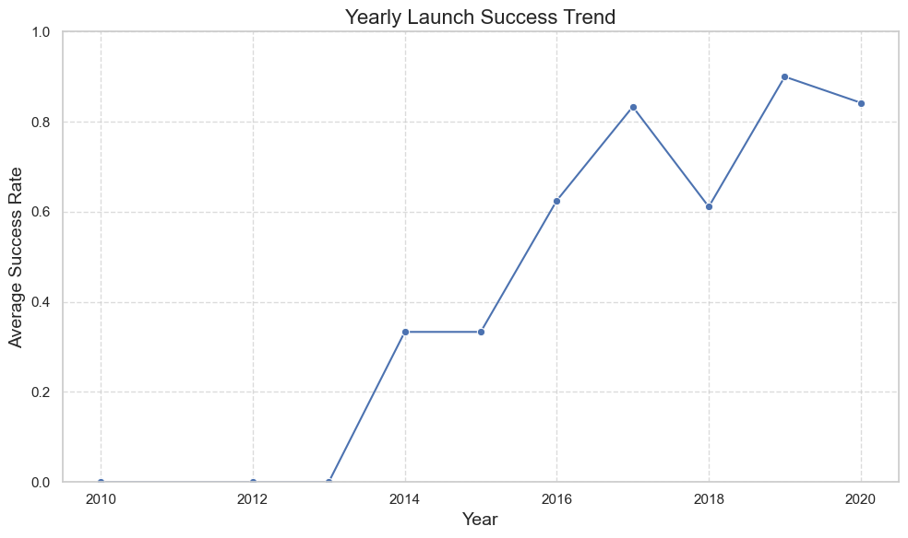
Yearly Launch Success Trend
This line plot shows the average success rate of launches over the years. It highlights trends in launch reliability, helping to identify periods of improvement or decline in launch success. There is steady improvement in launch success rate.

Slide 46
Introduction to Predictive Analysis
Predictive analysis is used to forecast outcomes based on historical data, and in this project, it involves classifying the success of a launch.
The models used for classification include Logistic Regression, Support Vector Machines (SVM), Decision Trees, and K-Nearest Neighbors (KNN).
The goal is to predict the success of a launch based on features like payload mass, orbit, and other mission-related attributes.

Slide 47
Data Preprocessing and Feature Engineering
Handling Missing Values: Imputation or removal of missing values from the dataset.
Feature Encoding: Encoding categorical features (e.g., encoding mission outcome and rocket types).
Feature Scaling: Normalizing or standardizing continuous variables like payload mass.
Data Split: Splitting the data into training (80%) and testing (20%) datasets.

Slide 48
Model Selection
Logistic Regression: Used for binary classification; calculates the probability of success.
SVM: SVM tries to maximize the margin between classes.
Decision Trees: A tree-based model that splits the data based on feature values.
K-Nearest Neighbors (KNN): Classifies based on the majority vote of neighbors.

Slide 49
Model Performance Metrics
The models are evaluated based on key performance metrics:
Accuracy: Percentage of correct predictions.
Precision: The proportion of positive predictions that are actually correct.
Recall: The proportion of actual positives that were identified.
F1 Score: Harmonic mean of Precision and Recall.
Confusion Matrix: To visualize True Positives, False Positives, True Negatives, and False Negatives.

Slide 50
Confusion Matrix
The confusion matrix shows the performance of the classification model. It displays the number of true positives, true negatives, false positives, and false negatives.
This helps understand the model’s classification ability by showing where it makes mistakes.

Slide 51
ROC Curve and AUC
ROC Curve: Plots the True Positive Rate (TPR) against the False Positive Rate (FPR).
AUC: Area Under the Curve (AUC) represents how well the model distinguishes between the classes. An AUC of 1 is perfect, while an AUC of 0.5 means the model performs no better than random guessing.

Slide 52
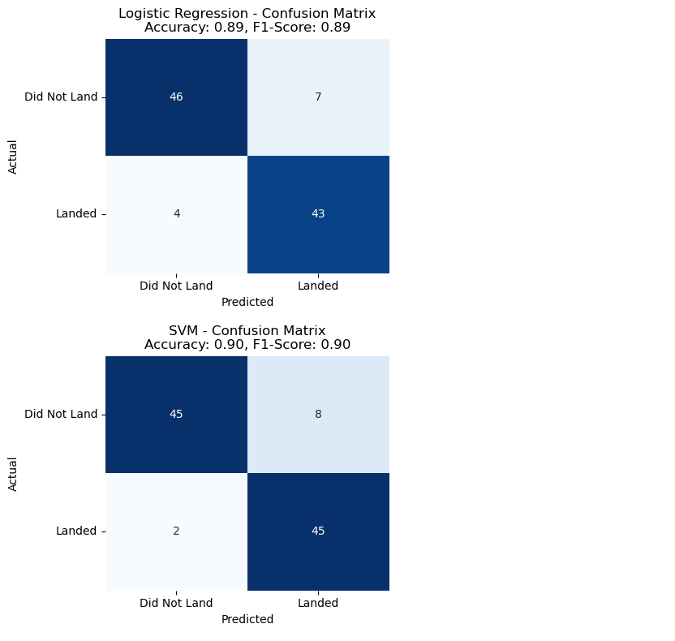
Comparison of confusion matrices across multiple classifiers

Slide 53
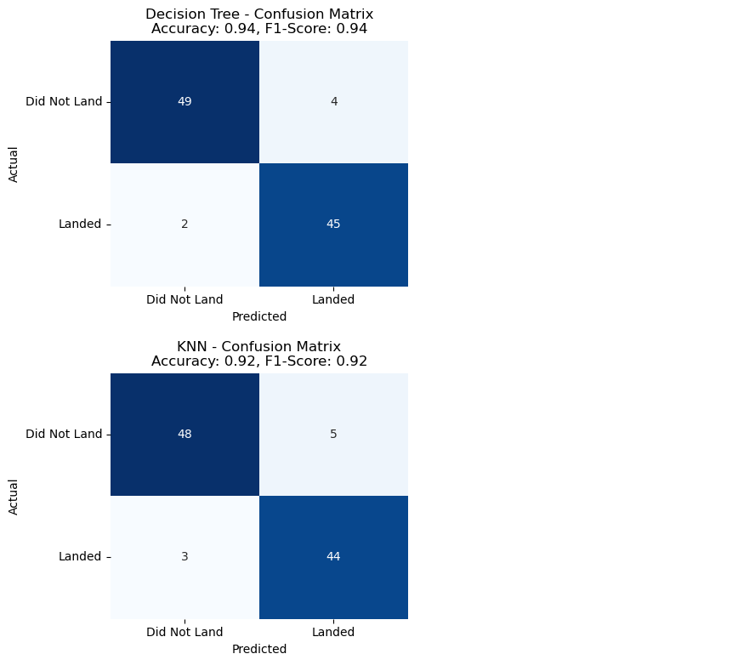
Comparison of Results

Slide 54
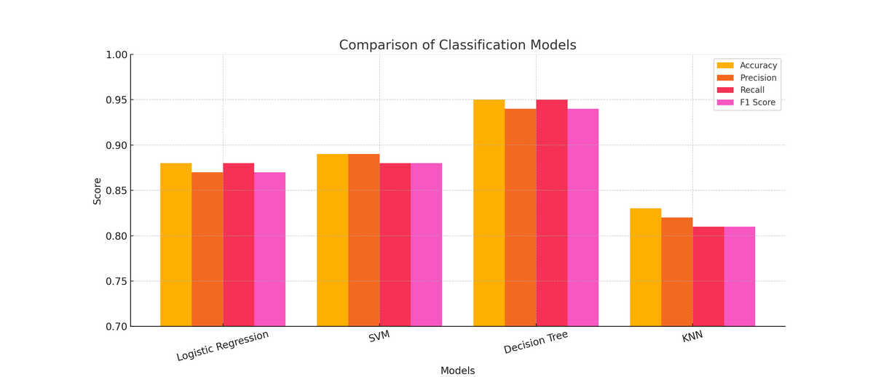
Comparison of Classification Models

Slide 55
Best Model Selection
Based on the results, the best-performing model, Decision Tree was selected.
The Decision Tree had a balance of good accuracy, precision, and recall.
Trade-offs - Decision Tree is faster but might overfit, while SVM is more complex but yields better results.

Slide 56
Conclusion
We successfully developed and evaluated multiple classification models to predict the target outcome with meaningful accuracy.
🧪 Models Compared
Logistic Regression
Support Vector Machine (SVM)
Decision Tree
K-Nearest Neighbors (KNN)
Best Performing Model
Decision Tree showed the highest accuracy and balanced performance across precision and recall, as shown by the confusion matrix.

Slide 57
Conclusion (continued)
Insights Gained
Feature importance and preprocessing had a notable effect on model performance.
Hyperparameter tuning (e.g., GridSearchCV) helped optimize model accuracy.
Confusion matrices helped identify where misclassifications occurred and what types of errors are most common.
Limitations
Model accuracy may vary with different or unseen data.
More data or feature engineering could improve performance further.

Slide 58
Business Impact
💼 How SpaceX or Other Agencies Can Use This
Integrate predictive models into launch planning systems.
Improve go/no-go decision-making using real-time success probabilities.
Optimize scheduling across multiple launch sites and mission profiles.
💰 Potential Cost/Time Savings
Reduce scrubbed or delayed launches due to suboptimal launch conditions.
Lower operational costs through better resource and crew allocation.
Increase launch cadence and reliability, enhancing customer satisfaction.

Slide 59
Future Innovation Project # 1 for Space X Data Science
Launch Scheduling Optimization
Create a machine learning model that predicts the optimal launch window based on:
Historical weather data
Air traffic
Orbital mechanics
Rocket readiness
Methods: Gradient boosting, constraint optimization, Bayesian scheduling Impact: Reduces delays and improves resource allocation.

Slide 60
Future Innovation Project #2 for Space X Data Science
Falcon Launch Telemetry Anomaly Detection
Build a real-time anomaly detection system using telemetry data (temperature, pressure, vibration, etc.) from Falcon rocket launches.
Tech stack:
Time-series analysis (e.g., LSTM, Prophet)
Autoencoders for anomaly detection
Kafka/Spark for real-time streaming
Innovation: Preventing failures pre-launch or mid-flight through predictive alerting.

Slide 61
Future Innovation Project #3 for Space X Data Science
Natural Language Processing (NLP) for Mission Documentation Insights
Idea: Use NLP to process thousands of SpaceX internal documents, technical logs, and engineer notes to surface:
Recurring failure modes
Knowledge transfer opportunities
Design evolution over time
Tech stack: Topic modeling (LDA) Named entity recognition (NER) Semantic search (e.g., SBERT)

Slide 62
Conclusion & Thank You
🚀 Key Takeaways
We explored how data science can optimize SpaceX launch scheduling
Machine learning models help predict success probabilities using real-world data
Integration of weather, solar activity, and rocket readiness enhances decision-making
🙏 Thank You!
Questions or feedback? . 📧 dariocccamo@myyahoo.com | 🌐 LinkedIn / GitHub / Portfolio
Let’s “boldly go where no man has gone before”.

