Slide 1
CROWD-SOURCED WATER-RELATED PROBLEM
PIP2001 Capstone Project
Final Review
Batch Number: CSD-16
NAME | ROLL NUMBER
DARIPINENI TEJA | 20211CSD0027
ACHANTA HIMA CHANDU | 20211CSD0006
Under the Supervision of,
Ms. Radhika Sreedharan
Assistant Professor
School of Computer Science & Engineering
Presidency University
Name of the Program: B.TECH
Name of the HoD: Dr. SAIRA BANU ATHAM
Name of the Program Project Coordinator: Dr. H.M MANJULA
Name of the School Project Coordinators: Dr. Sampath A K / Dr. Abdul Khadar A / Mr. Md Ziaur Rahman

Slide 2
Content
Abstract
Objective of project
Problem Statement
Scope And Motivation
Introduction
Literature survey
Existing Method
Disadvantages
Proposed method
Advantages
Project Flow
Hardware and Software Requirements
Architecture
Modules
References

Slide 3
Problem Statement Number:
Water scarcity and pollution are critical issues that require prompt action. This project provides a digital platform for users to report water-related problems efficiently. The system categorizes complaints, assigns tasks to workers, and allows real-time monitoring of complaint resolution. By leveraging a structured approach, this system enhances accountability and transparency. The admin can manage complaints, assign work, and track progress. Users can submit complaints with images and location data, while workers receive assignments and update statuses upon completion. This structured approach ensures systematic complaint resolution, benefiting both citizens and authorities. The platform simplifies issue tracking and work delegation, reducing delays in addressing water-related concerns. Through an interactive dashboard, the system offers insights into complaint trends, work efficiency, and unresolved issues. This structured approach improves response efficiency and ensures water-related issues are addressed effectively.
Keywords: Water issues, Complaint tracking, User participation, Task delegation, Efficient resolution.

Slide 4
INTRODUCTION
Water issues, including supply shortages and contamination, require immediate attention. However, conventional reporting methods often result in miscommunication and inefficiencies. This project introduces a digital complaint management system that allows users to report water-related concerns, enabling timely action. By structuring the complaint process, this system enhances coordination between users, workers, and administrators, ensuring faster issue resolution.

Slide 5
Github Link
The Github link provided should have public access permission.
Github Link
https://github.com/DaripineniTeja/Finalproject.git

Slide 6
OBJECTIVE OF PROJECT
The project aims to provide a digital platform for reporting and resolving water-related issues efficiently. It streamlines the complaint process by integrating user submissions, admin management, and worker assignments, ensuring quick issue resolution while promoting accountability and transparency in handling water complaints.

Slide 7
PROBLEM STATEMENT
Existing water complaint systems lack an organized structure, resulting in mismanagement and delayed resolutions. Users often struggle to report issues accurately, while authorities face difficulties in tracking complaints. Without a streamlined approach, water-related problems persist unresolved. This project provides an effective solution by enabling complaint tracking, structured assignments, and location-based reporting for efficient water issue management.

Slide 8
SCOPE
This project focuses on developing a structured platform for water-related complaint registration and resolution. It enables users to submit complaints with precise location details, allowing workers to address issues efficiently. The system provides an interactive dashboard for tracking complaint status. The platform benefits both authorities and citizens by ensuring proper issue delegation and systematic problem-solving.

Slide 9
LITERATURE SURVEY
Authors | Title | Date | Outcome
Junseok Eom, Taewook Choi, Yungsuk Yoon, Kyung Geun Lee | The Study of Customer Satisfaction Index Characteristic with Local Water Supply Service | 21-23 Oct 2020 | Developed a customer satisfaction prediction model (98.7%) to detect water supply complaints early, preventing major issues like underground accidents and water contamination.
Santoso Wibowo, Srimannarayana Grandhi | Evaluating the Sustainability Performance of Urban Water Services | 18-20 June 2017 | Proposed a fuzzy-based multi-criteria decision-making model for evaluating urban water service sustainability, improving decision accuracy using knowledge measures and aggregated fuzzy information.
D. Roopa, S. Mathupriya, A. Lazha, R. Prabha | Examining the Structure for Handling and Addressing Consumer Issues within the Water Utilities Industry | 08-09 Oct 2024 | Used machine learning (Random Forest) to analyze water complaints and environmental factors, predicting future complaints and enhancing infrastructure planning to prevent recurring issues.
Lakshmi Prasanna Divvela, V. Sravanthi, Pethakamsetty Hemannth, Tummalapalli Kesava Sai Avinash | Raise of Complaints on Day-to-Day Issues by the Public Using GPS | 17-18 Mar 2023 | Proposed a mobile app for GPS-based complaint reporting, automating issue categorization and improving complaint tracking for authorities via Google Maps navigation.
Mahfuzulhoq Chowdhury, Nura Hadi | Union Parishad: A Rural Village Council Based Mobile Application for Local, Medical, IT, and Complaint Assistance Services | 10-11 Aug 2023 | Developed a mobile app for rural services, offering medical, IT, legal, and complaint resolution, with over 75% user satisfaction in addressing local issues efficiently.

Slide 10
EXISTING METHODS
Traditional complaint management methods rely on manual logging, phone calls, or emails, leading to inefficiencies. Complaints are often lost or unresolved due to a lack of structured tracking. Without location-based reporting, authorities struggle to pinpoint problem areas. The absence of a centralized platform makes it difficult to assign, monitor, and resolve water-related issues efficiently.
Disadvantages in Existing method:
Complaints are often misplaced or overlooked due to manual logging.
No systematic way to track complaint progress or assign responsibilities.
Users lack real-time updates, causing frustration and uncertainty.
Authorities struggle to address complaints due to the absence of location data.

Slide 11
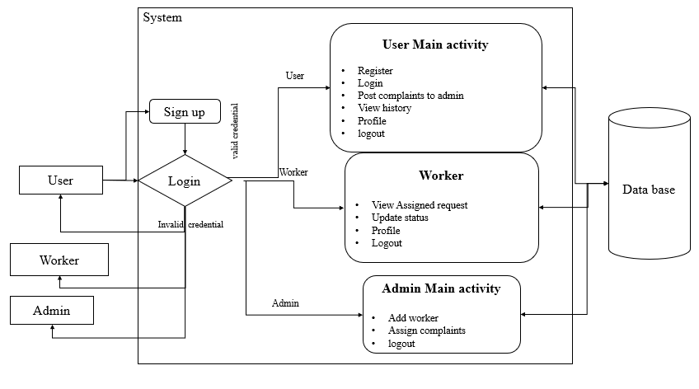
PROPOSE SYSTEM FLOW

Slide 12
HARDWARE & SOFTWARE REQUIREMENTS
SOFTWARE REQUIREMENS
Operating System - Windows 10
JDK - Java(kotlin)
SDK - Android
IDE - Android studio
Database - my SQL
HARDWARE REQUIREMENTS
Processor - I3/Intel Processor
RAM - 8 GB
Hard Disk - 1TB

Slide 13
MODULES
Admin Module: The admin manages complaints, assigns work to workers, and tracks complaint progress. They can view complaint trends via a dashboard, ensuring efficient resolution of water-related issues through systematic monitoring and task delegation.
User Module: Users can register, submit complaints with images and location details, and track their complaint status. A dashboard provides updates on complaint progress, enhancing user engagement in resolving water-related issues effectively.
Worker Module: Workers receive assigned complaints, view issue details, and update statuses upon resolution. They can access location data via maps, ensuring accurate issue resolution. A dashboard helps them manage and track assigned complaints efficiently.

Slide 14
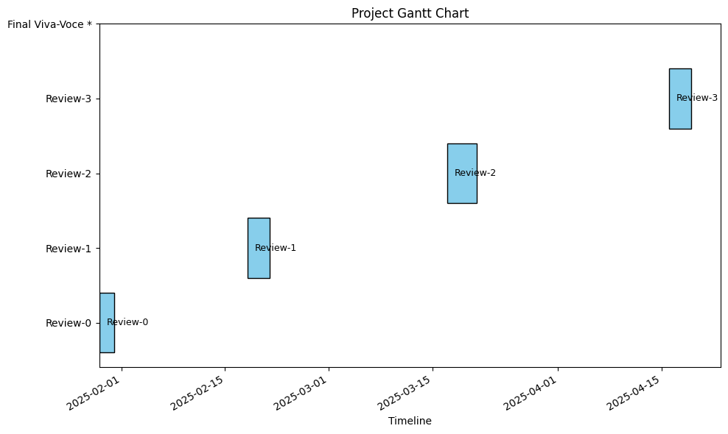
TIMELINE OF THE PROJECT (Gantt Chart)

Slide 15
REFERENCES (IEEE Paper format)
[1] Junseok Eom; Taewook Choi; Yungsuk Yoon; Kyung Geun Lee || The Study of Customer Satisfaction Index Characteristic with Local Water Supply Service || 21-23 October 2020
[2] Santoso Wibowo; Srimannarayana Grandhi || Evaluating the sustainability performance of urban water services || 18-20 June 2017
[3] D.Roopa; S.Mathupriya; A. Lazha; R. Prabha || Examining the Structure for Handling and Addressing Consumer Issues within the Water Utilities Industry || 08-09 October 2024
[4] Lakshmi Prasanna Divvela; V Sravanthi; Pethakamsetty Hemannth; Tummalapalli Kesava Sai Avinash || Raise of Complaints on day-to-day issues by the public using Global Positioning System for finding the exact location of the problem || 17-18 March 2023
[5] Mahfuzulhoq Chowdhury; Nura Hadi || Union Parishad: A Rural Village Council Based Mobile Application For Village Peoples Local, Medical, IT, and Complaint Assistance Services || 10-11 August 2023

Slide 16


