Slide 1
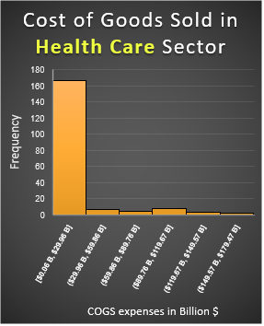
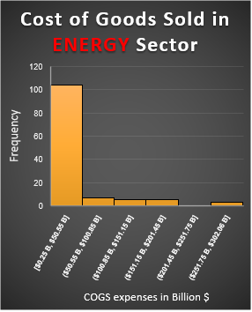
Find differences between Energy and Health Care sectors. What is the difference in expenditure between the two, what were the average expenses and what is in common in the last years?
Here are the histograms for Energy and Health Care sectors for the past four years.
Both histograms are positive and right skewed because of the mean bigger than the median.
The mean for healthcare is $15.3 billion, almost twice bigger for the energy sector, which is $27.6 billion. The maximum amount spent on healthcare is $179.4 billion, and the energy sector spent more than $302 billion. The median is almost the same for both, healthcare has $3.6 billion, and energy has $3.1 billion. The range for COGS in the Energy sector is higher ($301.8 billion) than in the healthcare sector, which is $179.4 billion. This means that COGS in the Energy sector are more volatile than in the healthcare sector. Also, the standard deviation is higher for the Energy sector too ($57.8 billion), and healthcare has much less ($33.2 billion). That means the variability in COGS expenses for the Energy sector is higher, with more companies spending above $57.8 billion, and more than 50% of companies from the Energy sector spending for COGS is more than $3.1 billion.

