Slide 1

Simple Vehicle Property Dashboard App in AAOS
Capstone Project 1 · Android Automotive OS · Java · Darius Achim
Reads real-time vehicle signals through the AAOS Car API and displays them on an automotive-optimized dashboard, with live updates from the Vehicle HAL.
ARCHITECTURE
Dashboard App
→
Car API
→
CarPropertyManager
→
Vehicle HAL
→
AAOS Emulator
Java · Views UI
Car.createCar()
get() + callbacks
vehicle properties
VHAL properties panel
VEHICLE PROPERTIES USED
PERF_VEHICLE_SPEED
FUEL_LEVEL
GEAR_SELECTION
INFO_MAKE / MODEL / MODEL_YEAR
INFO_FUEL_CAPACITY
NIGHT_MODE
ENGINE_RPM*
DOOR_POS*
* privileged properties — requested, refused by the platform, handled gracefully (see slide 3)
Built and tested on the Android Automotive emulator (API 33, Automotive 1408p landscape)
Notes:
Goal: a basic AAOS app that reads real-time vehicle signals and shows them on the UI. Flow: the app connects with Car.createCar(), obtains CarPropertyManager, reads static info with getProperty() and subscribes to dynamic properties with callbacks. The emulator's VHAL properties panel simulates the vehicle signals. Mention: language Java, MinSDK 29, manifest declares android.hardware.type.automotive.

Slide 2
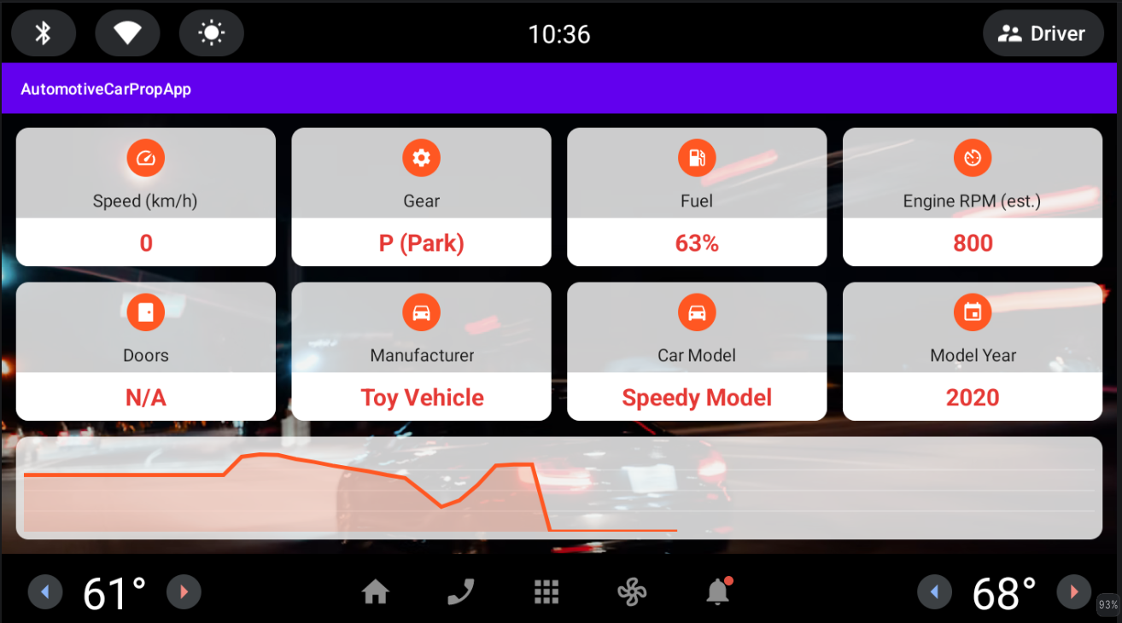



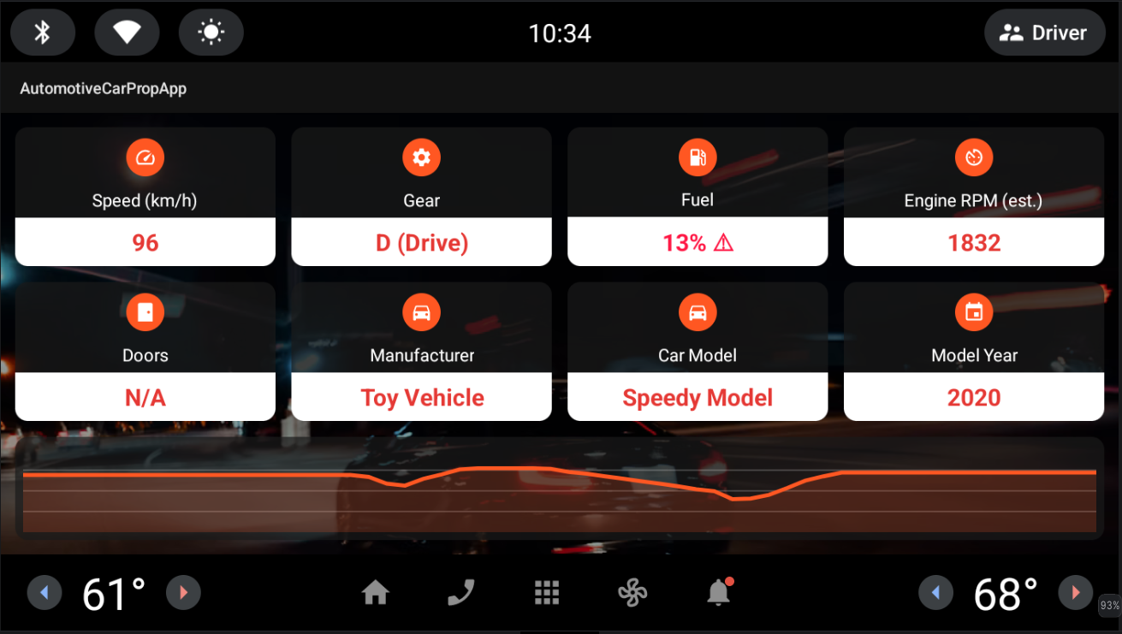


Live Dashboard & Features
Real-time data updates
CarPropertyManager callbacks — speed at UI rate, fuel and gear on change; initial values read at startup.
Low-fuel alert
Fuel shown as % of INFO_FUEL_CAPACITY; below 20% the value turns red with a warning icon.
Day / Night theme
DayNight theme + values-night resources; switches live when VHAL NIGHT_MODE changes.
Speed history graph
Custom Canvas view — last 60 seconds, sampled at 1 Hz, auto-scaling axis.
Runtime permissions
CAR_SPEED, CAR_POWERTRAIN, CAR_ENERGY requested at launch; app connects after grant.
Notes:
Demo idea: change PERF_VEHICLE_SPEED, FUEL_LEVEL and GEAR_SELECTION in the emulator's VHAL properties panel and show values updating instantly. Then toggle NIGHT_MODE for the live theme switch, and drop fuel below 20% to trigger the red alert. The graph fills as the demo runs. All three optional enhancements from the project brief are implemented: alerts, theme customization, historical trends.

Slide 3



Challenges & Lessons Learned
Driving UX restrictions
Two-tier permission model
While driving, AAOS blocked the app ("You can't use this feature while driving"). Fixed by declaring the activity distractionOptimized — the dashboard UI genuinely follows driver-distraction rules.
Speed, fuel and gear use runtime permissions. ENGINE_RPM and DOOR_POS need privileged permissions reserved for OEM system apps — refused even via adb ("not a changeable permission type"). The app catches this and degrades to N/A.
Honest RPM fallback
VHAL units matter
Instead of faking data, RPM is estimated from speed + gear with a simple 6-speed automatic model, and the card is explicitly labeled "Engine RPM (est.)" — transparent about what is real HAL data and what is not.
HAL reports speed in m/s and fuel in milliliters, while the emulator panel edits liters. A 100%-stuck fuel gauge turned into a lesson: always check units and verify with Logcat before trusting the UI.
Notes:
Closing message: the interesting part of this project was not displaying values, but understanding the AAOS security and UX model — what a third-party app may and may not access, and how to fail gracefully. If asked about RPM: the real property was requested first; the estimation only kicks in after a SecurityException, and it is labeled.

