Slide 1
MRI Blur Detection
Model comparisons

Slide 2
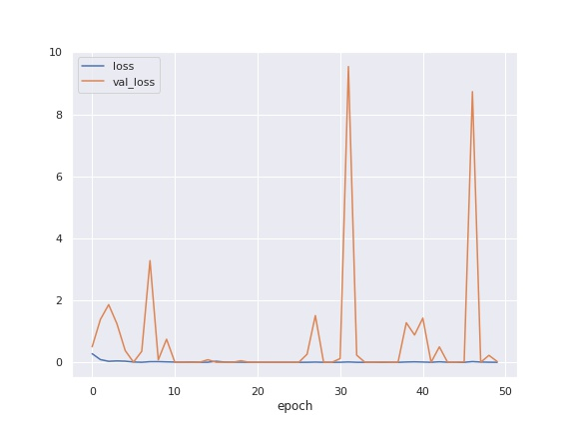
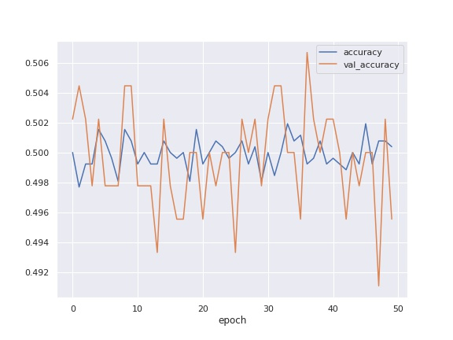
Model: 08-07-2022 20:00 ____________________________________________________________ Layer (type) Output Shape Param # ============================================================ input_1 (InputLayer) [(None, 256, 256, 1)] 0 conv2d (Conv2D) (None, 254, 254, 64) 640 max_pooling2d (MaxPooling2D) (None, 127, 127, 64) 0 batch_normalization (BatchNormalization) (None, 127, 127, 64) 256 conv2d_1 (Conv2D) (None, 125, 125, 64) 36928 max_pooling2d_1 (MaxPooling2D) (None, 62, 62, 64) 0 batch_normalization_1 (BatchNormalization) (None, 62, 62, 64) 256 conv2d_2 (Conv2D) (None, 60, 60, 64) 36928 max_pooling2d_2 (MaxPooling2D) (None, 30, 30, 64) 0 batch_normalization_2 (BatchNormalization) (None, 30, 30, 64) 256 conv2d_3 (Conv2D) (None, 28, 28, 128) 73856 max_pooling2d_3 (MaxPooling2D) (None, 14, 14, 128) 0 batch_normalization_3 (BatchNormalization) (None, 14, 14, 128) 512 conv2d_4 (Conv2D) (None, 12, 12, 256) 295168 max_pooling2d_4 (MaxPooling2D) (None, 6, 6, 256) 0 batch_normalization_4 (BatchNormalization) (None, 6, 6, 256) 1024 conv2d_5 (Conv2D) (None, 4, 4, 256) 590080 max_pooling2d_5 (MaxPooling2D) (None, 2, 2, 256) 0 batch_normalization_5 (BatchNormalization) (None, 2, 2, 256) 1024 global_average_pooling2d (GlobalAveragePooling2D) (None, 256) 0 dense (Dense) (None, 512) 131584 dropout (Dropout) (None, 512) 0 dense_1 (Dense) (None, 1) 513 ============================================================ Total params: 1,169,025 Trainable params: 1,167,361 Non-trainable params: 1,664 ____________________________________________________________ Optimizer: {"name": "Adam", "learning_rate": 0.001, "decay": 0.0, "beta_1": 0.9, "beta_2": 0.999, "epsilon": 1e-07, "amsgrad": false}

Slide 3
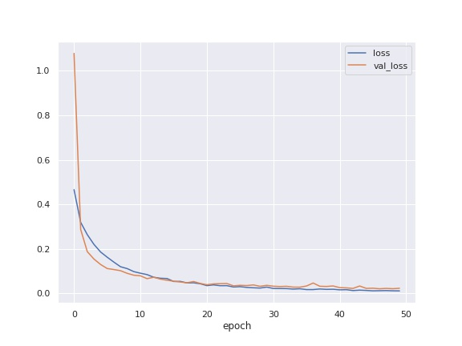
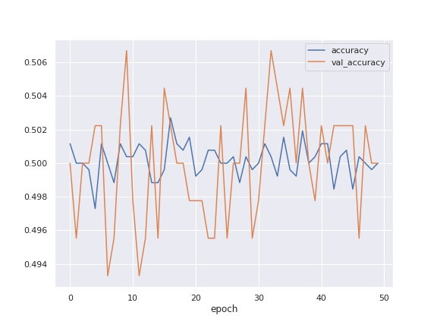
Model: 08-07-2022 20:10 ____________________________________________________________ Layer (type) Output Shape Param # ============================================================ input_1 (InputLayer) [(None, 256, 256, 1)] 0 conv2d (Conv2D) (None, 254, 254, 64) 640 max_pooling2d (MaxPooling2D) (None, 127, 127, 64) 0 batch_normalization (BatchNormalization) (None, 127, 127, 64) 256 conv2d_1 (Conv2D) (None, 125, 125, 64) 36928 max_pooling2d_1 (MaxPooling2D) (None, 62, 62, 64) 0 batch_normalization_1 (BatchNormalization) (None, 62, 62, 64) 256 conv2d_2 (Conv2D) (None, 60, 60, 64) 36928 max_pooling2d_2 (MaxPooling2D) (None, 30, 30, 64) 0 batch_normalization_2 (BatchNormalization) (None, 30, 30, 64) 256 conv2d_3 (Conv2D) (None, 28, 28, 128) 73856 max_pooling2d_3 (MaxPooling2D) (None, 14, 14, 128) 0 batch_normalization_3 (BatchNormalization) (None, 14, 14, 128) 512 conv2d_4 (Conv2D) (None, 12, 12, 256) 295168 max_pooling2d_4 (MaxPooling2D) (None, 6, 6, 256) 0 batch_normalization_4 (BatchNormalization) (None, 6, 6, 256) 1024 conv2d_5 (Conv2D) (None, 4, 4, 256) 590080 max_pooling2d_5 (MaxPooling2D) (None, 2, 2, 256) 0 batch_normalization_5 (BatchNormalization) (None, 2, 2, 256) 1024 global_average_pooling2d (GlobalAveragePooling2D) (None, 256) 0 dense (Dense) (None, 512) 131584 dropout (Dropout) (None, 512) 0 dense_1 (Dense) (None, 1) 513 ============================================================ Total params: 1,169,025 Trainable params: 1,167,361 Non-trainable params: 1,664 ____________________________________________________________ Optimizer: {"name": "Adagrad", "learning_rate": 0.001, "decay": 0.0, "initial_accumulator_value": 0.1, "epsilon": 1e-07}

Slide 4
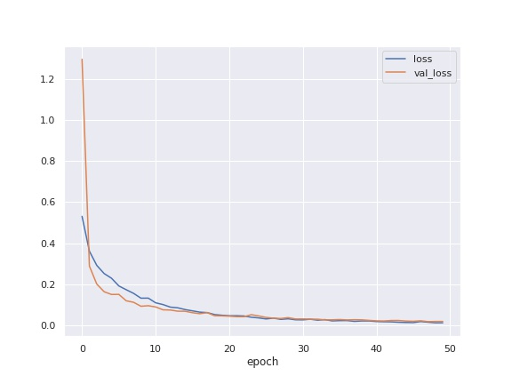
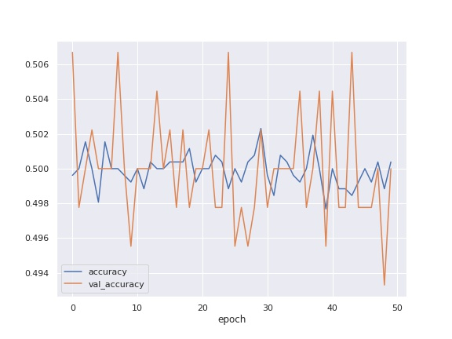
Model: 08-07-2022 20:19 ____________________________________________________________ Layer (type) Output Shape Param # ============================================================ input_1 (InputLayer) [(None, 256, 256, 1)] 0 conv2d_1 (Conv2D) (None, 254, 254, 64) 640 max_pooling2d_1 (MaxPooling2D) (None, 127, 127, 64) 0 batch_normalization_1 (BatchNormalization) (None, 127, 127, 64) 256 conv2d_2 (Conv2D) (None, 125, 125, 64) 36928 max_pooling2d_2 (MaxPooling2D) (None, 62, 62, 64) 0 batch_normalization_2 (BatchNormalization) (None, 62, 62, 64) 256 conv2d_3 (Conv2D) (None, 60, 60, 64) 36928 max_pooling2d_3 (MaxPooling2D) (None, 30, 30, 64) 0 batch_normalization_3 (BatchNormalization) (None, 30, 30, 64) 256 conv2d_4 (Conv2D) (None, 28, 28, 128) 73856 max_pooling2d_4 (MaxPooling2D) (None, 14, 14, 128) 0 batch_normalization_4 (BatchNormalization) (None, 14, 14, 128) 512 conv2d_5 (Conv2D) (None, 12, 12, 256) 295168 max_pooling2d_5 (MaxPooling2D) (None, 6, 6, 256) 0 batch_normalization_5 (BatchNormalization) (None, 6, 6, 256) 1024 conv2d_6 (Conv2D) (None, 4, 4, 256) 590080 max_pooling2d_6 (MaxPooling2D) (None, 2, 2, 256) 0 batch_normalization_6 (BatchNormalization) (None, 2, 2, 256) 1024 global_average_pooling2d (GlobalAveragePooling2D) (None, 256) 0 dense (Dense) (None, 512) 131584 dropout (Dropout) (None, 512) 0 dense_1 (Dense) (None, 1) 513 ============================================================ Total params: 1,169,025 Trainable params: 1,167,361 Non-trainable params: 1,664 ____________________________________________________________ Optimizer: {"name": "Adagrad", "learning_rate": 0.001, "decay": 0.0, "initial_accumulator_value": 0.1, "epsilon": 1e-07}

Slide 5
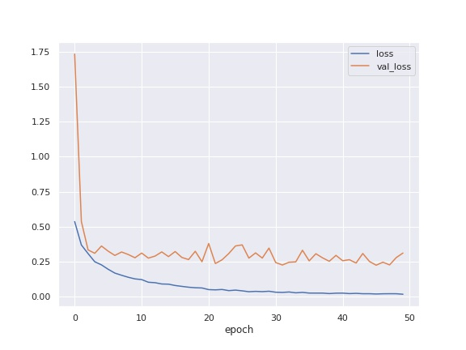
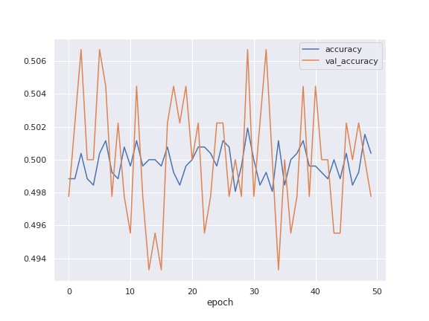
Model: 08-07-2022 20:32 ____________________________________________________________ Layer (type) Output Shape Param # ============================================================ input_1 (InputLayer) [(None, 256, 256, 1)] 0 conv2d (Conv2D) (None, 254, 254, 64) 640 max_pooling2d (MaxPooling2D) (None, 127, 127, 64) 0 batch_normalization (BatchNormalization) (None, 127, 127, 64) 256 conv2d_1 (Conv2D) (None, 125, 125, 64) 36928 max_pooling2d_1 (MaxPooling2D) (None, 62, 62, 64) 0 batch_normalization_1 (BatchNormalization) (None, 62, 62, 64) 256 conv2d_2 (Conv2D) (None, 60, 60, 64) 36928 max_pooling2d_2 (MaxPooling2D) (None, 30, 30, 64) 0 batch_normalization_2 (BatchNormalization) (None, 30, 30, 64) 256 conv2d_3 (Conv2D) (None, 28, 28, 64) 36928 max_pooling2d_3 (MaxPooling2D) (None, 14, 14, 64) 0 batch_normalization_3 (BatchNormalization) (None, 14, 14, 64) 256 conv2d_4 (Conv2D) (None, 12, 12, 128) 73856 max_pooling2d_4 (MaxPooling2D) (None, 6, 6, 128) 0 batch_normalization_4 (BatchNormalization) (None, 6, 6, 128) 512 conv2d_5 (Conv2D) (None, 4, 4, 256) 295168 max_pooling2d_5 (MaxPooling2D) (None, 2, 2, 256) 0 batch_normalization_5 (BatchNormalization) (None, 2, 2, 256) 1024 global_average_pooling2d (GlobalAveragePooling2D) (None, 256) 0 dense (Dense) (None, 512) 131584 dropout (Dropout) (None, 512) 0 dense_1 (Dense) (None, 1) 513 ============================================================ Total params: 615,105 Trainable params: 613,825 Non-trainable params: 1,280 ____________________________________________________________ Optimizer: {"name": "Adagrad", "learning_rate": 0.001, "decay": 0.0, "initial_accumulator_value": 0.1, "epsilon": 1e-07}

Slide 6
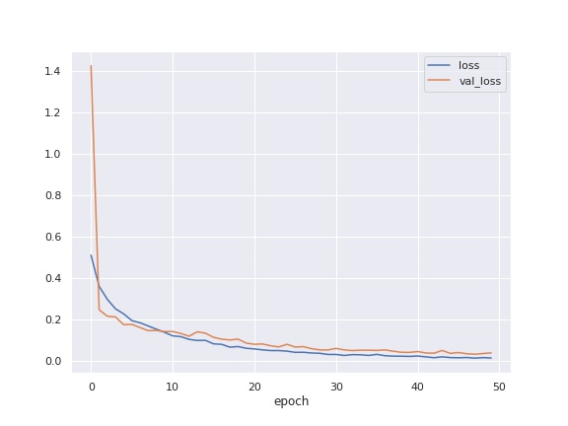
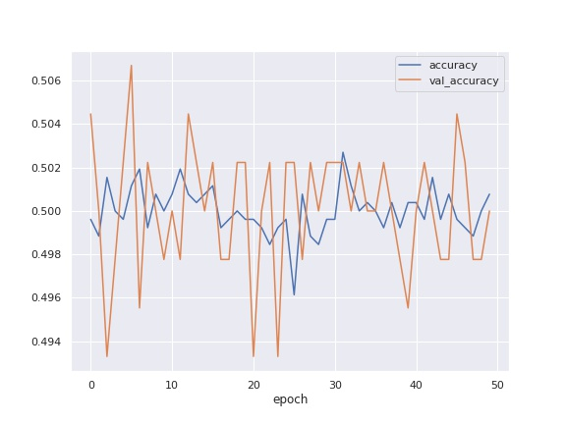
Model: 08-07-2022 20:46 ____________________________________________________________ Layer (type) Output Shape Param # ============================================================ input_1 (InputLayer) [(None, 256, 256, 1)] 0 conv2d_1 (Conv2D) (None, 254, 254, 64) 640 max_pooling2d_1 (MaxPooling2D) (None, 127, 127, 64) 0 batch_normalization_1 (BatchNormalization) (None, 127, 127, 64) 256 conv2d_2 (Conv2D) (None, 125, 125, 64) 36928 max_pooling2d_2 (MaxPooling2D) (None, 62, 62, 64) 0 batch_normalization_2 (BatchNormalization) (None, 62, 62, 64) 256 conv2d_3 (Conv2D) (None, 60, 60, 64) 36928 max_pooling2d_3 (MaxPooling2D) (None, 30, 30, 64) 0 batch_normalization_3 (BatchNormalization) (None, 30, 30, 64) 256 conv2d_4 (Conv2D) (None, 28, 28, 64) 36928 max_pooling2d_4 (MaxPooling2D) (None, 14, 14, 64) 0 batch_normalization_4 (BatchNormalization) (None, 14, 14, 64) 256 conv2d_5 (Conv2D) (None, 12, 12, 128) 73856 max_pooling2d_5 (MaxPooling2D) (None, 6, 6, 128) 0 batch_normalization_5 (BatchNormalization) (None, 6, 6, 128) 512 conv2d_6 (Conv2D) (None, 4, 4, 256) 295168 max_pooling2d_6 (MaxPooling2D) (None, 2, 2, 256) 0 batch_normalization_6 (BatchNormalization) (None, 2, 2, 256) 1024 global_average_pooling2d (GlobalAveragePooling2D) (None, 256) 0 dense (Dense) (None, 512) 131584 dropout (Dropout) (None, 512) 0 dense_1 (Dense) (None, 1) 513 ============================================================ Total params: 615,105 Trainable params: 613,825 Non-trainable params: 1,280 ____________________________________________________________ Optimizer: {"name": "Adagrad", "learning_rate": 0.001, "decay": 0.0, "initial_accumulator_value": 0.1, "epsilon": 1e-07}

Slide 7
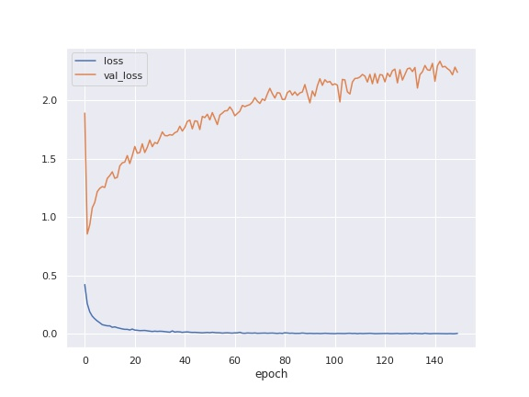
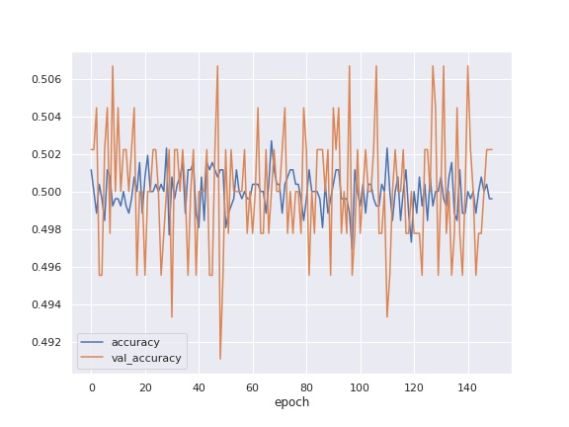
Model: 08-07-2022 20:54 ____________________________________________________________ Layer (type) Output Shape Param # ============================================================ input_1 (InputLayer) [(None, 256, 256, 1)] 0 conv2d_1 (Conv2D) (None, 254, 254, 64) 640 max_pooling2d_1 (MaxPooling2D) (None, 127, 127, 64) 0 batch_normalization_1 (BatchNormalization) (None, 127, 127, 64) 256 conv2d_2 (Conv2D) (None, 125, 125, 64) 36928 max_pooling2d_2 (MaxPooling2D) (None, 62, 62, 64) 0 batch_normalization_2 (BatchNormalization) (None, 62, 62, 64) 256 conv2d_3 (Conv2D) (None, 60, 60, 64) 36928 max_pooling2d_3 (MaxPooling2D) (None, 30, 30, 64) 0 batch_normalization_3 (BatchNormalization) (None, 30, 30, 64) 256 conv2d_4 (Conv2D) (None, 28, 28, 64) 36928 max_pooling2d_4 (MaxPooling2D) (None, 14, 14, 64) 0 batch_normalization_4 (BatchNormalization) (None, 14, 14, 64) 256 conv2d_5 (Conv2D) (None, 12, 12, 128) 73856 max_pooling2d_5 (MaxPooling2D) (None, 6, 6, 128) 0 batch_normalization_5 (BatchNormalization) (None, 6, 6, 128) 512 conv2d_6 (Conv2D) (None, 4, 4, 256) 295168 max_pooling2d_6 (MaxPooling2D) (None, 2, 2, 256) 0 batch_normalization_6 (BatchNormalization) (None, 2, 2, 256) 1024 global_average_pooling2d (GlobalAveragePooling2D) (None, 256) 0 dense (Dense) (None, 512) 131584 dropout (Dropout) (None, 512) 0 dense_1 (Dense) (None, 1) 513 ============================================================ Total params: 615,105 Trainable params: 613,825 Non-trainable params: 1,280 ____________________________________________________________ Optimizer: {"name": "Adagrad", "learning_rate": 0.001, "decay": 0.0, "initial_accumulator_value": 0.1, "epsilon": 1e-07}

