Slide 1

Simplification of Boolean Functions
Veitch-Karnaugh diagrams

Slide 2
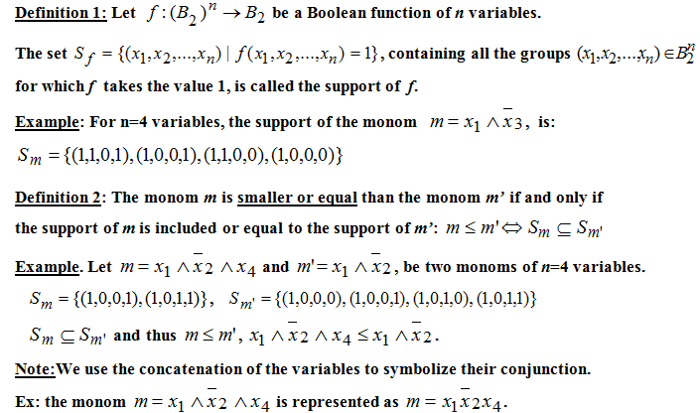
Definitions (I)

Slide 3
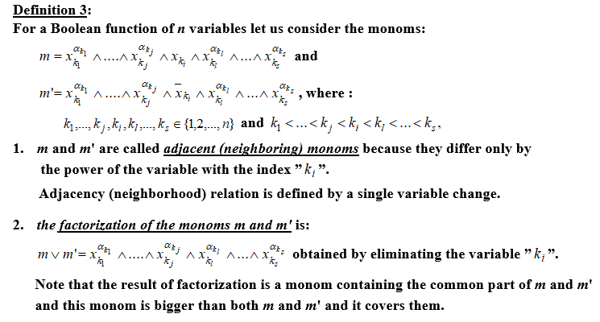
Definitions (II)

Slide 4
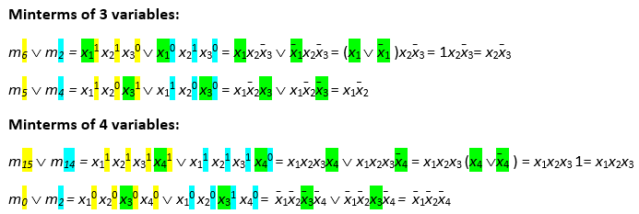
Factorization - examples

Slide 5
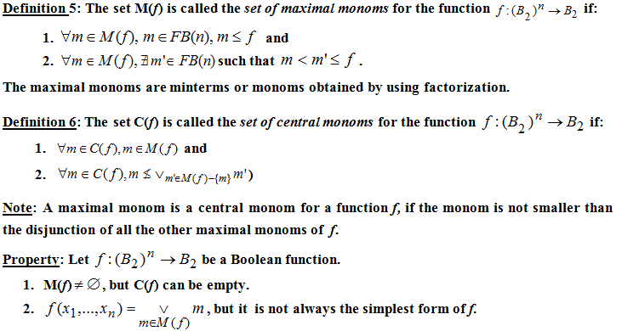
Definitions (III)

Slide 6
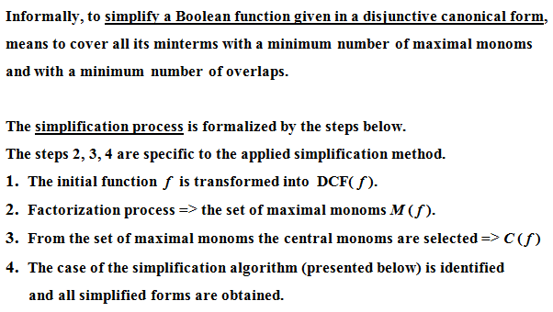
Simplification of Boolean Functions

Slide 7
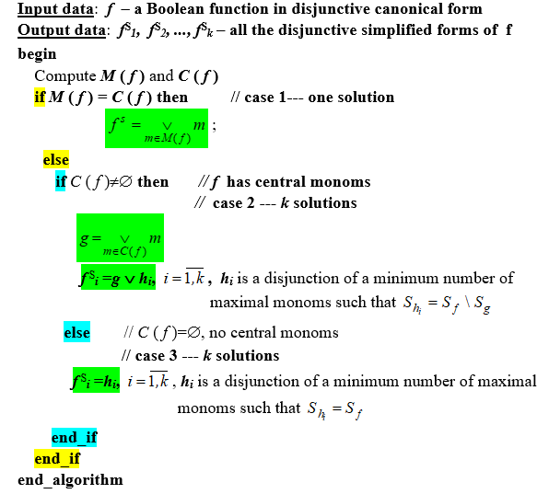
Simplification Algorithm

Slide 8

Simplification Methods

Slide 9




Veitch-Karnaugh Diagrams Method

Slide 10
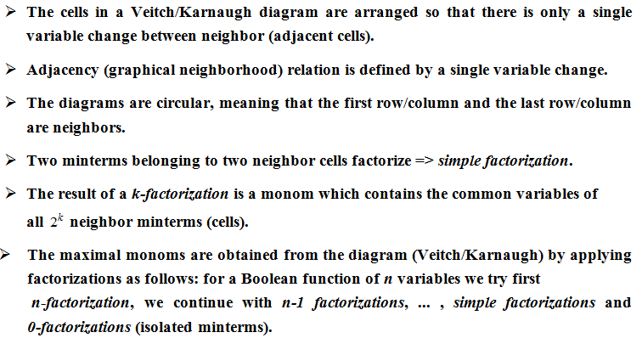
Veitch-Karnaugh Diagrams Method

Slide 11
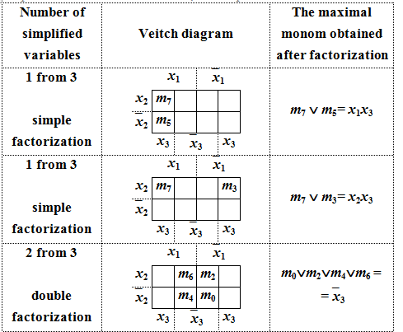
Examples of factorizations (I)

Slide 12
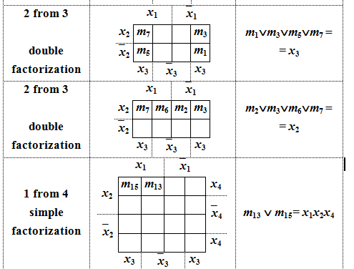
Examples of factorizations (II)

Slide 13

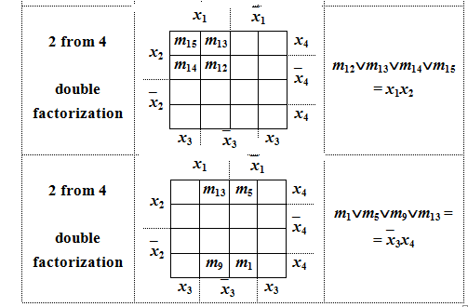
Examples of factorizations (III)

Slide 14

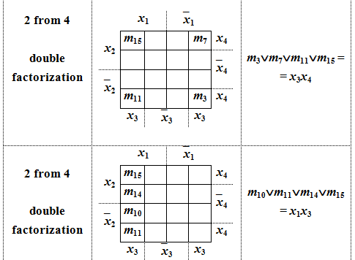
Examples of factorizations (IV)

Slide 15
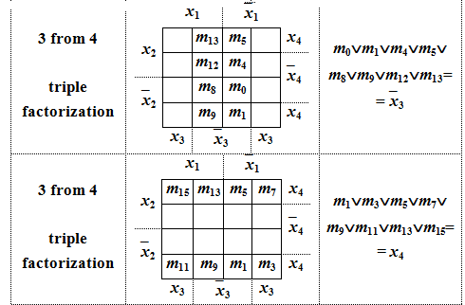
Examples of factorizations (V)

Slide 16
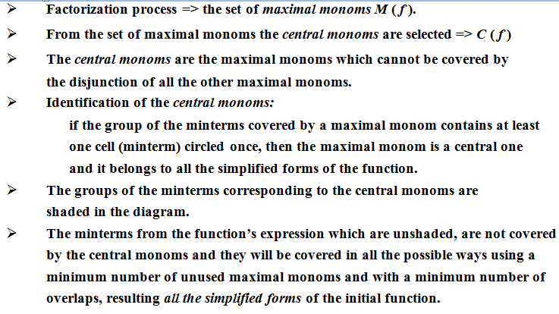
Veitch-Karnaugh Diagrams Method

Slide 17
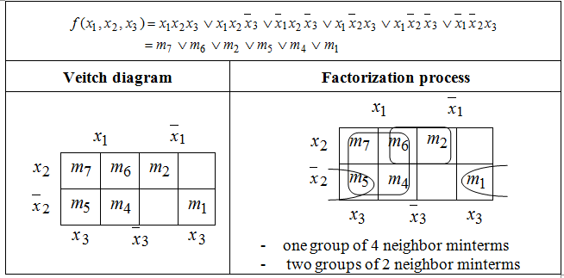
Example 1. simplify the Boolean function:

Slide 18
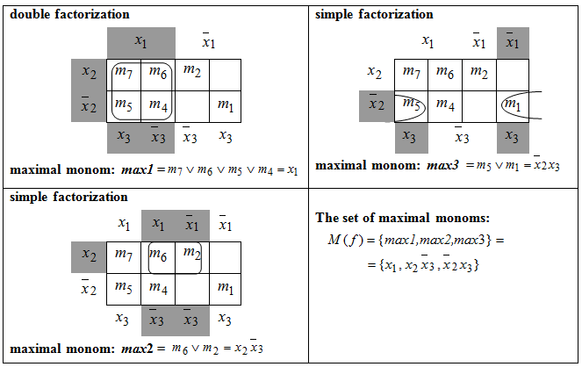
Example 1 – Factorization process

Slide 19
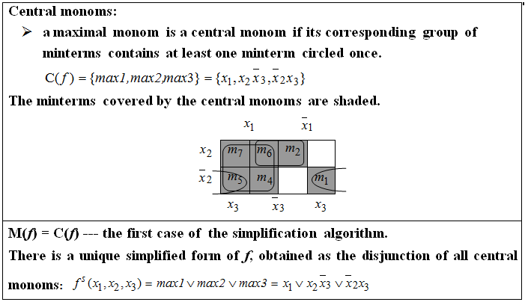
Example 1(contd.)

Slide 20


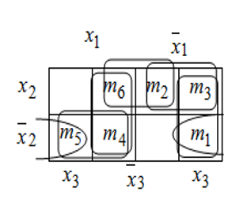
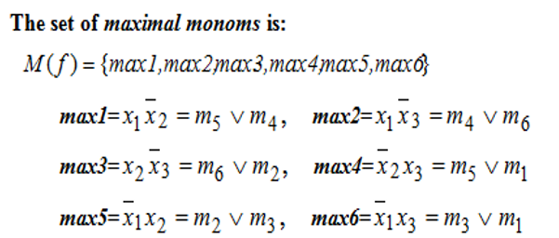

Example 2. simplify the Boolean function:
Representation:

Slide 21

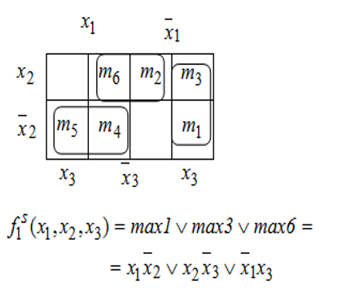
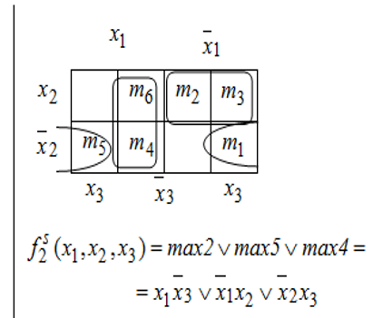
Example 2- Simplified forms

Slide 22
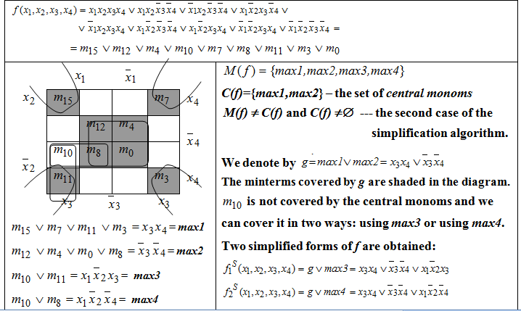
Example 3. simplify the Boolean function

Slide 23
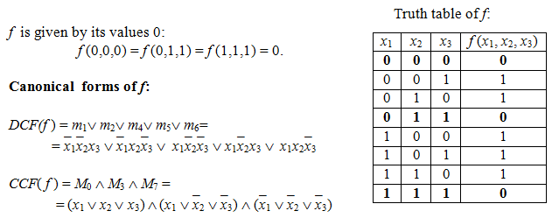
Example 4. simplify the Boolean function

Slide 24

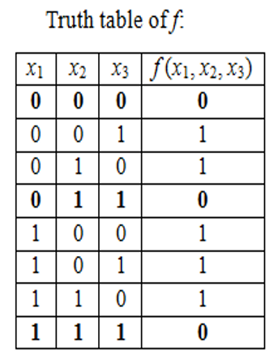


Example 4. simplify the Boolean function

Slide 25
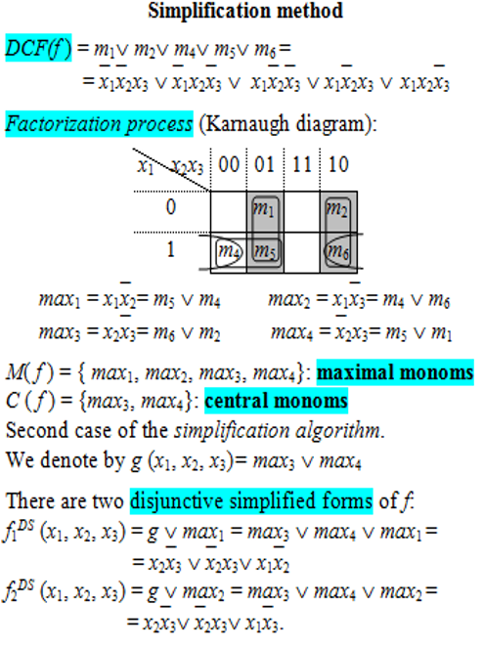
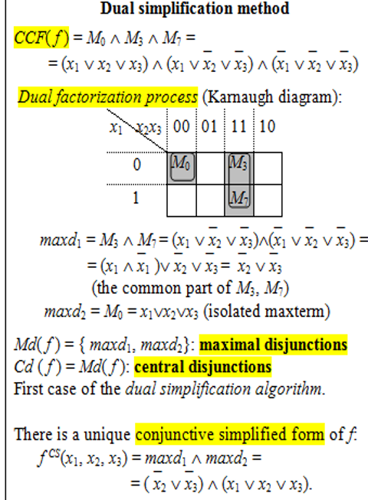
Example 4 (contd.)

Slide 26
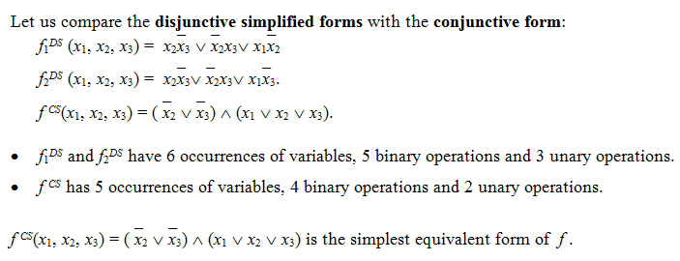
Example 4 (contd.)

