Slide 1

PROPOSITIONAL LOGIC
Syntactic Approach

Slide 2

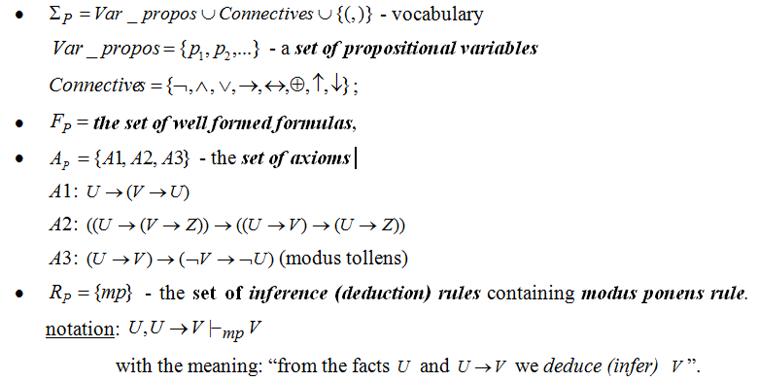
AXIOMATIC (FORMAL) SYSTEM:

Slide 3
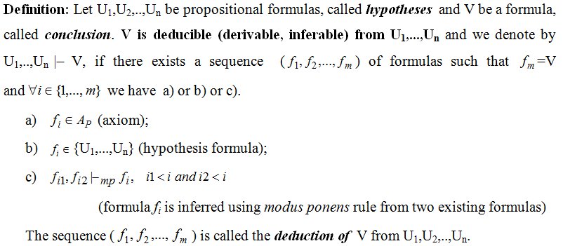
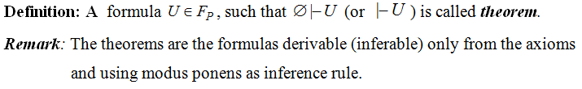
DEDUCTION

Slide 4
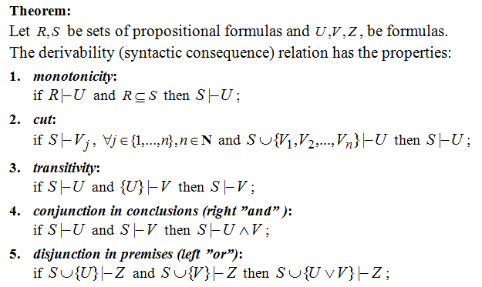
PROPERTIES OF DERIVABILITY RELATION

Slide 5
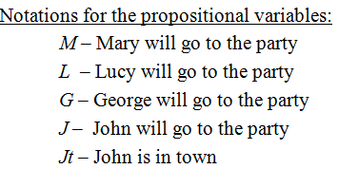
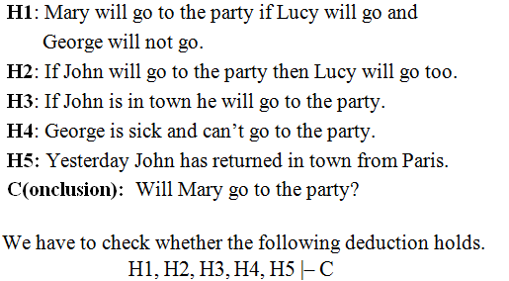
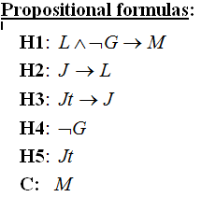
EXAMPLE 1 OF REASONING MODELING: PARTY

Slide 6
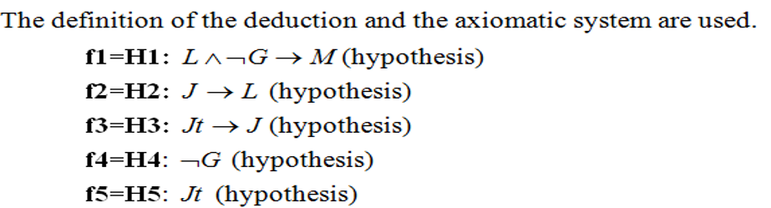




Slide 7
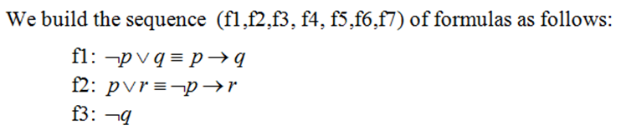

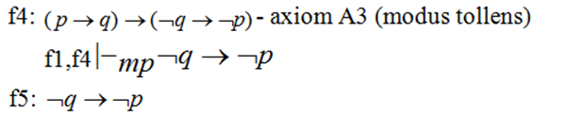
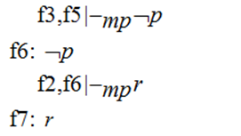
EXAMPLE 2

Slide 8
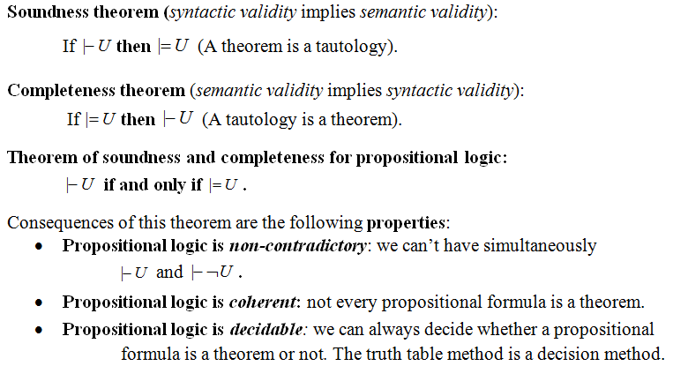
PROPERTIES OF PROPOSITIONAL LOGIC

Slide 9
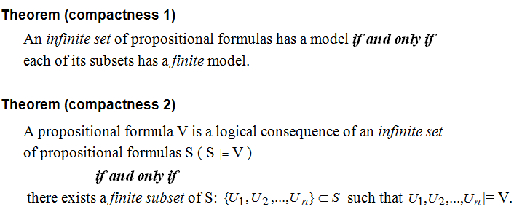
COMPACTNESS PROPERTY

Slide 10
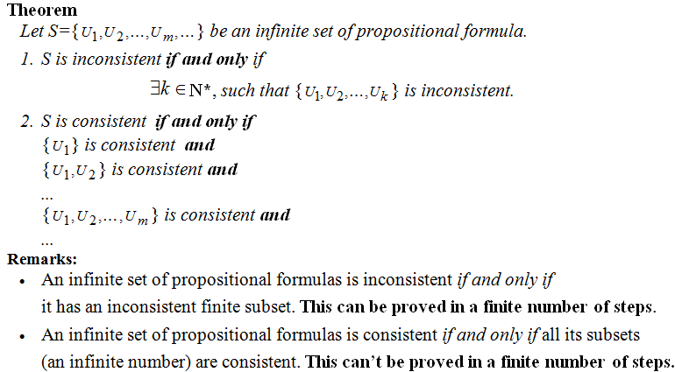
COMPACTNESS PROPERTY (CONTD.)

Slide 11
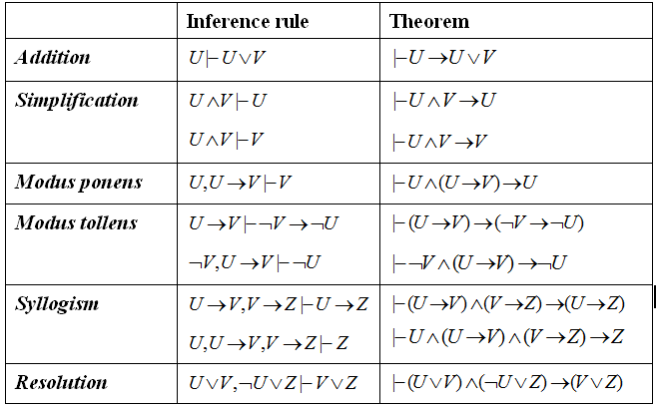
PROPOSITIONAL INFERENCE RULES

Slide 12
EXAMPLE 3 OF REASONING MODELING
Build a deduction of the conclusion (C) from the hypotheses H1, H2, H3, H4.
H1: If it is rainy Kate goes to the library or she goes shopping.
H2: Kate goes shopping only with her friend Carla.
H3: John goes to the library daily.
H4: It is rainy today, Carla is sick and she will not go shopping.
C (conclusion) Kate will meet John at the library today.

Slide 13
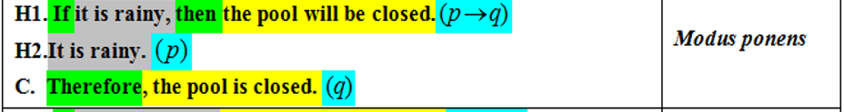
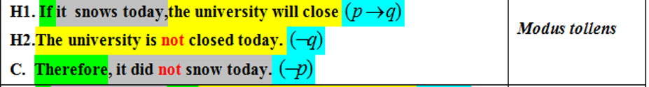
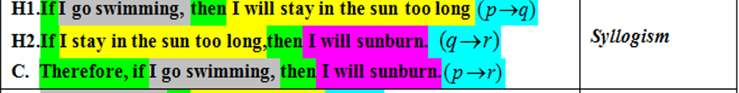
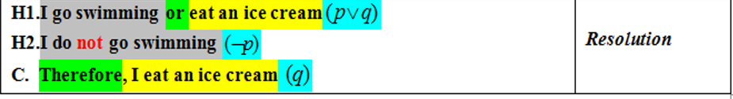
WHICH RULE OF INFERENCE IS USED IN EACH ARGUMENT BELOW?

Slide 14
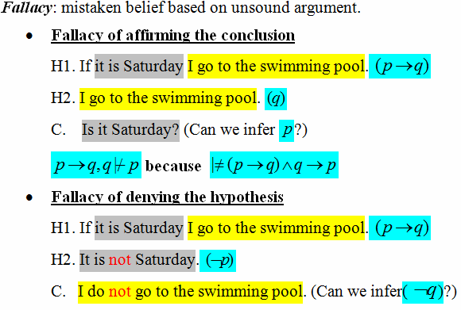
FALLACIES

Slide 15
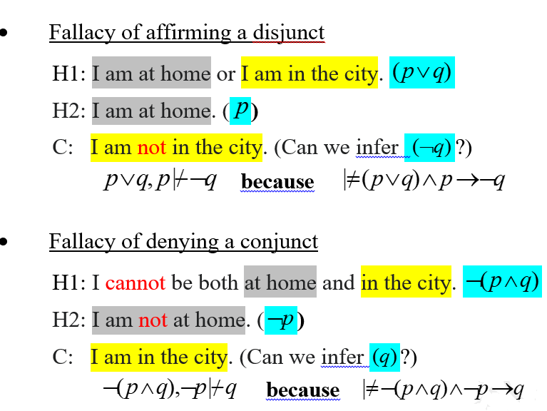
FALLACIES (contd.)

Slide 16

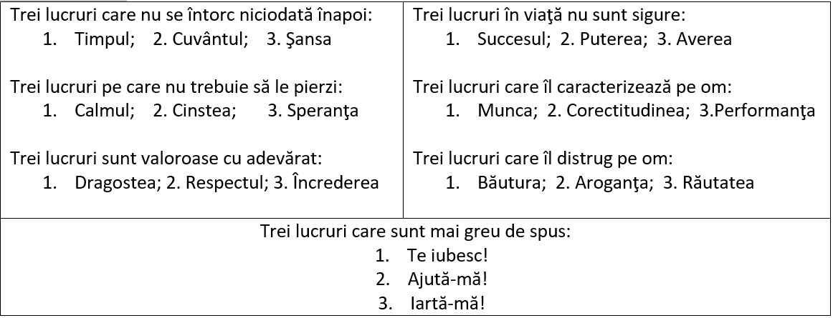
ÎNŢELEPCIUNE

Slide 17
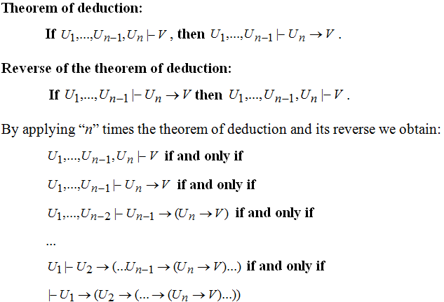
THEOREM OF DEDUCTION AND ITS REVERSE

Slide 18
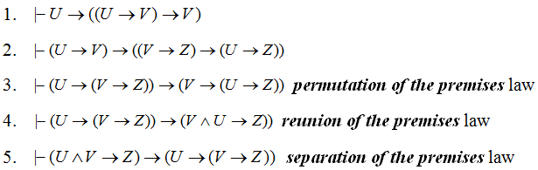
Theorem of deduction - consequences

Slide 19

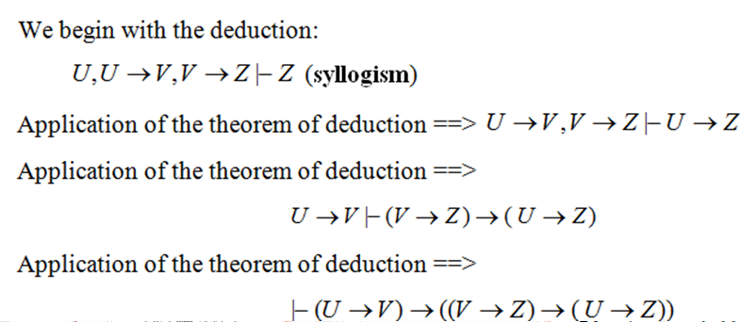
Proof

Slide 20
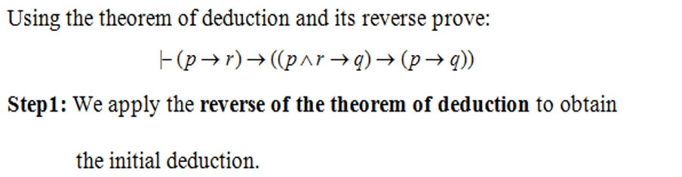
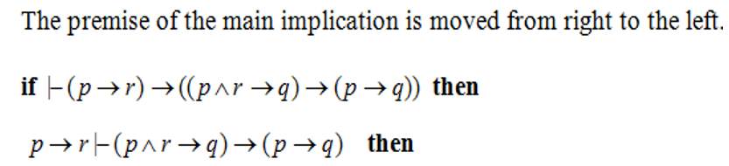

EXAMPLE 4 – THEOREM OF DEDUCTION

Slide 21
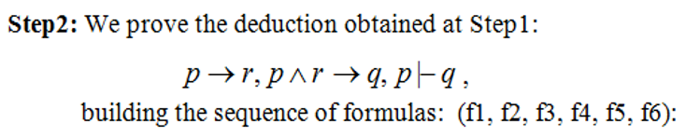





EXAMPLE 4 (CONTD.)

Slide 22
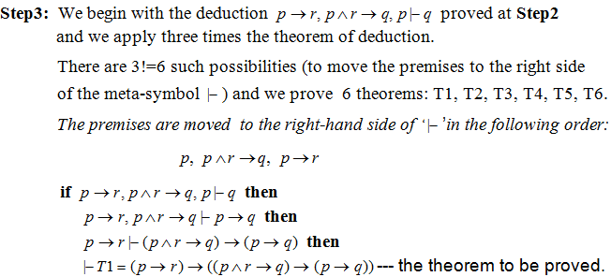
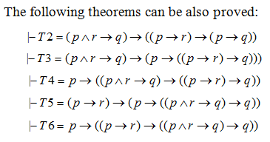
EXAMPLE 4 (CONTD.)

Slide 23
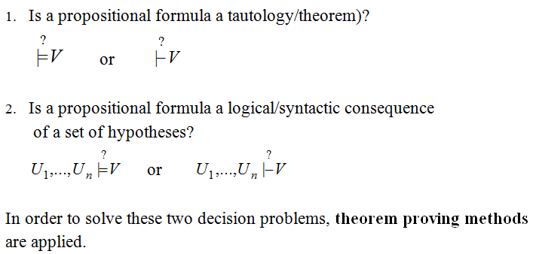
DECISION PROBLEMS IN PROPOSITIONAL LOGIC

Slide 24
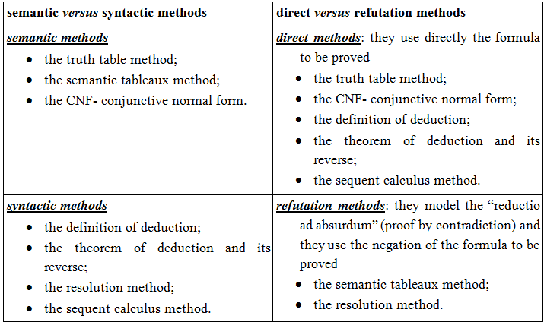
CLASSIFICATION OF PROOF METHODS

