Slide 1

Resolution Proof Method
IN PROPOSITIONAL LOGIC

Slide 2
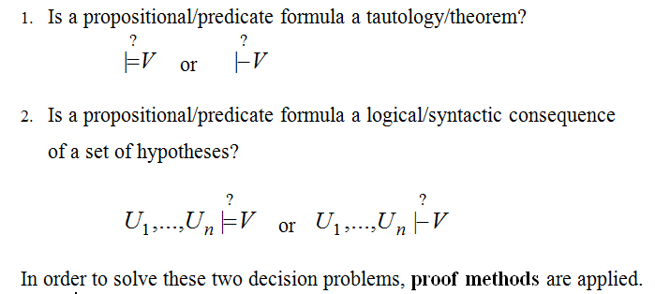
DECISION PROBLEMS IN PROPOSITIONAL/PREDICATE LOGIC

Slide 3
Resolution Proof Method
It was proposed by J.A. Robinson in 1965 as a proof method for classical logics
Dedicated theorem provers based on resolution:
OTTER, PCPROOVE, AMPHION, Jape
It was easily adapted to nonstandard logics (modal, temporal, many-valued, non-monotonic).
Its basic aim is to check the consistency/inconsistency of a set of clauses.
It is based on syntactic considerations => syntactic method
The validity of a formula is proved by contradiction=>
=> refutation method

Slide 4
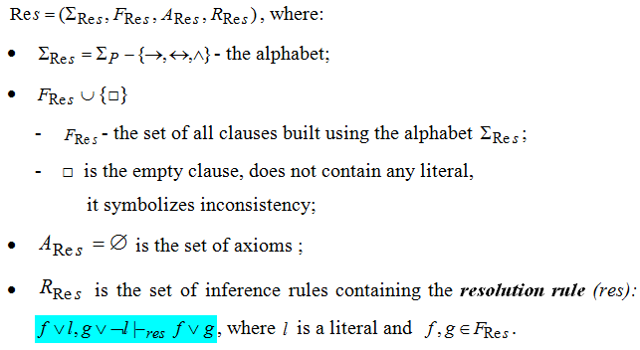
Resolution method - formal system for propositional logic -

Slide 5
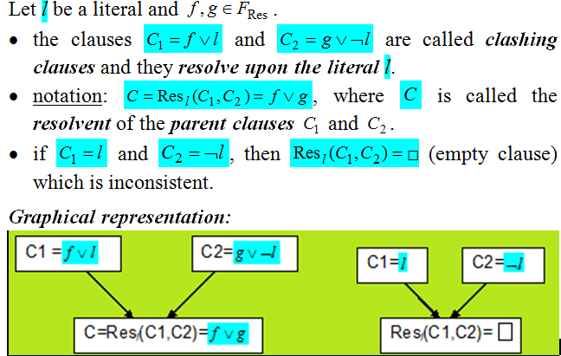
Definitions

Slide 6
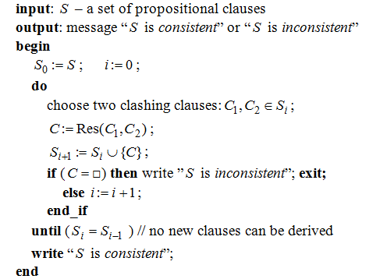
Algorithm: General_propositional_resolution

Slide 7
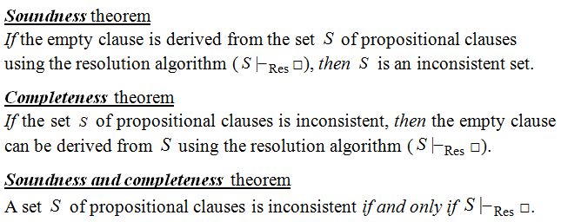
Theoretical Results

Slide 8
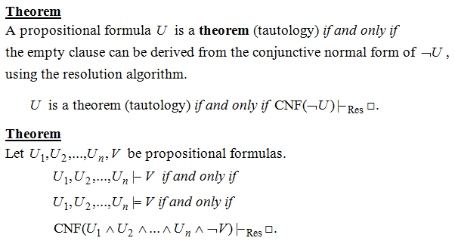
Resolution - a refutation Proof method

Slide 9
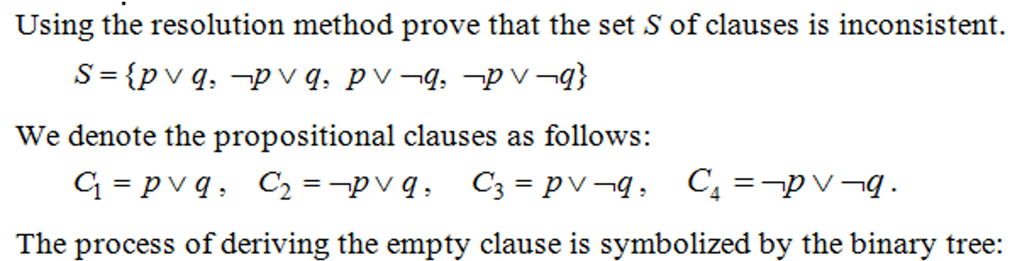
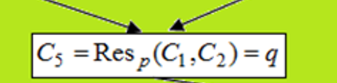
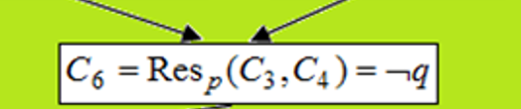

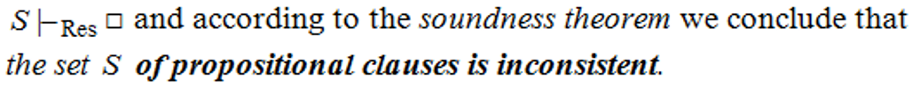
Example 1

Slide 10
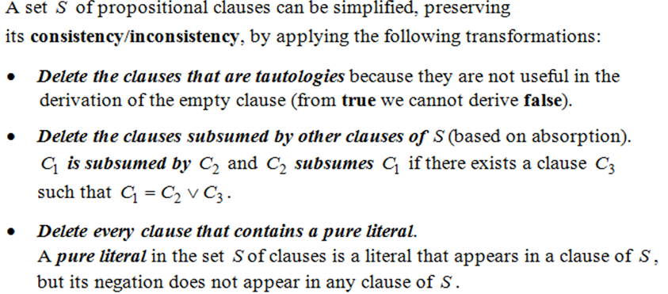
Theorem (based on Davis-Putman procedure)

Slide 11
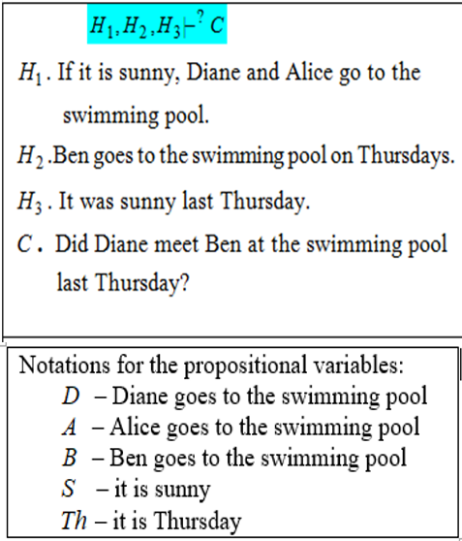
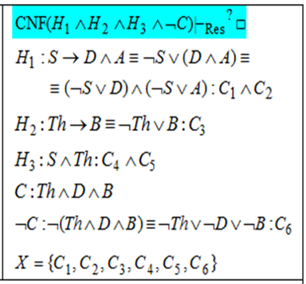
Example 2. Modeling reasoning

Slide 12
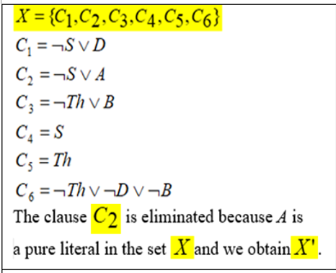
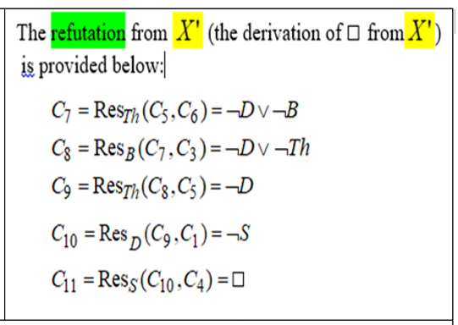
Example 2 – general Resolution(contd.)

Slide 13
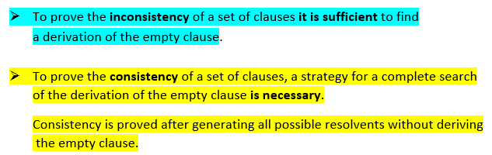
IMPORTANT!

Slide 14
Strategies and Refinements of Resolution
Strategies:
assure that all the possible clauses to be derived are generated
try to avoid the derivation of redundant and irrelevant clauses in order to obtain the empty clause.
level-saturation strategy, deletion strategy,
set-of-support strategy
Refinements
make the resolution process more efficient by imposing restrictions on the clashing clauses
lock resolution, linear resolution,
semantic resolution

Slide 15
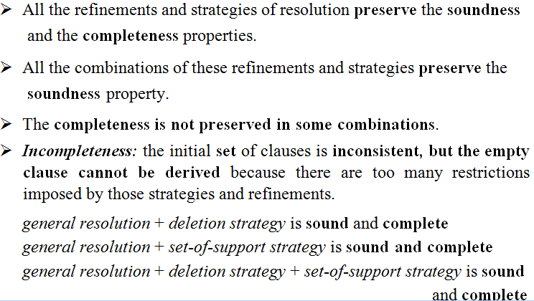
Remarks

Slide 16
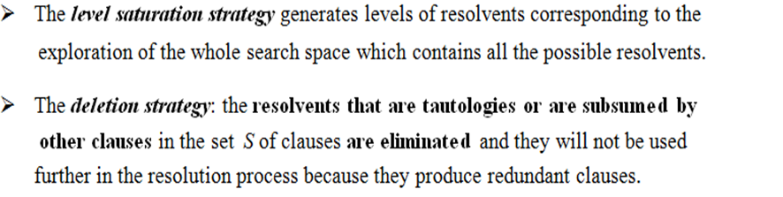
Strategies of Resolution

Slide 17
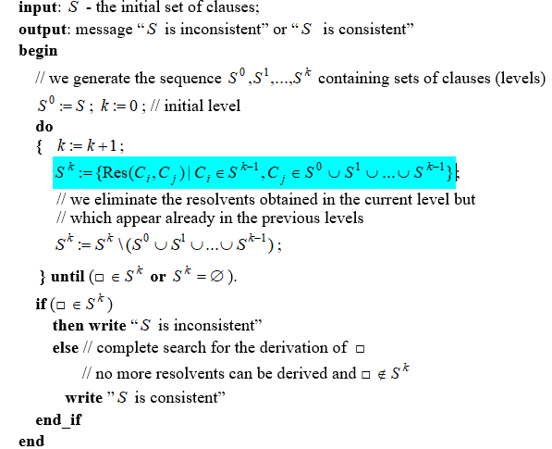
Algorithm: level-saturation-strategy

Slide 18
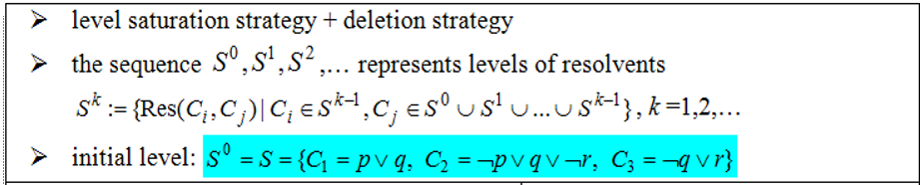
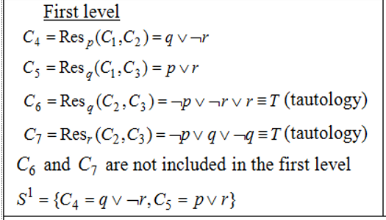
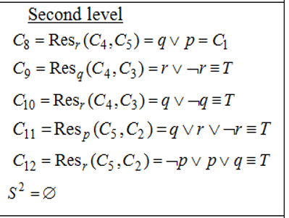

Example 3

Slide 19
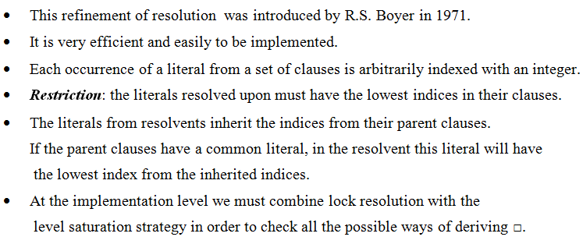
Lock Resolution

Slide 20
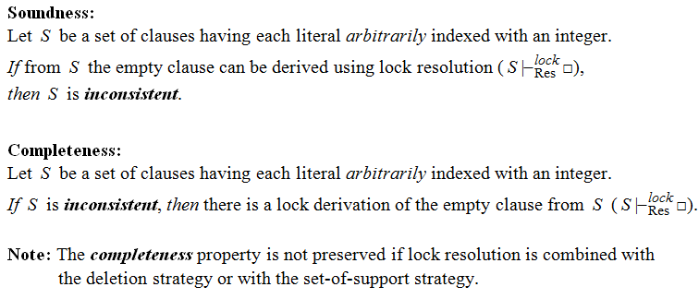
Theorems – Lock resolution

Slide 21
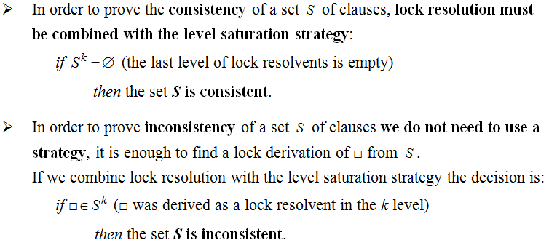
Remarks

Slide 22
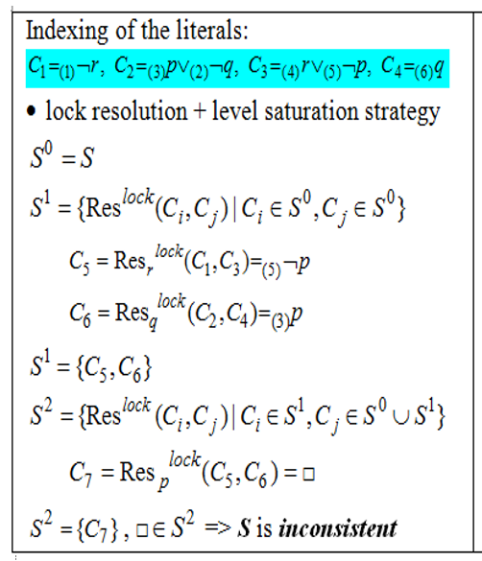
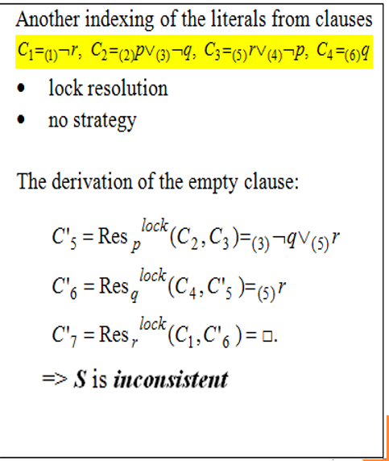
Example 4

Slide 23
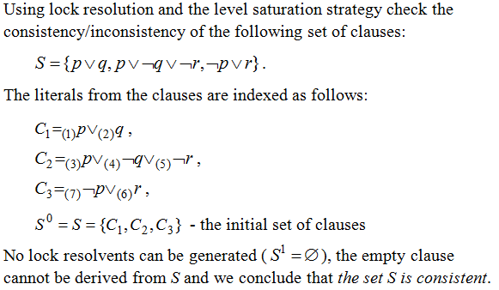
Example 5

Slide 24

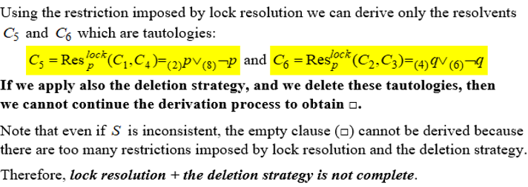
Example 6

Slide 25
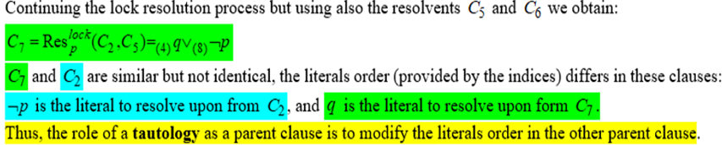
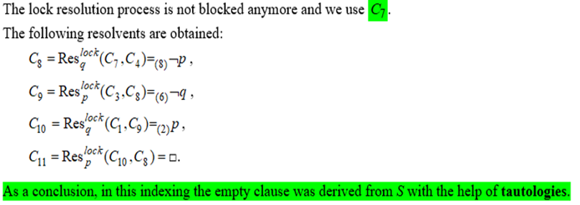
Example 6 (contd.)

Slide 26
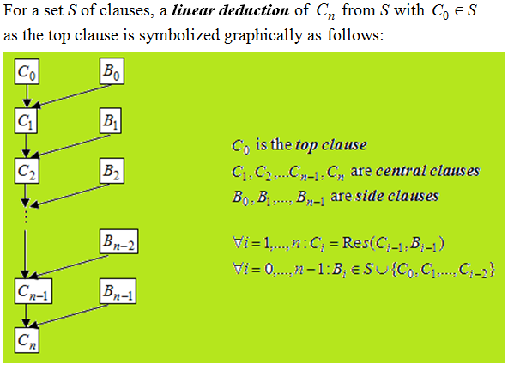
Linear Resolution (Loveland 1971)

Slide 27
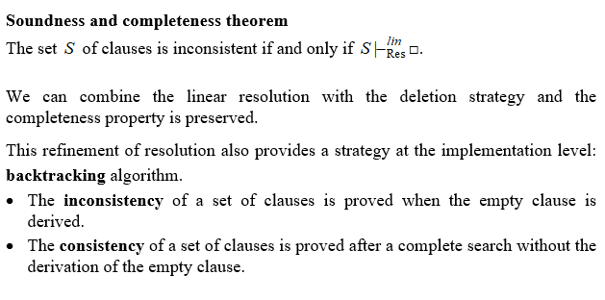
Theoretical results

Slide 28
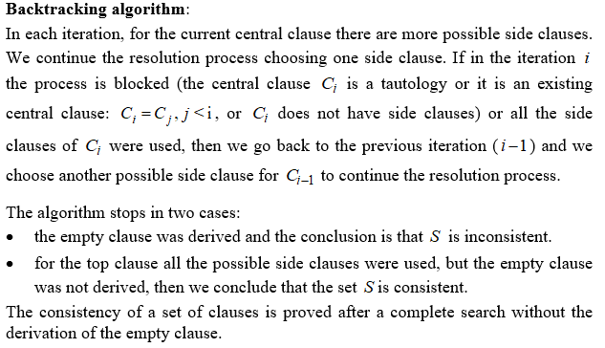

Slide 29
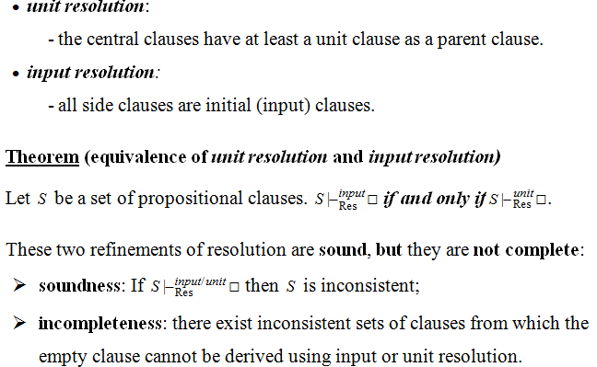
Special cases of linear resolution

Slide 30
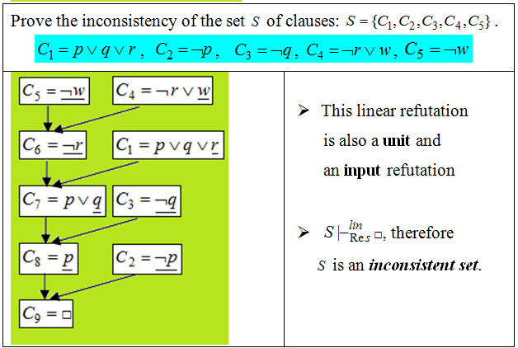
Example 8

Slide 31
