Slide 1
Proprioception & Adaptation
Experiment 1 (n=30)
Gradual VMR to 30 deg
2 day experiment (same schedule on both days)
Experiment 2 (n=32)
30 deg Error Clamp

Slide 2
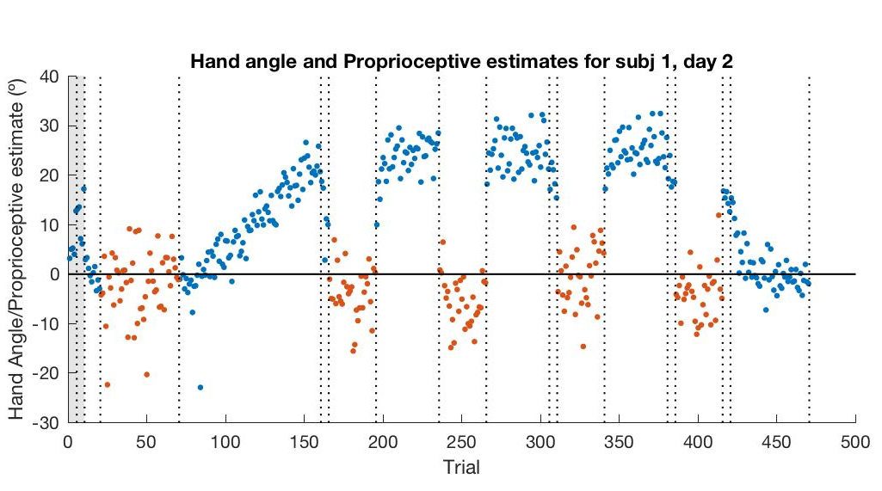
E1 – VMR: Example subject
30° gradual VMR
Blue – Hand angle
Orange – Proprioceptive estimate (angle)

Slide 3
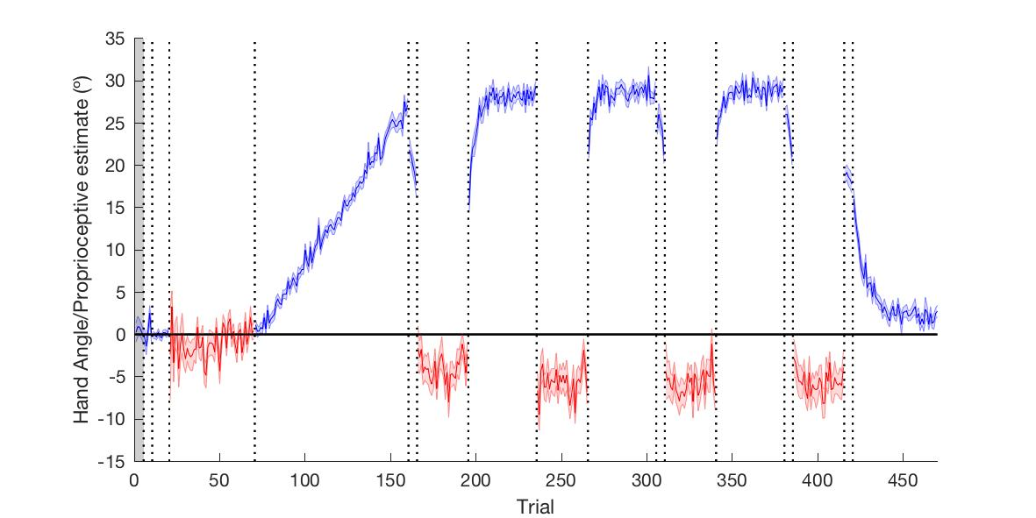
E1 – Group Average (day1)
“Aftereffect” trials

Slide 4
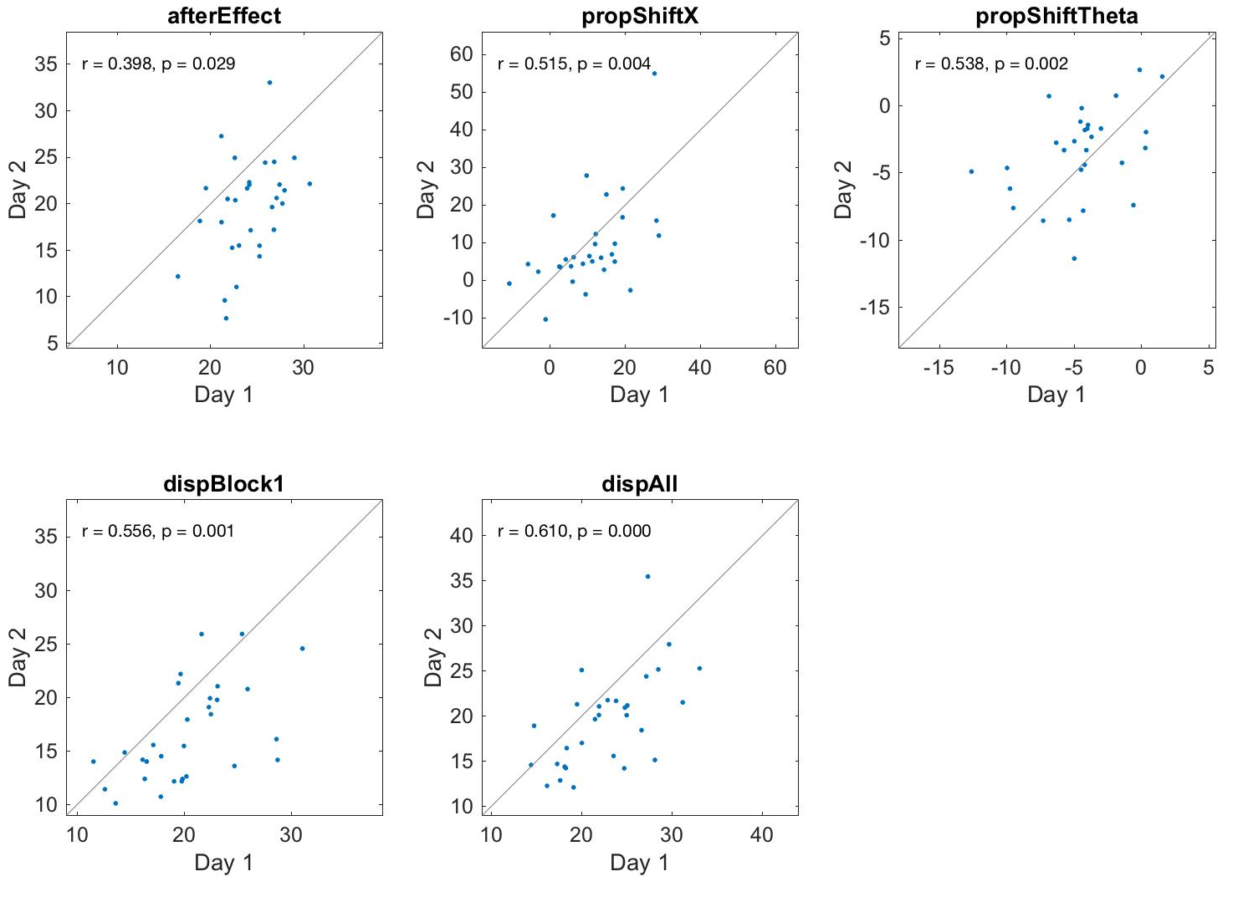
E1 – Inter subject reliability from Day 1 – Day 2
All flipped so that rotation was 30° clockwise
Significant reliability on all measures:
Aftereffect
propShiftX = Proprioceptive shift to the right (expected direction) in mm
propShiftTheta = same but as an angle (positive is CCW)
dispBlock1 = dispersion (proprioceptive variability) calculated using block 1
dispAll = dispersion calculated over all blocks

Slide 5
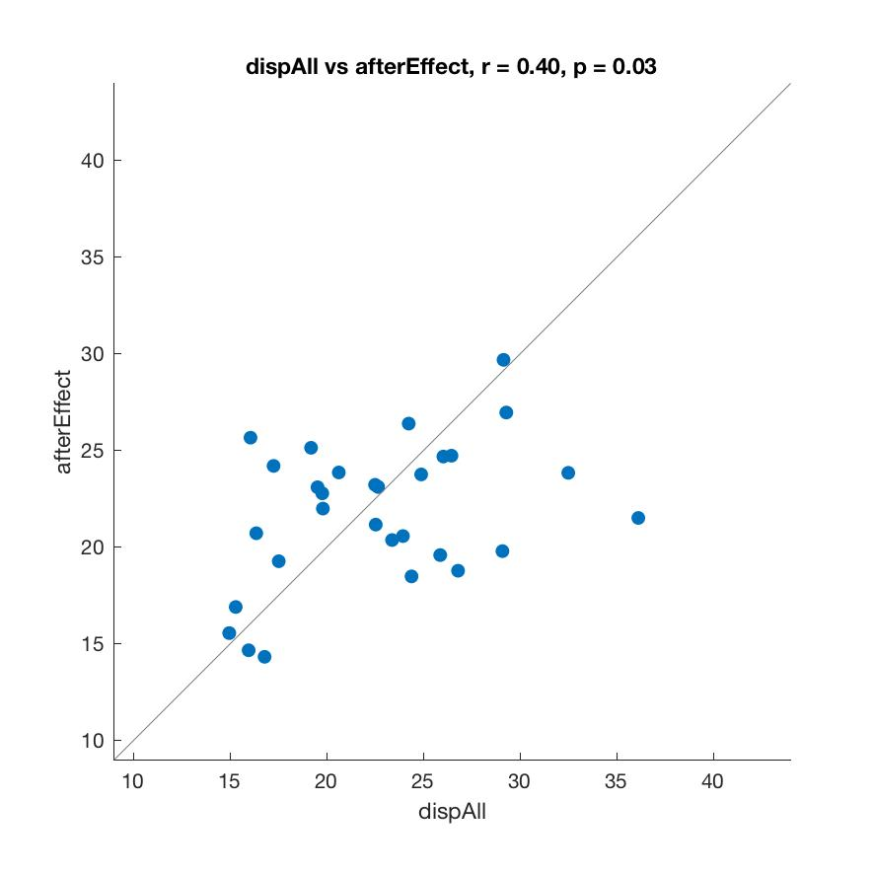
E1 – Significant correlation between proprioceptive variability and aftereffect
Mean dispersion and mean aftereffect for both days.

Slide 6
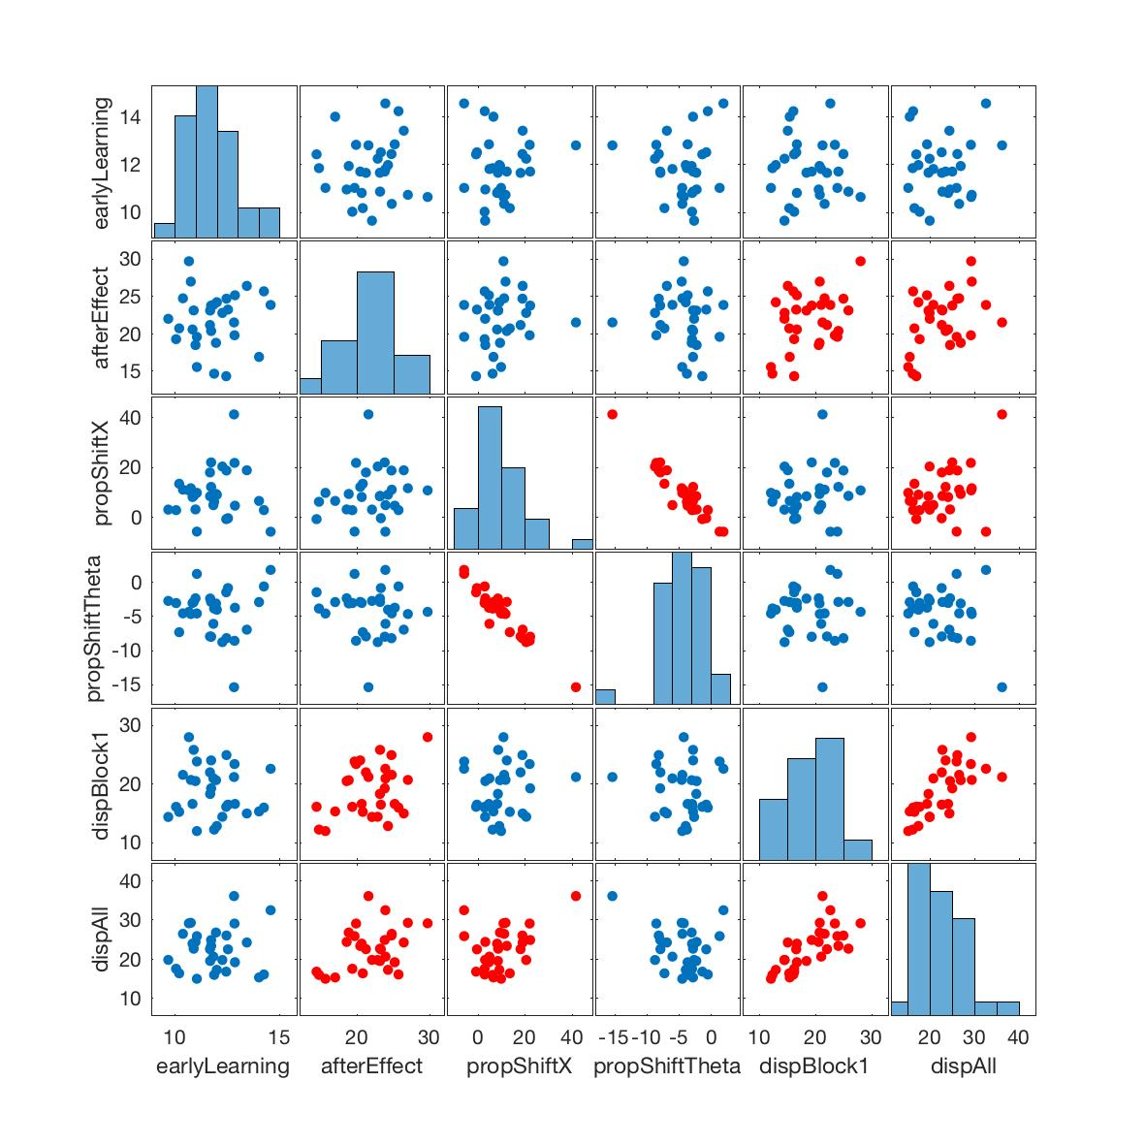
E1 – Correlation matrix
Also significant correlation between proprioceptive shift in X and proprioceptive variability, although only just: r = 0.39, p = 0.04
However, not significant when measuring proprioceptive shift as an angle: r = -0.29, p = 0.13

Slide 7
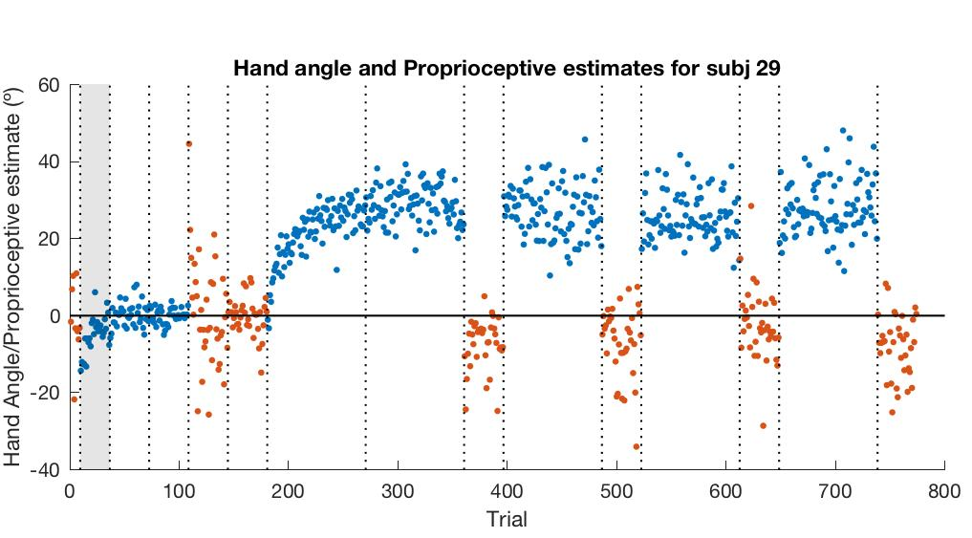
E2 – Error Clamp: Example subject
30° Error Clamp
Blue – Hand angle
Orange – Proprioceptive estimate (angle)

Slide 8
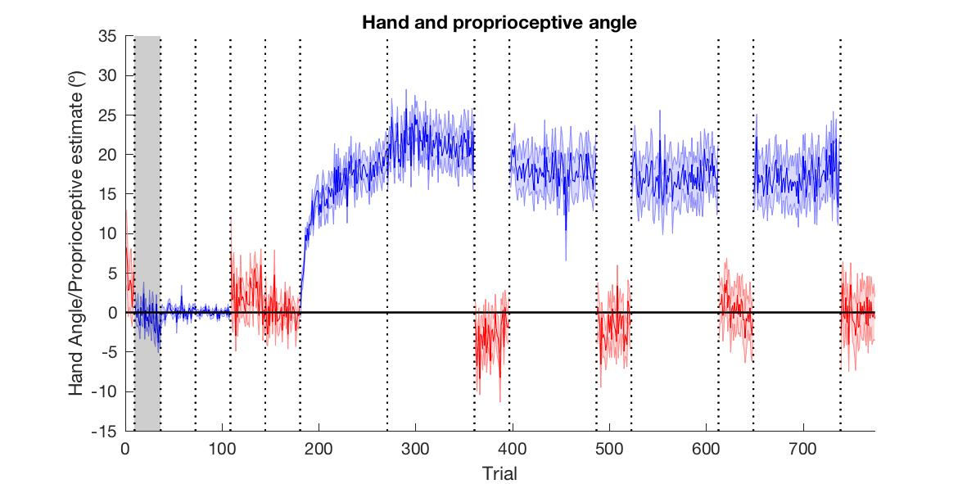
E2 – Group Average
“Asymptote” trials

Slide 9
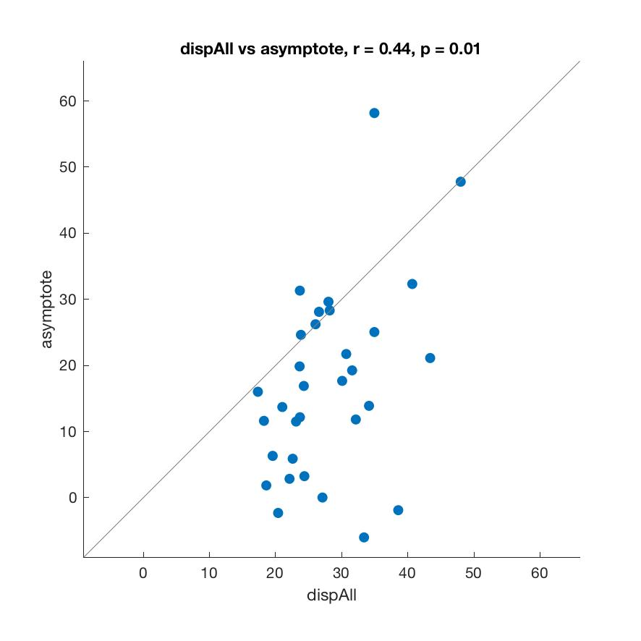
E2 – Significant correlation between proprioceptive variability and aftereffect

Slide 10
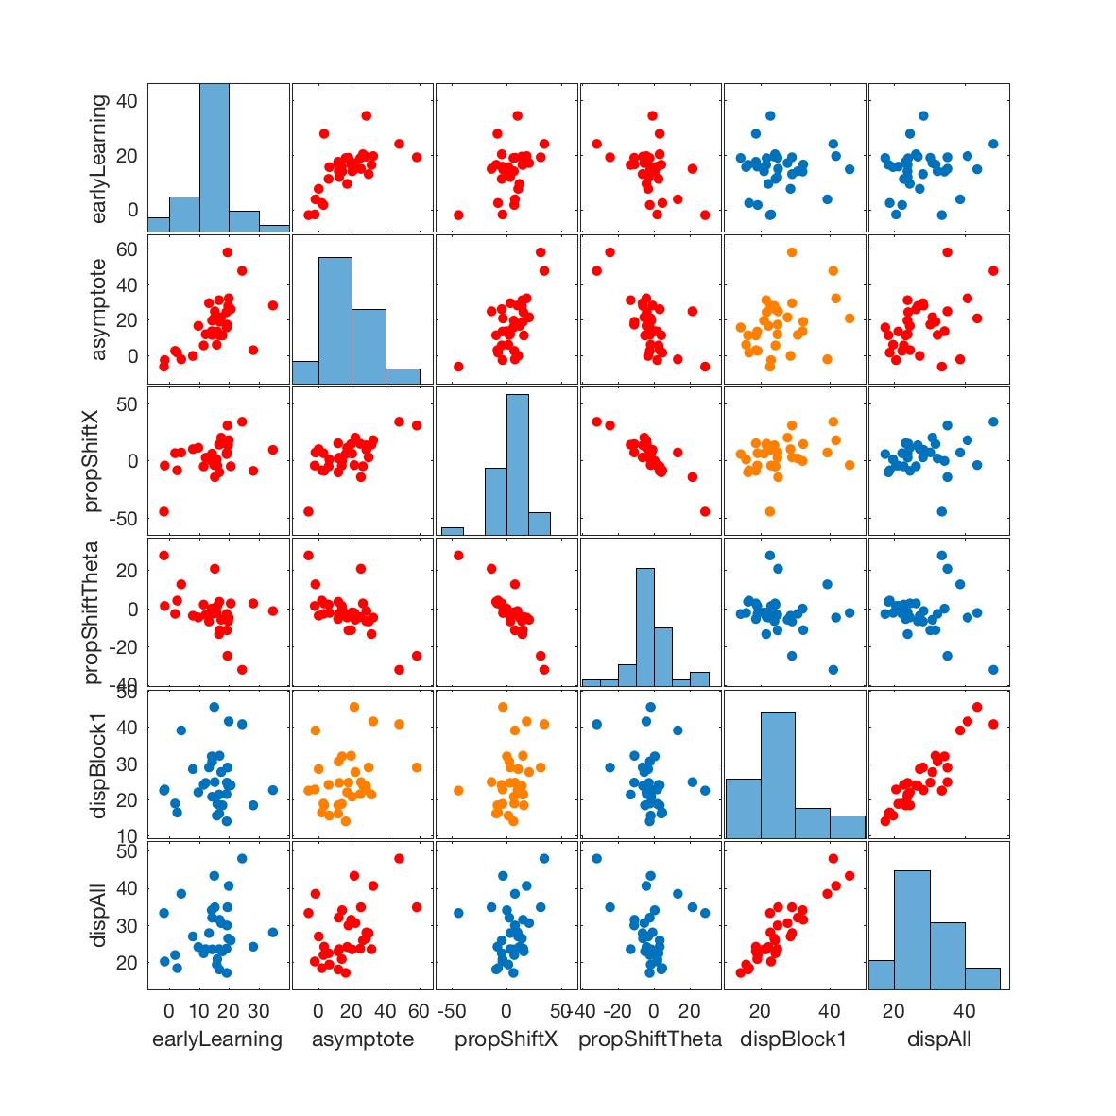
E2 – Correlation matrix
Also significant correlation between proprioceptive shift in X and asymptote r = 0.65, p = 0.00
Also significant when measuring proprioceptive shift as an angle: r = -0.67, p = 0.00

