Slide 1
Automatyzacja procesu testowania hurtowni danych

Slide 2

HELLO!
Dariusz Szudrzyński
Email: dareknet@gmail.com

Slide 3
1.Hurtownia danych- teoria

Slide 4
Hurtownia danych (ang. data warehouse) – rodzaj bazy danych, która jest zorganizowana i zoptymalizowana pod kątem pewnego wycinka rzeczywistości.

Slide 5
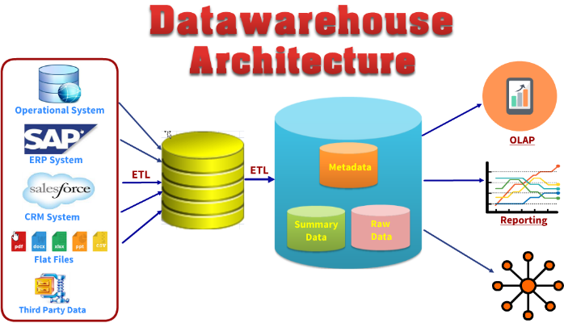
Schemat hurtowni danych

Slide 6
Wielowymiarowy model danych
Fakty
Wymiary

Slide 7
2.Hurtownia danych- testowanie

Slide 8
Operacje na danych
Ekstrakcja
Filtrowanie
Łączenie
Agregowanie

Slide 9
Czego potrzebujemy do efektywnego testowania?
Danych
Platformy programistycznej
Repozytorium kodu
Ciągłej integracji
Raportowania błędów

Slide 10
Co testować?
Przepływ danych
Zbiory danych
Poprawność/jakość danych
Wydajność

Slide 11
3. Część praktyczna

Slide 12
BIG CONCEPT
Bring the attention of your audience over a key concept using icons or illustrations

Slide 13
YOU CAN ALSO SPLIT YOUR CONTENT
White
Is the color of milk and fresh snow, the color produced by the combination of all the colors of the visible spectrum.
Black
Is the color of coal, ebony, and of outer space. It is the darkest color, the result of the absence of or complete absorption of light.

Slide 14
IN 2 OR 3 COLUMNS
Yellow
Is the color of gold, butter and ripe lemons. In the spectrum of visible light, yellow is found between green and orange.
Blue
Is the colour of the clear sky and the deep sea. It is located between violet and green on the optical spectrum.
Red
Is the color of blood, and because of this it has historically been associated with sacrifice, danger and courage.

Slide 15
A PICTURE IS WORTH A THOUSAND WORDS
A complex idea can be conveyed with just a single still image, namely making it possible to absorb large amounts of data quickly.

Slide 16
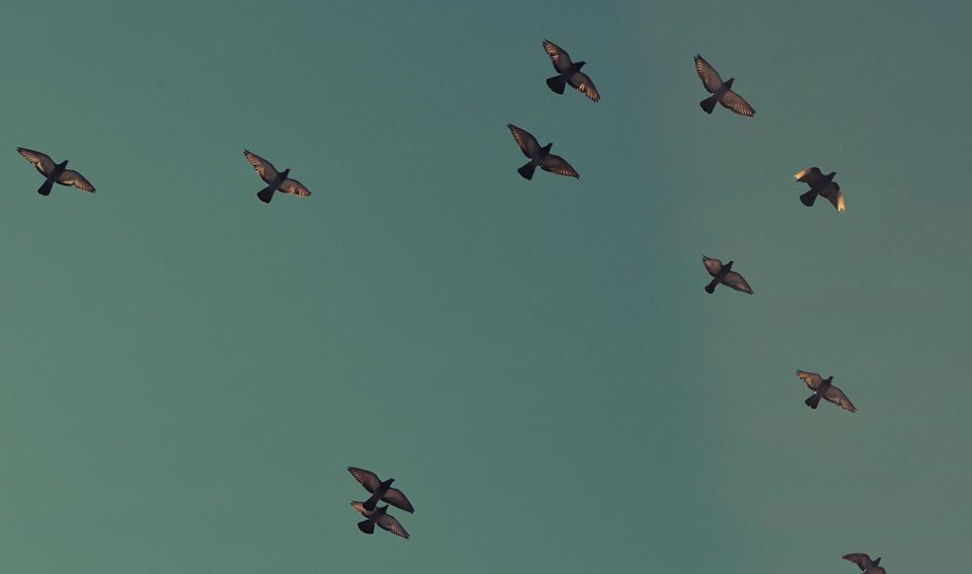
Want big impact?
USE BIG IMAGE

Slide 17
USE CHARTS TO EXPLAIN YOUR IDEAS
White
Gray
Black

Slide 18
AND TABLES TO COMPARE DATA
 | A | B | C
Yellow | 10 | 20 | 7
Blue | 30 | 15 | 10
Orange | 5 | 24 | 16

Slide 19
MAPS
our office

Slide 20
89,526,124
Whoa! That’s a big number, aren’t you proud?

Slide 21
89,526,124$
185,244 users
100%
That’s a lot of money
And a lot of users
Total success!

Slide 22
OUR PROCESS IS EASY
first
second
last

Slide 23
LET’S REVIEW SOME CONCEPTS
Yellow
Is the color of gold, butter and ripe lemons. In the spectrum of visible light, yellow is found between green and orange.
Blue
Is the colour of the clear sky and the deep sea. It is located between violet and green on the optical spectrum.
Red
Is the color of blood, and because of this it has historically been associated with sacrifice, danger and courage.
Yellow
Is the color of gold, butter and ripe lemons. In the spectrum of visible light, yellow is found between green and orange.
Blue
Is the colour of the clear sky and the deep sea. It is located between violet and green on the optical spectrum.
Red
Is the color of blood, and because of this it has historically been associated with sacrifice, danger and courage.

Slide 24
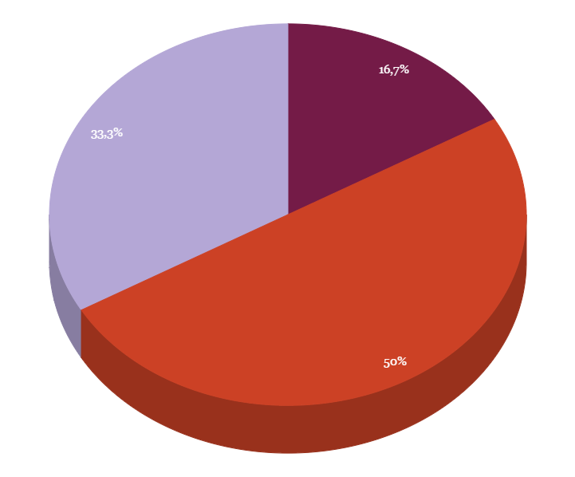
You can insert graphs from Google Sheets

Slide 25
ANDROID PROJECT
Show and explain your web, app or software projects using these gadget templates.
Place your screenshot here

Slide 26
iPHONE PROJECT
Show and explain your web, app or software projects using these gadget templates.
Place your screenshot here

Slide 27
TABLET PROJECT
Show and explain your web, app or software projects using these gadget templates.
Place your screenshot here

Slide 28
DESKTOP PROJECT
Show and explain your web, app or software projects using these gadget templates.
Place your screenshot here

Slide 29
THANKS!
Any questions?
You can find me at @username & user@mail.me

Slide 30
CREDITS
Special thanks to all the people who made and released these awesome resources for free:
Presentation template by SlidesCarnival
Photographs by Unsplash

Slide 31
PRESENTATION DESIGN
This presentation uses the following typographies and colors:
Titles: Oswald
Body copy: Tinos
You can download the fonts on this pages:
https://www.fontsquirrel.com/fonts/oswald · https://www.fontsquirrel.com/fonts/tinos
You don’t need to keep this slide in your presentation. It’s only here to serve you as a design guide if you need to create new slides or download the fonts to edit the presentation in PowerPoint®

Slide 32
SlidesCarnival icons are editable shapes.
This means that you can:
Resize them without losing quality.
Change fill color and opacity.
Isn’t that nice? :)
Examples:

Slide 33
😉
Now you can use any emoji as an icon!
And of course it resizes without losing quality and you can change the color.
How? Follow Google instructions https://twitter.com/googledocs/status/730087240156643328
✋👆👉👍👤👦👧👨👩👪💃🏃💑❤😂😉😋😒😭👶😸🐟🍒🍔💣📌📖🔨🎃🎈🎨🏈🏰🌏🔌🔑 and many more...

