Slide 1

Please can you add an extra line under the Friday Routine headline so that it lines up with the article next to it.

Slide 2
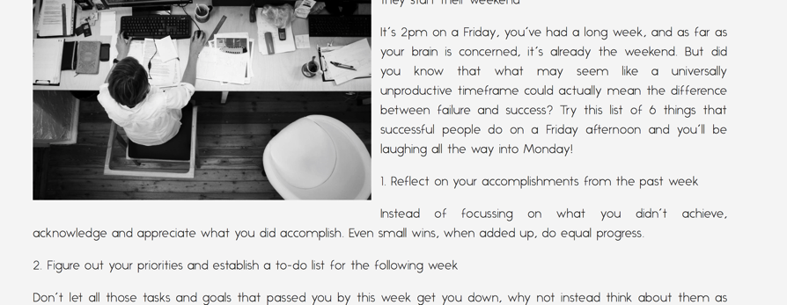
Can you drop point 1 to start under the image. It starts at an unfortunate section on the page. Please also check the Social Media sharing function. Ask Olivia for the share copy. Facebook is sharing a dummy.url?

Slide 3
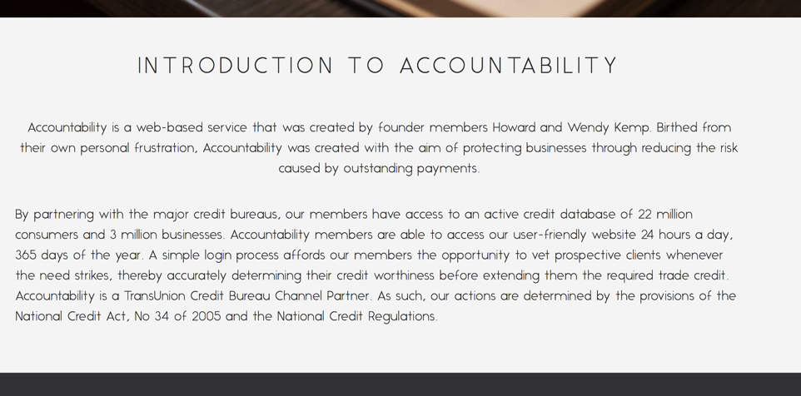
Can you adapt the second paragraph to be center aligned as per the paragraph above it.

Slide 4
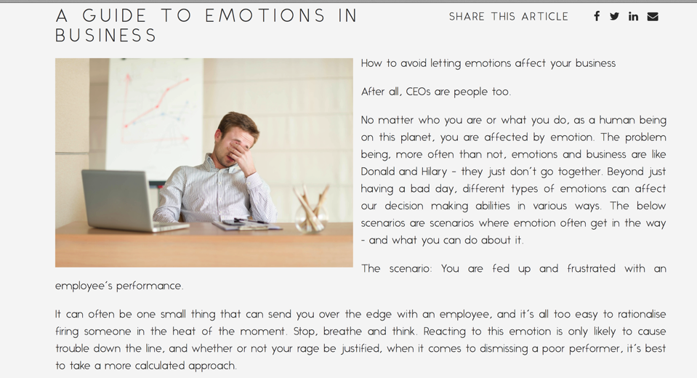
Can you check the spacing on the articles. For example the top line looks like there are 2 spaces between the first and second line. The Scenario: also starts at an unfortunate place on the article. We somehow need to find a bold for the sections. They do not differentiate themselves.

