Slide 1
ROast
&
Rave
A Place where reality & Facts Unveiled

Slide 2
Introduction
Got something to share but don’t want to be judged? Our platform is a safe, anonymous space for students to share their experiences and opinions freely. We believe the truth matters—but how we share and receive it matters too. So, express yourself, connect, and let your voice be heard!

Slide 3
Problem Statement
Students struggle to find reliable food reviews near their university.
Many online reviews are bland and lack humor, making food choices uninteresting.

Slide 4
Our SOlution
We provide a platform for students to freely express their opinion. Sometimes truth does matter but the way we receive the information also matters. We allow any user to upload their experience with a random anonymously.

Slide 5
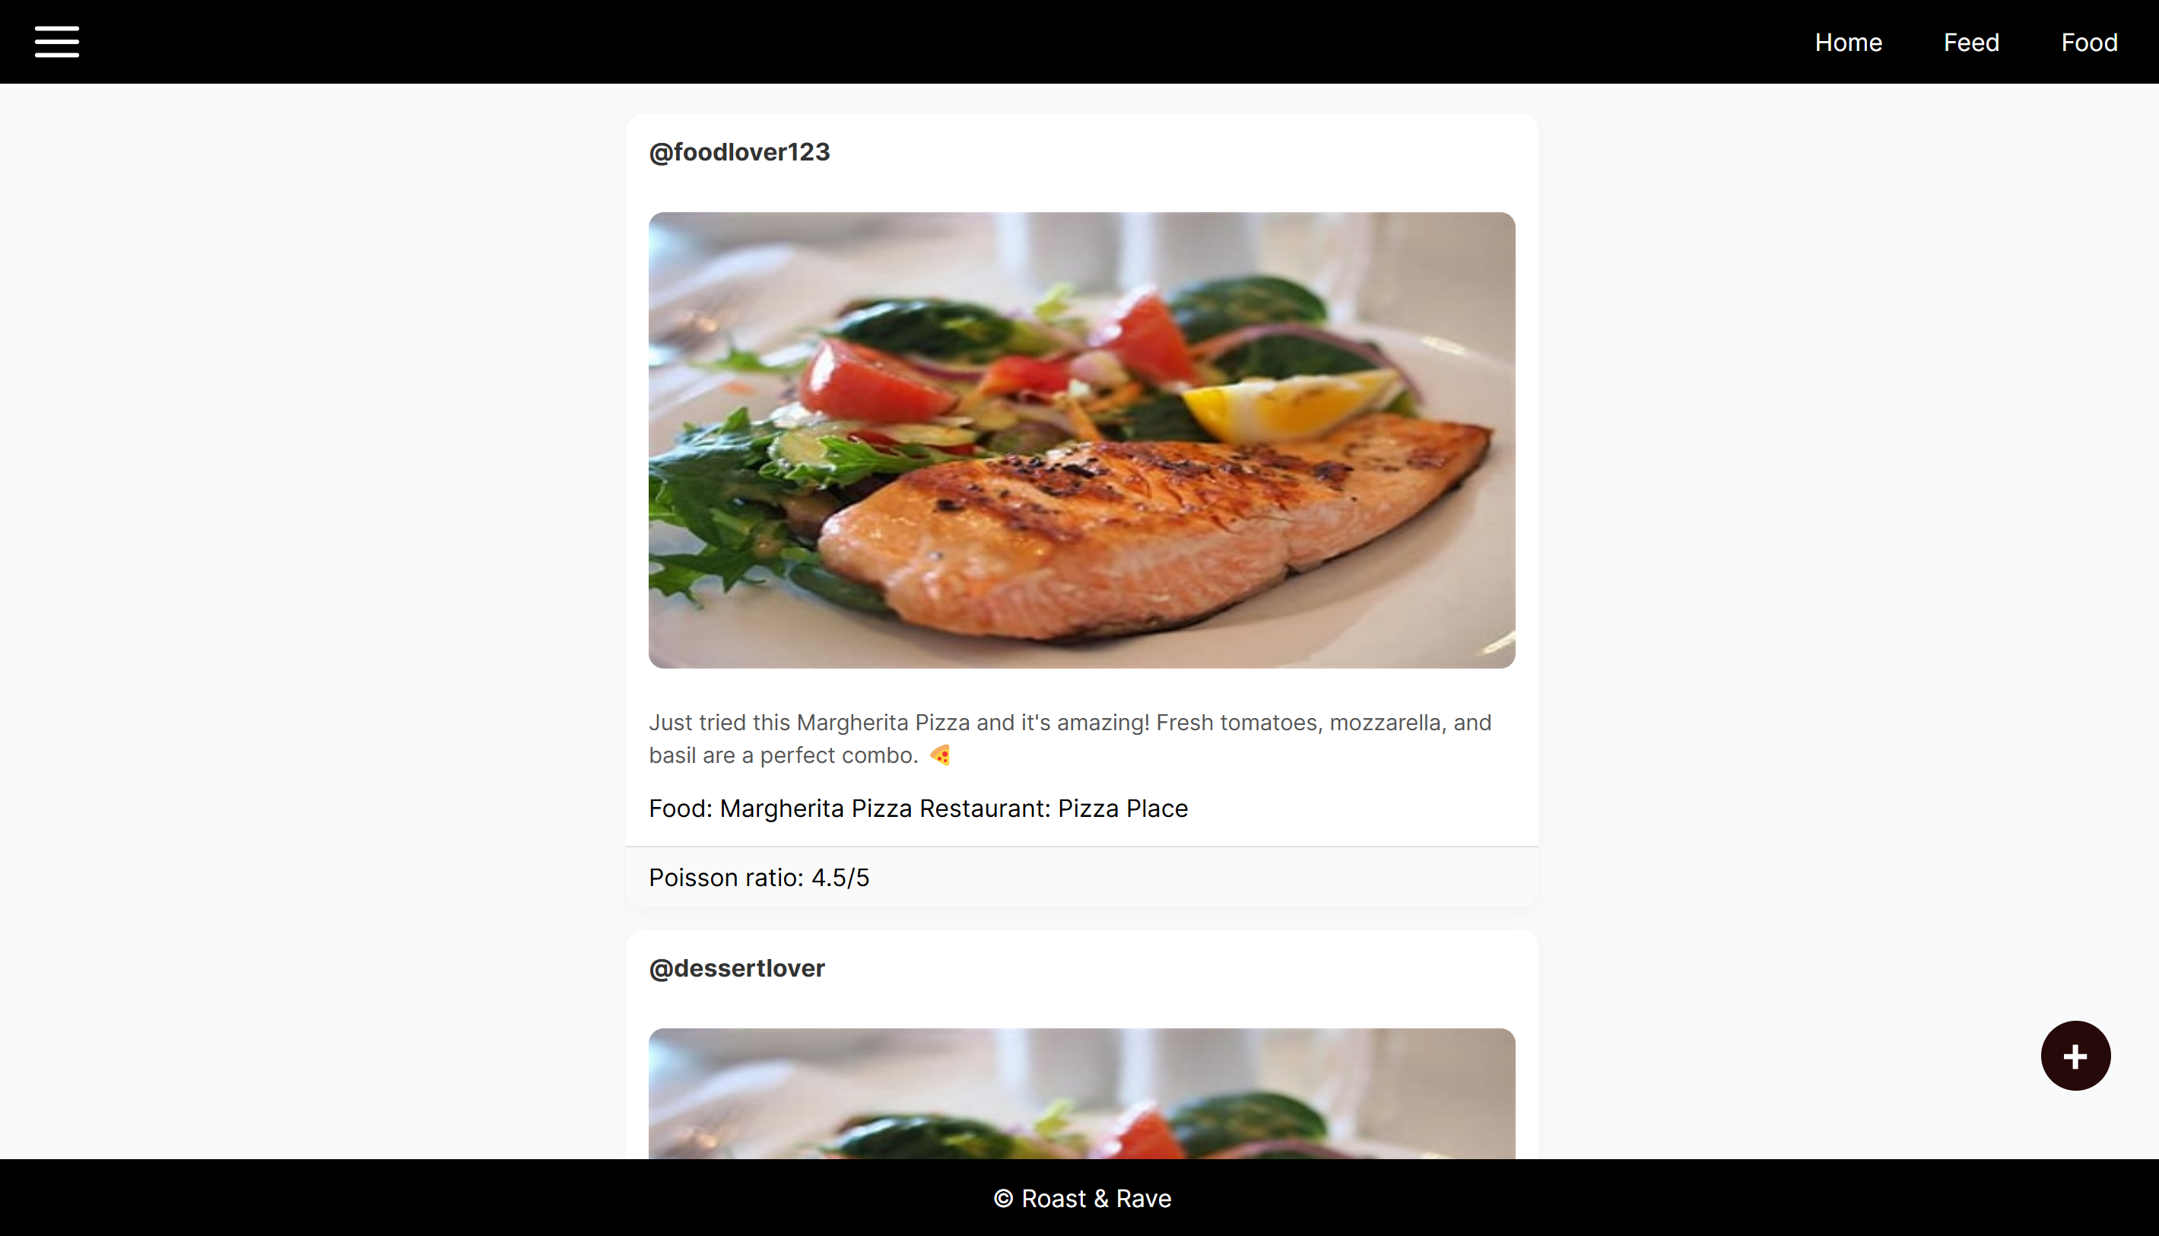
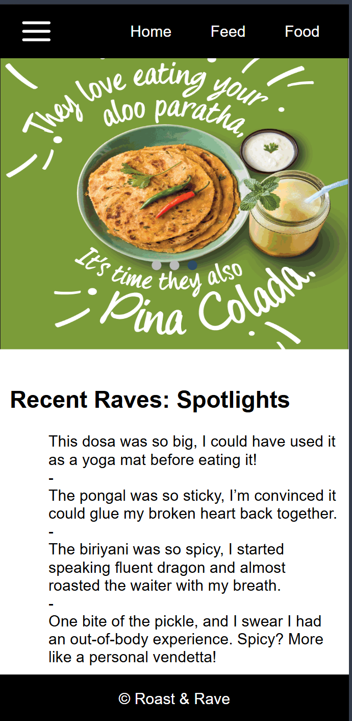
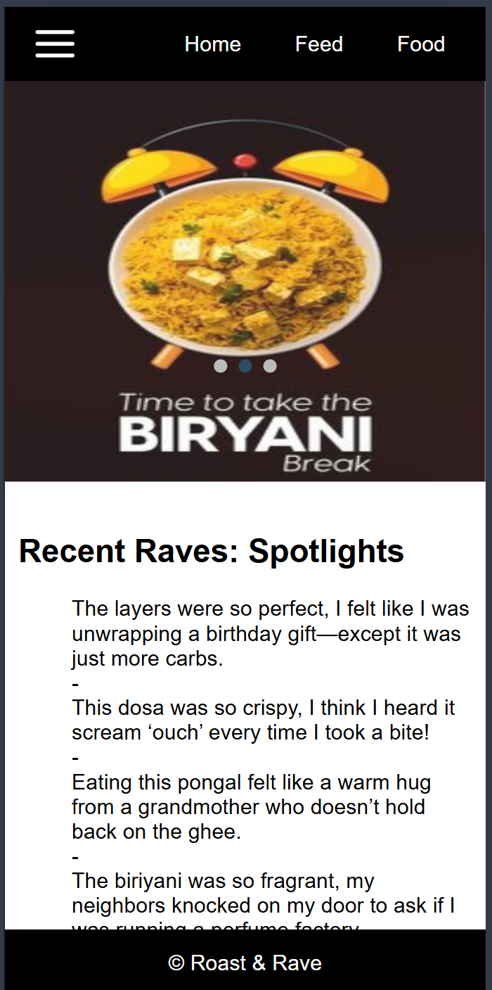
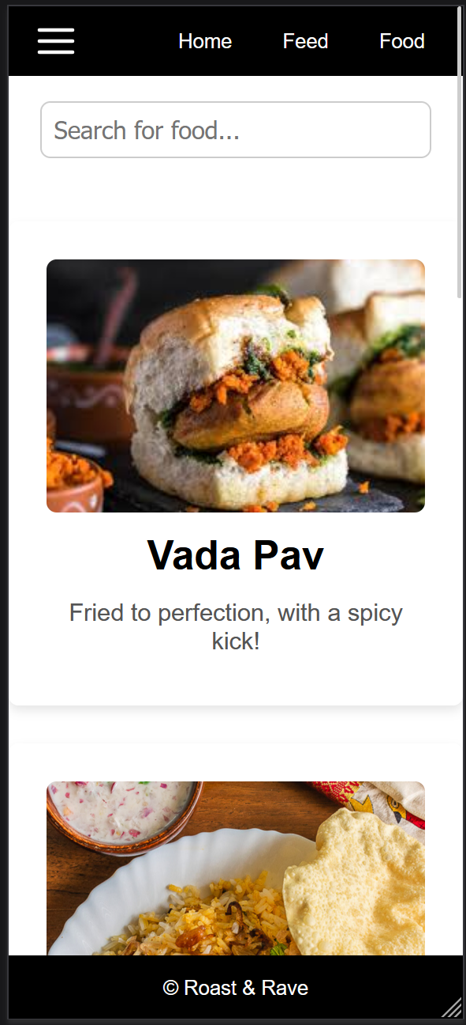
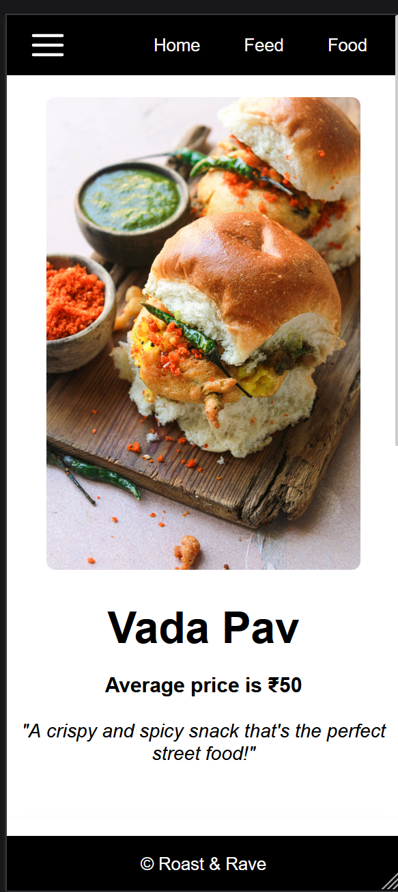
My Gallery

Slide 6
Current Status
We are actively integrating AI to enhance how you express your experiences.

Slide 7
Tech Stack
Frontend:
HTML, CSS, JavaScript
Backend:
JavaScript, Python, Flask
Version Control:
GitHub
Design: ​
Figma​
Api: ​
openai

Slide 8
Future Scope
Anonaymous Groups.
Advanced Search Filters.
Chatbots.

Slide 9
Thank you
PRESENTED BY:
ASHWIN. S
GOPINATH. R
RUTHRA MOORTHY. J
SUHAIB. A
UDHAYA. M

