Slide 1

Analysis of Methods on Sentiment Analysis for social big data
Andrew Turangan

Slide 2
Motivation

Slide 3
Motivation
Growth in big data, consumer reviews

Slide 4
Motivation
Growth in big data, consumer reviews
Consumer analysis more cumbersome

Slide 5
Motivation
Growth in big data, consumer reviews
Consumer analysis more cumbersome
Important applications in consumer analysis

Slide 6
Motivation
Growth in big data, consumer reviews
Consumer analysis more cumbersome
Important applications in consumer analysis
Gain idea of current state-of-the-art methods for social big data

Slide 7
Computational Challenges

Slide 8
Computational Challenges
Limited resources

Slide 9
Computational Challenges
Limited resources
One machine

Slide 10
Computational Challenges
Limited resources
One machine
Unable to perform full training

Slide 11
Computational Challenges
Limited resources
One machine
Unable to perform full training
Unable to perform to prove reproducibility

Slide 12
Computational Challenges
Limited resources
One machine
Unable to perform full training
Unable to perform to prove reproducibility
Missing training information

Slide 13
Computational Challenges
Limited resources
One machine
Unable to perform full training
Unable to perform to prove reproducibility
Missing training information
Lexicon features

Slide 14
Paper 1: ATLX (Bao et al., 2022)

Slide 15
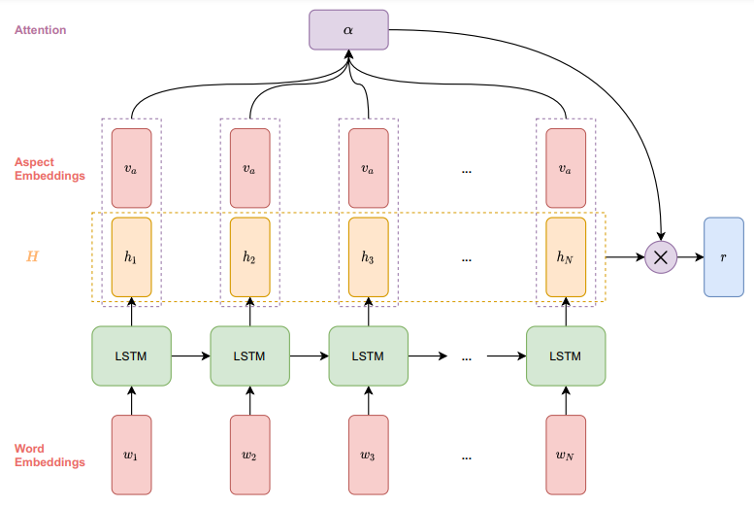
Paper 1: ATLX (Bao et al., 2022)

Slide 16
Paper 2: Co-LSTM (Behera et al., 2021)

Slide 17
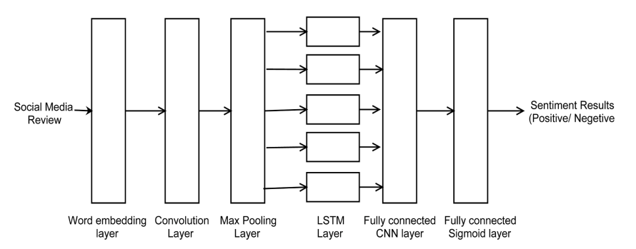
Paper 2: Co-LSTM (Behera et al., 2021)

Slide 18
Dataset

Slide 19
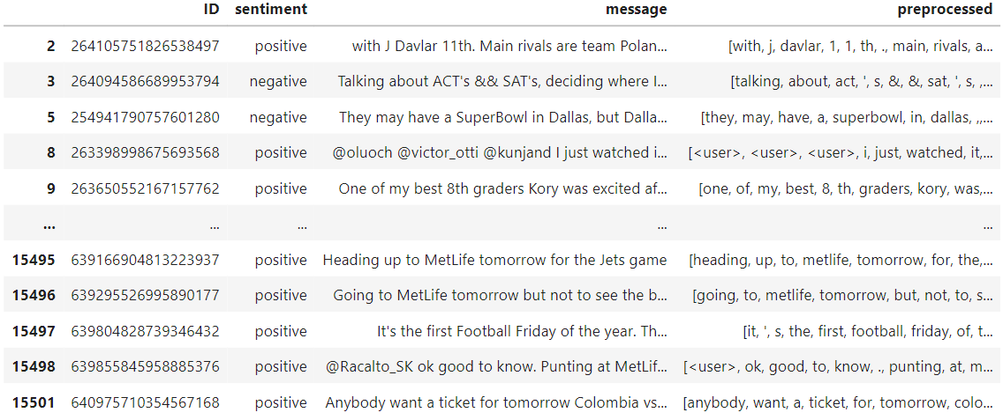
Dataset

Slide 20
Experiment Design

Slide 21
Experiment Design
Jupyter Notebook

Slide 22
Experiment Design
Jupyter Notebook
TensorFlow, Keras

Slide 23
Experiment Design
Jupyter Notebook
TensorFlow, Keras
Preprocessing

Slide 24
Experiment Design
Jupyter Notebook
TensorFlow, Keras
Preprocessing
Training: 25 epochs each

Slide 25
Experiment Design
Jupyter Notebook
TensorFlow, Keras
Preprocessing
Training: 25 epochs each
Training accuracy, loss (training and validation) recorded

Slide 26
Experiment Results - ATLX

Slide 27
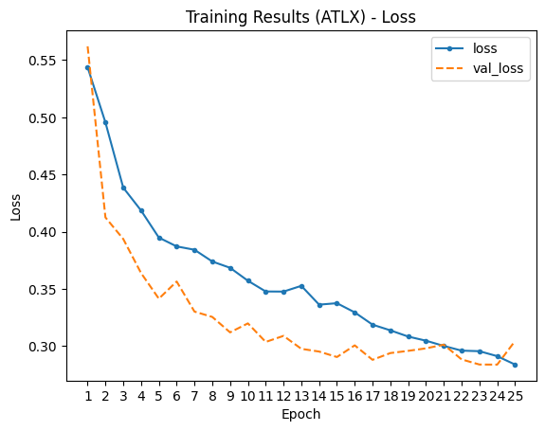
Experiment Results - ATLX

Slide 28
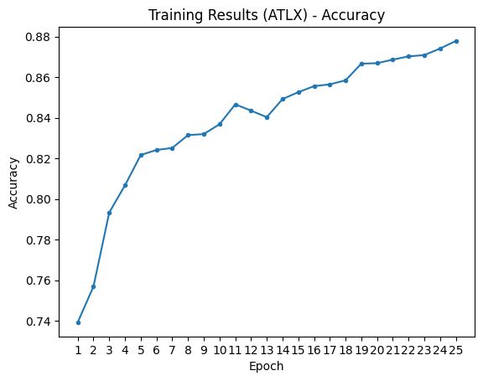
Experiment Results - ATLX

Slide 29
Experiment Results – Co-LSTM

Slide 30
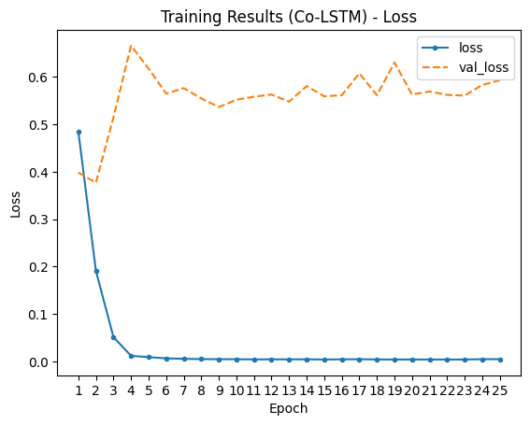
Experiment Results – Co-LSTM

Slide 31
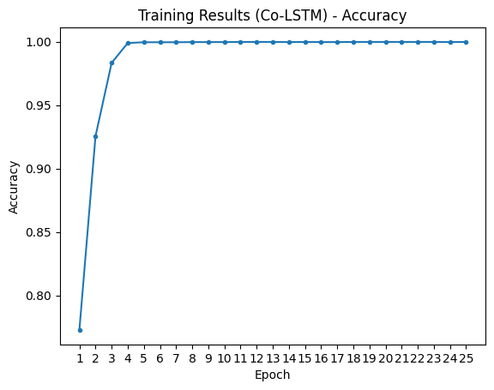
Experiment Results – Co-LSTM

Slide 32
Evaluation – Test Accuracy

Slide 33
Evaluation – Test Accuracy
ATLX: 84%
Co-LSTM: 81%

Slide 34
Conclusions

Slide 35
Conclusions
ATLX outperforms Co-LSTM

Slide 36
Conclusions
ATLX outperforms Co-LSTM
Aspects more important than “local features” and word sequences

Slide 37
Conclusions
ATLX outperforms Co-LSTM
Aspects more important than “local features” and word sequences
Twitter stories ⊂ Social media domain

Slide 38
Conclusions
ATLX outperforms Co-LSTM
Aspects more important than “local features” and word sequences
Twitter stories ⊂ Social media domain
Room for reproducibility evaluation

Slide 39
Thank You!
References:
Bao, L., Lambert, P., & Badia, T. (2022). Improving aspect-based neural sentiment classification with lexicon enhancement, attention regularization and sentiment induction. Natural Language Engineering, 1-30. doi:10.1017/S1351324922000432
Behera, R. K., Jena, M., Rath, S. K., & Misra, S. (2021). Co-LSTM: Convolutional LSTM model for sentiment analysis in Social Big Data. Information Processing & Management, 58(1), 102435. https://doi.org/10.1016/j.ipm.2020.102435

