Slide 1


Introduction to Sentiment Analysis
Sentiment analysis involves interpreting emotions in data. We explore text and image-based methods: text analyzes written content, while image analysis interprets visual cues. Combining both offers a holistic view, providing insights into human emotions across various contexts.

Slide 2
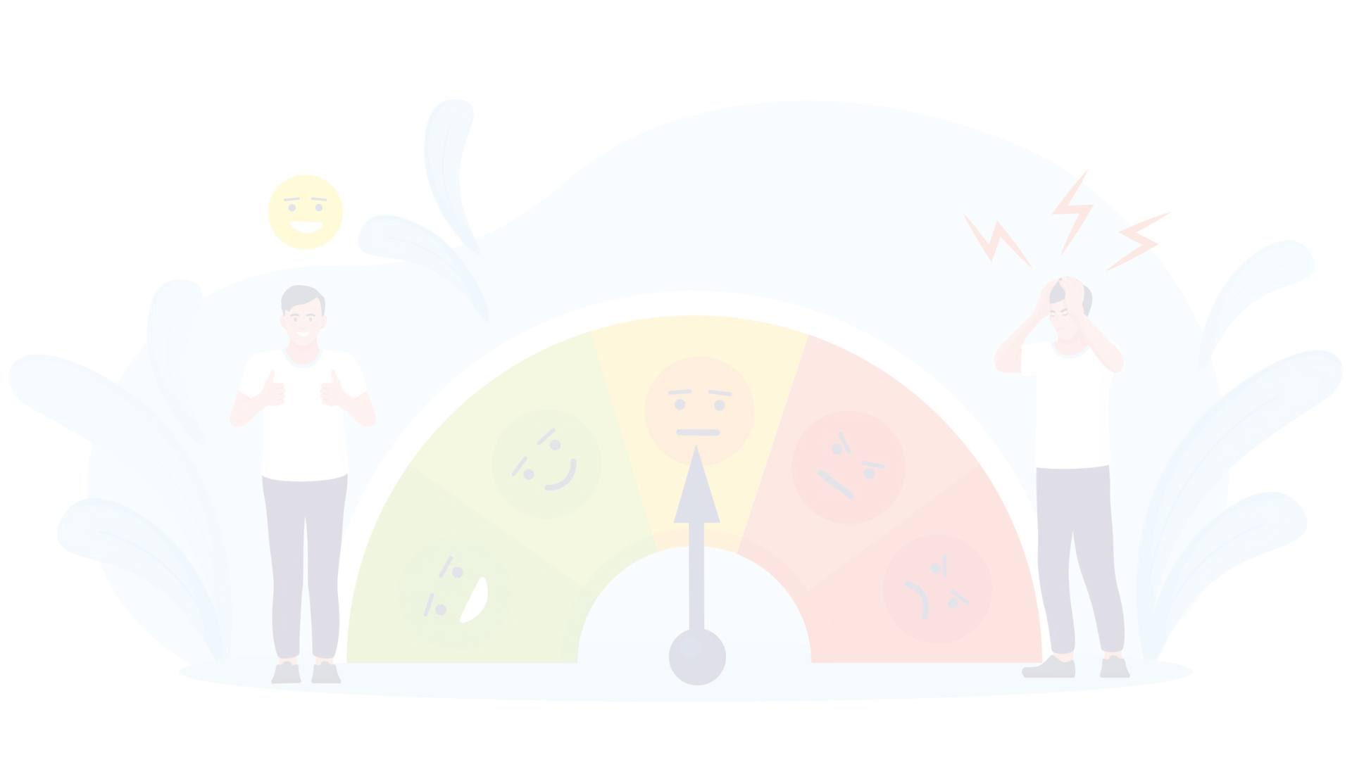
Sentiment Analysis: What is Sentiment Analysis?
1
Emotion Classification
2
Customer Insights
3
Decision Making
Delve into the minds of your customers by extracting valuable insights from their reviews and social media posts, revealing public opinion and brand perception.
Empowers the strategic decision-making process with sentiment analysis, guiding your business decisions, product development, and impactful marketing campaigns.
Unleash the power of sentiment analysis to decode the true emotions behind text - whether it's positivity, negativity, or neutrality.

Slide 3
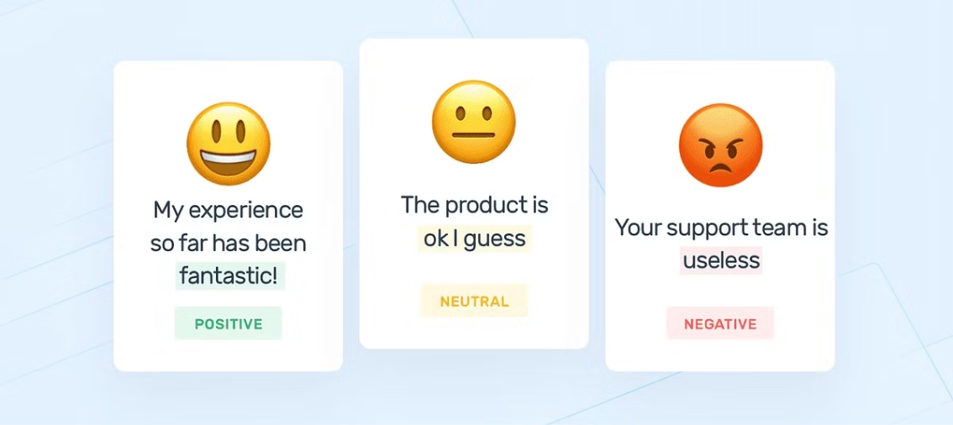
Text Based Sentiment Analysis
Text-based sentiment analysis involves analyzing written content to determine the sentiment conveyed, whether it's positive, negative, or neutral. Natural language processing techniques are used to extract features and classify text data. It finds applications in customer feedback analysis, social media monitoring, and brand sentiment tracking, providing valuable insights into public opinion and sentiment trends.

Slide 4
Part-of-Speech (POS) Tagging and Text Analysis
POS Tagging
Text Analysis
Applications
POS tagging is the process of assigning parts of speech (e.g., noun, verb, adjective) to each word in a text. This helps unlock the grammatical structure and meaning of the text.
NLP techniques like word frequency analysis, sentiment analysis, and named entity recognition can provide deeper insights into the content and context of a text.
POS tagging and text analysis have applications in areas like search engines, content moderation, and language learning.

Slide 5

Binary Classification of Flowers
Binary image classification of flowers involves categorizing images into two classes: distinguishing between flowers such as dandelions and daisies. Using machine learning or deep learning algorithms, the model learns features from images to accurately classify them. This process is crucial in various fields such as agriculture, ecology, and botany for species identification, conservation efforts, and agricultural management.

Slide 6
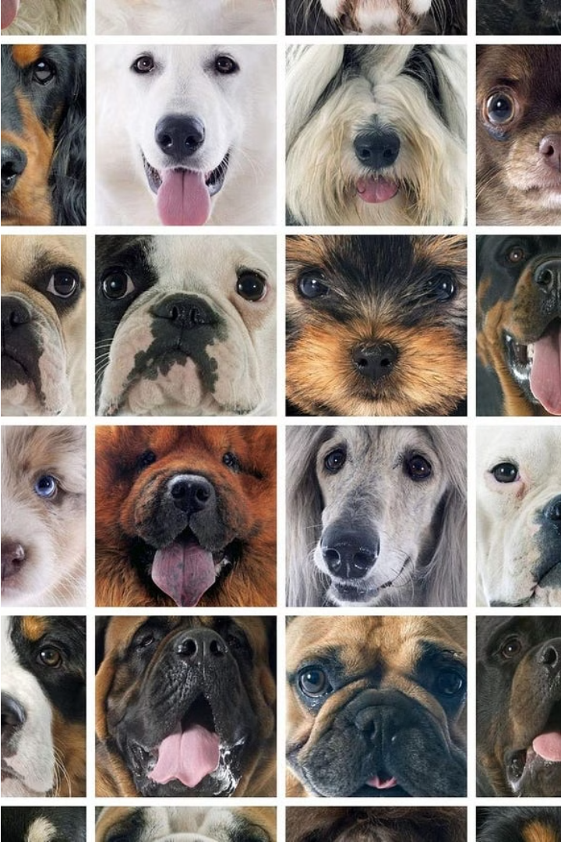
Multiple Classification of Stanford Dogs
Multiclass dog classification using the Stanford dataset involves categorizing images into multiple breeds. The process includes data collection, preprocessing (resizing, normalization, augmentation), and splitting data into training and testing sets. Annotations are used to label the images with the correct breed. Feature extraction is done using Convolutional Neural Networks (CNNs). Models like CNNs, ResNet, and Inception are used for their effectiveness in handling image data. Performance is evaluated with metrics like accuracy, precision, recall, and F1-score for each class.

Slide 7

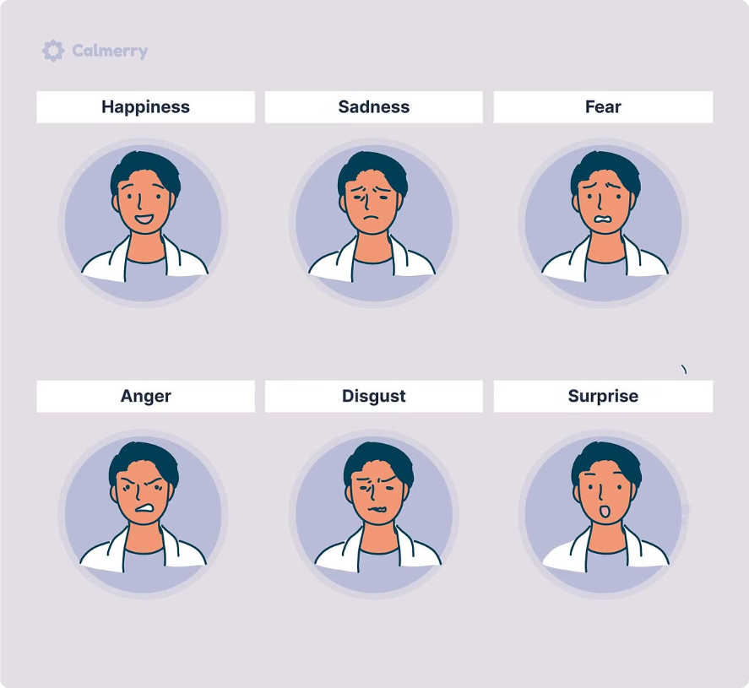
Facial Emotion Detection
Facial emotion detection is a technology that uses computer vision and machine learning to identify and analyze the emotions expressed on a person's face. It can detect emotions such as happiness, sadness, anger, surprise, and more. This technology has applications in various fields, including psychology, market research, and human-computer interaction.

Slide 8
Facial Recognition Dataset
The dataset contains folders with different expressions of the human face including Surprise, Anger, Happiness, Sad, Neutral, Disgust, and Fear.
The folders are split into two super-folders, Training and Testing, making it easier for the end user to configure any model using this data.
The training set consists of 28,079 samples in total, while the testing set consists of 7,178 samples in total.
The data consists of 48x48 pixel grayscale images of faces that have been automatically registered, so that the face is more or less centered and occupies about the same amount of space in each image.

Slide 9
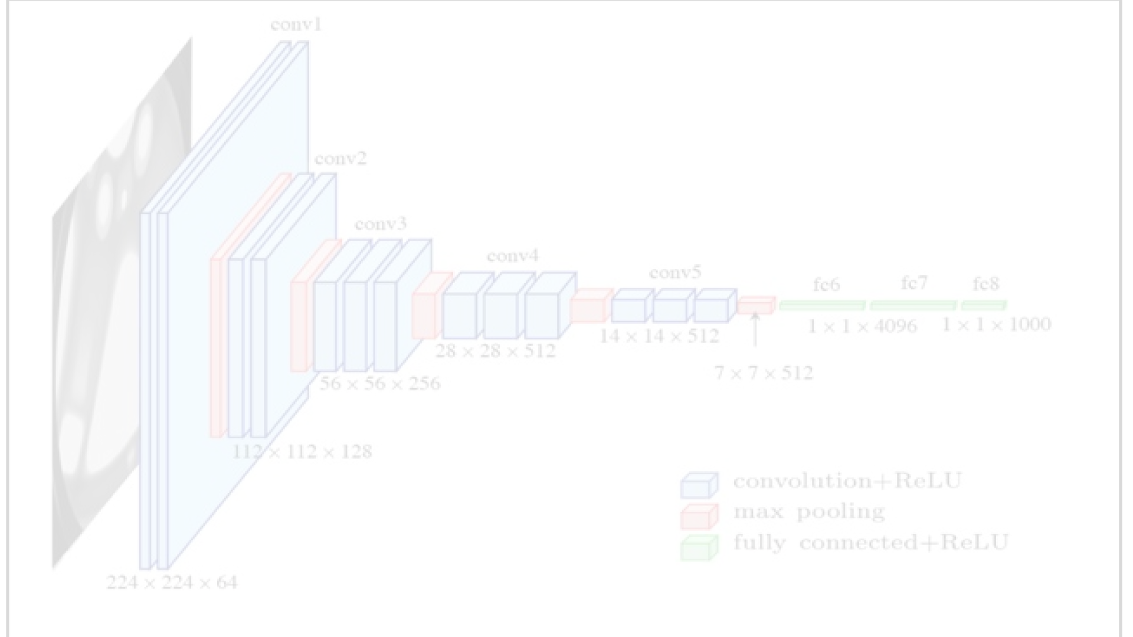
Facial Emotion Detection Implementation using VGG16
We used the VGG16 deep learning model to develop a facial emotion detection system.
The model was trained on a diverse dataset consisting of thousands of labeled facial images to accurately classify emotions expressed by individuals of different ages, genders, and ethnicities.
The VGG16 model is composed of multiple layers that help in extracting meaningful features from the input images, making it ideal for image classification tasks.
We initialized the VGG16 model with pre-trained weights on a large-scale image classification dataset using transfer learning.
Our model achieved an accuracy of 81.43% with a loss of 0.51 in emotion detection results, and can be used to analyze real-time or pre-recorded video footage, webcam streams, or images to detect and classify emotions accurately.

Slide 10

Code Snippet:

Slide 11
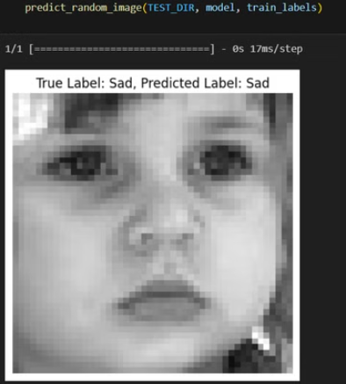
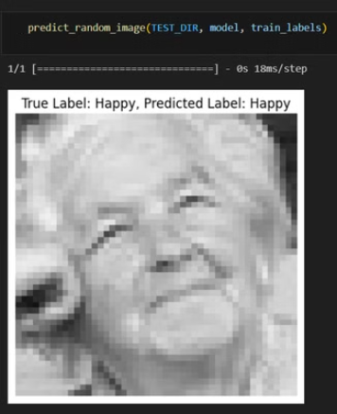
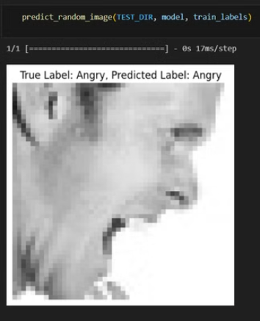
Results : Predicted Emotions

Slide 12
Image Processing and Deep Learning Relevance
Computer Vision
Image Enhancement
Medical Imaging
Deep learning models can be trained to analyze and understand the content of images, enabling applications like object detection and facial recognition.
Deep learning techniques can be used to improve image quality, remove noise, and enhance features like edges and textures.
Deep learning models have shown promise in assisting medical professionals with tasks like tumor detection and disease diagnosis from medical images.

Slide 13

Future Considerations
Multimodal Sentiment Analysis
Text Based Sentiment Analysis
Combining text and image data to analyze emotions, providing a more comprehensive understanding of sentiment from multiple sources.
Analyzing emotions in written content using natural language processing to determine positive, negative, or neutral sentiment.
Image based Sentiment Analysis
Interpreting emotions from visual content, such as facial expressions and scenes, using computer vision techniques.

Slide 14
Advantages and Disadvantages of Sentiment Analysis
Advantages
Limitations
Sentiment analysis can provide valuable insights, automate customer service, and help businesses make data-driven decisions.
Sentiment analysis can be challenging due to ambiguity, sarcasm, and the complexity of human language. Biases in training data can also affect accuracy.
Ethical Considerations
Future Improvements
Sentiment analysis raises concerns around privacy, data ethics, and the potential for misuse. Responsible development and deployment is crucial.
Continued research and advancements in natural language understanding and contextual analysis can help address the limitations of sentiment analysis.

Slide 15




Impact on Society and Implications
Customer Experience
Data Ethics
Social Impact
Future Implications
The responsible use of sentiment analysis data is crucial to protect individual privacy and prevent misuse.
Sentiment analysis can provide insights into public opinion on important social and political issues.
Sentiment analysis can help businesses better understand and address customer needs and concerns.
Advancements in sentiment analysis may lead to new applications and have far-reaching societal implications.

Slide 16
Conclusion
1
Powerful Tool
2
Diverse Applications
Sentiment analysis is a powerful tool that allows us to gain valuable insights into the sentiment and opinions expressed in textual data. It helps us understand the emotions, attitudes, and preferences of individuals and groups.
Sentiment analysis has diverse applications across various industries and domains. It can be used for social media monitoring, brand reputation management, market research, customer feedback analysis, and more. The possibilities are endless.
3
Ethical Considerations
4
Practical Considerations
While sentiment analysis provides valuable insights, it's important to address ethical considerations. Ensuring privacy, handling sensitive data, and avoiding biases are crucial aspects to consider when using sentiment analysis technology.
There are practical considerations to keep in mind when working with sentiment analysis. These include data quality, model accuracy, scalability, and the need for continuous improvement and adaptation as language and user behavior evolve.

Slide 17
Thank You!

