Slide 1
Secure Data Hiding in Image Using Steganography
CAPSTONE PROJECT
Presented By: Aayush Dharmadhikari
Student Name : Aayush Dharmadhikari
College Name : Smt. Kashibai Navale College of Engineering
Department : Information Technology

Slide 2
OUTLINE
Problem Statement
Technology used
Wow factor
End users
Result
Conclusion
Git-hub Link

Slide 3
Problem Statement
In today's digital age, data security and privacy are major concerns, especially with increasing cyber threats and surveillance.
Traditional encryption methods often attract attention, making sensitive information vulnerable.
This project aims to develop a steganography-based approach to conceal secret messages within images, ensuring covert communication.
By integrating password-protected decryption and dynamic character encoding, this solution enhances data confidentiality while maintaining image integrity.

Slide 4
Technology used
The scripts utilize the following technologies and libraries:
Python : The programming language used to implement the steganography algorithm.
OpenCV (cv2) : Used for image processing (reading, modifying, and saving images).
File Handling (os, open) : Manages file input/output for storing the encrypted image.
Basic Cryptography (Steganography) :Hides a message within an image by modifying pixel values.

Slide 5
Wow factors
Image-Based Steganography : Instead of traditional encryption methods, your project hides secret messages within an image by modifying pixel values. This makes it a creative and covert way to store sensitive data.
Password-Protected Decryption : The script includes a passcode authentication system, ensuring that only authorized users can retrieve the hidden message. This adds an extra layer of security and exclusivity.
Lightweight & Simple Implementation : Your project uses only OpenCV and Python, making it lightweight and easy to run without complex dependencies. It's straightforward yet powerful in execution.
Dynamic Character Encoding : The script dynamically converts characters into pixel values using a custom ASCII mapping, ensuring that data is encoded efficiently within the image. This is a unique approach compared to common LSB (Least Significant Bit) methods.
Automatic Encrypted Image Preview : After hiding the message, the script automatically opens the encrypted image, giving users an instant look at the modified file. This makes the experience more interactive and engaging.

Slide 6
End users
Cybersecurity Enthusiasts & Ethical Hackers
Security professionals can use this as a learning tool to understand and develop better encryption techniques.
Ethical hackers can test steganographic vulnerabilities in images to improve data protection.
Journalists & Whistleblowers
Investigative reporters working in sensitive environments can use this tool to hide confidential messages in images to communicate securely.
Whistleblowers can share critical information discreetly without attracting attention.
Developers & Cryptography Students
Aspiring programmers can study and improve upon the existing code to explore advanced steganographic techniques.
Cryptography students can modify this project to experiment with different encoding methods.
Digital Artists & Content Creators
Artists can embed secret messages in their artwork as a fun and interactive way to engage their audience.
Content creators can use it for hidden giveaways, secret puzzles, or ARG (Alternate Reality Games).
Government & Intelligence Agencies
Intelligence agencies may use steganography for covert communications and secure data transmission.
Law enforcement could analyze encrypted images for cybersecurity threats.

Slide 7
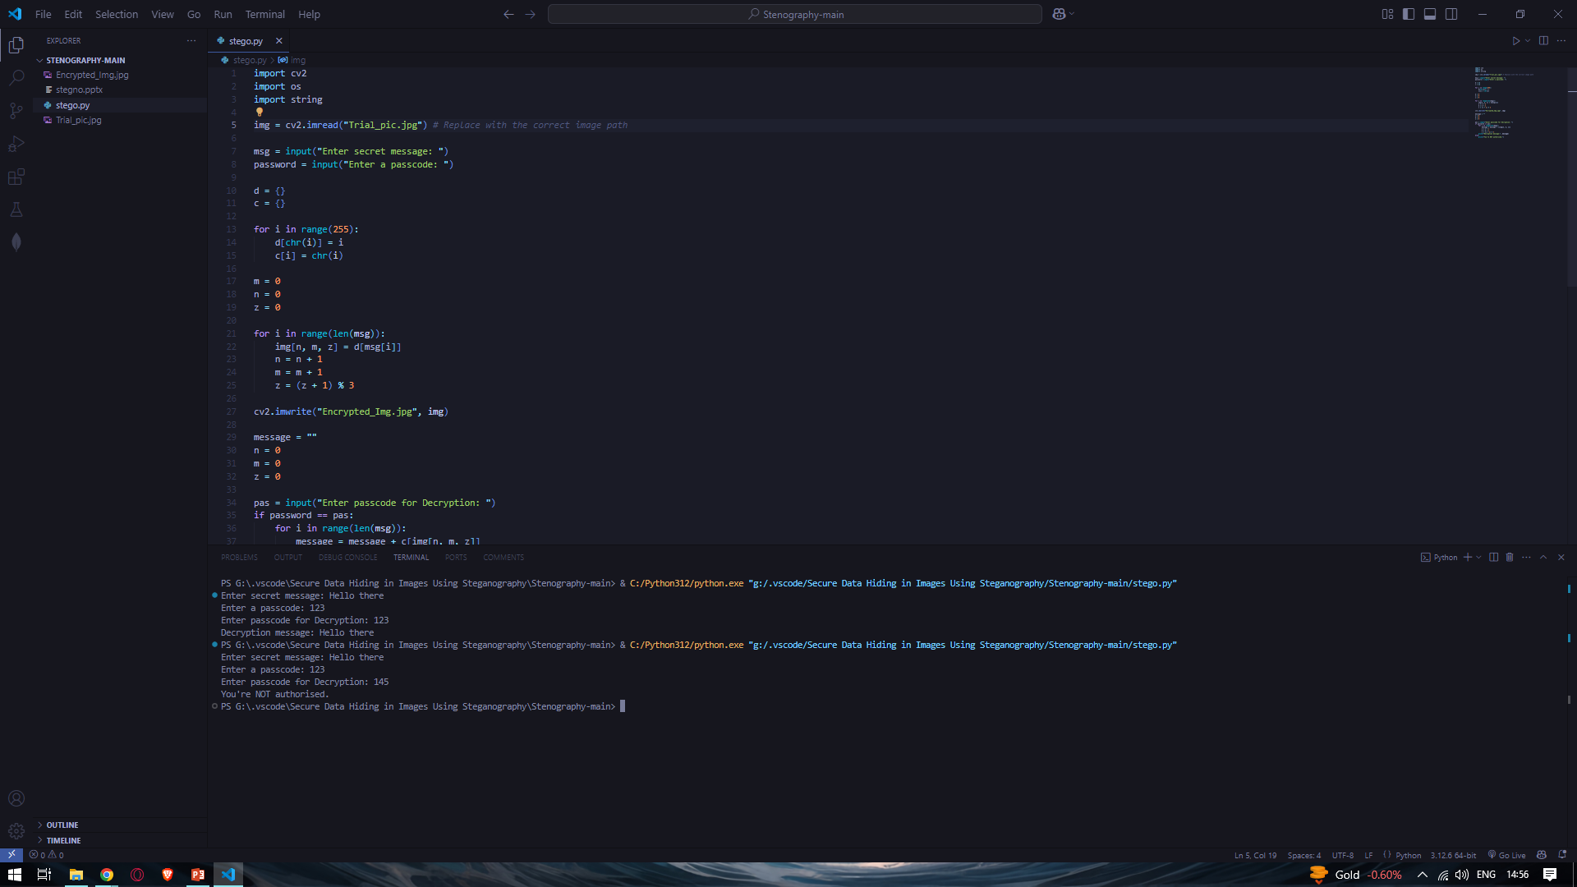
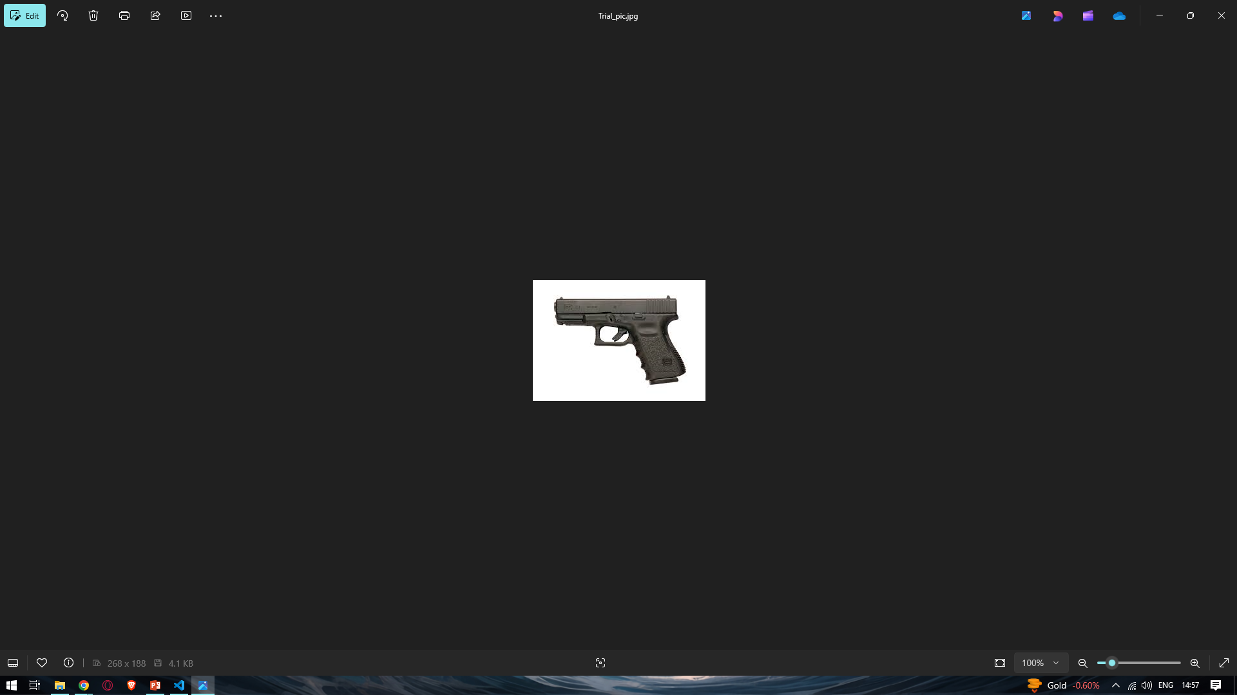
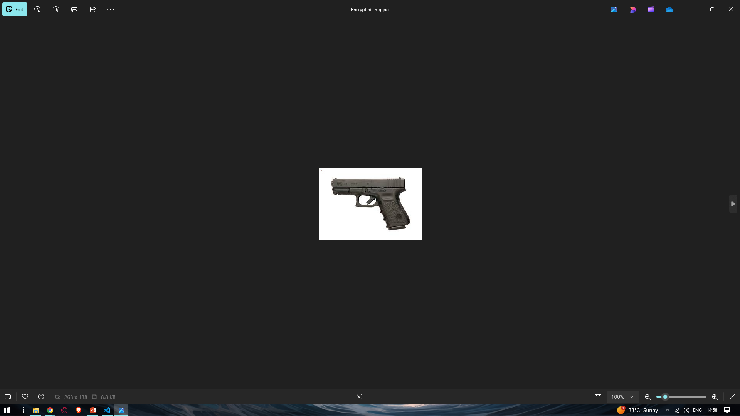
Results

Slide 8
Conclusion
This Secure Data Hiding in Image Using Steganography Project is a creative and effective way to securely hide messages within images using pixel manipulation. With its password-protected decryption, dynamic character encoding, and lightweight implementation, it serves as a great foundation for exploring data security and cryptography.
This project has multiple real-world applications, from secure communication to digital forensics and even artistic encryption. While already functional, it has huge potential for expansion, such as improving encryption strength, adding a graphical interface, or integrating AI for more advanced steganographic techniques.
Ultimately, this project showcases how steganography can be both practical and fascinating, blending security, coding, and creativity into one unique tool.

Slide 9
GitHub Link
https://github.com/DarkAlpha31/IBM-Skillsbuild

Slide 10
THANK YOU

