Slide 1





BEHAVIORAL AI × ADAPTIVE VERIFICATION × DIGITAL BANKING SECURITY
AI FRAUDSHIELD
"Proactive protection before the money is gone."
USER
FRAUD TRANSACTION
FRAUDSHIELD
PROTECTED

Slide 2
01 — THE PROBLEM
THE TRANSACTION LOOKS NORMAL. UNTIL IT DOESN'T.
VULNERABLE CUSTOMERS
TRANSACTION HISTORY
Senior citizens
First-time digital banking users
Digitally inexperienced individuals
₹1,200 | ₹3,500
₹5,000 | ₹8,500
₹12,000 | —
Vulnerability is contextual and behavioral — not a personal failing. These users face greater difficulty recognizing social engineering, fake payment requests, suspicious recipients, and unusual transaction patterns.
₹75,000 → NEW RECIPIENT
Something is different.
Fraud prevention should happen before the money leaves the account.

Slide 3

02 — THE GAP
DETECTION ALONE IS NOT ENOUGH.
TRADITIONAL FLOW
FRAUDSHIELD APPROACH
01
01
Transaction
Transaction
02
02
Fraud Detection
Behavioral Analysis
03
03
Alert Sent
Risk Assessment
04
04
User Notices
Immediate Intervention
05
User must recognize and act — often after funds are difficult to reverse.
Verification + User Confirmation
06
ALLOW / HOLD / BLOCK
Move from passive alerts to proactive intervention.

Slide 4
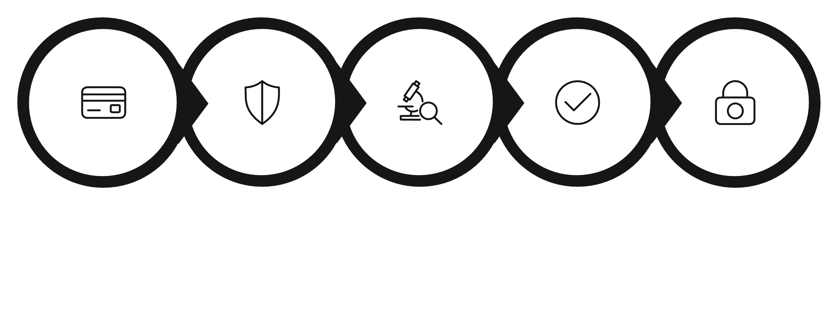
03 — THE SOLUTION
MEET AI FRAUDSHIELD
An intelligent security layer that evaluates every transaction against the customer's normal behavioral pattern — and intervenes when risk is high.
01 — BEHAVIORAL ML
02 — RISK SCORING
Learns normal transaction behavior
Calculates transaction risk likelihood
03 — EXPLAINABLE ALERT
04 — FACE VERIFICATION
Shows why a transaction was flagged
Step-up identity check for high-risk transactions
05 — AI VOICE CONFIRMATION
06 — DECISION ENGINE
Initiated after 20-second timeout
Allows, holds, or blocks based on verification
TRANSACTION
AI FRAUDSHIELD
RISK ASSESSMENT
VERIFY
PROTECT

Slide 5
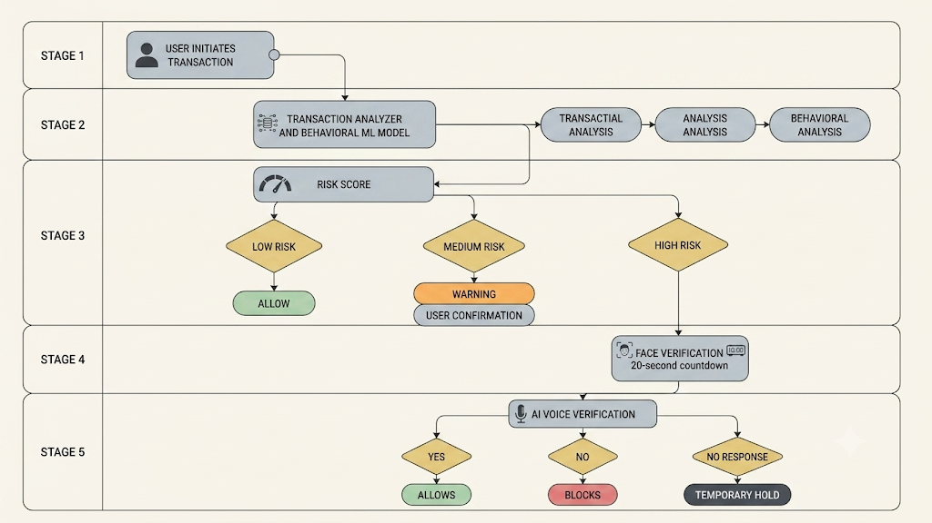
04 — END-TO-END WORKFLOW
ONE TRANSACTION. MULTIPLE LAYERS OF PROTECTION.
The system escalates verification only when behavioral risk increases — low-risk transactions proceed with zero added friction.

Slide 6
05 — THE ML ENGINE
THE MODEL LEARNS WHAT "NORMAL" LOOKS LIKE.
CUSTOMER PROFILE
MODEL INPUT SIGNALS
Typical range | ₹500 – ₹15,000
Max normal | ₹15,000
Current tx | ₹75,000
Recipient | NEW
Behavior | UNUSUAL
Transaction amount vs. historical average
Amount deviation from normal range
New recipient indicator
Transaction frequency and timing
Device familiarity
Location / access anomaly
Previous behavioral patterns
Possible models: Random Forest · XGBoost · Logistic Regression
Evaluation focus: Precision · Recall · F1-score · ROC-AUC
RISK SCORE: 94% (hypothetical / demo value)
RISK LEVEL: HIGH

Slide 7
06 — ADAPTIVE VERIFICATION
SECURITY THAT ESCALATES ONLY WHEN NEEDED.
LEVEL 01 — NORMAL
1
Low risk → No friction → Transaction proceeds
LEVEL 02 — CAUTION
2
Moderate risk → Warning → User confirmation required
LEVEL 03 — HIGH RISK
3
Face verification → 20-second countdown → AI voice confirmation → Allow / Hold / Block
HIGH-RISK TRANSACTION

Slide 8
07 — LIVE DEMO
LET'S FOLLOW ONE TRANSACTION.
STEP 01 — BASELINE
1
₹2,500 → Known recipient
Risk: 8% → 🟢 ALLOWED
2
STEP 02 — ANOMALY
₹75,000 → NEW RECIPIENT
Amount far above normal · New recipient · Unusual behavior
🚨 HIGH RISK
STEP 03 — FACE CHECK
3
System requests face verification.
User does not complete it.
20 → 10 → 5 → 0
4
STEP 04 — VOICE CALL
AI: "Did you authorize the ₹75,000 transaction?"
USER: "No."
STEP 05 — DECISION
5
🔴 TRANSACTION BLOCKED

Slide 9

08 — TECHNOLOGY + IMPACT
UNDER THE HOOD.
TECHNOLOGY STACK
IMPACT
Frontend: HTML + CSS + JS + GSAP
Backend: Python + FastAPI
ML: scikit-learn / XGBoost
Database: MongoDB
Face Verification: OpenCV + face embedding model
Voice: Speech-to-text / Text-to-speech / TWILIO
For Customers
For Banks
Reduce risky transfers · Improve protection for inexperienced users · Make warnings understandable
Add adaptive security · Reduce unnecessary friction · Enable earlier intervention
WHAT MAKES IT DIFFERENT
Not every unusual transaction is fraud. Not every user needs the same level of security.
Behavioral — Personalized to each user's normal activity
Proactive — Intervenes before transaction completion
Explainable — Shows why a transaction was flagged
Adaptive — Adds friction only when risk increases
Human-in-the-Loop — User confirmation drives the final decision

Slide 10
09 — FUTURE + CLOSING
DETECT. EXPLAIN. VERIFY. PROTECT.
NEXT STEPS
PRODUCT PHILOSOPHY
Real-time banking integration
Continuous behavioral learning
Scam / social-engineering pattern detection
Multilingual voice verification
Liveness detection
Accessibility-first voice interaction
Privacy-preserving / federated learning
Human fraud analyst escalation
Trusted-contact escalation with explicit consent
"Fraud prevention shouldn't begin after the money is gone."
AI FRAUDSHIELD
"Proactive protection before the money is gone."
TEAM: [Lone Wolf] · MEMBER: [Dinesh D]
NORMAL TRANSACTION
SUSPICIOUS TRANSACTION
HIGH-RISK TRANSACTION
UNAUTHORIZED TRANSACTION
Frictionless
Explain
Verify
Protect

Slide 11
THANK
YOU
Let’s save vulnerable customer from Fraudulent transactions

